Slide 1
Mathematics for Computer Science MIT 6.042J/18.062J
Sums
(Money & Books)

Slide 2
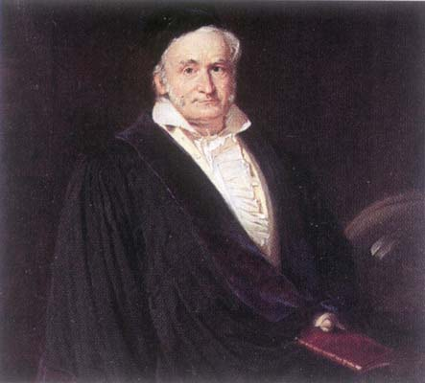
C. F. Gauss
Picture source: http://www-groups.dcs.st-and.ac.uk/~history/PictDisplay/Gauss.html

Slide 3
Sum for Children
89 + 102 + 115 + 128 + 141 +
154 + ··· +
193 + ··· +
232 + ··· +
323 + ··· +
414 + ··· + 453 + 466

Slide 4
Sum for Children
Nine-year old Gauss saw
30 numbers, each 13 greater than the previous one.
(So the story goes.)

Slide 5
Sum for Children
1st + 30th = 89 + 466 = 555
2nd + 29th =
(1st+13) + (30th-13) = 555
3rd + 28th =
(2nd+13) + (29th-13) = 555


Slide 6
Sum for Children
Sum of k^{th} term and (31-k)^{th} term
is invariant! 15 pairs of terms, so
Total = 555 - 15
= (1st + last)¢(# terms/2)
= (1st + last)/2 ¢(# terms)

Slide 7
Sum for Children
example:
1 + 2 +☹+ (n-1) + n =
(1 + n)n
2

Slide 8
Geometric Sum

Slide 9
Geometric Sum
G_{n}−xG_{n}=
1 − x^{n+1}

Slide 10
Geometric Sum
G_{n}−xG_{n}=
1 − x^{n+1}

Slide 11
Geometric Sum
Consider infinite sum (series)

Slide 12
Infinite Geometric Series

Slide 13
Infinite Geometric Series
for |x| < 1

Slide 14
The future value of $$
I will pay you $100 in 1 year,
if you will pay me $X now.

Slide 15
The future value of $$
bank will pay me 3% interest:
bankrate b ::= 1.03
-- bank increases my $ by
this factor in 1 year.

Slide 16
The future value of $$
If I deposit the $X now,
I will have $bX in 1 year,
so I break even iff bX = 100.
X=100r where r ::= 1/b.
So $100 in 1 year is worth
$100r = $97.09 today.

Slide 17
The future value of $$
$1 in 1 year is worth $0.9709 now.
$r last year is worth $1 today,
where r ::= 1/b.
So $n paid in 2 years is worth
$nr paid in 1 year, and is worth
$nr² today.

Slide 18
The future value of $$
$n paid k years from now
is worth $nr^{k} today
where r ::= 1/bankrate.

Slide 19
Annuities
I pay you $100/year for 10 years,
if you will pay me $Y now.
I break even iff you pay me
(value of $100 in 1 year) +
(value of $100 in 2 years) + ☹ +
(value of $100 in 10 years)

Slide 20
Annuities
I pay you $100/year for 10 years,
if you will pay me $Y now.
I break even iff you pay me
100r + 100r² + 100r³ +  + 100r¹⁰
= 100r(1 + r +  + r⁹)
= 100r(1-r¹⁰)/(1-r) = $853.02

Slide 21
Annuities
I pay you $100/year for 10 years,
if you will pay me $853.02 now.
QUICKIE: If bankrates unexpectedly
increase in the next few years,
You come out ahead
The deal stays fair
I come out ahead

Slide 22
Manipulating Sums

Slide 23
Manipulating Sums

Slide 24

Crossing a Desert
Gas
depot
truck
How big a desert can the truck cross?

Slide 25
1 Tank of Gas
1 tank
D₁::= max distance on 1 tank = 1

Slide 26
D_{n} ::=
max distance into the
desert using n tanks
of gas from the depot

Slide 27
n+1 Tanks of Gas
x
1 −2x
1−2x
n
1−2x
1−x

Slide 28
n+1 Tanks of Gas
x
So have:
(1−2x)n
+ (1−x)
grow depot at x
to be n tanks;
continue from
x with n tank
method.

Slide 29
depot at x
Set (1−2x)n + (1−x) = n.
Then using n tank strategy
from position x, gives
D_{n+1} = D_{n} + x

Slide 30
(1−2x)n + (1−x) = n
1
2n+1
x =
1
2n+1
D_{n+1} = D_{n} +

Slide 31
Can cross any desert!

