Slide 1
Induction

Slide 2
The Idea of Induction
Color the integers ≥ 0
0, 1, 2, 3, 4, 5, …
I tell you, 0 is red, & any int
next to a red integer is red,
then you know that
all the ints are red!

Slide 3
The Idea of Induction
Color the integers ≥ 0
0, 1, 2, 3, 4, 5, …
I tell you, 0 is red, & any int
next to a red integer is red,
then you know that
all the ints are red!

Slide 4
Induction Rule

Slide 5

Like Dominos…

Slide 6
Example Induction Proof
Let’s prove:
(for r ≠ 1)

Slide 7
Example Induction Proof
Statements in magenta form a
template for inductive proofs:
Proof: (by induction on n)
The induction hypothesis, P(n), is:
(for r ≠ 1)

Slide 8
Example Induction Proof
Base Case (n = 0):
1
OK!

Slide 9
Correction
Theorem:
Induction Hypothesis:

Slide 10
Example Induction Proof
Inductive Step: Assume P(n) for some n ≥ 0 and prove P(n+1):

Slide 11
Example Induction Proof
Now from induction
hypothesis P(n) we have
so add r^{n+1} to both sides

Slide 12
Example Induction Proof
adding r^{n+1} to both sides,
This proves
P(n+1)
completing the
proof by induction.

Slide 13
example induction proof
That is,
But since r ≠ 1 was arbitrary, we
conclude (by UG), that
as required.
This completes the induction
proof. QED.

Slide 14
an aside: ellipsis
Means you
should see a pattern:
“☹” is an ellipsis.
Can lead to confusion (n = 0?)
Sum notation more precise

Slide 15
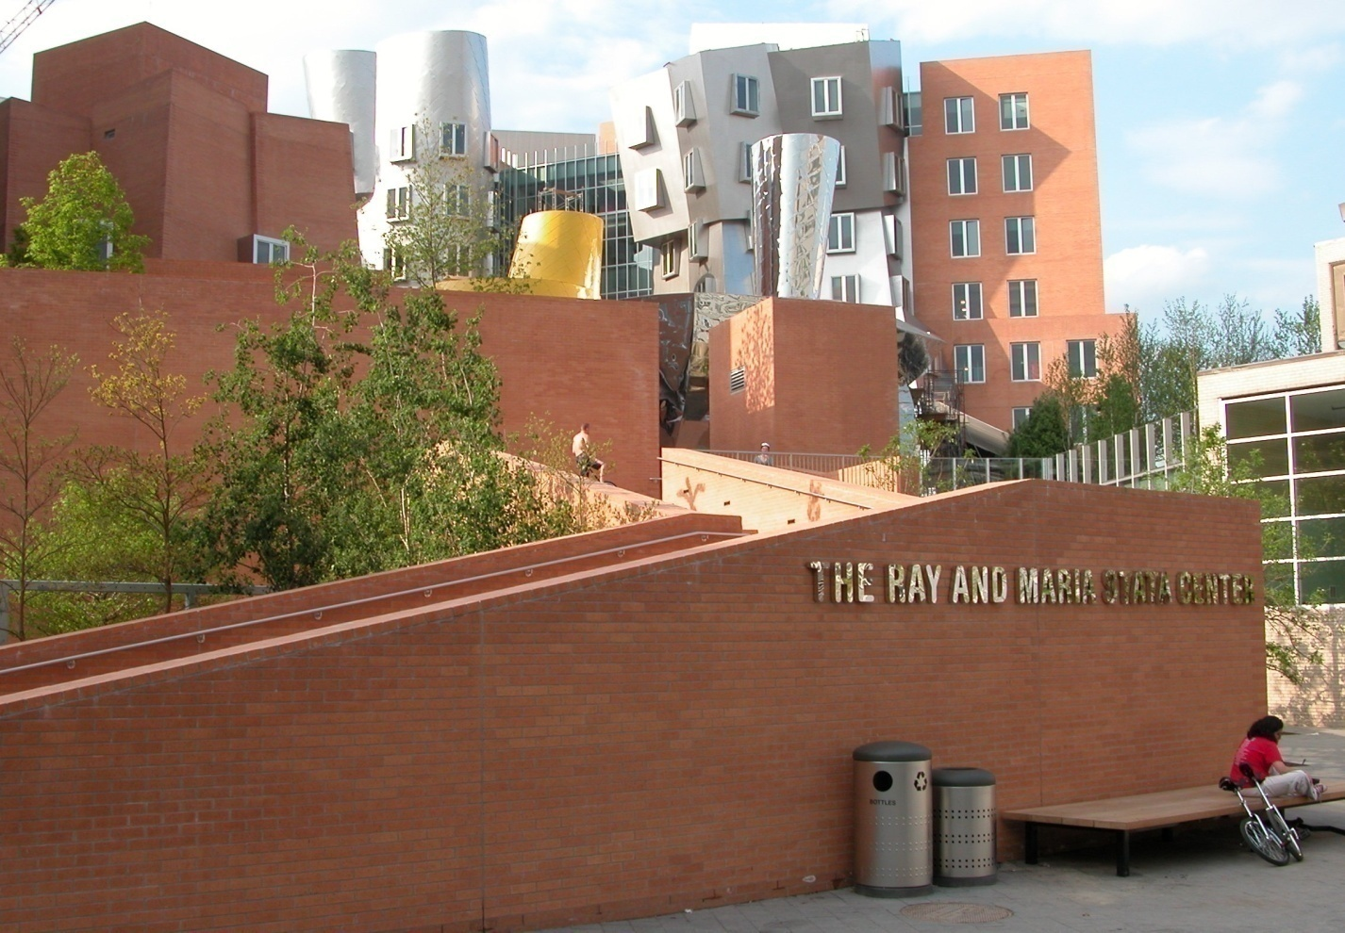
The MIT Stata Center

Slide 16
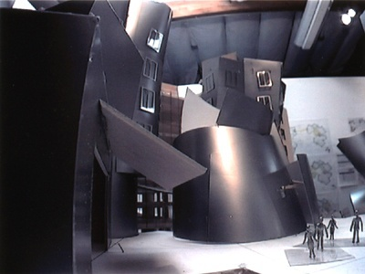
Design Mockup: Stata Lobby

Slide 17

Mockup: Plaza Outside Stata
Goal: Tile the plaza
, except for 1×1
square in the middle for Bill.
(Picture source: http://www.microsoft.com/presspass/exec/billg/default.asp)

Slide 18

Plaza Outside Stata
Gehry speciﬁes L-shaped tiles covering
three squares:
For example, for 8 x 8 plaza might tile for Bill
this way:

Slide 19
Plaza Outside Stata
Theorem: For any 2^{n}⋅2^{n} plaza, we can
make Bill and Frank happy.
Proof: (by induction on n)
P(n) ::= can tile 2^{n}⋅2^{n} with Bill in middle.
Base case: (n=0)
(no tiles needed)

Slide 20
Plaza Outside Stata
Induction step: assume can tile
2^{n}⋅2^{n}, prove can tile 2^{n+1}⋅2^{n+1}.
2
n
+
1

Slide 21
Plaza Outside Stata
Now what?...
2
n
+
1

Slide 22
Plaza Outside Stata
The fix:
prove something stronger
--that we can always
find a tiling with Bill
in any square.

Slide 23
Plaza Theorem
Theorem: For any 2^{n}⋅2^{n} plaza, we can
make Bill and Frank happy.
Proof: (by induction on n)
REVISED induction hypothesis P(n) ::=
can tile 2^{n}⋅2^{n} with Bill anywhere
Base case: (n=0) as before

Slide 24
Plaza Proof
Induction step:
Assume we can get Bill anywhere in 2^{n}⋅2^{n}.
Prove we can get Bill anywhere in 2^{n+1}⋅2^{n+1}.

Slide 25
Plaza Proof
Now group the squares together,
and fill the center Bill’s with a tile.
Done!

Slide 26
Recursive Procedure
Note: The induction proof
implicitly defines a
recursive procedure
for tiling with Bill anywhere.

Slide 27
plaza outside Stata
The fix:
prove something else
--that we can always
find a tiling with
Bill in the corner.

Slide 28
plaza outside Stata
Once have Bill in corner,
can get Bill in middle:

Slide 29
plaza outside Stata
method:
rotate the squares as indicated.

Slide 30



plaza outside Stata
after rotation have:

Slide 31
plaza outside Stata
now group the 4 squares together,
and insert a tile.
Done!
Bill in
middle

Slide 32
plaza theorem
Theorem: For any 2^{n}⋅2^{n} plaza, we can
make Bill and Frank happy.
Proof: (by induction on n)
REVISED induction hypothesis P(n) ::=
can tile 2^{n}⋅2^{n} with Bill in the corner
Base case: (n=0) as before

Slide 33
plaza proof
Induction step:
Assume we can get Bill in corner of 2^{n}⋅2^{n}.
Prove we can get Bill in corner of 2^{n+1}⋅2^{n+1}.

Slide 34
plaza proof
method: rotate the squares as indicated.

Slide 35
plaza proof
after rotation have:

Slide 36
plaza proof
now group the squares together,
and fill the center with a tile.
Done!

Slide 37
ingenious induction hypothesis
Note 1: To prove
“Bill in middle,” we
proved something else: “Bill in corner.”

Slide 38
stronger induction hypotheses
Note 2: It may help to
choose a stronger hypothesis
than the desired result.
(example in class problem)

Slide 39
recursive procedure
Note 3: The induction proof
of “Bill in corner” implicitly
defines a recursive procedure
for finding corner tilings.

Slide 40
A False Proof
Theorem: All horses are the same color.
Proof: (by induction on n)
Induction hypothesis:
P(n) ::= any set of n horses have the same color
Base case (n=1):
horse is same color as itself!
…

Slide 41
A False Proof
(Inductive case)
Assume any n horses have the same color.
Prove that any n+1 horses have the same color.
…
n+1

Slide 42
A False Proof
(Inductive case)
Assume any n horses have the same color.
Prove that any n+1 horses have the same color.
2nd set of n horses have the same color
…
first set of n horses have the same color

Slide 43
A False Proof
(Inductive case)
Assume any n horses have the same color.
Prove that any n+1 horses have the same color.
1st and last same color as
the middle ones
…
therefore the set of n+1 have the same color!

Slide 44
A False Proof
(Inductive case)
Assume any n horses have the same color.
Prove that any n+1 horses have the same color.
so 1st and last
…
therefore the set of n+1 have the same color!

Slide 45
A False Proof
What’s wrong?
Proof that P(n) → P(n+1) is wrong
if n = 1
, because there are
no “middle” horses!
2nd set of n=1 horses
no horses
1st set of n=1 horses

Slide 46
A False Proof
What’s wrong?
Proof that P(n) → P(n+1) is wrong
if n = 1
, because there are
no “middle” horses!
(But proof works for all n ≠ 1)

Slide 47
Strong Induction
Prove P(0). Then prove P(n+1)
assuming all of
P(0), P(1), …, P(n)
(instead of just P(n)).
Conclude ∀m.P(m)

Slide 48
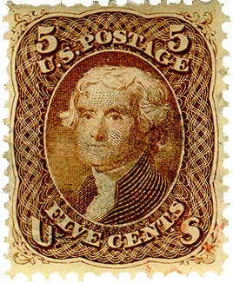

Postage by Strong Induction
available stamps:
5¢
3¢
Thm: Get any amount ≥ 8¢
By strong induction with hyp:
P(n) ::= can form n + 8¢.

Slide 49
Postage by Strong Induction
available stamps:
5¢
3¢
Thm: Get any amount ≥ 8¢
base case P(0): make 0 + 8¢

Slide 50
Postage by Strong Induction
available stamps:
5¢
3¢
Thm: Get any amount ≥ 8¢
inductive step:
Assume m+8¢ for n ≥ m ≥ 0.
Prove can get (n+1)+8¢.
n+9¢

Slide 51
Postage by Strong Induction
inductive step cases:
n=0, 0+9¢ =
n=1, 1+9¢ =

Slide 52
Postage by Strong Induction
n ≥ 2:
so by hypothesis
can get (n-2)+8¢
= n+9¢
+
3¢
(n-2)+8¢

Slide 53
Unstacking game
Start: a stack of boxes
Move: split any stack into two of sizes a,b>0
Scoring: a⋅b points
Keep moving: until stuck
Overall score: sum of move scores
a+b
a
b

Slide 54
Analyzing the Stacking Game
Claim: Every way of unstacking
n blocks gives the same score:
(n-1)+(n-2)+☹+1

Slide 55
Analyzing the Game
Claim: Starting with size n stack,
final score will be
Proof: by Induction with
Claim(n) as hypothesis

Slide 56
Proving the Claim by Induction
Base case n = 0:
score = 0
Claim(0) is

Slide 57
Proving the Claim by Induction
Inductive step. assume for
stacks ≤ n, and prove C(n+1):
(n+1)-stack score =

Slide 58
Proving the Claim by Induction
Inductive step.
Case n+1 = 1. verify for 1-stack:
C(1) is

Slide 59
Proving the Claim by Induction
Inductive step.
Case n+1 > 1. Split n+1 into an
a-stack and b-stack,
where a + b = n +1.
(a + b)-stack score = ab +
a-stack score + b-stack score

Slide 60
Proving the Claim by Induction
by strong induction:

Slide 61
Proving the Claim by Induction
total (a + b)-stack score =
so C(n+1) is
We’re done!

Slide 62
Team Problems
Problems
1−4

