Slide 1
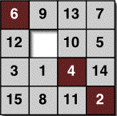
Mathematics for Computer Science MIT 6.042J/18.062J
State Machines

Slide 2
State machines
step by step processes
(may step in response
to input ―not today)

Slide 3
State machines
The state graph of a 99-bounded counter:
start state
0
1
2
99
overflow
States: {0,1,…,99, overflow}
Transitions:
0 ≤ i < 99
i
i+1
99
overflow
overflow
overflow

Slide 4
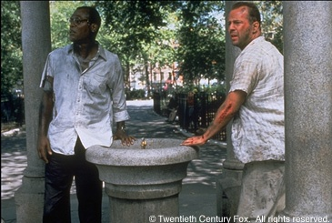
Die Hard
Picture source: http://movieweb.com/movie/diehard3/

Slide 5
Die Hard
Simon says: On the fountain, there should be 2 jugs, do you see them? A 5-gallon and a 3-gallon. Fill one of the jugs with exactly 4 gallons of water and place it on the scale and the timer will stop. You must be precise; one ounce more or less will result in detonation. If you're still alive in 5 minutes, we'll speak.

Slide 6

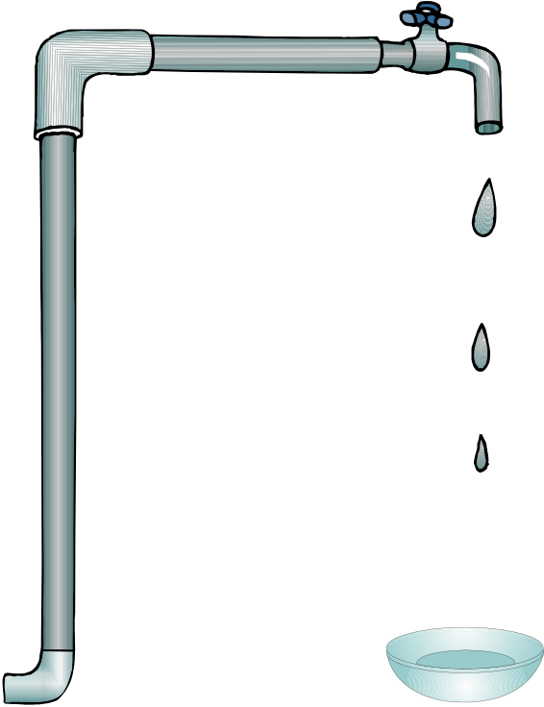
Die Hard
Supplies:
3 Gallon Jug
5 Gallon Jug
Water

Slide 7
Die Hard
Transferring water:
3 Gallon Jug
5 Gallon Jug

Slide 8
Die Hard
Transferring water:
3 Gallon Jug
5 Gallon Jug

Slide 9
Die hard state machine
State:
amount of water in jugs: (b,l)
0 ≤ b ≤ 5, 0 ≤ l ≤ 3
Start State: (0,0)

Slide 10
State machines
Die Hard Transitions:
1. Fill little jug: (b, l) → (b, 3) for l < 3
2. Fill big jug: (b, l) → (5, l) for b < 5
3. Empty little jug: (b, l) → (b, 0) for l > 0
4. Empty big jug: (b, l) → (0, l) for b > 0

Slide 11
State machines
5. Pour big jug into little jug
(i) If no overflow, then (b,l)→(0,b+l)
(ii) otherwise (b,l) →(b−(3−l),3)
6. Pour little jug into big jug. Likewise
b+l ≤ 3

Slide 12
Die Hard
Simon’s challenge:
Disarm the bomb by putting precisely 4 gallons of water on the scale, or it will blow up.
(You can figure out how)

Slide 13
Die Hard
Work it out now!

Slide 14
How to do it
Start with empty jugs: (0,0)
Fill the big jug: (5,0)
3 Gallon Jug
5 Gallon Jug

Slide 15
How to do it
Pour from big to little:
(2,3)
3 Gallon Jug
5 Gallon Jug

Slide 16
How to do it
Empty the little: (2,0)
3 Gallon Jug
5 Gallon Jug

Slide 17
How to do it
Pour from big to little: (0,2)
3 Gallon Jug
5 Gallon Jug

Slide 18
How to do it
Fill the big jug: (5,2)
3 Gallon Jug
5 Gallon Jug

Slide 19
How to do it
Pour from big to little:
(4,3)
3 Gallon Jug
5 Gallon Jug
Done!

Slide 20
Die Hard once and for all
What if have a 9 gallon jug instead?
3 Gallon Jug
5 Gallon Jug
9 Gallon Jug
Can you do it? Can you prove it?

Slide 21
Die Hard Once & For All
Supplies:
3 Gallon Jug
9 Gallon Jug
Water

Slide 22
Preserved Invariants
Die hard once and for all
preserved invariant:
P(state) ::= “3 divides the number of gallons in each jug.”

Slide 23
Preserved Invariants
Floyd’s Invariant Method
(just like induction)
Base case: Show P(start)
Preservation case: Show
if P(q) and , then P(r)
Conclusion: P holds for all reachable states, including final state (if any)
q
r

Slide 24
Die Hard Once & For All
Corollary: No state
(4,x) is reachable, so
Bruce Dies!

Slide 25
Die Hard
Picture source: http://movieweb.com/movie/diehard3/

Slide 26
Die Hard
Simon says: On the fountain, there should be 2 jugs, do you see them? A 5-gallon and a 3-gallon. Fill one of the jugs with exactly 4 gallons of water and place it on the scale and the timer will stop. You must be precise; one ounce more or less will result in detonation. If you're still alive in 5 minutes, we'll speak.

Slide 27
Die Hard
Supplies:
3 Gallon Jug
5 Gallon Jug
Water

Slide 28
Die Hard
Transferring water:
3 Gallon Jug
5 Gallon Jug

Slide 29
Die Hard
Transferring water:
3 Gallon Jug
5 Gallon Jug

Slide 30
Die hard state machine
State:
amount of water in jugs: (b,l)
0 ≤ b ≤ 5, 0 ≤ l ≤ 3
Start State: (0,0)

Slide 31
State machines
Die Hard Transitions:
1. Fill little jug: (b, l) → (b, 3) for l < 3
2. Fill big jug: (b, l) → (5, l) for b < 5
3. Empty little jug: (b, l) → (b, 0) for l > 0
4. Empty big jug: (b, l) → (0, l) for b > 0

Slide 32
State machines
5. Pour big jug into little jug
(i) If no overflow, then (b,l)→(0,b+l)
(ii) otherwise (b,l) →(b−(3−l),3)
6. Pour little jug into big jug. Likewise
b+l ≤ 3

Slide 33
Die Hard
Simon’s challenge:
Disarm the bomb by putting precisely 4 gallons of water on the scale, or it will blow up.
(You can figure out how)

Slide 34
Die Hard
Work it out now!

Slide 35
How to do it
Start with empty jugs: (0,0)
Fill the big jug: (5,0)
3 Gallon Jug
5 Gallon Jug

Slide 36
How to do it
Pour from big to little:
(2,3)
3 Gallon Jug
5 Gallon Jug

Slide 37
How to do it
Empty the little: (2,0)
3 Gallon Jug
5 Gallon Jug

Slide 38
How to do it
Pour from big to little: (0,2)
3 Gallon Jug
5 Gallon Jug

Slide 39
How to do it
Fill the big jug: (5,2)
3 Gallon Jug
5 Gallon Jug

Slide 40
How to do it
Pour from big to little:
(4,3)
3 Gallon Jug
5 Gallon Jug
Done!

Slide 41
Die Hard once and for all
What if have a 9 gallon jug instead?
3 Gallon Jug
5 Gallon Jug
9 Gallon Jug
Can you do it? Can you prove it?

Slide 42
Die Hard Once & For All
Supplies:
3 Gallon Jug
9 Gallon Jug
Water

Slide 43
Preserved Invariants
Die hard once and for all
preserved invariant:
P(state) ::= “3 divides the number of gallons in each jug.”

Slide 44

The Diagonal Robot
the robot is on a grid
y
2
1
0
x
0 1 2 3

Slide 45
The Diagonal Robot
it can move diagonally
y
2
1
0
x
0 1 2 3

Slide 46
The Diagonal Robot
can it get from (0,0) to (1,0)?
y
?
2
1
0
GOAL
x
0 1 2 3

Slide 47
Robot Preserved Invariant
NO!
preserved invariant:
P((x, y)) ::= x + y is even
move adds ±1 to both x & y,
preserving parity of x+y.
Also, P((0, 0)) is true.

Slide 48
Robot Preserved Invariant
So in all positions (x,y)
reachable from (0,0),
x + y stays even
But 1 + 0 = 1 is odd, so
(1,0) is not reachable

Slide 49
Floyd’s Invariant Principle
(induction for state machines)
Preserved Invariant, P(state):
if P(q) and , then P(r)
Conclusion: if P(start), then P(r)
for all reachable states r,
including final state (if any)
q
r

Slide 50
Die Hard Once & For All
Corollary: No state
(4,x) is reachable, so
Bruce Dies!

Slide 51
The Fifteen Puzzle
Explained!
--by similar reasoning
details in problem 2

Slide 52
Fast Exponentiation
compute a^{b} using registers X,Y,Z,R
X:= a; Y:= 1; Z:= b;
REPEAT:
if Z=0, then return Y
R:= remdr(Z,2); Z:= quotnt(Z,2)
if R=1,then Y:= X⋅Y
X:= X²

Slide 53
Fast Exponentiation
State Machine:
States ::=
start ::= (a,1,b)
transitions ::= (X,Y,Z) →
(X², Y , quotnt(Z,2)) if Z>0 is even
(X², X⋅Y, quotnt(Z,2)) if Z>0 is odd

Slide 54
Fast Exponentiation
Preserved Invariant: YX^{Z} = a^{b}
(X,Y,Z) → [Z>0 is odd]
(X²,X⋅Y,(Z-1)/2)
(X⋅Y)(X²)^{(Z-1)/2} =(X⋅Y)X^{Z-1}
=YX^{Z} = a^{b}

Slide 55
Partial Correctness
preserved invariant: YX^{Z} = a^{b}
at end Z=0, so return
Y=YX⁰ = a^{b}

Slide 56
Fast Termination
at each transition
Z:= quotient(Z,2)
Z= b at start, so Z= 0
in ≤ log₂(b) transitions

Slide 57
GCD correctness
Euclidean Algorithm --for GCD(a, b)
x := a, y := b.
If y = 0, return x & terminate;
else (x, y) := (y, rem(x,y)) simultaneously;
Go to step 2.

Slide 58
GCD correctness
Example: GCD(662,414)
= GCD(414, 248) since rem(662,414) = 248
= GCD(248, 166) since rem(414,248) = 166
= GCD(166, 82) since rem(248,166) = 82
= GCD(82, 2) since rem(166,82) = 2
= GCD(2, 0) since rem(82,2) = 0
return value: 2

Slide 59
GCD correctness
Euclid Algorithm as State Machine:
States ::=
start ::= (a,b)
state transitions defined by
(x,y) → (y, rem(x,y)) for y ≠ 0

Slide 60
GCD correctness
preserved invariant is
P((x,y)) ::= [gcd(a,b) = gcd(x,y)]
P(start): at start x = a , y = b, so
P(start) ≡ [gcd(a,b) = gcd(a,b)]
which holds trivially

Slide 61
GCD correctness
transitions: (x, y) → (y, rem(x, y))
P is preserved because:
Lemma: gcd(x,y) = gcd(y, rem(x,y))
for y ≠ 0
Proof: x = qy + rem.
any divisor 2 of these 3 terms
divides all 3.

Slide 62
GCD correctness
Conclusion: on termination
x = gcd(a,b)
Proof: at termination, y = 0, so
x = gcd(x,0) = gcd(x,y)
= gcd(a,b)
preserved invariant

Slide 63

GCD Termination
y decreases at each step
y (another invariant)
Well Ordering implies reaches minimum & stops

Slide 64
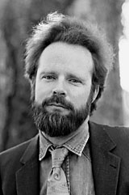
Robert W Floyd (1934−2001)
Eulogy by Knuth: http://www.acm.org/pubs/membernet/stories/floyd.pdf
Picture source: http://www.stanford.edu/dept/news/report/news/november7/floydobit-117.html

Slide 65
Team Problems
Problems
1 - 3
lec 4F.65

