Slide 1
Mathematics for Computer Science MIT 6.042J/18.062J
Harmonic Sum
Integral Method

Slide 2
Book Stacking
table
Copyright © Albert R. Meyer, 2007. All rights reserved.

Slide 3
Book Stacking
How far out?
?
overhang
Copyright © Albert R. Meyer, 2007. All rights reserved.

Slide 4
Book Stacking
One book
book center
of mass
Copyright © Albert R. Meyer, 2007. All rights reserved.

Slide 5
Book Stacking
One book
book center
of mass
Copyright © Albert R. Meyer, 2007. All rights reserved.

Slide 6
Book Stacking
balances if
center of mass
over table
book center
of mass
One book
1
2
Copyright © Albert R. Meyer, 2007. All rights reserved.

Slide 7
n books
1
2
n
Copyright © Albert R. Meyer, 2007. All rights reserved.

Slide 8
n books
1
2
n
center
of mass
Copyright © Albert R. Meyer, 2007. All rights reserved.

Slide 9
n books
1
2
n
Copyright © Albert R. Meyer, 2007. All rights reserved.

Slide 10
n books
1
2
center of mass
of the whole stack
n
balances if
center of mass
over table
Copyright © Albert R. Meyer, 2007. All rights reserved.

Slide 11
n+1 books
1
2
center of mass
of all n+1 books
at table edge
center of mass of top n books at edge of book n+1
n
n+1
∆overhang
Copyright © Albert R. Meyer, 2007. All rights reserved.

Slide 12
Δ-overhang ::=
horizontal distance from
n-book to (n+1)-book
centers of mass

Slide 13
Δ-overhang
Δ
n
1
1/2

Slide 14
center of n-stack at x = 0.
center of n+1st book is at x = 1/2,
so center of n+1-stack is at

Slide 15
n+1 books
1
2
center of mass
of all n+1 books
center of mass of top n books
n
n+1

Slide 16
Book stacking summary
B_{n} ::= overhang of n books
B₁ = 1/2
B_{n+1} = B_{n} +
B_{n} =

Slide 17
Harmonic Sums
n^{th} Harmonic number
B_{n} = H_{n}/2

Slide 18
Integral estimate for H_{n}
1
1
x+1
1
2
1
3
1
1
2
1
3
0 1 2 3 4 5 6 7 8

Slide 19
Integral estimate for H_{n}
H_{n} = area of rectangles
> area under 1/(x+1) =

Slide 21
ln (n+1) ≤ H_{n}

Slide 22
Book stacking
for overhang 3, need B_{n} ≥ 3
H_{n} ≥ 6
integral bound: ln(n+1) ≥ 6
so ok with n ≥ ⎡e⁶-1⎤ = 403 books
actually calculate H_{n}:
227 books are enough.

Slide 23
Book stacking
H_{n}→∞ as n→∞,
so overhang can be
as big as desired!

Slide 24
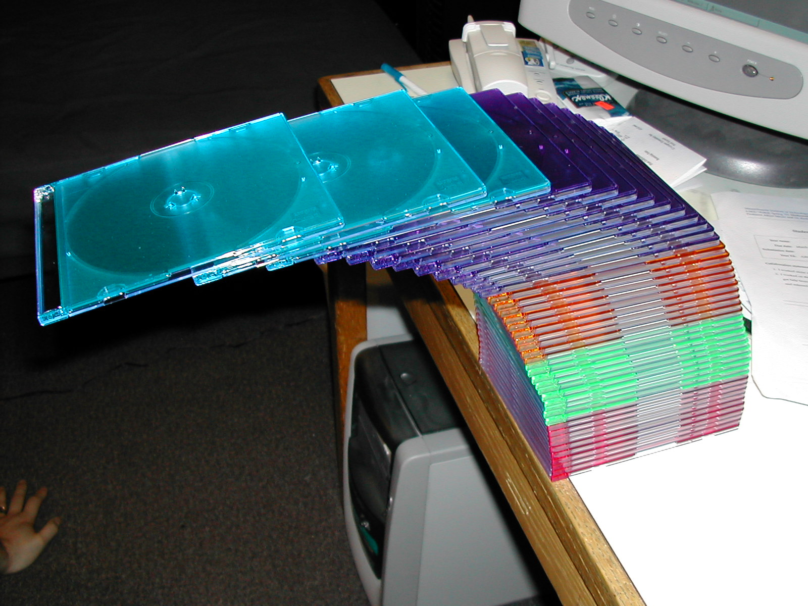
CD cases over the edge
43 cases high --top 4 cases completely off the table --1.8 or 1.9 case-lengths

Slide 25
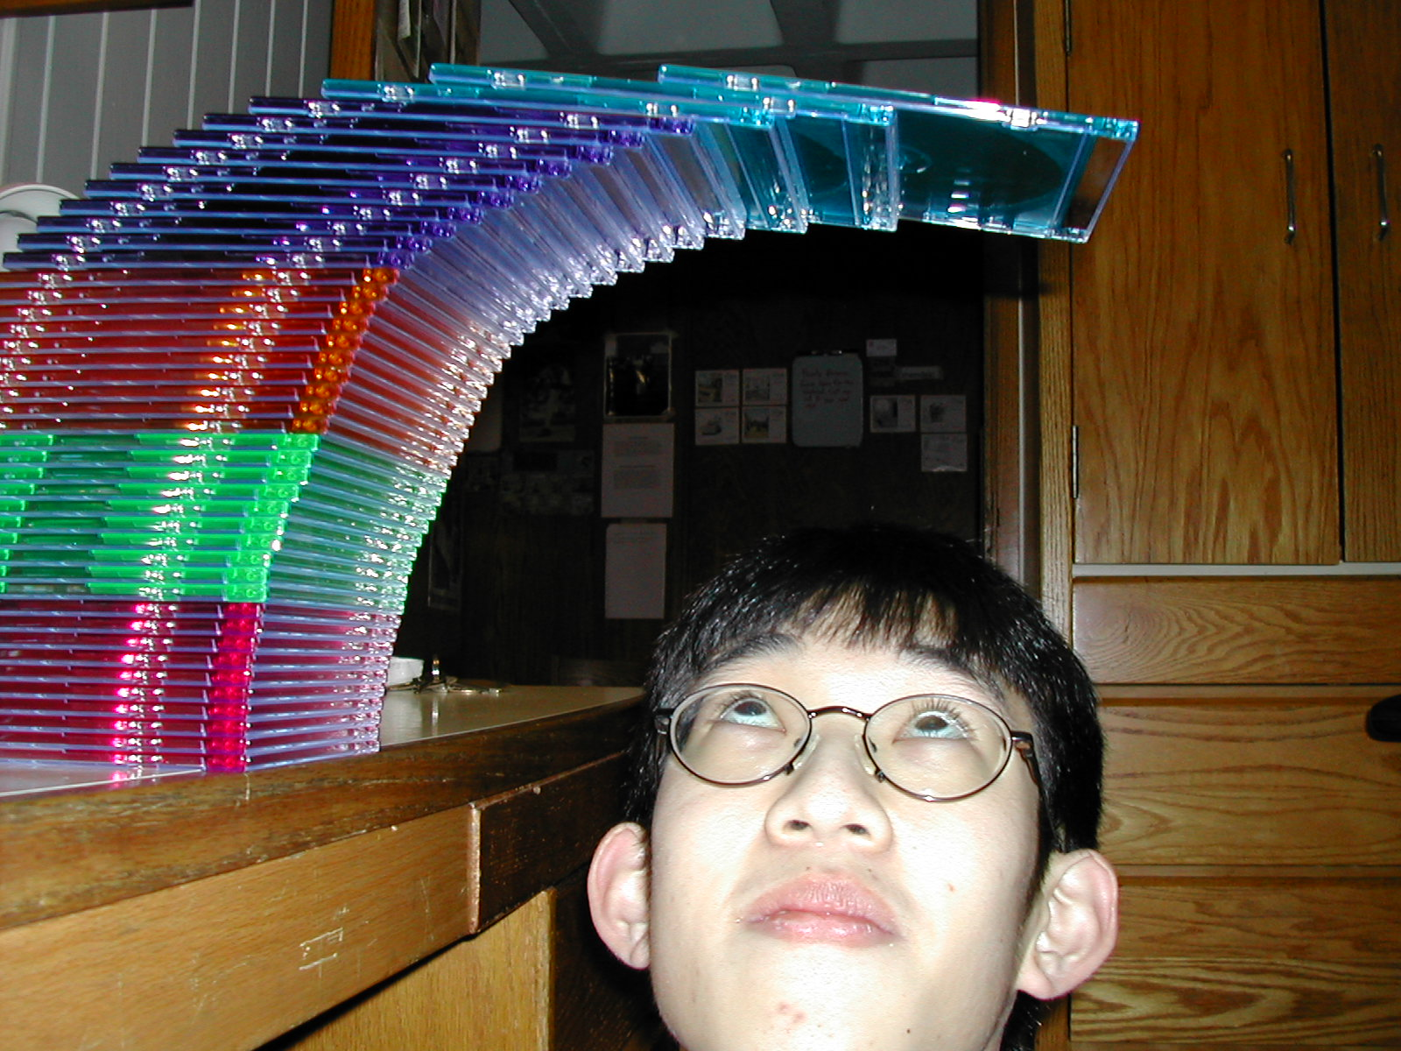
stack of 43 CD’s
see 6.042 Spring02 demo page for credits

Slide 26
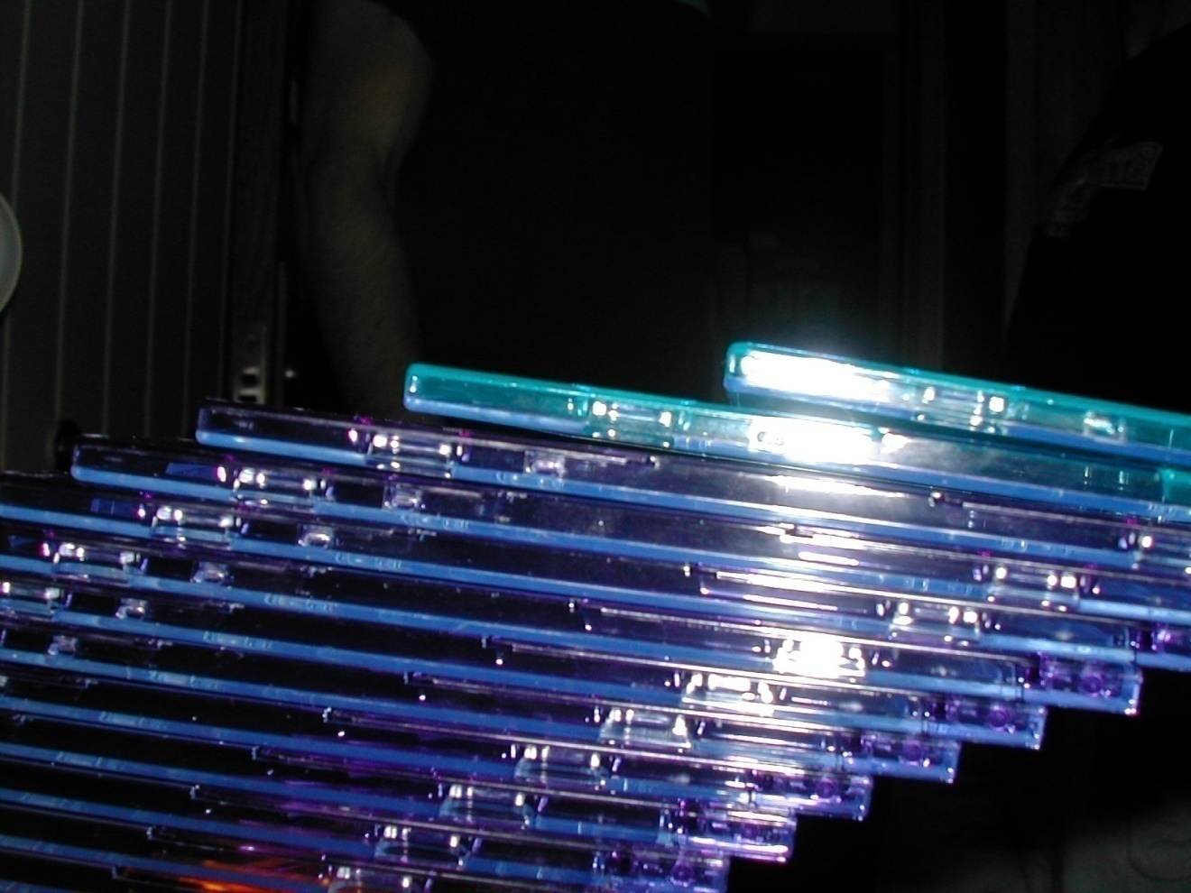
don’t sneeze

Slide 27
Upper bound for H_{n}
1
1
2
1
3
1
1
2
1
3
0 1 2 3 4 5 6 7 8

Slide 28
Upper bound for H_{n}

Slide 29
Asymptotic bound for H_{n}
ln(n+1) < H_{n} < 1+ ln(n)
H_{n} ∼ ln(n)

Slide 30
Asymptotic Equivalence
Def: f(n) ~ g(n)

Slide 31
Asymptotic Equivalence ~
Example: (n² + n) ~ n²
pf:

Slide 32
Team Problems
Problems
1―4
Notes:
36

Slide 33
Closed form for n!
Turn product into a sum taking logs:
ln(n!) = ln( 1·2·3···(n – 1)·n ) =
ln 1 + ln 2 + · · · + ln(n – 1) + ln(n)

Slide 34
Closed form for n!
Integral Method to bound
ln n
ln(x)
…
ln(x+1)
ln 5
ln 4
ln 3
ln
n-1
ln n
ln 5
ln 2
ln 4
…
ln 3
ln 2
1
2
3
4
5
n–2
n–1
n

Slide 35
Closed form for n!
reminder:

Slide 36
Closed form for n!
exponentiating:

Slide 37
Stirling’s Formula
A precise approximation:

