Slide 1
Mathematics for Computer Science MIT 6.042J/18.062J
Euler’s Theorem
RSA encryption
TexPoint fonts used in EMF.
Read the TexPoint manual before you delete this box.: AA

Slide 2
Euler φ function
φ(n) ::=
# k ∈ 0,1,…,n-1 s.t.
k rel. prime to n
has a (mod n)
inverse

Slide 3
Euler φ function
φ(n) ::= # k ∈ 0,1,…,n-1 s.t.
k rel. prime to n
φ(7) = 6
φ(12) = 4
1,2,3,4,5,6
0,1,2,3,4,5,6,7,8,9,10,11

Slide 4
Calculating φ
If p prime, everything from
1 to p-1 is rel. prime to p, so
φ(p) = p – 1

Slide 5
Euler φ function
φ(9)?
0,1,2,3,4,5,6,7,8
0,1,2,3,4,5,6,7,8
k rel. prime to 9 iff
k rel. prime to 3
3 divides every 3rd number
so, φ(9) = 9-(9/3) = 6

Slide 6
Calculating φ(p^{k})
0,1,...,p,...,2p,.....,p^{k}-p,...,p^{k}-1
0,1,...,p,...,2p,.....,p^{k}-p,...,p^{k}-1
p divides every pth number
p^{k}/p of these numbers
are not rel. prime to p^{k}

Slide 7
Calculating φ(p^{k})
0,1,...,p,...,2p,.....,p^{k}-p,...,p^{k}-1
p divides every pth number
p^{k}/p of these numbers
are not rel. prime to p^{k}

Slide 8
Calculating φ(p^{k})
so
φ(p^{k}) = p^{k} – p^{k}/p
– p^{k-1}

Slide 9
Calculating φ(a⋅b)
Lemma :
For a, b relatively prime,
φ(a⋅b) = φ(a)⋅φ(b)
pf: Pset 8. Another way
in 2 weeks.

Slide 10
Calculating φ(a⋅b)
φ(12) = φ(3⋅4)
= φ(3)⋅φ(4)
= (3 - 1)⋅(2² - 2²⁻¹)
= 2⋅(4 - 2) = 4

Slide 11
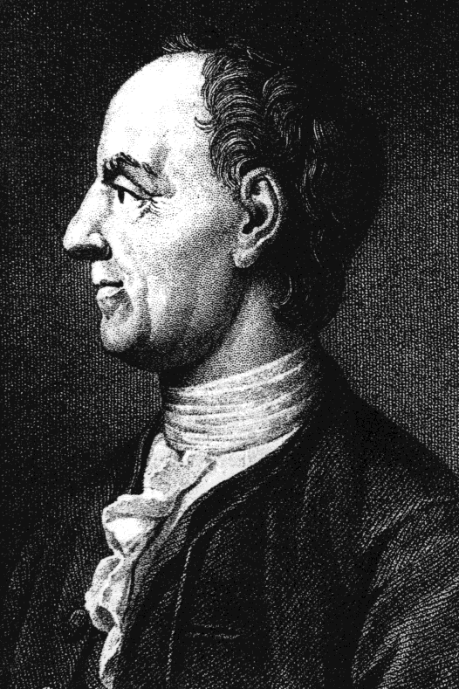
Euler’s Theorem
For k relatively
prime to n,
k^{φ(n)} ≡ 1 (mod n)

Slide 12
Fermat’s Little Theorem
special case of Euler:
k^{p-1} ≡ 1 (mod p)
for prime p

Slide 13
Proof of Euler’s Theorem
n* ::=
{m| 0<m<n & gcd(m,n)=1}
= {rem(m,n)|m rel. prime to n}
Note: m,k ∈ n* implies
m⋅k rel. prime to n

Slide 14
Proof of Euler’s Theorem
n* ::=
{m|0<m<n, m rel prime to n}
Note: m,k ∈ n* implies
m⋅k rel. prime to n
rem(mk,n) ∈ n*

Slide 15
Proof of Euler’s Theorem
n* ::=
{m|0<m<n, m rel prime to n}
Lemma: mult by k∈n*,
permutes n*.

Slide 16
permuting (mod 9)
φ(9) = 3²-3 = 6
9*=
 | 1 | 2 | 4 | 5 | 7 | 8

Slide 17
permuting (mod 9)
φ(9) = 3²-3 = 6
 | 1 | 2 | 4 | 5 | 7 | 8
2⋅ | 2 | 4 | 8 | 1 | 5 | 7
9*=
 | 1 | 2 | 4 | 5 | 7 | 8

Slide 18
permuting (mod 9)
φ(9) = 3²-3 = 6
9*=
 | 1 | 2 | 4 | 5 | 7 | 8
2⋅ | 2 | 4 | 8 | 1 | 5 | 7
7⋅ | 7 | 5 | 1 | 8 | 4 | 2

Slide 19
Permuting n*
Lemma:
For k∈n*, the mapping
m → rem(km, n)
is a bijection from n* to n*
lec 9M.19

Slide 20
Proof of Euler’s Thm
So

Slide 21
Proof of Euler’s Thm

Slide 22
Proof of Euler’s Thm

Slide 23
Proof of Euler’s Thm
But OK to cancel , so
1 ≡ k^{φ(n)} (mod n).
QED

Slide 24
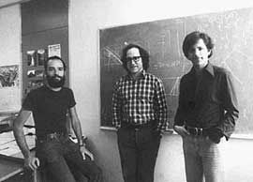
RSA Public Key Encryption

Slide 25
Beforehand
receiver generates primes p, q
n ::= p•q
selects e rel. prime to (p-1)(q-1)
(e, n) ::= public key, publishes it
finds d, inverse mod (p-1)(q-1) of e
d is secret key, keeps hidden

Slide 26
RSA
(0 ≤ m < n)
Encoding message m:
send m’ ::= rem(m^{e}, n)
Decoding m’:
receiver computes
rem((m’)^{d}, n )
= m

Slide 27
Receiver’s abilities
find two large primes p, q
- ok because: lots of primes
- fast test for primality
find e rel. prime to (p-1)(q-1)
- ok: lots of rel. prime nums
- gcd easy to compute
find (mod (p-1)(q-1)) inverse of e
- easy using Pulverizer or Euler

Slide 28
Why does this work?
follows easily from
Euler’s Theorem when
m has inverse mod n

Slide 29
Why does this work?
actually works for
all m
… explained in
Class Problem 2

Slide 30
Why is it secure?
easy to break if can factor n
(find d same way receiver did)
conversely, from d can factor n
(but factoring appears hard
so finding d must also be hard)
RSA has withstood 30 years of attacks

Slide 31
Team Problems
Problems
1 & 2
Notes:
36

Slide 32
Proof of Euler’s Theorem
Remark:
If m,k have inverses
(mod n), then so does
rem(m⋅k, n)
WHY?

Slide 33
Proof of Lemma
inverse of m⋅k is
k⁻¹⋅m⁻¹

Slide 34
Proof of Euler’s Thm
m₁,m₂,…,m_{r} : ints from 1 to n-1
rel. prime to n. say k has
inverse mod n. Then
÷n remainders of
m₁k, m₂k, …, m_{r}k
are a permutation of
m₁, m₂, …, m_{r}

Slide 35
Proof of Euler’s Thm
why? …k cancels,
so same number, r, of
m_{i}’s and rem(m_{i}k, n)’s

Slide 36
Proof of Euler’s Thm
why? … and rem(m_{i}k, n) has inverse m_{i}⁻¹k⁻¹, so
rem(m_{i}k, n) is an m_{j}.

Slide 37
Proof of Euler’s Thm
So m₁ ∙∙∙ m_{r}
≡ (m₁k)(m₂k) ∙∙∙ (m_{r}k) (mod n)
= k^{r}∙m₁ ∙∙∙ m_{r} (mod n)
But OK to cancel m₁,∙∙∙,m_{r}, so
1 ≡ k^{r} (mod n).
QED

