Slide 1
Gambler’s Ruin
Mathematics for Computer Science MIT 6.042J/18.062J

Slide 2
(let’s go to Vegas)
Gambler’s Ruin

Slide 3
Gambler’s Ruin
Place $1 bets until going broke or reaching target
What is Pr[reach target]?

Slide 4
Gambler’s Ruin
T
”target"
$$$
n
"initial capital"
# of bets

Slide 5
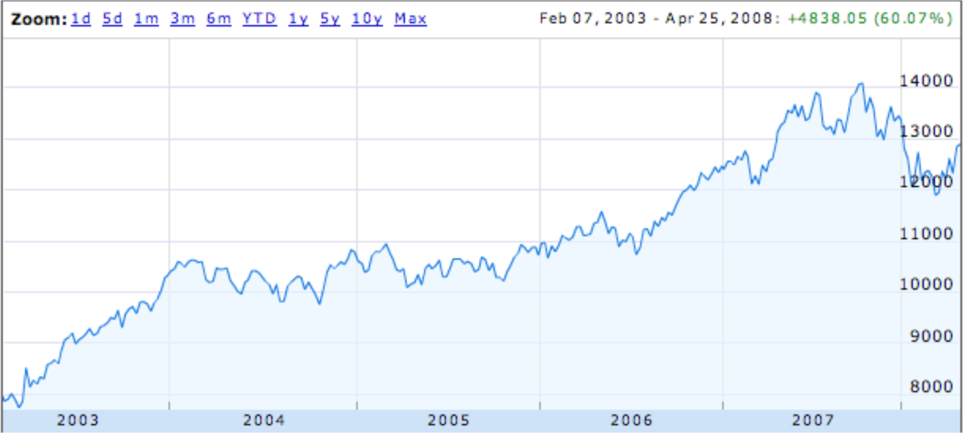
Dow Jones Trend
random steps with “up” bias?

Slide 6
Gambling: Fair Case
Suppose we’re playing a fair game:
Pr[win bet] = 1/2.
What is Pr[reach $200] if we start with $100?
1/2
What about Pr[reach $600] if we start with $500?
5/6

Slide 7
Gambling: Fair Case
In general, if we start with $n
Pr[reach $T] = n/T
What about an unfair game?

Slide 8
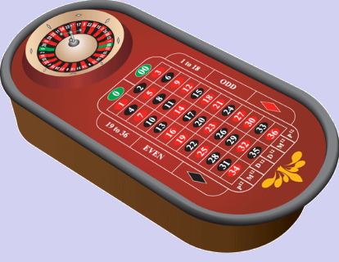
Gambling: Slightly Unfair
Betting black in US roulette
Pr[win bet] = 18/38 = 9/19 < 1/2

Slide 9
US Roulette
What is Pr[reach $500+100] starting with $500? (5/6 when fair)
< 1 / 37,000
What is Pr[reach $1,000,100] starting
with $1,000,000? (≈ 1 when fair)
< 1 / 37,000
no matter how many $ at start!

Slide 10
Gambler’s Ruin
Parameters
p ::= Pr[win $1 bet]
n ::= initial capital
T ::= gambler’s target
What is Pr[reach target]?

Slide 11
Gambler’s Ruin
In fair game
(that is, p = 1/2):

Slide 12
Gambler’s Ruin
unfair game (p < 1/2):
intended
profit

Slide 13
Profit $100 in US Roulette
Pr[Profit $100] < (9/10)¹⁰⁰
< 1/37,648

Slide 14
Gambler’s Ruin
View as random walk on a line.
…
…
$0
$1
n-1
n
n+1
T-1
T
p
p ::=Pr[win a bet]
k
k+1
q ::= 1-p = Pr[lose a bet]
k-1
k
q
What is Pr[reach T before 0]?

Slide 15
General Approach
p
…
…
n-1
n
n+1
q
w_{n} ::= Pr{hit target | start at n}
= Pr{target | n+1} • Pr{win bet}
= w_{n+1} • p
+ Pr{target | n-1} • Pr{lose bet}
+ w_{n-1} • q

Slide 16
General Approach
p
…
…
n-1
n
n+1
q
w_{n} = pw_{n+1} + qw_{n-1}, so
w_{n+1} = (1/p)w_{n} - (q/p)w_{n-1}
we have a linear recurrence!

Slide 17
Linear Recurrence
w_{n+1} = (1/p)w_{n} - (q/p)w_{n-1}
w₀ = 0 (Gambler is broke)
w_{T} = 1 (Gambler is at target)
Solve using generating functions, with one twist:
We know w_{T} instead of w₁!

Slide 18
Condition on 1st bet
w_{n}::= Pr[win starting with $n]
Pr[w_{n}| win 1st bet] = w_{n+1}
Pr[w_{n}| lose 1st bet] = w_{n-1}
w_{n}= w_{n+1}∙p + w_{n-1}∙q

Slide 19
A Linear Recurrence
w_{n+1} = (1/p)w_{n} - (q/p)w_{n-1}
w₀ = 0 (Gambler is broke)
w_{T} = 1 (Gambler at target)
Solve as usual and get:

Slide 20
Linear Recurrence
Twist: we don’t know w₁
for r ::= q/p ≠ 1.
But w_{T} = 1, so can solve for w₁. Then

Slide 21
Winning when Biased Against
intended profit
Suppose p < q, so r ::= q/p > 1.

Slide 22
Winning when Biased Against
w_{n} < (1/r)^{intended profit}
w_{n} bound does not depend on n!
1/r < 1, so w_{n} is exponentially
decreasing in intended profit!

Slide 23
Profit $100 in US Roulette
p = 18/38
q = 20/38
1/r = 9/10
Pr[Profit $100] < (9/10)¹⁰⁰
< 1/37,648

Slide 24
Profit $200 in US Roulette
p = 18/38
q = 20/38
1/r = 9/10
Pr[Profit $200] < (9/10)²⁰⁰
< (1/37,648)²
< 1/70,000,000

Slide 25
What About the Fair Case?
(r ::= q/p = 1)
Uh oh, dividing by 0.
Use l’Hôpital’s Rule
d(r^{n}-1)/dr
nr^{n-1}
lim_{r→1} = =
d(r^{T}-1)/dr
Tr^{T-1}

Slide 26
Expected number of bets

Slide 27
Expected number of bets

Slide 28
Linear recurrence

Slide 29
Expected number of bets
Solve linear recurrence as usual.
Elegant result in the fair case:
e_{n} = n(T-n)
= (initial stake)
∙(intended profit)

Slide 30
Expected number of fair bets
For example, starting with $1
aiming to reach $1000,
expect to make 999 bets
(and most likely go broke)
Problem: There must be an intuitive proof.
Find one.

Slide 31
Team Problems
Problems
1-2

