Slide 1
Mathematics for Computer Science MIT 6.042J/18.062J
A Famous
Linear Recurrence
fibonacci.1

Slide 2
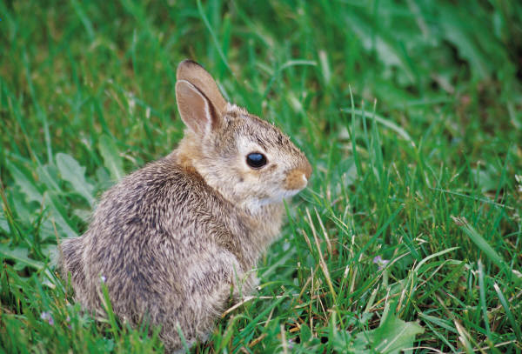
The Rabbit Population
A breeding pair of rabbits
produces a newborn pair every month.
Rabbits breed after one month.
After n months:
w_{n}::= # newborn pairs
b_{n}::= # breeding pairs
Start with a newborn pair: w₀ = 1
b₀ = 0
fibonacci.2

Slide 3
The Rabbit Population
w_{n}::= # newborn pairs
b_{n}::= # breeding pairs
Therefore,
fibonacci.3

Slide 4
The Rabbit Population
b_{n} = b_{n-1} + b_{n-2}
Fibonacci was studying rabbit population growth!
fibonacci.4

Slide 5
Generating Function for Rabbits

Slide 6
Generating Function for Rabbits

Slide 7
Generating Function for Rabbits

Slide 8
Geometric Series Recurrence
fibonacci.8

Slide 9
Geometric Series Recurrence
fibonacci.9

Slide 10
Geometric Series Recurrence
fibonacci.10

Slide 11
Generating Function for Rabbits
use partial fraction expansion to find
closed form for b_{n}
fibonacci.11

