Slide 1
Random Walks
Mathematics for Computer Science MIT 6.042J/18.062J

Slide 2
Applications of Random Walk
Physics — Brownian motion
Finance — stocks, options
Algorithms — web search, clustering

Slide 3
Google Page Rank
How do we decide which pages are “more important?”
Model of internet:
Users click random link on a page.
Occasionally start over.
A page is “more important” if the users spend a large fraction of time there.

Slide 4
Graph With Probable Transitions
1/3
Outgoing-edge probabilities sum to 1
O
1/4
2/3
B
G
1/4
1/2
1

Slide 5
Questions About the Graph
O
1/3
1/4
2/3
B
1/4
G
1/2
1
Pr{reach G before O | start at B}
Pr{ever reach O | start at B}
Average # steps for B to O
probability p_{B} of being at B
(p_{B}, p_{O}, p_{G}) ?

Slide 6
Distribution Over Nodes
1/3
1/4
1/4
0
0
1/4
2/3
1/4
1/4
1/4
1/4
1/4
0
1/2
1
0
1
1/2
1
1/2
1/2
(p_{B}, p_{O}, p_{G})
(1, 0, 0)
Suppose you start at B:
What is p_{B}’, p_{G}’, or p_{O}’ after 1 step?
Lec 14W.6
Notes:
6

Slide 7
Distribution Over Nodes
1/3
1/4
1/4
0
0
1/4
2/3
1/4
1/4
1/4
1/4
1/4
0
1/2
1
0
1
1/2
1
1/2
1/2
(p_{B}, p_{O}, p_{G})
(1, 0, 0)
Suppose you start at B:
What is p_{B}’, p_{G}’, or p_{O}’ after 1 step?
Lec 14W.7
Notes:
7

Slide 8
Distribution Over Nodes
1/3
1/4
1/4
0
0
1/4
2/3
1/4
1/4
1/4
1/4
1/4
0
1/2
1
0
1
1/2
1
1/2
1/2
(p_{B}, p_{O}, p_{G})
(1, 0, 0)
Suppose you start at B:
What is p_{B}’, p_{G}’, or p_{O}’ after 1 step?
Lec 14W.8
Notes:
8

Slide 9
Distribution Over Nodes
1/3
1/4
1/4
0
0
1/4
2/3
1/4
1/4
1/4
1/4
1/4
0
1/2
1
0
1
1/2
1
1/2
1/2
(p_{B}, p_{O}, p_{G})
(1, 0, 0)
Suppose you start at B:
p_{B}’ = Pr{B to B|at B}•p_{B}
+ Pr{G to B|at G}•p_{G}
+ Pr{O to B|at O}•p_{o}
Lec 14W.9
Notes:
9

Slide 10
Distribution Over Nodes
1/3
1/4
1/4
0
0
1/4
2/3
1/4
1/4
1/4
1/4
1/4
0
1/2
1
0
1
1/2
1
1/2
1/2
(p_{B}, p_{O}, p_{G})
(1, 0, 0)
Suppose you start at B:
p_{B}’ = 1/2 •1/2
= 1/2
+ 1 •1/4
+ 0 •1/4
Lec 14W.10
Notes:
10

Slide 11
Distribution Over Nodes
1/3
1/4
1/4
2/3
1/4
1/2
1/4
1/2
1
Dist after 1 step is: (1/2, 1/4, 1/4)
p_{O}’’ = Pr{B to O|at B}•p_{B}’
+ Pr{G to O|at G}•p_{G}’
+ Pr{O to O|at O}•p_{o}’

Slide 12
Distribution Over Nodes
1/3
1/4
1/4
2/3
1/4
1/2
1/4
1/2
1
Dist after 1 step is: (1/2, 1/4, 1/4)
p_{O}’’ = 1/4 •1/2
= 5/24
+ 0 •1/4
+ 1/3 •1/4

Slide 13
Distribution Over Nodes
1/3
1/4
5/24
2/3
1/4
1/2
7/24
1/2
1
distribution after 2 steps:
(p_{B}’’, p_{O}’’, p_{G}’’)
(1/2, 5/24, 7/24)

Slide 14
Distribution Over Nodes
1/3
1/4
p_{O}^{t}
2/3
1/4
p_{B}^{t}
p_{G}^{t}
1/2
1
distribution after t steps?
…and as t→∞?

Slide 15
Stationary Distribution
1/3
1/4
p_{O}
2/3
1/4
p_{B}
p_{G}
1/2
1
distribution (p_{B}, p_{O}, p_{G}) is stationary
if next-step distribution is the same.
What is a stationary dist. here?

Slide 16
Finding Stationary Dist.
1/3
1/4
p_{O}
2/3
1/4
p_{G}
p_{B}
1/2
1
p_{B} =
p_{O} =
p_{G} =
p_{B}’ = (1/2)p_{B} + 1p_{G}
p_{O}’ = (1/4)p_{B} + (1/3)p_{O}
p_{G}’ = (1/4)p_{B} + (2/3)p_{O}
p_{B} + p_{O} + p_{G} = 1

Slide 17
Finding Stationary Dist.
1/3
1/4
p_{O}
2/3
1/4
p_{G}
p_{B}
1/2
1
(8/15, 3/15, 4/15)

Slide 18
Google Page Rank
View the entire web as a graph
vertices are webpages
edge (u,v) exists if link from page u to page v
Pr{go to v from u} = 1/outdeg(u)
Find stationary distribution {p_{u}}
Rank u above v if p_{u} > p_{v}.

Slide 19
Questions on Stationary Dist
Yes
(if graph finite)
Does a stationary dist exist?
Is it unique?
Does a random walk approach it from any starting distribution?
How quickly?
Sometimes
Sometimes

Slide 20
(let’s go to Vegas)
Gambler’s Ruin

Slide 21
Gambler’s Ruin
Decide to place $1 bets until either going broke or reaching some target amount of money.
What is Pr{reach target}?

Slide 22
Gambling: Fair Case
Suppose we’re playing a fair game:
Pr{win bet} = 1/2.
What is Pr{reach $200} if we start with $100?
1/2
What about Pr{reach $600} if we start with $500?
5/6

Slide 23
Gambling: Fair Case
In general, if we start with $n
Pr{reach $T} = n/T
What about an unfair game?

Slide 24
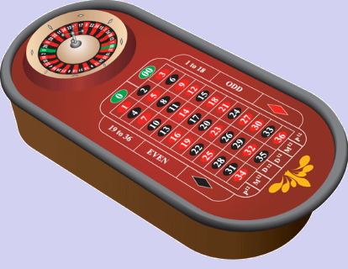
Gambling: Slightly Unfair
Betting black in US roulette
Pr{win bet} = 18/38 = 9/19 < 1/2

Slide 25
US Roulette
What is Pr{reach $500+100} starting with $500? (5/6 when fair)
< 1 / 37,000
What is Pr{reach $1,000,100} starting
with $1,000,000? (≈ 1 when fair)
< 1 / 37,000
no matter how many $ at start!

Slide 26
Gambler’s Ruin
Play $1 bets until going broke or make enough money.
Parameters
p ::= Pr{win $1 bet}
n ::= initial capital
T ::= gambler’s target
Question: What is Pr{reach target}?

Slide 27
Gambler’s Ruin
T
”target"
$$$
n
"initial capital"
# of bets

Slide 28
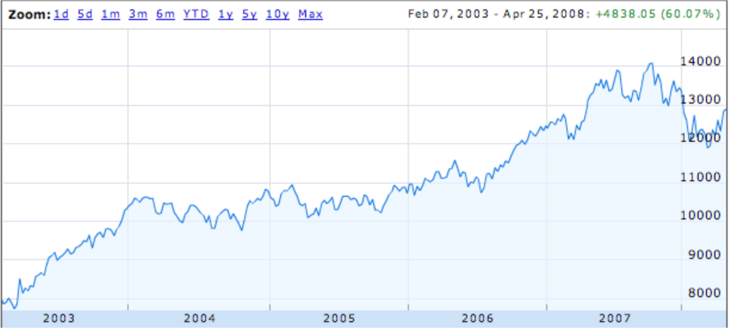
Dow Jones Trend
random steps with “up” bias?

Slide 29
Gambler’s Ruin
View as random walk on a line.
…
…
$0
$1
n-1
n
n+1
T-1
T
p
p ::=Pr{win a bet}
k
k+1
q ::= 1-p = Pr{lose a bet}
k-1
k
q
What is Pr{reach T before 0}?

Slide 30
General Approach
p
…
…
n-1
n
n+1
q
w_{n} ::= Pr{hit target | start at n}
= Pr{target | n+1} • Pr{n+1}
= w_{n+1} • p
w_{n} = pw_{n+1} + qw_{n-1}, so
w_{n+1} = (1/p)w_{n} - (q/p)w_{n-1}
+ w_{n-1} • q
+ Pr{target | n-1} • Pr{n-1}
we have a linear recurrence!

Slide 31
General Approach
p
…
…
n-1
n
n+1
q
w_{n} ::= Pr{hit target | start at n}
= Pr{target | n+1} • Pr{n+1}
= w_{n+1} • p
w_{n} = pw_{n+1} + qw_{n-1}, so
w_{n+1} = (1/p)w_{n} - (q/p)w_{n-1}
+ w_{n-1} • q
+ Pr{target | n-1} • Pr{n-1}
we have a linear recurrence!

Slide 32
Linear Recurrence
w_{n+1} = (1/p)w_{n} - (q/p)w_{n-1}
w₀ = 0 (Gambler is broke)
w_{T} = 1 (Gambler is at target)
Solve using generating functions, with one twist:
We know w_{T} instead of w₁!

Slide 33
Linear Recurrence
w_{n+1} = (1/p)w_{n} - (q/p)w_{n-1}
w₀ = 0 (Gambler is broke)
w_{T} = 1 (Gambler is at target)
Solve using generating functions
and get:

Slide 34
Linear Recurrence
Twist: we don’t know w₁
for r ::= q/p ≠ 1.
But w_{T} = 1, so can solve for w₁. Then

Slide 35
Winning when Biased Against
intended profit
Suppose p < q, so r ::= q/p > 1.

Slide 36
Winning when Biased Against
(r ::= q/p > 1.)
w_{n} < (1/r)^{T-n}
T-n = intended profit
w_{n} < (1/r)^{intended profit}
Bound for Pr{intended profit} does not depend on n!
Since (1/r) < 1, w_{n} is exponentially decreasing in intended profit!

Slide 37
Profit $100 in US Roulette
p = 18/38
q = 20/38
1/r = 9/10
Pr{Profit $100} < (9/10)¹⁰⁰
< 1/37,648

Slide 38
Profit $200 in US Roulette
p = 18/38
q = 20/38
1/r = 9/10
Pr{Profit $200} < (9/10)²⁰⁰
< 1/70,000,000

Slide 39
What About the Fair Case?
(r ::= q/p = 1)
Uh oh, dividing by 0.
Use l’Hôpital’s Rule
d(r^{n}-1)/dr
nr^{n-1}
lim_{r→1} = =
d(r^{T}-1)/dr
Tr^{T-1}

Slide 40
Team Problems
Problems
1 & 2

