Slide 1
Mathematics for Computer Science MIT 6.042J/18.062J
Stable
Matching

Slide 2
Stable Marriage
A Marriage Problem
1 2 3 4 5
Boys
Girls
A B C D E

Slide 3
Stable Marriage
Preferences
Boys Girls
1 : CBEAD A : 35214
2 : ABECD B : 52143
3 : DCBAE C : 43512
4 : ACDBE D : 12345
5 : ABDEC E : 23415

Slide 4
Stable Marriage
1: CBEAD
2 : ABECD
3 : DCBAE
4 : ACDBE
5 : ABDEC
Preferences
Try “greedy”
strategy for boys

Slide 5
Stable Marriage
Preferences
Marry Boy 1 with Girl C
(his 1st choice)
1: CBEAD
2 : ABECD
3 : DCBAE
4 : ACDBE
5 : ABDEC
1
C

Slide 6
Stable Marriage
Preferences
2 : ABE D
3 : D BAE
4 : A DBE
5 : ABDE

Slide 7
Stable Marriage
Preferences
2 : ABED
3 : DBAE
4 : ADBE
5 : ABDE

Slide 8
Stable Marriage
Next:
Preferences
Marry Boy 2 with Girl A
(his remaining 1st choice)
2 : ABED
3 : DBAE
4 : ADBE
5 : ABDE
2
A

Slide 9
Stable Marriage
Final “boy greedy” marriages
1 C
2 A
3 D
4 B
5 E

Slide 10
Stable Marriage
Trouble!
1
C
4
B

Slide 11
Stable Marriage
Boy 4 likes Girl C better than his wife.
1
C
4
B

Slide 12
Stable Marriage
and vice-versa
1
C
4
B

Slide 13
Stable Marriage
a rogue couple
1
C
4
B

Slide 14
Stable Marriage
Stable Marriage Problem:
Marry everyone without any rogue couples!

Slide 15
Stable Marriage
Let’s try it!

Slide 16
Stable Marriage I
5 A
2 B
4 C
3 D
1 E
“boy optimal”

Slide 17
Stable Marriage II.
3 A
5 B
4 C
1 D
2 E
all girls get 1st choice

Slide 18
Stable Marriage
More than a puzzle:
College Admissions
(original Gale & Shapley paper, 1962)
Matching Hospitals & Residents.
Matching Dance Partners.

Slide 19
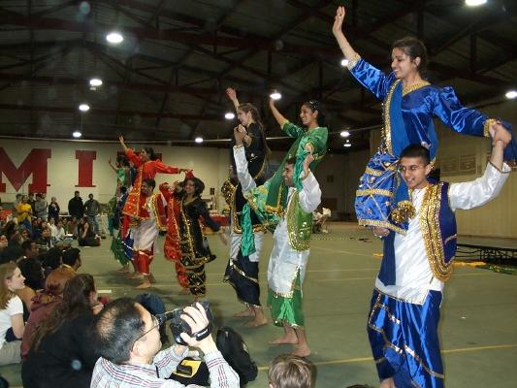
Stable Marriage

Slide 20
The Mating Ritual
(day by day)

Slide 21
Mating Ritual
Morning: boy serenades favorite girl
Angelina
Billy Bob
Brad

Slide 22
Mating Ritual
Morning: boy serenades favorite girl
Afternoon: girl rejects all but favorite
If you’re not Brad
take a hike!
Angelina
Billy Bob
Brad

Slide 23
Mating Ritual
Morning: boy serenades his favorite girl
Afternoon: girl rejects all but her
favorite boy
Evening: rejected boy writes off girl
…
Angelina
…
Billy Bob

Slide 24
Mating Ritual
Stop when no girl rejects.
Each girl marries her
favorite suitor (if any).

Slide 25
Mating Ritual
Termination:
There exists a Wedding Day.
Partial Correctness:
Everyone is married.
Marriages are stable.

Slide 26
Stable Marriage: termination
total # remaining names
on boys’ lists:
strictly decreasing
& ℕ-valued
So ∃ Wedding Day

Slide 27
Mating Ritual
Different girls have different
favorites, because boys
serenade one girl at a time.

Slide 28
Mating Ritual: girls improve
Lemma:
A girl’s favorite tomorrow
will be at least as desirable
to her as today’s.
…because today’s favorite will
stay until she rejects him for someone better.

Slide 29
Mating Ritual: boys get worse
Lemma:
A boy’s favorite tomorrow
will be no more desirable
to him than today’s.
…because boys work straight down their lists.

Slide 30
Mating Ritual: invariant
If G is not on B’s list, then she
has a better current favorite.
Proof: When G rejected B she
had a better suitor (her favorite
that day), and her favorites
never get worse.

Slide 31
On Wedding Day
Each girl has ≤ 1 suitor.
(by def of wedding day)
Each boy is married, or
has no girls on his list.

Slide 32
Mating Ritual: everyone marries
Everyone is married on wedding day
Proof: By contradiction.
If B is not married, his list is empty.
By invariant, all girls have favorites
better than B -- so they do have a favorite.
That is, all girls are married,
so all boys are married.

Slide 33
Mating Ritual: stable marriages
Marriages are Stable:
Bob won’t be in rogue couple with
case 1: a girl G on his final list,
since he’s already married to the best of them.

Slide 34
Mating Ritual: stable marriages
Marriages are Stable:
Bob won’t be in rogue couple with
case 2: a girl G not on his list,
since by invariant, G likes her spouse better than Bob.

