Slide 1
Mathematics for Computer Science MIT 6.042J/18.062J
Euler’s Theorem

Slide 2
Euler φ function
φ(n) ::=
# k ∈ 0,1,…,n-1 s.t.
k rel. prime to n
[0,n)
has a (mod n)
inverse

Slide 3
Euler φ function
φ(n) ::= # k ∈ [0,n) s.t.
k rel. prime to n
φ(7) = 6
φ(12) = 4
1,2,3,4,5,6
0,1,2,3,4,5,6,7,8,9,10,11

Slide 4
Calculating φ
If p prime, everything in
[1,p) is rel. prime to p, so
φ(p) = p – 1

Slide 5
Euler φ function
φ(9)?
0,1,2,3,4,5,6,7,8
0,1,2,3,4,5,6,7,8
k rel. prime to 9 iff
k rel. prime to 3
3 divides every 3rd number
so, φ(9) = 9-(9/3) = 6

Slide 6
Calculating φ(p^{k})
0,1,...,p,...,2p,.....,p^{k}-p,...,p^{k}-1
0,1,...,p,...,2p,.....,p^{k}-p,...,p^{k}-1
p divides every pth number
p^{k}/p of these numbers
are not rel. prime to p^{k}

Slide 7
Calculating φ(p^{k})
0,1,...,p,...,2p,.....,p^{k}-p,...,p^{k}-1
p divides every pth number
p^{k}/p of these numbers
are not rel. prime to p^{k}

Slide 8
Calculating φ(p^{k})
so
φ(p^{k}) = p^{k} – p^{k}/p
– p^{k-1}

Slide 9
Calculating φ(a⋅b)
Lemma :
For a, b relatively prime,
φ(a⋅b) = φ(a)⋅φ(b)
pf: Class prob. Another
way later by “counting.”

Slide 10
Calculating φ(a⋅b)
φ(12) = φ(3⋅4)
= φ(3)⋅φ(4)
= (3 - 1)⋅(2² - 2²⁻¹)
= 2⋅(4 - 2) = 4

Slide 11
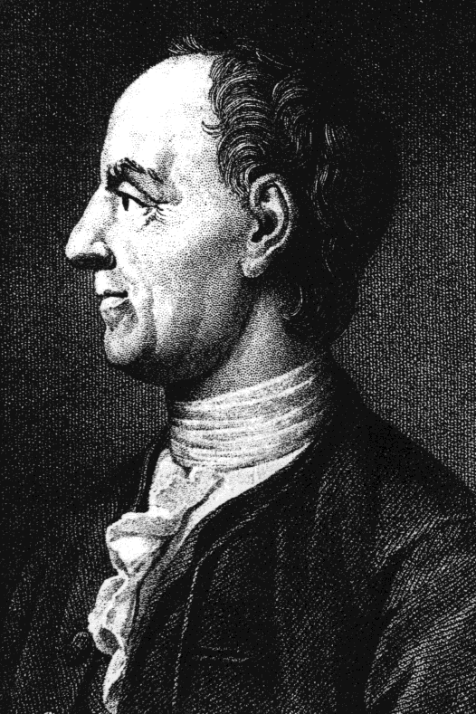
Euler’s Theorem
For k relatively
prime to n,
k^{φ(n)} ≡ 1 (mod n)

Slide 12
Fermat’s “Little” Theorem
special case:
k^{p-1} ≡ 1 (mod p)
for prime p

Slide 13
Proof of Euler’s Theorem
n* ::=
{m∈[1,n)| gcd(m,n)=1}
= {rem(m,n)|m rel. prime to n}
Note: m,k ∈ n* implies
m⋅k rel. prime to n

Slide 14
Proof of Euler’s Theorem
n* ::=
{m∈[1,n)| m rel prime to n}
Note: m,k ∈ n* implies
m⋅k rel. prime to n
rem(mk,n) ∈ n*

Slide 15
Proof of Euler’s Theorem
n* ::=
{m∈[1,n)| m rel prime to n}
lemma:
mult by k∈n*, permutes n*

Slide 16
Proof of Euler’s Theorem
n* ::=
{m|0<m<n, m rel prime to n}
Lemma: mult by k∈n*,
permutes n*.

Slide 17
permuting (mod 9)
φ(9) = 3²-3 = 6
9*=
 | 1 | 2 | 4 | 5 | 7 | 8

Slide 18
permuting (mod 9)
φ(9) = 3²-3 = 6
 | 1 | 2 | 4 | 5 | 7 | 8
2⋅ | 2 | 4 | 8 | 1 | 5 | 7
9*=
 | 1 | 2 | 4 | 5 | 7 | 8

Slide 19
permuting (mod 9)
φ(9) = 3²-3 = 6
9*=
 | 1 | 2 | 4 | 5 | 7 | 8
2⋅ | 2 | 4 | 8 | 1 | 5 | 7
7⋅ | 7 | 5 | 1 | 8 | 4 | 2

Slide 20
Permuting n*
Lemma:
For k∈n*, the mapping
m → rem(km, n)
is a bijection from n* to n*
lec 5F.20

Slide 21
Proof of Euler’s Thm
say n*= {m₁,m₂,…,m_{s}}, k∈n*
none of
≡ (mod n) because k cancels
so each m_{i}k ≡ m_{j} (mod n)
for a unique m_{j.}
m₁k, m₂k, …, m_{s}k

Slide 22
Proof of Euler’s Thm
in particular,
m₁⋅m₂ ∙∙∙ ⋅m_{s}
≡ (m₁k)⋅(m₂k)∙∙∙(m_{s}k) (mod n)
now cancel the m_{i}’s

Slide 23
Proof of Euler’s Thm
in particular,
1
≡ ( k)⋅( k) ∙∙∙ ( k) (mod n)

Slide 24
Proof of Euler’s Thm
in particular,
1
≡ k^{s} (mod n)

Slide 25
Proof of Euler’s Thm
in particular,
1 ≡ k^{s} (mod n)
φ(n)
QED

Slide 26
Proof of Euler’s Thm
So

Slide 27
Proof of Euler’s Thm

Slide 28
Proof of Euler’s Thm

Slide 29
Proof of Euler’s Thm
But OK to cancel , so
1 ≡ k^{φ(n)} (mod n).
QED

Slide 30
Receiver’s abilities
find two large primes p, q
- ok because: lots of primes
- fast test for primality
find e rel. prime to (p-1)(q-1)
- ok: lots of rel. prime nums
- gcd easy to compute
find (mod (p-1)(q-1)) inverse of e
- easy using Pulverizer or Euler

Slide 31
Why is it secure?
easy to break if can factor n
(find d same way receiver did)
conversely, from d can factor n
(but factoring appears hard
so finding d must also be hard)
RSA has withstood 30 years of attacks

Slide 32
Team Problems
Problems
1-4
Notes:
36

Slide 33
Proof of Euler’s Thm
say n*= {m₁,m₂,…,m_{s}}, k∈n*
none of
≡ (mod n) because k cancels
so neither are rem(m_{i}k, n)
r₁, r₂, …, r_{s}
so each one is different.
so just a permutation of m_{i}’s
∈[1,n)

Slide 34
Proof of Euler’s Thm
So m₁ ∙∙∙ m_{r}
≡ (m₁k)(m₂k) ∙∙∙ (m_{r}k) (mod n)
= k^{r}∙m₁ ∙∙∙ m_{r} (mod n)
But OK to cancel m₁,∙∙∙,m_{r}, so
1 ≡ k^{r} (mod n).
QED

