Slide 1
Mathematics for Computer Science MIT 6.042J/18.062J
Generating Functions for Linear Recurrences:
Homogeneous
linrec-hom.1

Slide 2
Generating Functions so far
sums

Slide 3
Generating Functions so far
shifts

Slide 4
Generating Functions so far
products

Slide 5
Shifting Right
linrec-hom.5

Slide 6
Homogenous Recurrence Relation
-
linrec-hom.6

Slide 7
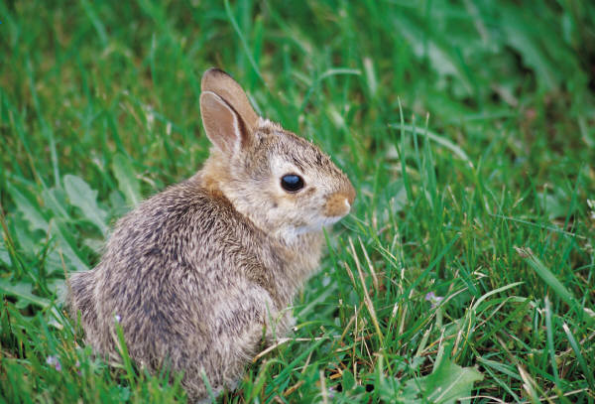
The Rabbit Population
A breeding pair of rabbits
produces a newborn pair every month.
Rabbits breed after one month.
After n months:
w_{n}::= # newborn pairs
b_{n}::= # breeding pairs
Start with a newborn pair: w₀ = 1
b₀ = 0
linrec-hom.7

Slide 8
The Rabbit Population
w_{n}::= # newborn pairs
b_{n}::= # breeding pairs
Therefore,
linrec-hom.8

Slide 9
The Rabbit Population
b_{n} = b_{n-1} + b_{n-2}
It was Fibonacci who was studying rabbit population growth!
linrec-hom.9

Slide 10
Generating Function for Rabbits

Slide 11
Generating Function for Rabbits

Slide 12
Generating Function for Rabbits

Slide 13
Coefficient notation

Slide 14
Generating Function for Rabbits
use partial fraction expansion to find closed form for
linrec-hom.14

Slide 15
Closed Form for [x^{n}]B(x)
factor the denominator
use quadratic formula
linrec-hom.15

Slide 16
Closed Form for [x^{n}]B(x)
factor the denominator
linrec-hom.16

Slide 17
Closed Form for [x^{n}]B(x)
Method of partial fractions:
linrec-hom.17

Slide 18
Closed Form for [x^{n}]B(x)
need to solve for a and b
linrec-hom.18

Slide 19
Closed Form for [x^{n}]B(x)
Multiply both sides by
Solve for a and b
⎯letting
x be 1/α, then 1/β makes it easy
linrec-hom.19

Slide 20
the answer
amazing!
linrec-hom.20

Slide 21
the answer
linrec-hom.21

Slide 22
the answer
converges to 0 as n grows
linrec-hom.22

Slide 23
the answer
rabbit population grows
exponentially
linrec-hom.23

Slide 24
Simpler Closed Form
round to nearest integer
linrec-hom.24

