Slide 1
Mathematics for Computer Science MIT 6.042J/18.062J
Simple Graphs:
Degrees
Isomorphism

Slide 2
Types of Graphs
Simple
Graph
Directed Graph
last week
Multi-Graph
this week

Slide 3
A simple graph:
Definition:
A simple graph G consists of
a nonempty set, V, of vertices, and
a set, E, of edges such that
each edge has two endpoints in V

Slide 4
A Simple Graph
edge
vertices, V
undirected edges, E
::= { , }
“adjacent ”

Slide 5
A simple graph G:
V={a,b,c,d,e,f}
E={{a,d},{a,e},{b,c},{b,e},
{b,f},{c,f},{d,f},{e,f}}
d
b
c
a
f
e
picture of G

Slide 6
Vertex degree
degree of a vertex is
# of incident edges
deg( ) = 2

Slide 7
Vertex degree
degree of a vertex is
# of incident edges
deg( ) = 4

Slide 8
Possible Graph?
Impossible Graph
Is there a graph with
vertex degrees 2,2,1?
?
NO!
orphaned edge
2
1
2

Slide 9
Handshaking Lemma
sum of degrees is
twice # edges
Proof: Each edge contributes
2 to the sum on the right

Slide 10
Handshaking Lemma
sum of degrees is
twice # edges
2+2+1 = odd,
so impossible

Slide 11
Sex in America: Men more Promiscuous?
Study claims:
Men average many more
partners than women.
Graph theory shows
this is nonsense

Slide 12
Sex Partner Graph
M
F
partners

Slide 13
Counting pairs of partners
divide by both sides by |M|

Slide 14
Average number of partners
1.035
Averages differ solely by
ratio of females to males.
No big difference
Nothing to do with promiscuity

Slide 15
Isomorphism

Slide 16
The Graph Abstraction
Same graph (different layouts)
122
257
122
257
145
99
306
67
99
67
306
145

Slide 17
The Graph Abstraction
Same graph (different labels)
122
145
Albert
Grant
Sharat
257
306
67
Christos
Sonya
99
Jessica

Slide 18
The Graph Abstraction
All that matters
are the connections:
graphs with the
same connections
are isomorphic

Slide 19
Isomorphism
two graphs are isomorphic
when there is an
edge-preserving
matching
of their vertices.

Slide 20
Are these isomorphic?
Hay
Dog
Pig
Corn
Cow
Cat
Beef
Tuna
f(Dog) = Beef
f(Cat) = Tuna
f(Cow) = Hay
f(Pig) = Corn

Slide 21
Edges preserved?
Hay
Dog
Pig
Corn
Cow
Cat
Beef
Tuna

Slide 22
Edges preserved?
YES!
Hay
Dog
Pig
Corn
Cow
Cat
Beef
Tuna

Slide 23
Nonedges preserved?
YES!
Hay
Dog
Pig
Corn
Cow
Cat
Beef
Tuna
isomorphic!

Slide 24
Formal Def of Graph Isomorphism
G₁ isomorphic to G₂ means
edge-preserving vertex matching:
∃ bijection f:V₁ → V₂ with
u—v in E₁ IFF f(u)—f(v) in E₂

Slide 25
Nonisomorphism
degree 2
all degree 3

Slide 26
Proving nonisomorphism
If some property preserved by
isomorphism differs for two
graphs, then they’re not isomorphic:
# of nodes,
# of edges,
degree distributions, ….

Slide 27
Finding an isomorphism?
many possible mappings: large search
can use properties preserved by
isomorphisms as a guide, for example:
a deg 4 vertex adjacent to a deg 3
can only match with
a deg 4 vertex also adjacent to a deg 3
but even so…

Slide 28
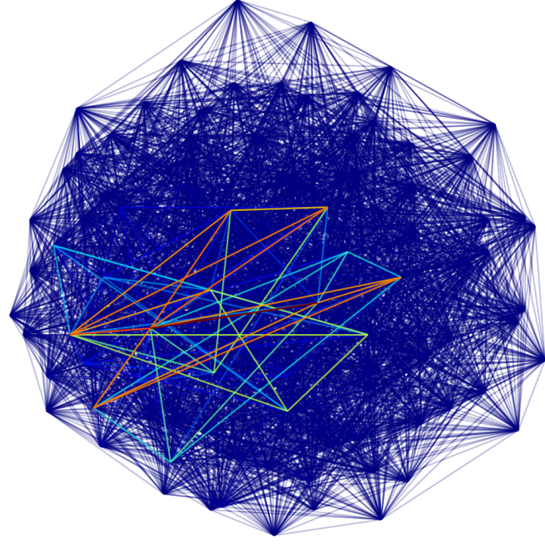
Are these two graphs isomorphic?
...nothing known is sure to be much faster than searching thru all bijections for an isomorphism

Slide 29
Team Problems
Problems
1 − 4

