Slide 1
Random Walks
Mathematics for Computer Science MIT 6.042J/18.062J

Slide 2
Applications of Random Walk
Finance — stocks, options
Algorithms — web search, clustering
Physics — Brownian motion

Slide 3
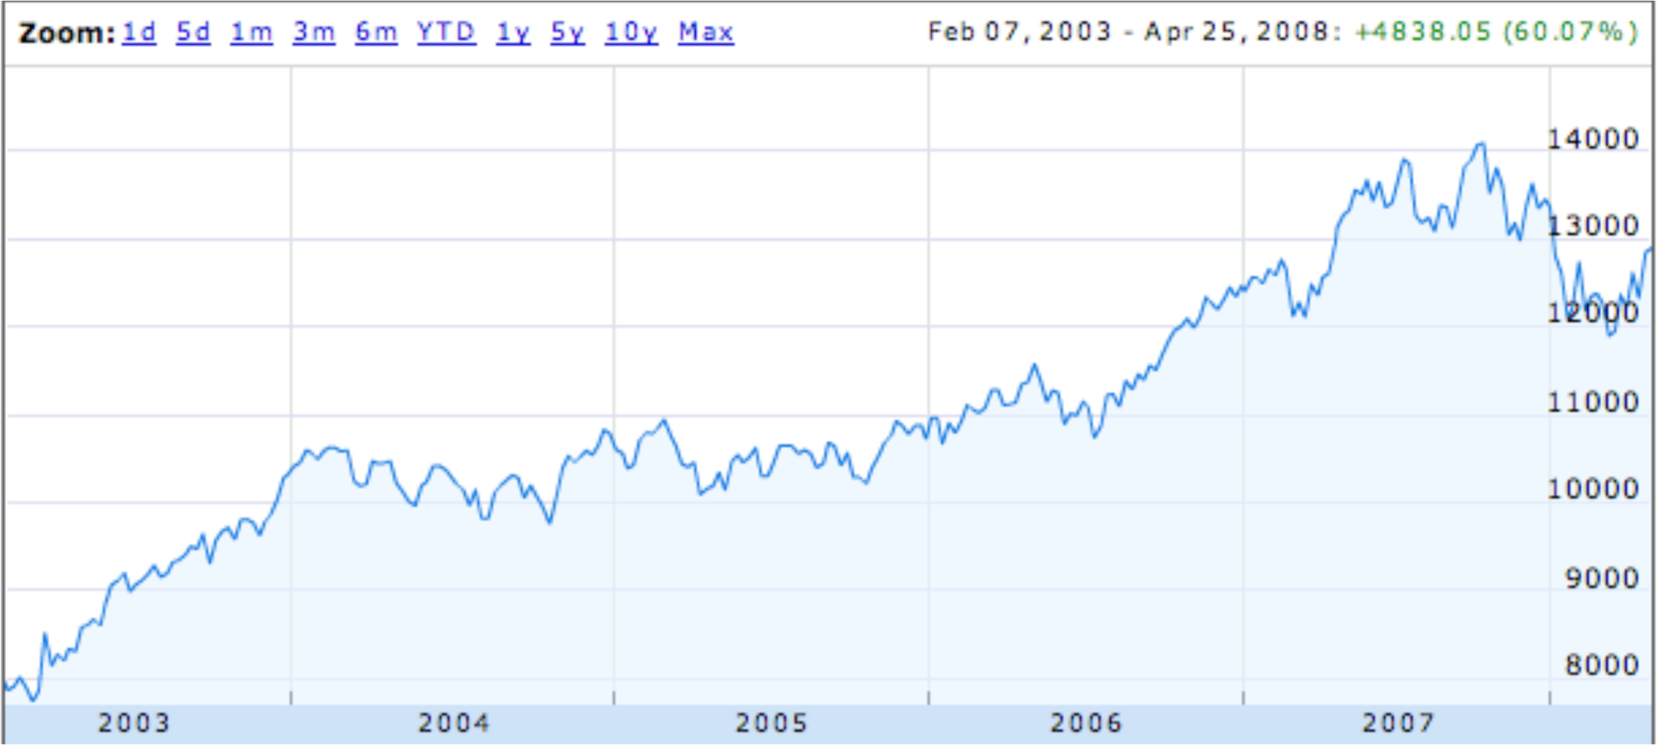
Dow Jones Trend
Random steps with “up” bias.
Similar to “gambler’s ruin”—later today.

Slide 4
Google Page Rank
How do we decide which pages are “more important?”
Model of internet:
Users click random link on a page.
Occasionally start over.
A page is “more important” if the users spend a large fraction of time there.

Slide 5
Graph With Probable Transitions
1/3
Outgoing-edge probabilities sum to 1
O
1/4
2/3
B
G
1/4
1/2
1

Slide 6
Questions About the Graph
O
1/3
1/4
2/3
B
1/4
G
1/2
1
Pr{reach G before O | start at B}
Pr{ever reach O | start at B}
Average # steps for B to O
Average fraction of time at B

Slide 7
Distribution Over Nodes
1/3
1/4
1/4
1/4
0
1/4
2/3
1/4
1/4
1/4
1/4
1/4
1/4
1/2
1
0
1/2
1/2
1
1/2
1/2
Suppose you start at B (p_{B}=1):
(1, 0, 0)
What is p_{B}’, p_{G}’, or p_{O}’ after 1 step?
Dist after 1 step is: (1/2, 1/4, 1/4)
Lec 14W.7
Notes:
7

Slide 8
Distribution Over Nodes
1/3
1/4
1/4
2/3
1/4
1/2
1/4
1/2
1
Dist after 1 step is: (1/2, 1/4, 1/4)
p_{B}’ = Pr{B to B|at B}•p_{B}
p_{B}’ = 1/2 •1/2 +
(1/2, 5/24, 7/24)
Pr{G to B|at G}•p_{G}
1 •1/4
+ Pr{O to B|at O}•p_{O}
+ 0 •1/4
What is distribution after t steps?

Slide 9
Distribution Over Nodes
1/3
1/4
1/4
2/3
1/4
1/2
1/4
1/2
1
Dist after 1 step is: (1/2, 1/4, 1/4)
What about as t→∞ ?
What is distribution after t steps?

Slide 10
Stationary Distribution
1/3
1/4
p_{O}
2/3
1/4
p_{G}
p_{B}
1/2
1
Distribution (p_{B}, p_{O}, p_{G}) is stationary if next-step distribution is the same
What is a stationary dist. here?

Slide 11
Finding Stationary Dist.
1/3
1/4
p_{O}
2/3
1/4
p_{G}
p_{B}
1/2
1
p_{B} =
p_{O} =
p_{G} =
p_{B}’ = (1/2)p_{B} + 1p_{G}
p_{O}’ = (1/4)p_{B} + (1/3)p_{O}
p_{G}’ = (1/4)p_{B} + (2/3)p_{O}
(8/15, 3/15, 4/15)
p_{B} + p_{O} + p_{G} = 1

Slide 12
Stationary Distribution & Google Page Rank
View the entire web as a graph
Vertices are webpages
Edge (u,v) exists if link from page u to page v
Pr{go to v from u} = 1/outdeg(u)
Find stationary distribution {p_{u}}
Rank u above v if p_{u} > p_{v}.

Slide 13
Questions on Stationary Dist
Yes
(if graph finite)
Does a stationary dist exist?
Is it unique?
Does a random walk approach it from any starting distribution?
How quickly?
Sometimes
Sometimes

Slide 14
Let’s Go to Vegas
Decide to place $1 bets until either going broke or reaching some target amount of money.
What is Pr{reach target}?

Slide 15
Gambling: Fair Case
Suppose we’re playing a fair game:
Pr{win bet} = 1/2.
What is Pr{reach $200} if we start with $100?
1/2
What about Pr{reach $600} if we start with $500?
5/6

Slide 16
Gambling: Fair Case
In general, if we start with $n
Pr{reach $T} = n/T
What about an unfair game?

Slide 17
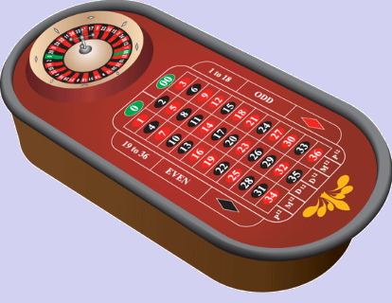
Gambling: Slightly Unfair
Betting black in US roulette
Pr{win bet} = 18/38 = 9/19 < 1/2

Slide 18
US Roulette
What is Pr{reach $500+100} starting with $500? (5/6 for fair)
< 1 / 37,000
What is Pr{reach $n+100} starting with $n? (n/(n+100) for fair)
< 1 / 37,000

Slide 19
Gambler’s Ruin
Play $1 bets until going broke or make enough money.
Parameters
p ::= Pr{win $1 bet}
n ::= initial capital
T ::= gambler’s target
Question: What is Pr{reach target}?

Slide 20
Gambler’s Ruin
T
”target"
$$$
n
"initial capital"
# of bets

Slide 21
Gambler’s Ruin
View as random walk on a line.
…
…
$0
$1
n-1
n
n+1
T-1
T
p
p ::=Pr{win a bet}
k
k+1
q ::= 1-p = Pr{lose a bet}
k-1
k
q
What is Pr{reach T before 0}?

Slide 22
General Approach
p
…
…
n-1
n
n+1
q
w_{n} ::= Pr{hit target | start at n}
= Pr{target | n+1} • Pr{n+1}
= w_{n+1} • p
w_{n} = pw_{n+1} + qw_{n-1}, so
w_{n+1} = (1/p)w_{n} - (q/p)w_{n-1}
+ w_{n-1} • q
+ Pr{target | n-1} • Pr{n-1}
we have a linear recurrence!

Slide 23
Linear Recurrence
w_{n+1} = (1/p)w_{n} - (q/p)w_{n-1}
w₀ = 0 (Gambler is broke)
w_{T} = 1 (Gambler is at target)
Solve using generating functions, with one twist:
We know w_{T} instead of w₁!

Slide 24
Solving the Recurrence: Biased Case
Let r ::= q/p ≠ 1.
Twist: we don’t know w₁
(r^{n}-1)
w_{n} = w₁
(r-1)
But w_{T} = 1, so can solve for w₁
(r^{n}-1)
w_{n} =
(r^{T}-1)

Slide 25
Winning when Biased Against
Suppose p < q. (Recall r ::= q/p > 1.)
(r^{n}-1)
w_{n} =
(r^{T}-1)
r^{n}
<
= (1/r)^{T-n}
r^{T}

Slide 26
Winning when Biased Against
(r ::= q/p > 1.)
w_{n} < (1/r)^{T-n}
T-n = intended profit
w_{n} < (1/r)^{intended profit}
Bound for Pr{intended profit} does not depend on n!
Since (1/r) < 1, w_{n} is exponentially decreasing in intended profit!

Slide 27
Profit $100 in US Roulette
p = 18/38
q = 20/38
1/r = 9/10
Pr{Profit $100} < (9/10)¹⁰⁰
< 1/37,648

Slide 28
Profit $200 in US Roulette
p = 18/38
q = 20/38
1/r = 9/10
Pr{Profit $200} < (9/10)²⁰⁰
< 1/70,000,000

Slide 29
What About the Fair Case?
(r ::= q/p = 1.)
Uh oh, dividing by 0.
(r^{n}-1)
w_{n} =
(r^{T}-1)
Use l’Hôpital’s Rule
d(r^{n}-1)/dr
nr^{n-1}
lim_{r→1} = = n/T
d(r^{T}-1)/dr
Tr^{T-1}

Slide 30
Team Problems
Problems
1 — 4

