Slide 1
Propositional Normal Forms
Mathematics for Computer Science 6.042J/18.062J

Slide 2
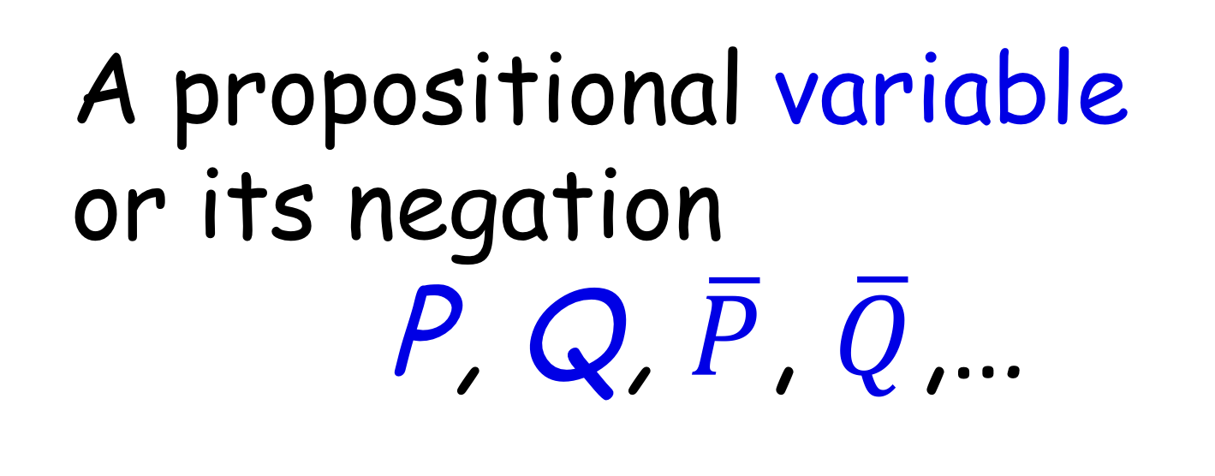
Literals
A propositional variable
or its negation
P, Q, $\overline{P}$, $\overline{Q}$,…

Slide 3
Sum of Products Form
(OR of ANDs)
Disjunctive Normal Form
(DNF)

Slide 4

Products (AND’s)
( AND Q)
(P AND Q AND R)
P
$$\overline{P}$$

Slide 5
Majority function M
P | Q | R | M(P,Q,R)
T | T | T | T
T | T | F | T
T | F | T | T
T | F | F | F
F | T | T | T
F | T | F | F
F | F | T | F
F | F | F | F

Slide 6
A Product (AND) Term
Row TTF has value T

Slide 7
A Sum (OR) of ANDs
Rows with value T

Slide 8
A Sum (OR) of ANDs

Slide 9
Disjunctive Form for M

Slide 10
Disjunctive Form for M

Slide 11
Disjunctive Normal Form
Each product has all variables

Slide 12
Every formula ≡ DNF
Read the DNF right
off the Truth Table

Slide 13
Every formula ≡ DNF
Corollary: Two formulas
are equivalent iff they
have the same* DNF
*alphabetized

Slide 14
Product of Sums Form
AND of ORs
Conjunctive Form

Slide 15
A Sum (OR) Term
Row TFF has value F
Apply DeMorgan Law

Slide 16
A Sum (OR) Term
Row TFF has value F
Apply DeMorgan Law

Slide 17
Prod (AND) of ORs
Rows with value F

Slide 18
Conjunctive Form

Slide 19
Conjunctive Normal Form
Each sum has all variables

Slide 20
Every formula is equivalent to a CNF

Slide 21
Every formula ≡ CNF
Read the CNF right
off the Truth Table

