Slide 1



Motivation Theories and
Motivational Techniques
Principles of Management (MG1701A)
Unit IV – Directing ·
Presenter: [SARANG M], Register No: [111923CB01048],
Dept. of [CSE Cyber Security]

Slide 2

Introduction to Motivation
Definition: Motivation is the internal and external forces that stimulate goal-directed behavior.
Objectives: Stimulate performance, align individual goals with organizational goals, and sustain effort.
Importance in management: Drives productivity, improves engagement, and enables effective directing.
Speaker note: Emphasize connection between motivation and managerial responsibility to design meaningful work.

Slide 3
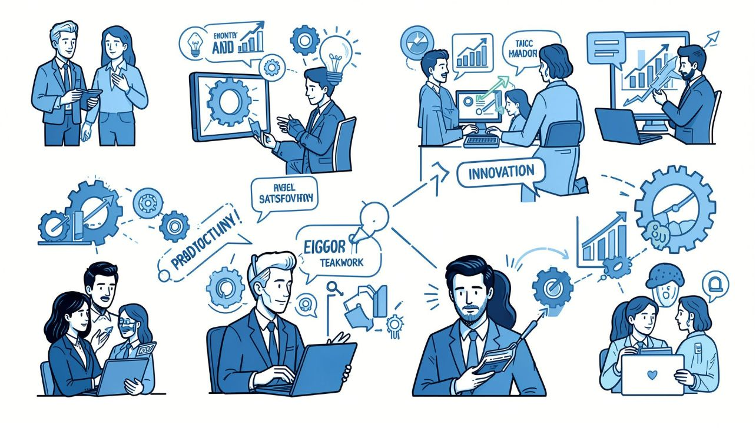
Why Motivation Matters
Improves productivity — employees perform more consistently and efficiently.
Increases job satisfaction — fosters commitment and morale.
Reduces turnover — motivated staff stay longer, lowering recruitment cost.
Enhances teamwork — collaboration increases when people feel valued.
Encourages innovation — motivated teams take initiative and suggest improvements.

Slide 4
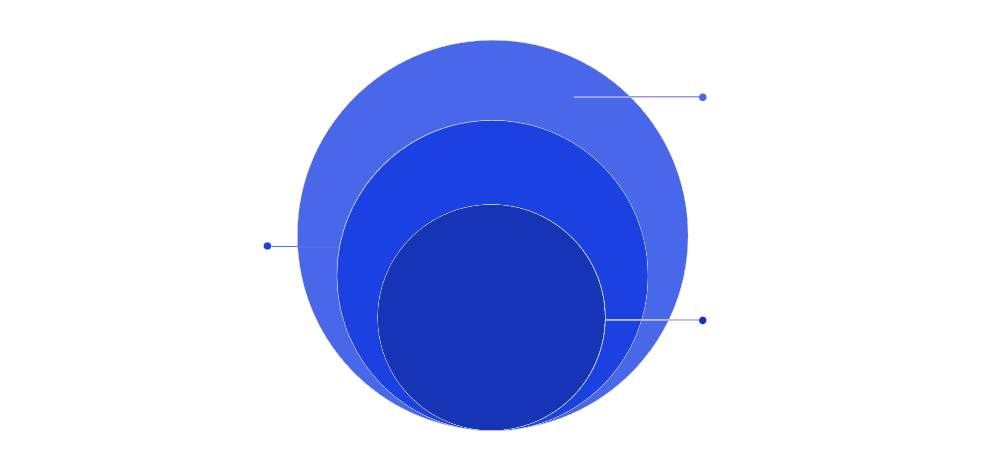
Maslow's Hierarchy of Needs
Outer: Foundational Needs
Social, safety, and physiological essentials
Middle: Esteem
Recognition, achievement, and confidence
Core: Self‑Actualization
Personal growth and meaningful work
Physiological: Basic survival needs. Safety: Job security, safe workplace. Social: Team belonging and relationships. Esteem: Recognition and achievement. Self‑Actualization: Personal growth and meaningful work.

Slide 5
Herzberg's Two‑Factor Theory
Hygiene Factors
Motivators
Salary, company policies, working conditions — prevent dissatisfaction.
Achievement, recognition, responsibility — drive satisfaction and performance.
Example: Safe lab equipment, clear HR policies.
Example: Project ownership, public recognition for technical innovation.
Speaker tip: Fix hygiene issues first; then invest in motivators to boost long-term performance.

Slide 6
McGregor's Theory X and Theory Y
Theory X
Theory Y
Assumes employees dislike work, need control, prefer direction.
Assumes employees are self-motivated, seek responsibility, can be creative.
Manager approach: Tight supervision, formal systems, rewards/punishments.
Manager approach: Participative leadership, delegation, developmental feedback.
Application: Engineering teams benefit from a Theory Y approach for innovation-driven projects.

Slide 7
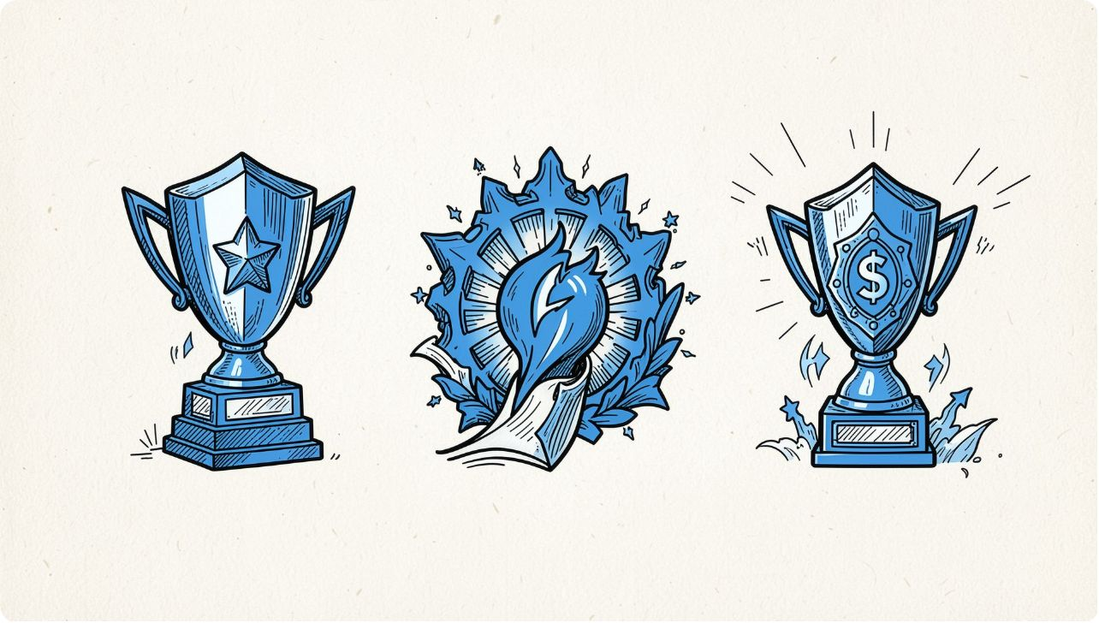
McClelland's Need Theory
Need for Achievement (nAch): Drives goal-setting, prefers challenging but achievable tasks. Example: lead a capstone project.
Need for Power (nPow): Seeks influence and impact. Example: lead technical committees or mentor juniors.
Need for Affiliation (nAff): Values relationships and teamwork. Example: cross-functional team roles and peer recognition.
Tip: Match roles and incentives to dominant needs to improve fit and performance.

Slide 8



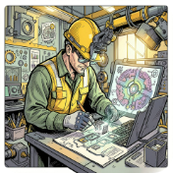


Motivational Techniques — Practical Toolkit
Financial incentives
Recognition & appreciation
Participation
Job enrichment & rotation
Involve employees in decision-making and process improvement.
Bonuses, performance-linked pay, profit sharing.
Public praise, awards, technical showcases.
Expand responsibilities, rotate tasks to build skills and reduce monotony.
Career development
Empowerment & flexibility
Training, mentoring, clear promotion paths.
Autonomy, flexible schedules, and supportive policies.
Use a mix of financial and intrinsic approaches tailored to team needs.

Slide 9
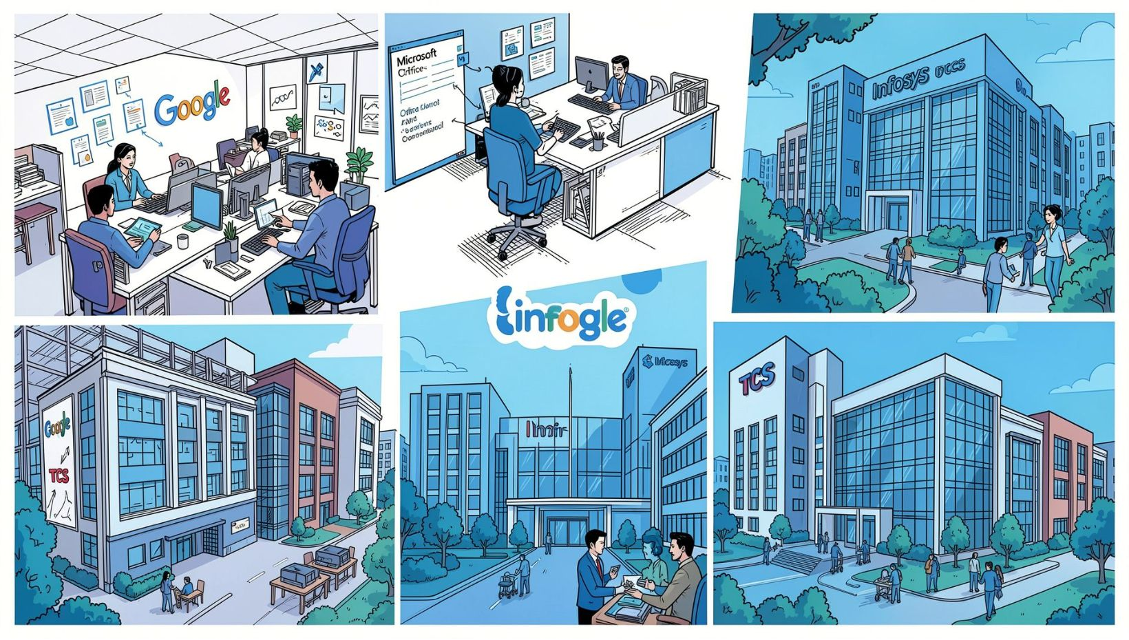
Real‑Life Applications
Google: Autonomy, 20% time-style projects, strong recognition culture.
Microsoft: Career pathways, technical fellowships, performance bonuses.
TCS: Structured career development, certification programs, stable rewards.
Infosys: Training academies, global project exposure, employee recognition systems.
Key lesson: Combine organizational systems (Hygiene) with motivators (growth, recognition) for sustainable engagement.

Slide 10

Conclusion & Key Takeaways
Motivation links individual needs to organizational goals — crucial for directing.
Select theories and techniques based on context: hygiene first, then motivators.
Align roles with intrinsic needs (achievement, power, affiliation) for better fit.
Blend financial, developmental, and cultural practices for lasting engagement.
Questions?

