Slide 1


Department of Computer Science and Engineering
DAYANANDA SAGAR UNIVERSITY
SCHOOL OF ENGINEERING
Major Project Stage-II
NEWS SUMMARIZER
Under the Supervision
Dr. Meenakshi Malhotra
Presented By:
Chatterjee Keshav (ENG19CS0071)
Harshita Chaurasia (ENG19CS0115)
Shushant Rishav (ENG19CS0306)

Slide 2
Overview
Abstract
Problem Statement
Introduction
State of the Art work
Design
Implementation
References

Slide 3
Abstract
In Recent years the quantity of text data available has increased exponentially from a variety of sources.
About 85 to 90% of news is kept in the unstructured form, making it difficult for a user to get all the information manually.
The main objective of this project is to develop an efficient news article summarization model.
Build an app to show the news in a categorized manner (i.e., Sports, Politics, Crime, etc.)
To give the user freedom to pick the news from multiple publishers.
The model will be able to summarize the content by reducing it to 70-80% while preserving the actual context of the news article.
It will provide news from all the major categories i.e., Crime, Sports, and Politics.

Slide 4
Problem Statement
There are plenty of news articles but it has a small amount of useful information in the articles and it is hard to read the whole article and find informative news manually.
People in today's quick-paced society usually don't have the patience or time to read in-depth articles, resulting in a lack of focus and enthusiasm for the news.
In this project we are looking into the problem of the enormous amount of readable articles whether it be a crime, sports, or politics.
The proposed solution to this problem is the use of text summarization to reduce the length of documents or reports while preserving crucial information.

Slide 5
Introduction
News summarization is the process of reducing the length of an article into a shorter form and still providing all the important information of the article.
By just reading the summary of the article a user will be able to get all information present in the article.
There are many reasons why news summaries are important it saves time because they provide a quick and concise overview of the latest events.
The primary objective of this model is to provide users with a quick and efficient way to stay informed about current events.
With the use of the Machine learning and Natural Language a Model can be developed to summarize news.

Slide 6
State of the Art-work
Author’s Name/ Paper Title | Conference/Journal Name and year | Technology/ Design | Results shared by author | What you infer
Learning to Predict the Need of Summarization on News Articles (Lee J.E, Park H.S) | 17th Asia Pacific Symposium on Intelligent and Evolutionary Systems(2013) | Naïve Bayes, C4.5 algorithm, WEKA. | The model predicts user’s desire whether news should be or should not be summarized. | Requirement for summarization of news articles.
Automatic News Article Summarization (Rananavare L, Reddy P.V.S) | International Journal of Computer Sciences and Engineering(2018) | Punkt sentence tokenizer | Automation in collection, collation and summarization of online articles based on a user submitted query. | Sentence tokenization technique and automation
Sentence Centrality Revisited for Unsupervised Summarization (Zheng H,Lapata M) | Proceedings of the 57th Annual Meeting of the Association for Computational Linguistics(2019) | BERT,Graph Based Ranking Algorithm | An Unsupervised and portable summarization system which has very modest data requirements. | BERT machine learning technique and simplifying data requirements.

Slide 7
Author’s Name/ Paper Title | Conference/Journal Name and year | Technology/ Design | Results shared by author | What you infer
Multi-Document Bi-Lingual News Summarization (Alubelli S.T,Dr. Deepthi K. S.) | International Journal of Research and Analytical Reviews (2020) | Implemented measures like Word overload, TF-IDF. Translates telugu language and then summaries of both languages are combined. | The end user gets the information for the news articles which are been missed by the other papers. | Scraps Data from multiple sources and NLP approaches.
NLP based Text Summarization Techniques for News Articles: Approaches and Challenges | International Research Journal of Engineering and Technology(2020) | RSS Feed Crawling, Search Strategy: ➢Site based ➢String based ➢Timeline based | An extractive approach is more convenient since it assures grammar and accuracy by copying large portions of text from the source. | Bi directional LSTM and summarization parameters
Tweet-aware News Summarization with Dual-Attention Mechanism (Zheng X,Sun A) | In Companion Proceedings of the Web Conference Association for Computing Machinery(2021) | BERT,DAS,LexRank | Proposed an unsupervised extractive summarization model named DAS. | Web scraping technique and Text ranking

Slide 8
Author’s Name/ Paper Title | Conference/Journal Name and year | Technology/ Design | Results shared by author | What you infer
End-to-End Segmentation-based News Summarization (Liu Y, Zhu C) | Findings of the Association for Computational Linguistics: ACL (2022) | Segmentation based news summarization. | Built a new benchmark dataset SEGNEWS to study and evaluate the task. | Segmentation based news summarization.
NeuS: Neutral Multi-News Summarization for Mitigating Framing Bias (Bang Y,Yu T) | Conference of the North American Chapter of the Association for Computational Linguistics(2022) | Multi-task learning (MTL), BART autoencoder | Introduced Neutral Multi-News Summarization to mitigate media framing bias by providing a neutral summary of articles. | Methods to implement neutral summary of articles.

Slide 9
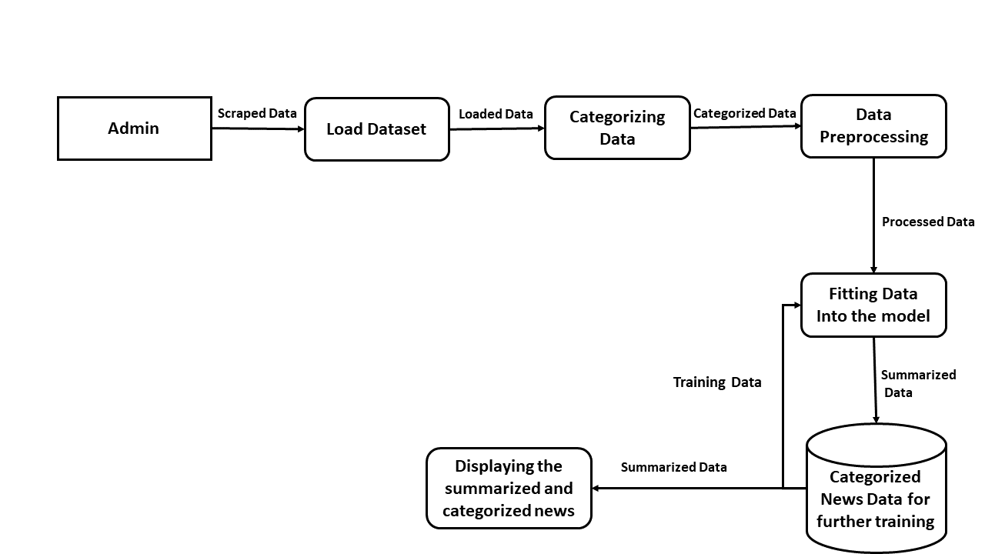
System Design

Slide 10
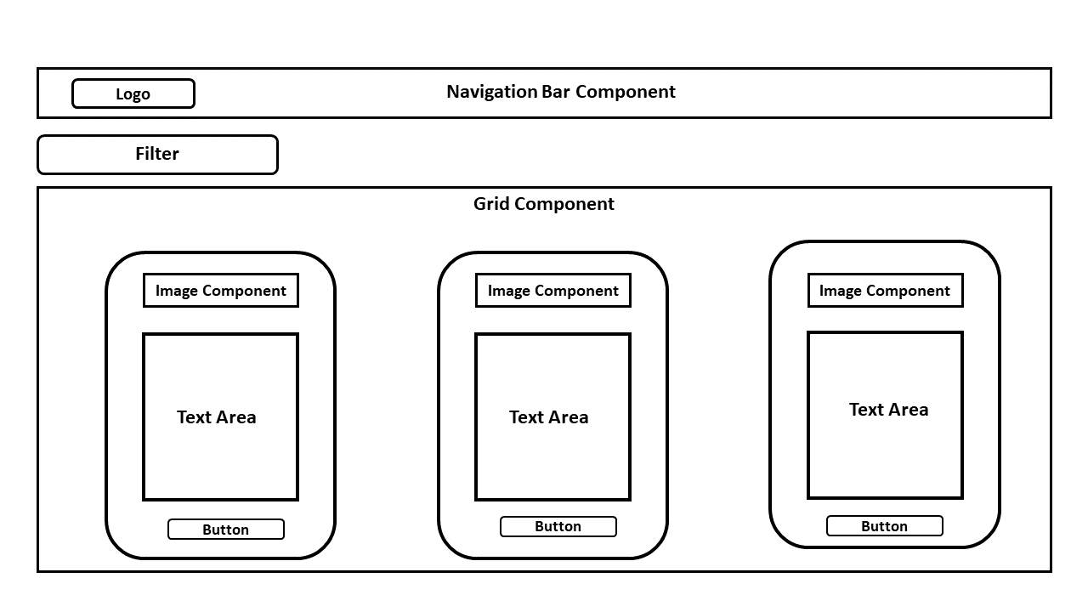
Design- Screen Design

Slide 11
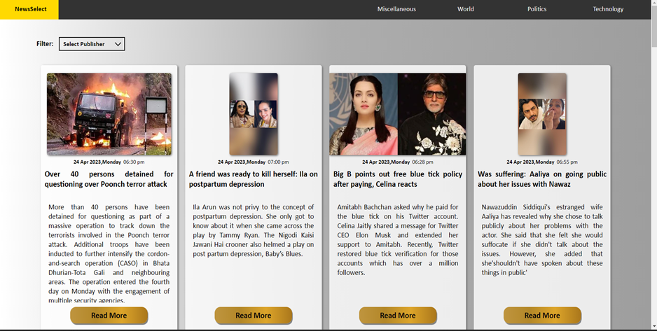
Design (Desktop)

Slide 12
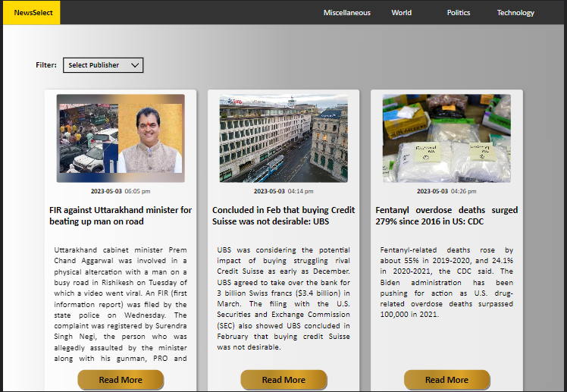
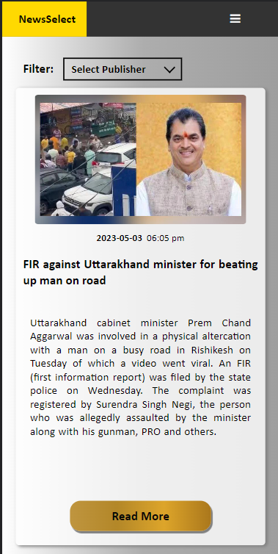
Design (Tablet And Phone)

Slide 13
Implementation and Testing
About Dataset:
The dataset being used in this project is taken from Kaggle, comprises two CSV files that contain a collection of news articles and their corresponding headlines.
Over 44,000 news articles from various sources were collected, such as The Times of India, NDTV, and Hindustan Times, among others, are included in the first file named "news_summary.csv" Each article encompasses Author name, Headlines, URL of Article, Short text and Complete Article.

Slide 14
Implementation and Testing
This project was implemented using three models namely:
Build_seq2seq_model_with_lstm - using LSTM networks for both the encoder and decoder.
Build_seq2seq_model_with_bidirectional_lstm - using Bidirectional LSTM networks for both the encoder and decoder.
Build_hybrid_seq2seq_model - using Bidirectional LSTM networks for the encoder and LSTM networks for the decoder

Slide 15
Implementation and Testing
Steps for model training :
Import the required libraries including pandas, numpy, re, tensorflow, and matplotlib.pyplot.
Initialize the TPUClusterResolver to use TPUs for distributed computing.
Create a TPUStrategy object to distribute the computation across multiple TPU cores.
Load the dataset from the CSV file using pandas.
Clean the text data using the clean_text() function defined in the code
Preprocess the text data using the Tokenizer and pad_sequences functions to convert the text data into sequences of integers and pad the sequences to a fixed length.
Define the model using the Keras functional API and compile it with the rmsprop optimizer and the sparse_categorical_crossentropy loss function.
After defining the model, train it using the fit() function and the early_stopping callback to prevent overfitting.
Plot the accuracy and loss history of the model during training using matplotlib.

Slide 16
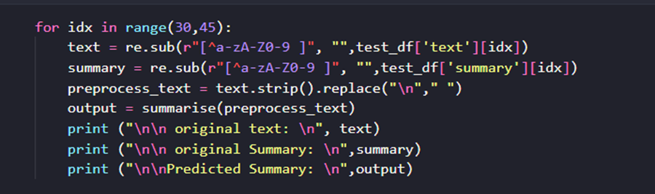
Implementation and Testing
Testing the dataset on Bi-directional model:

Slide 17
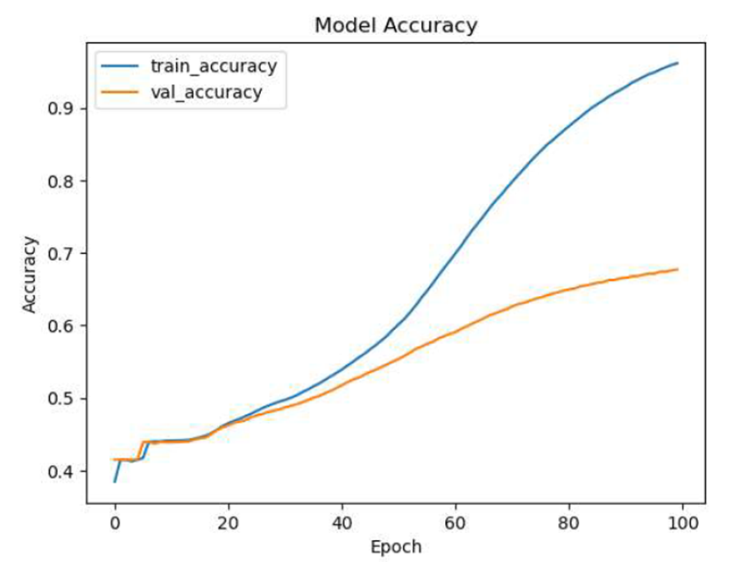
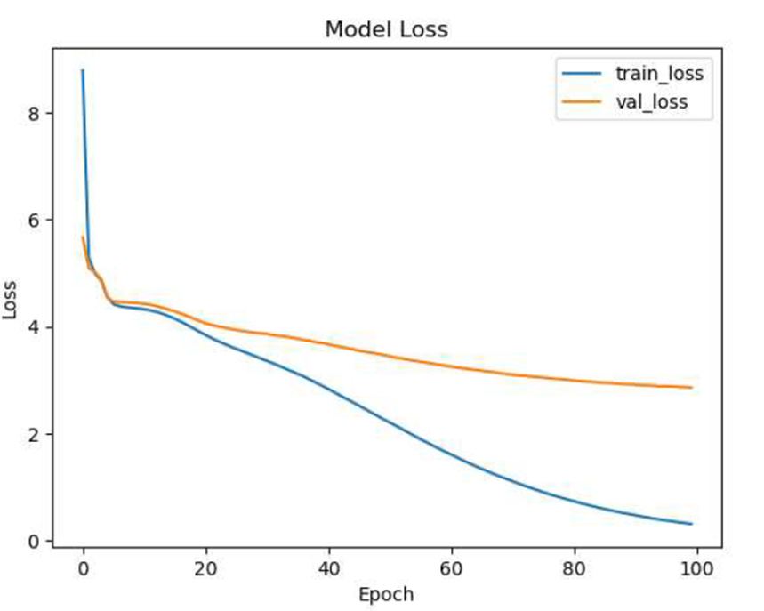
Implementation and Testing
Accuracy and Loss for Bi-directional LSTM.

Slide 18
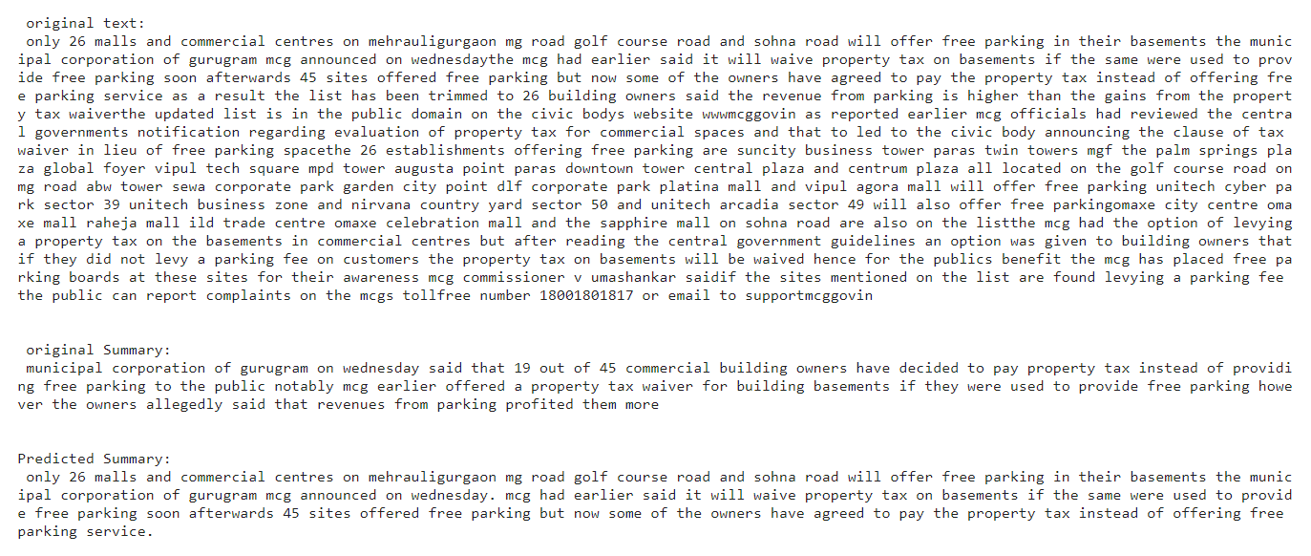
Results
The model has been trained on 100 epochs having metrics such as batch size =128, maximum length of the input text = 300, maximum summary length = 80, and which have achieved accuracy of 90% followed by the loss 2.86 as shown in the given example.

Slide 19
Conclusion
In conclusion, the news summarizer is a tool that uses advanced algorithms to condense news articles into shorter summaries and was implemented using Seq2seq with Bi-directional LSTM, with an accuracy of 90% and the validation accuracy 86.04%.
The news summarizer will be integrated with the Front-end designed which will serve the news in a categorised manner.
By leveraging machine learning and natural language processing techniques, this tool can help readers save time and quickly understand the key points of a news story.
The scope for this technology is promising with natural language processing and machine learning algorithms continuing to improve, we can expect news summarizers to become even more accurate and efficient.

Slide 20
References
[1] Ji Eun Lee, Hyun Soo Park, Kyung Joong Kim, Jae Chun No (2013). "Learning to Predict the Need of Summarization on News Articles 2013" 17th Asia Pacific Symposium on Intelligent and Evolutionary Systems, IES2013, Procedia Computer Science 24:274 – 279: 2013.
[2] Laxmi B. Rananavare and P. Venkata Subba Reddy (2018), “Automatic News Article Summarization 2018” International Journal of Computer Sciences and Engineering, vol. 6, Issue-2: 2018.
[3] Hao Zheng and Mirella Lapata (2019). “Sentence Centrality Revisited for Unsupervised Summarization, 2019”;
[4] Dr. K. S. Deepthi, Janni Ramdhar Thanmayi Sharon, Sai Teja Alubelli (2020).” Multi-Document Bi-Lingual News Summarization 2020”. IJRAR March 2019, Volume 6, Issue 1; 2020.
[5] Sara Tarannum, Piyush Sonar, Aashi Agrawal, Krishnai Khairnar (2020). “NLP based Text Summarization Techniques for News Articles: Approaches and Challenges 2020”. International Research Journal of Engineering and Technology (IRJET); Volume: 08 Issue: 12; Dec 2021.

Slide 21
References
[6] Xin Zheng, Aixin Sun, Karthik Muthuswamy (2021). “Tweet-aware News Summarization with Dual-Attention Mechanism 2021”; Companion Proceedings of the Web Conference 2021 (WWW '21). Association for Computing Machinery: 2021.
[7] Yang Liu, Chenguang Zhu, Michael Zeng (2022). “End-to-End Segmentation-based News Summarization 2022”; Findings of the Association for Computational Linguistics: ACL 2022.
[8] Nayeon Lee, Yejin Bang, Tiezheng Yu, Andrea Madotto, Pascale Fung (2022).”NeuS: Neutral Multi-News Summarization for Mitigating Framing Bias” 20 conference of the North American Chapter of the Association for Computational Linguistics: 2022.

Slide 22

Links
Visit our app on :
https://www.newsselect.live/

Slide 23


