Slide 1

01
Smart Inventory Palletes
(Embedded + SaaS Integration)
Smart Inventory System for Beverage Distribution Using Embedded IoT Devices and Cloud-Based SaaS Platform
Chameera K.H.D
220080N

Slide 2
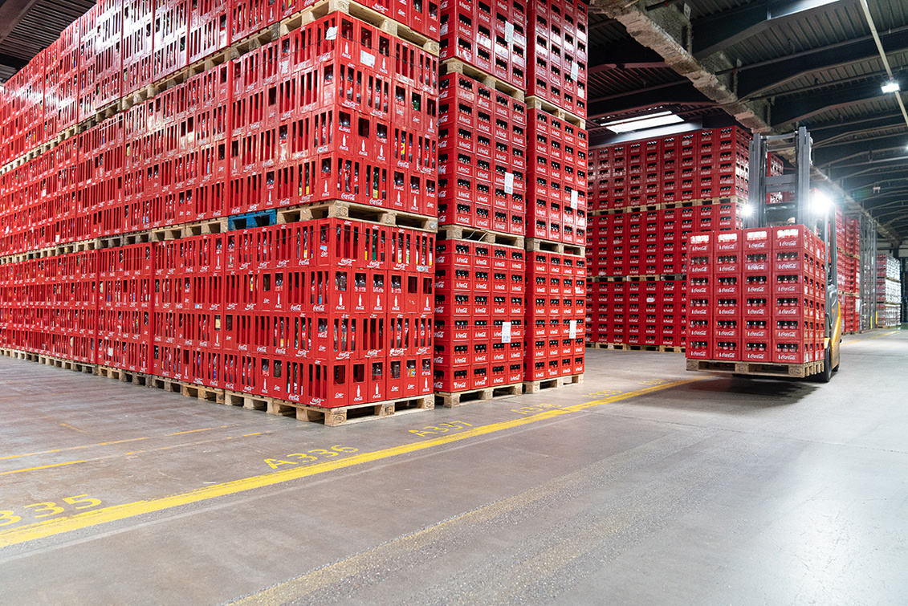
02
About the Project
Beverage inventory management often faces issues like manual stock handling, delays in restocking, and poor real-time visibility. This project proposes an embedded IoT solution that automates stock tracking by integrating smart sensing devices with a cloud-based SaaS platform. It builds on my existing SaaS system for beverage distribution and focuses on real-time, automated warehouse inventory updates using embedded hardware.

Slide 3
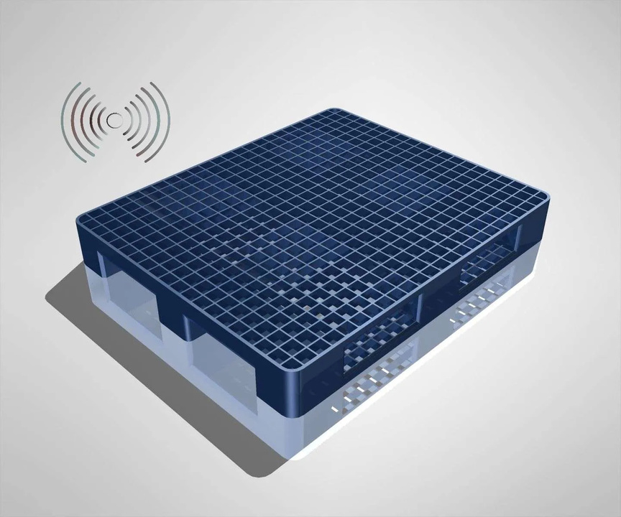
03
Solution
Smart Inventory Palletes (Embedded Device)
Load Sensors measures weight of bottle crates or product bins.
Microcontroller reads sensor data and calculates real-time stock quantity based on weight.
Device sends data to cloud every few seconds or when weight changes.
SaaS Integration (Backend & Dashboard)
Cloud API receives weight data and maps it to specific product units (e.g., 1 bottle = 1kg).
Automatically updates:
Current Stock
Sales (difference between load & unload weight)
Daily/weekly reports
Real-Time Updates
Data is visualized on the existing SaaS dashboard.
Alerts are sent if stock drops below threshold.
All actions logged for reporting and auditing.
Result
A fully automated, real-time warehouse management system with zero manual input

Slide 4
04
Thank you!

