Slide 1

Emoji Translator
Team 3: <div>ine coders

Slide 2
Contents
1
Our team
2
Project Design
3
Demo
4
User Feedback
5
Future Directions
6
Key Takeaways

Slide 3

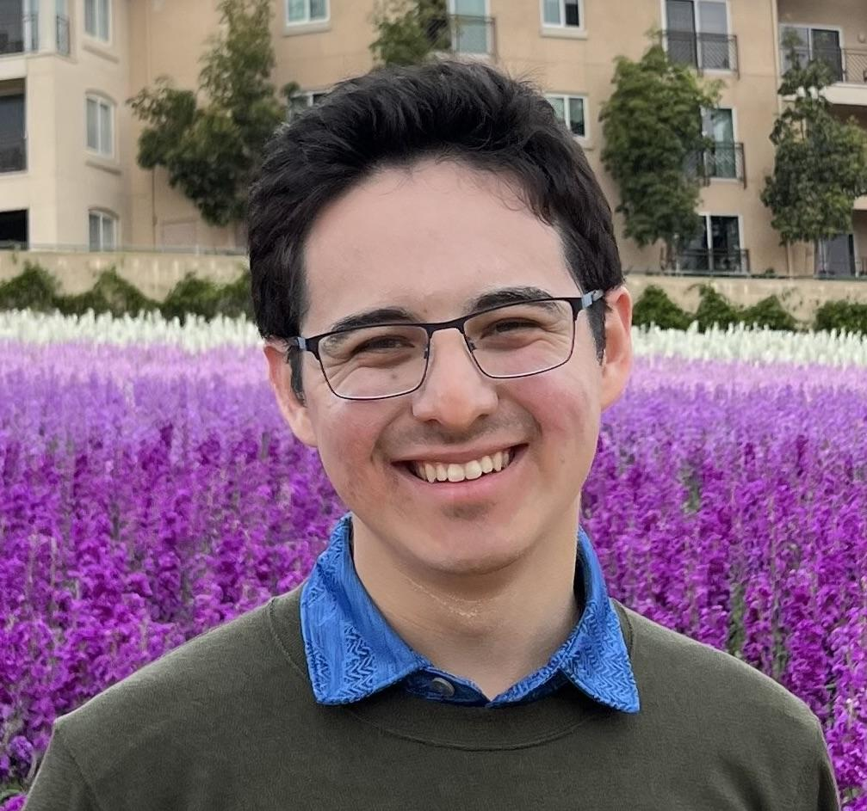

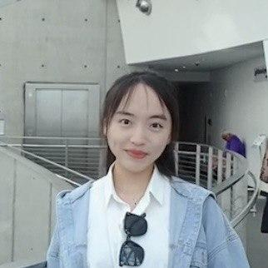
Team Members
Abhishek Dhaka
Khang Duc Tran
Andrew Pan
Audria
Montalvo
Gabrielle Kim
Hongyi Pan
Bobby Zhu
Aditya Melkote
Rui Sun
Yuting Wu
Yueqi Wu
Tongfei Yang
Name

Slide 4
Team Organizing
Team Leaders
Github Repository
Meeting notes
Meeting
Slack discussion
Dynamic task allocation
Project Manager
Front End
Back End
Cloud
Development
Algorithm

Slide 5
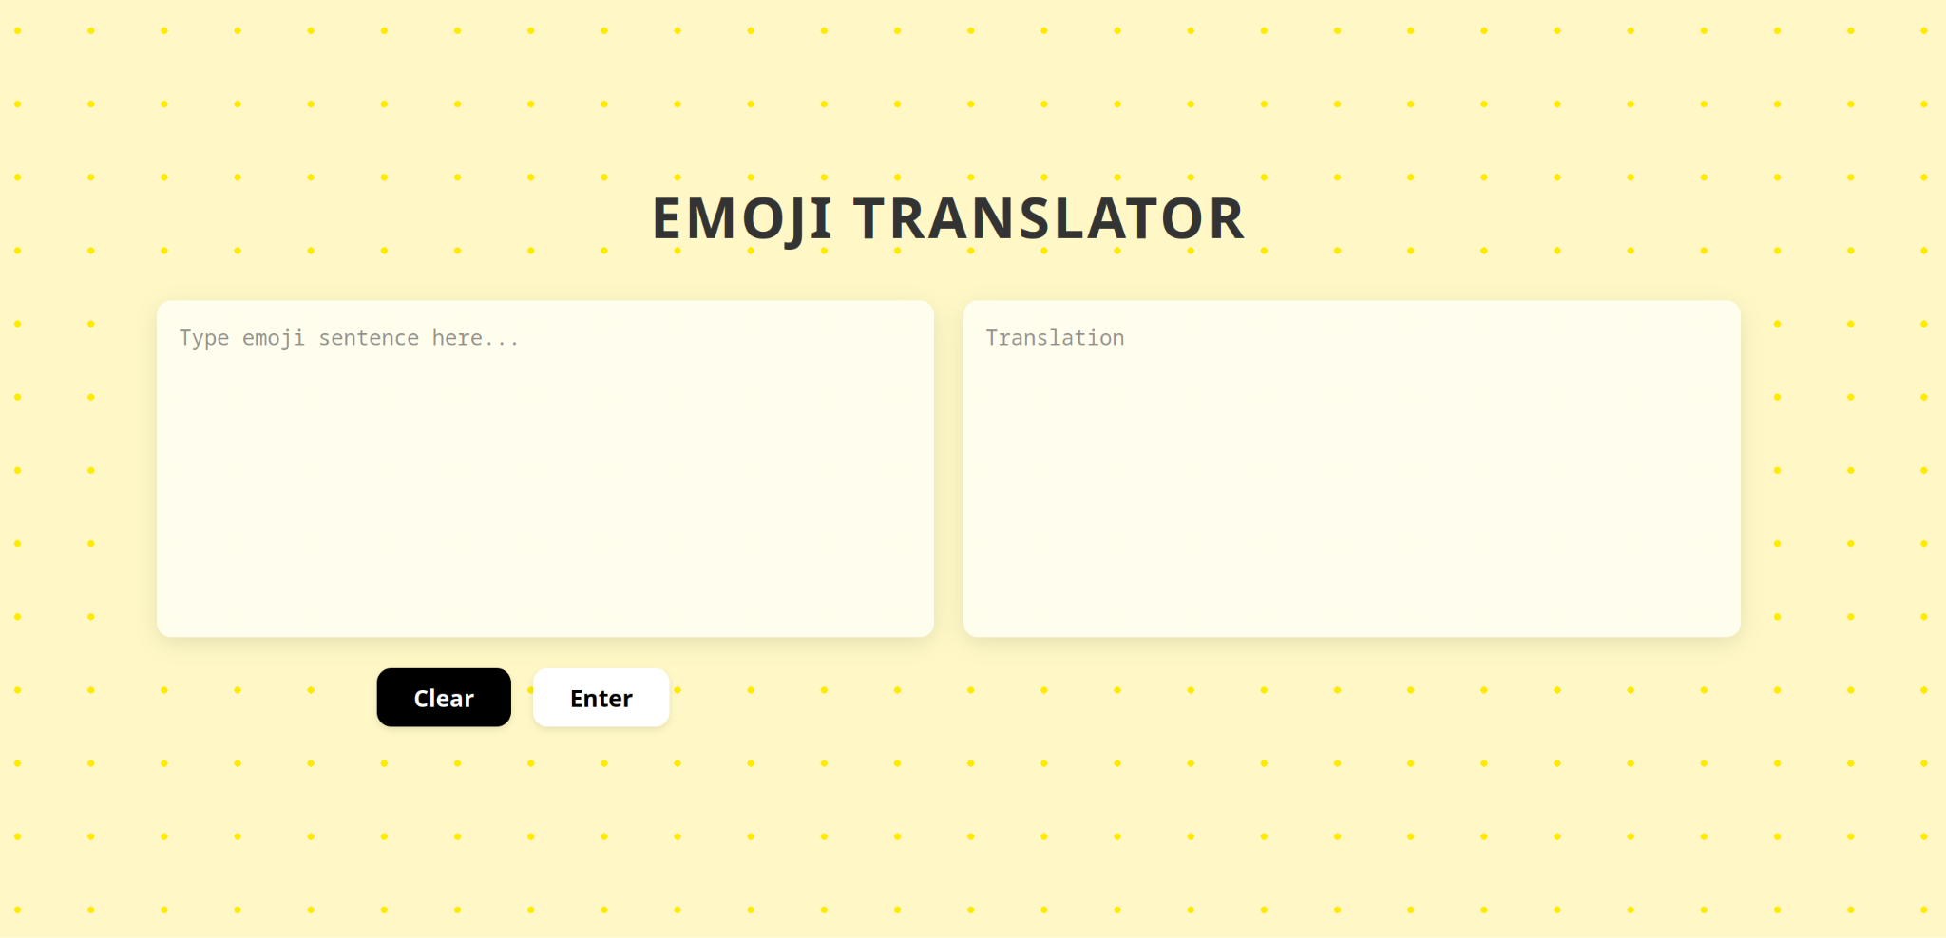
User Interface

Slide 6
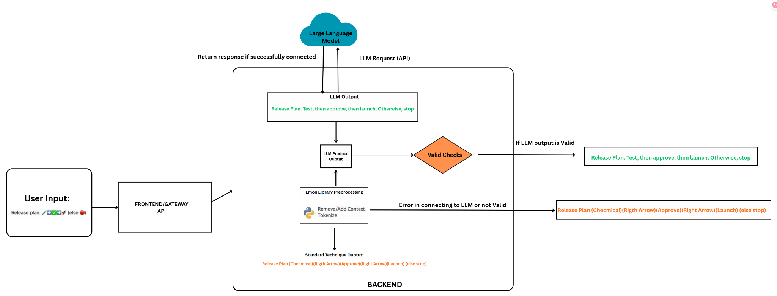
Process Workflow

Slide 7

Demo
first front-end design
final front-end design

Slide 8
Demo
Fallback when LLM is not working

Slide 9
User Feedback
The user interface looks simple, could be more design in the background(add some emojis stickers and their meaning in the background)
Add different variations for interpretations to choose from
LLM output still outputting the literal meaning sometimes
Learn user preferences to choose the most appropriate variation automatically
Add functionality to convert backwards from plain text to emoji (for accessibility and speech to text)

Slide 10


Future Directions
When it's converting we can add a popup progress bar Or just a popup ”converting…”
Save converting history (maybe～10？）
an icon for “copy”
Accessibility for different screen sizes and devices (i.e. phones, tablets, laptop)
when the user didn’t put anything and pressed “enter”, could show a popup window saying “please put the sentences in the box”

Slide 11
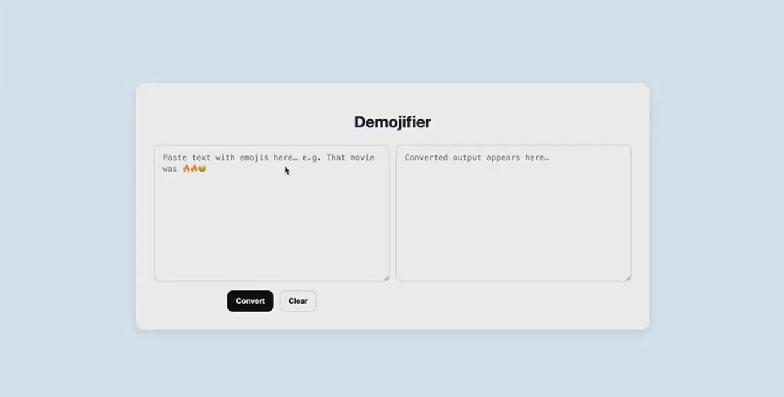
Considerations
We changed the color to yellow to resemble the color of the most common emoji known which is the yellow smiley face 😀

Slide 12

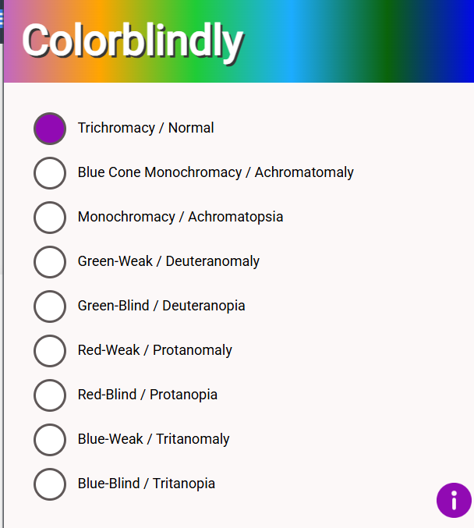
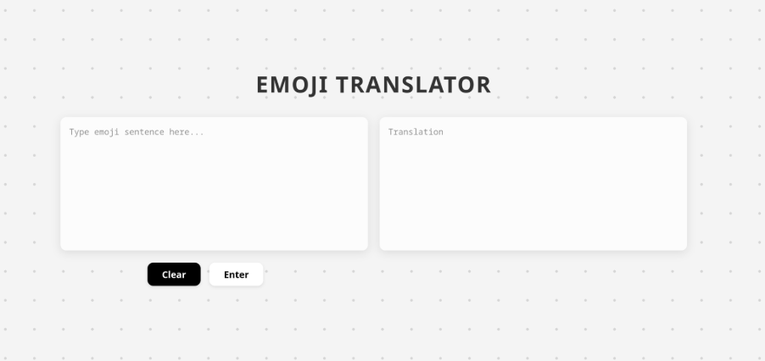

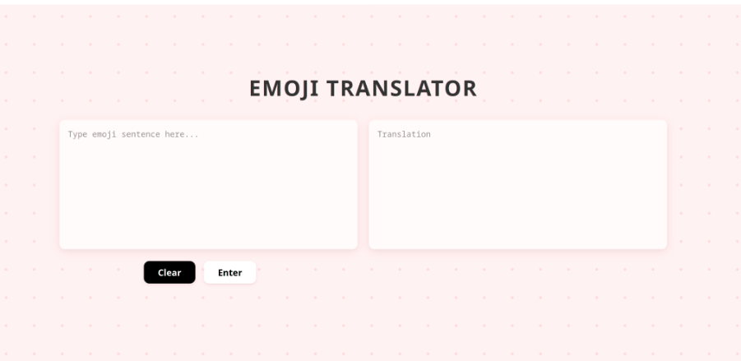
Considerations
We used the extension “Colorblindly” to ensure the change in color is still viewable for for users with colorblindness

Slide 13
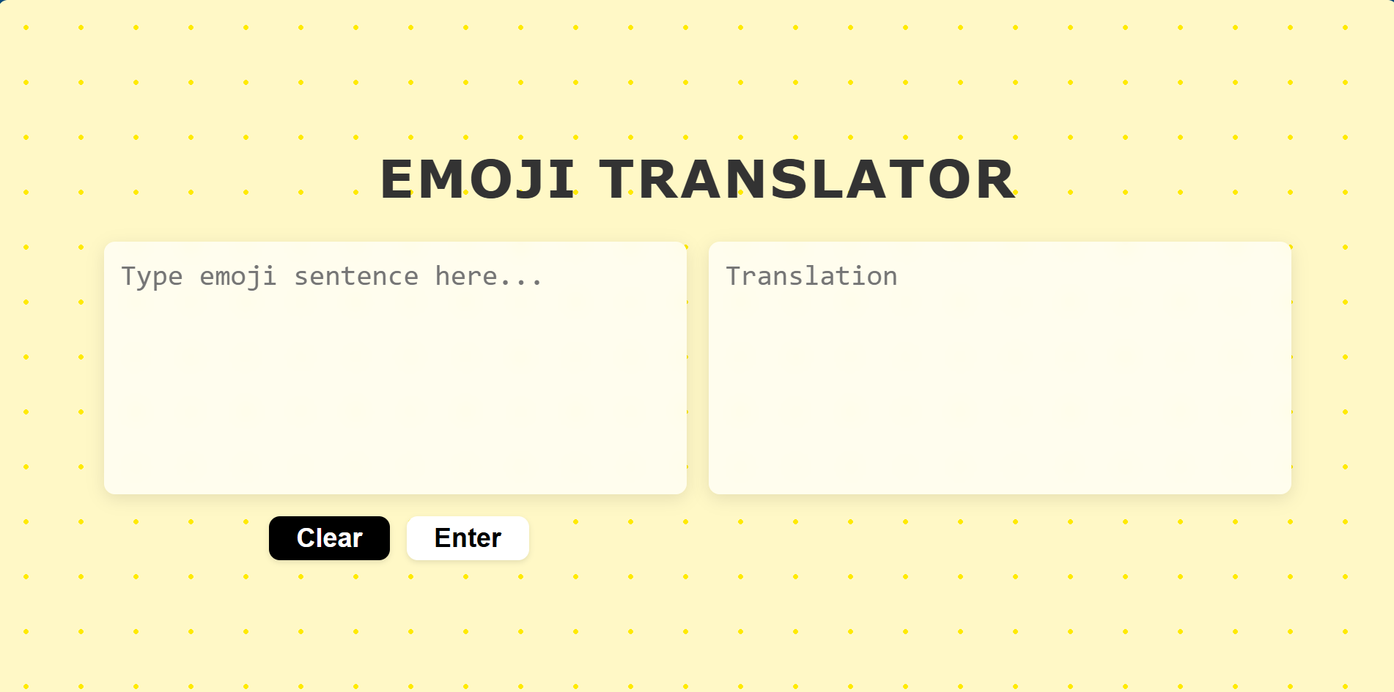
Considerations
Made the text bigger, keeping in mind our intended audience are adults

Slide 14
Key Takeaways
Regular communication
Also letting the team know what days we are completely unavailable to better coordinate synchronize work times
Check in meeting even if there has been not much progress
Shared project documentation
Using the repo as our “google drive”
As for our meeting notes, also have everyone type theris comments, questions, ideas, concerns that way we can all brainstorm independently before sharing with the team
Clean & documented code
Code review and testing
Version control collaboration
As a group, we need to refresh on github usage
Parallel prototyping > serial prototyping
aka having more than one design ready before sharing with team → feedback vs 1 design → feedback

Slide 15
Thank you!

