Slide 1

Conductor Review
& Retrospective
Team 10
CSE 210
November, 2025

Slide 2
Scope
Frontend
Backend
Infrastructure
Retrospective

Slide 3
Frontend
Gather User Requirements and understand constraints
Analyzed which api we need to connect to backend
Design a draft layout on Figma
More frontend content will be added (attendance, etc)
Implemented login, course, dashboard pages
Fusce dictum luctus ex lacinia posuere.
CSE 210
Conductor

Slide 4
Back
end
Initialized the Node.js server and set up Express
Implemented QR Code Attendance System
Initialized the PostgreSQL database
Collaborated with Frontend on API calls
Implemented Google OAuth for Login
Set up the backend testing pipeline
Set up the backend testing pipeline
CSE 210
Conductor

Slide 5
Infra
Structure
Created ADR for Infrastructure
Tested Node.js server in Docker
Created Docker File and Docker Compose
Created basic CI/CD pipeline with linting
Integrated Backend Postgres with Docker and Tested
Fusce dictum luctus ex lacinia posuere.
CSE 210
Conductor

Slide 6
Retrospective
Next, we performed a reflection on what went well and what needed improvement on our first sprint.
CSE 210
Conductor

Slide 7
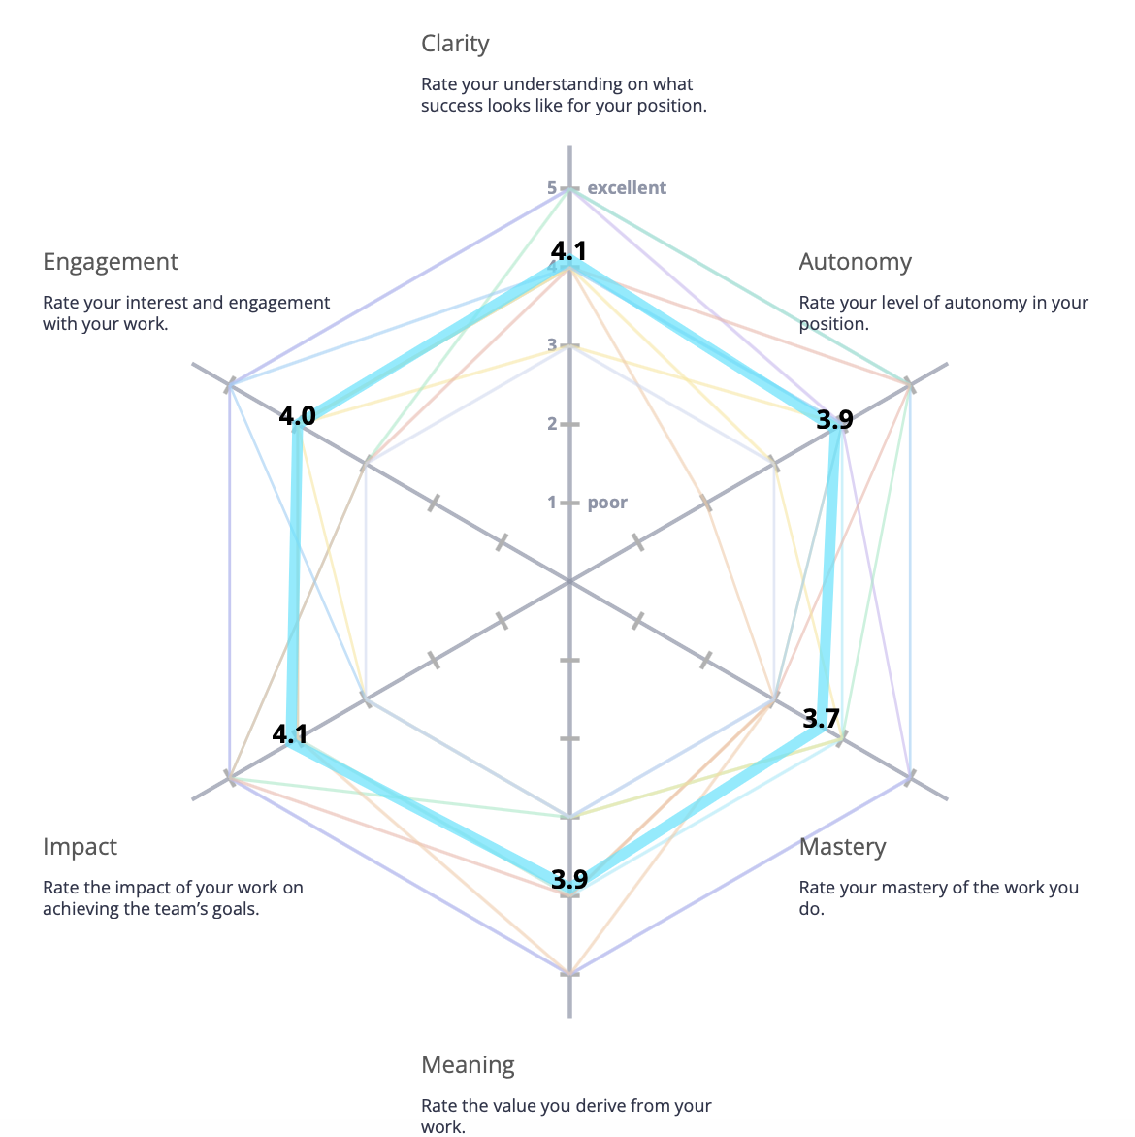
TEAM REFLECTION RADAR
CSE 210
Conductor

Slide 8
What was
“The design was more complicated than I expected.”
“trying to log out the app was difficult”
“No PR, just commits”
Mad?
CSE 210
Conductor
Notes:
Key Idea—Conductor more complex and in depth than anticipated. Next slide—> structure issues

Slide 9
What was
“Branch protection rules for main should probably be added.”
“We may need stronger documentation standards, both for documents and in code.”
Sad?
CSE 210
Conductor
Notes:
Key Idea—Stronger organizational rules required in future sprints

Slide 10
Action Plan
Action Items
Repository control rules for PRs and pushing to main
Requirements for JSDocs and Test Modules
Using rebase instead of merge to clean up the git history tree
Giving a more concrete definition (shaping more) to assigned tasks
Sharing notes and key decisions between teams in a common space
CSE 210
Conductor

Slide 11
What was
“I think we did great splitting up the work and everybody was working on something”
“I am glad that everyone is communicating well right now. I feel supported and caught up :)”
“Meetings went well within group and some tickets are closely fast”
Glad?
CSE 210
Conductor
Notes:
Main Idea—Good Team Communication

Slide 12
Remaining Todo
High Priority
Medium Priority
Low Priority
Connect Conductor's Backend to Frontend
Attendance page
Sentiment Analysis
Set up EC2 instance
Assignment page
Data Summarization
Complete Ports & Adapters for API
Implement CI/CD Pipeline
Notification System
CSE 210
Conductor

Slide 13

Thank You

