Slide 1
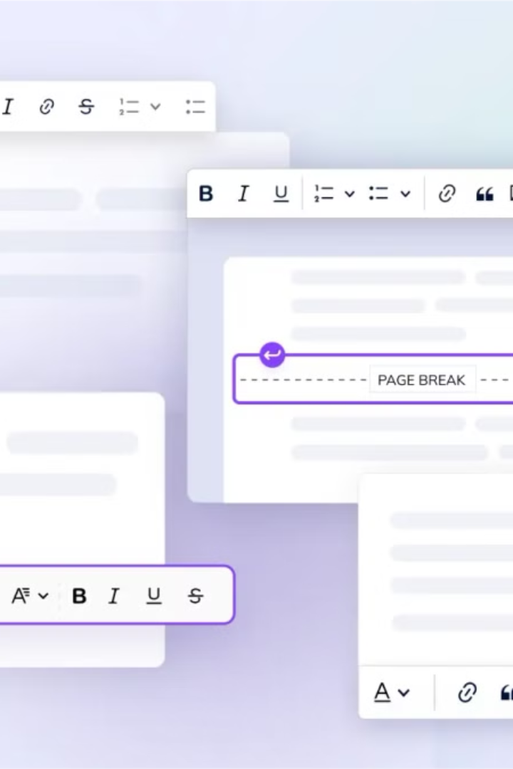
A Text Editor with Systax Highliting
This presentation showcases a text editor built with Swing, emphasizing its key features, implementation details, and future potential. It's a demonstration of how Swing can be used to build functional and sophisticated applications.

Slide 2
Features Overview
Text Editing
Font Management
Uses JTextPane for rich text formatting, and syntax highlighting for code constructs, string literals, and comments.
Dynamically change font family and size using JComboBox and JSpinner. Color customization is available through JColorChooser.

Slide 3
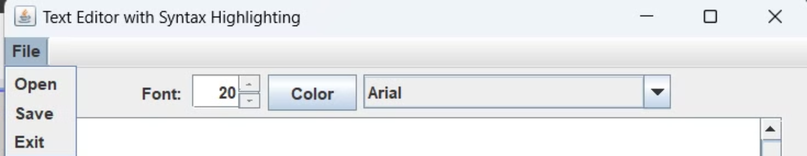
File Operations
Open File
Save File
Threading
Supports reading and displaying various file types: .txt, .java, .py, .html.
Allows users to save their work to a specified location.
File handling is executed on a separate thread for UI responsiveness.

Slide 4
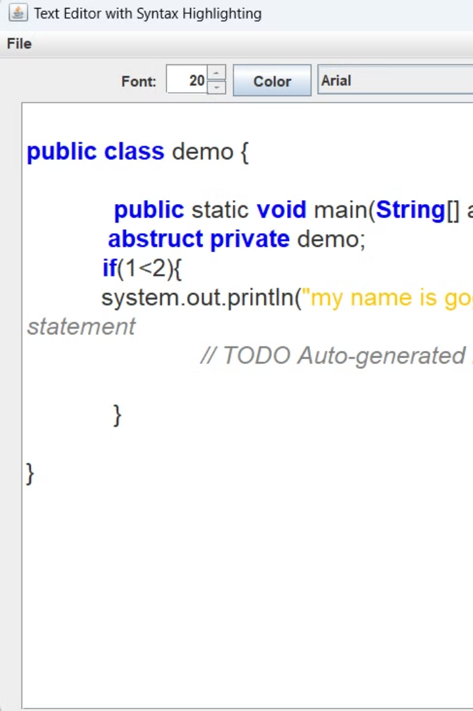
Syntax Highlighting
1
Regular Expressions
2
Dynamic Update
Keywords, string literals, and comments are highlighted using regular expressions.
Highlighting is triggered dynamically on text changes using DocumentListener.

Slide 5


Implementation Details
TextEditor Class
SyntaxHighlighter Class
Constructs the GUI and manages user interactions.
Applies syntax highlighting using regular expressions.

Slide 6
Design Highlights
Event Handling
Modularization
Event-driven programming is used for button clicks, menu selections, and document updates.
Syntax highlighting and file operations are separated into dedicated classes, improving code maintainability.

Slide 7
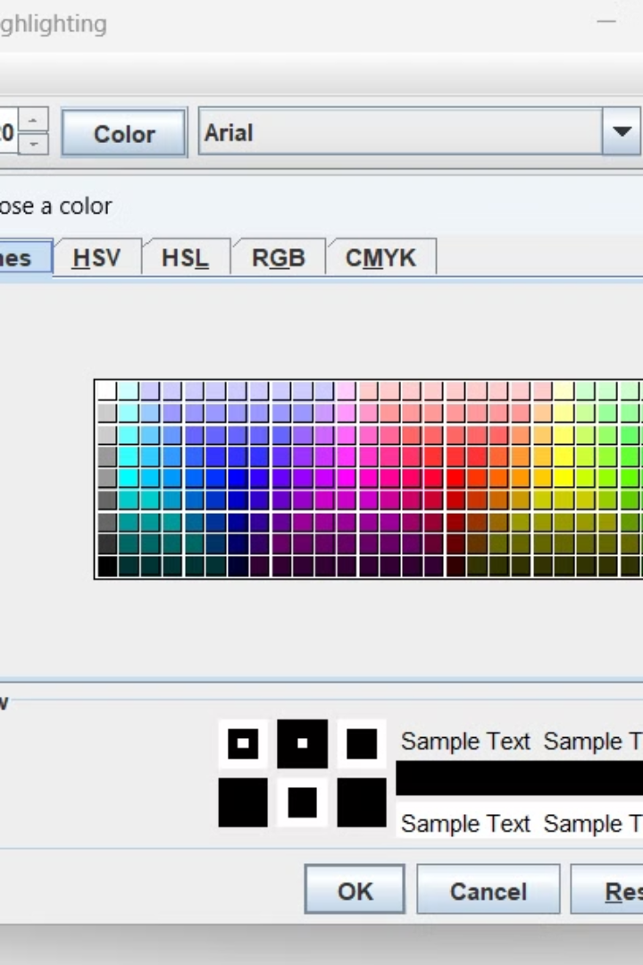
Strengths
Responsiveness
Flexibility
File operations are executed on separate threads, ensuring smooth UI performance.
Supports multiple file types and allows customization of font and color settings.

Slide 8
Conclusion
This program showcases a functional text editor using Swing and its advanced features. Future enhancements include more robust error handling, user-defined syntax highlighting, and improved GUI design. This project is a commendable foundation for building more sophisticated IDE-like tools.

