Slide 1
DATA SCIENCE AND BIG DATA
Sibel Aymış
Bahar Kahya
Sema Çevik

Slide 2
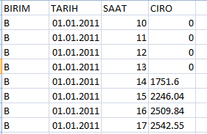
Sample of Data
Our goal is to estimate the future turnover with tha datas are given to us.

Slide 3
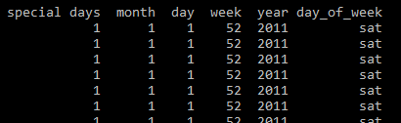
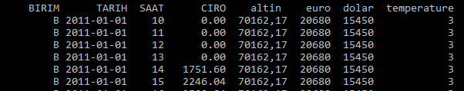
Datas are seperated new features that manes are day, week, month, year, day of weeks, special days, dolar, euro, gold and temperature.

Slide 4
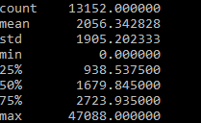
We find ciros’ mean , std , etc.. We use df.describe()

Slide 5
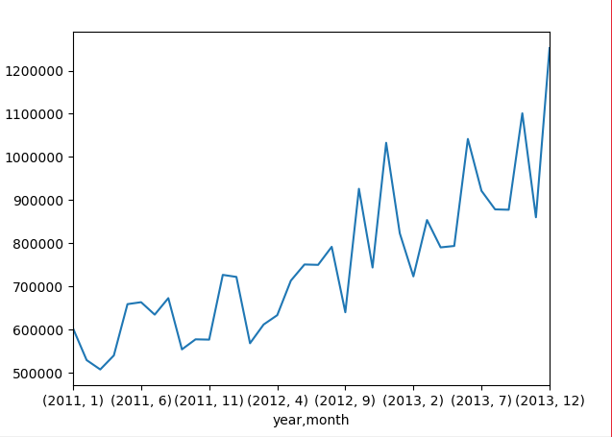
For all three years;
Montly-ciro graph
We see that same days have high ciro. This can be a special days, discount days, etc.

Slide 6
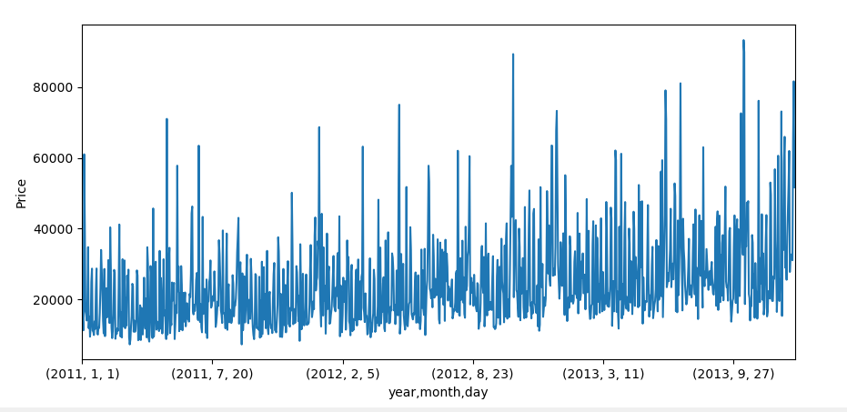
Daily-ciro graph for 3 years.

Slide 7
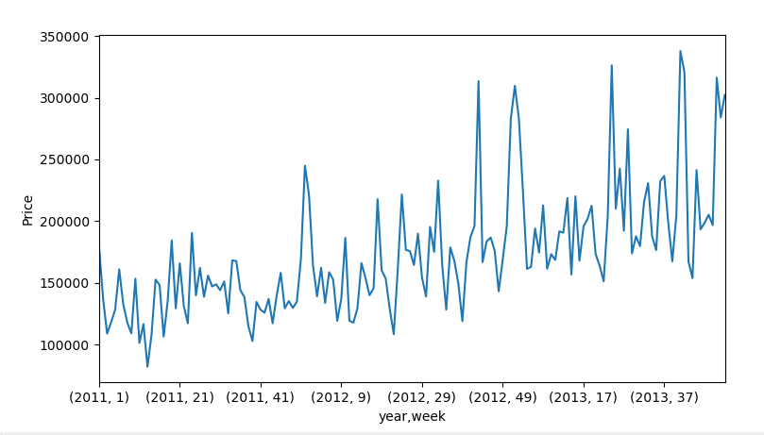
Weekly –ciro for 3 years

Slide 8
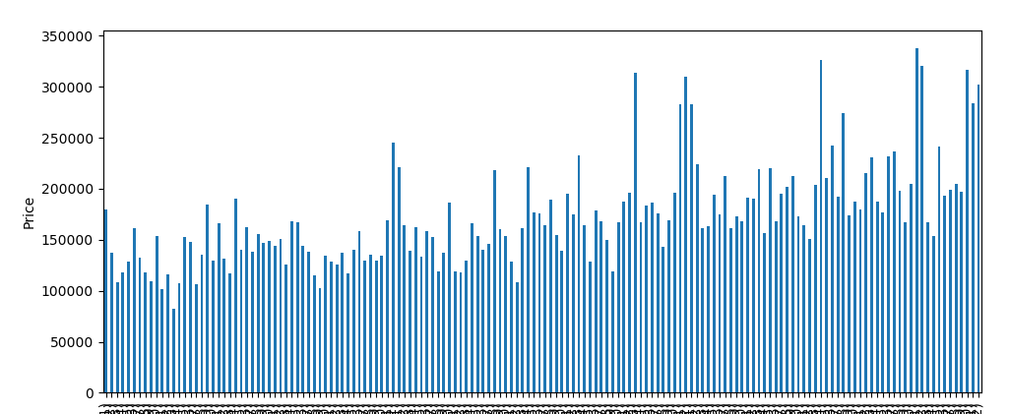
Daily –ciro for 2011 ;

Slide 9
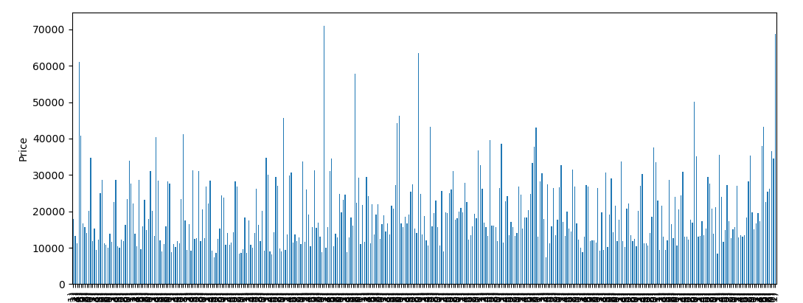
Daily – ciro for 2012

Slide 10
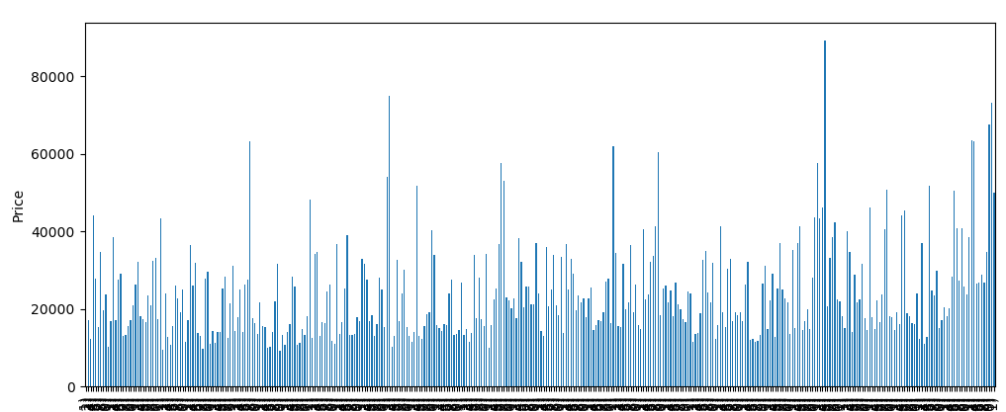
Daily –ciro for 2013

Slide 11
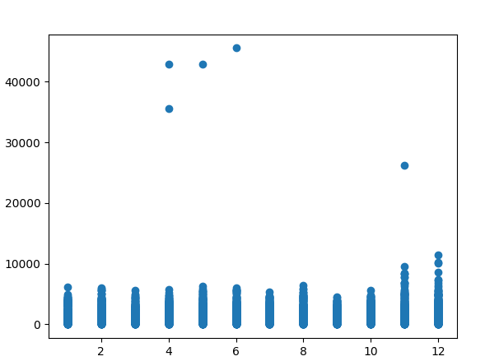
For 2011 scatter plot;

Slide 12
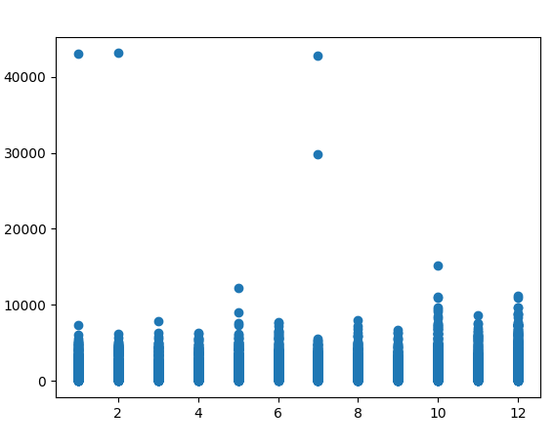
2012;

Slide 13
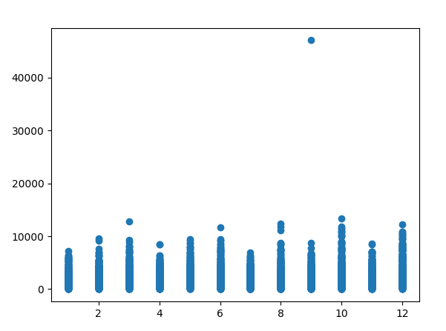
2013;

Slide 14
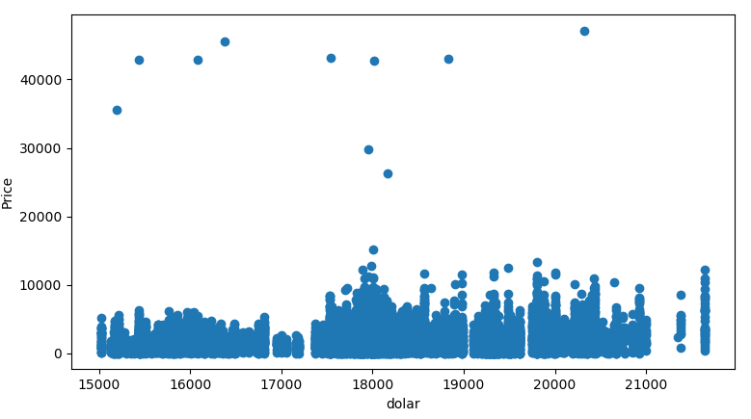
Dolar-ciro graph. We see that can’t say if the dolar is increasing, ciro is ingreasing or decreasing.

Slide 15
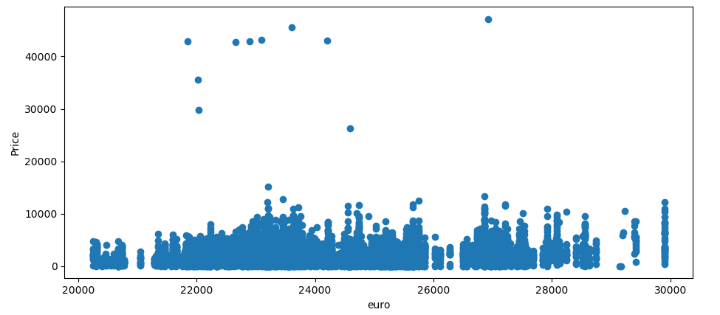
Euro-ciro graph

Slide 16
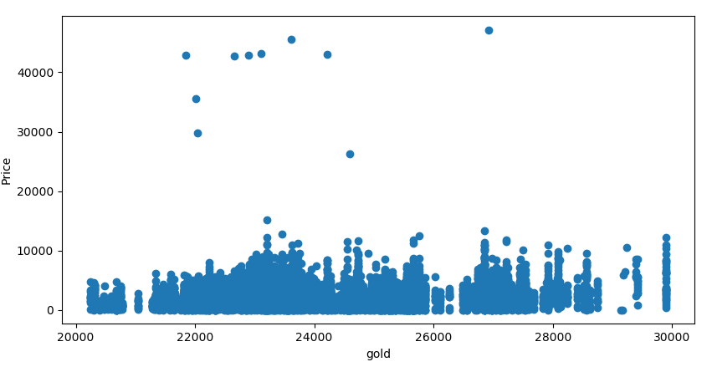
Gold-ciro graph. We see three graphs and can’t say directly proportional or inversely proportional for none of them. But there may be a little effect.

Slide 17
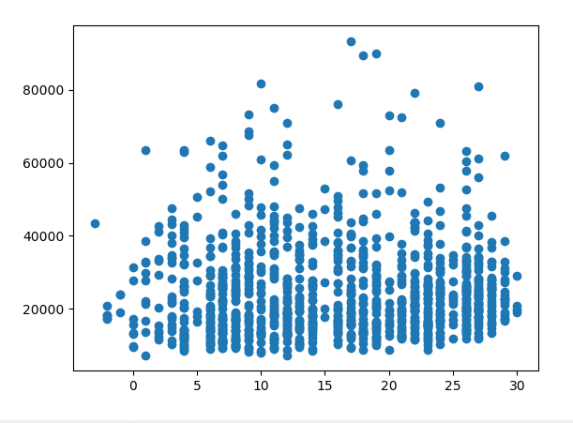
Temperature-ciro grapth
While the temperature is ingreasing, ciro is increasing some times. İt effects with special days or discount.

Slide 18
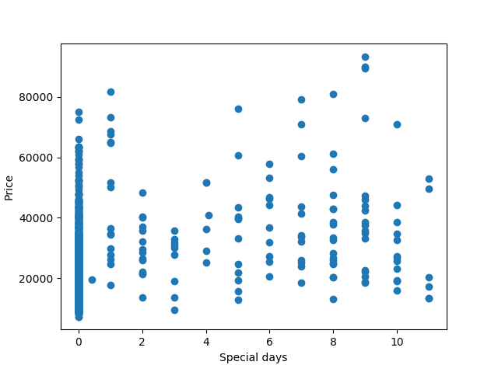
Special days is effected to Giro. For example ; New years days ,shopping is incresing (1 : new years days). At kurban bayram, shopping is very high because these days can not be discount . At other special days, people buys lots of things

Slide 19
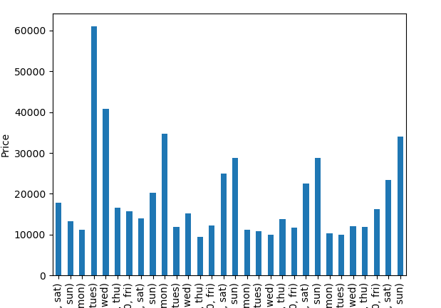
Day –ciro for January 2011. Wee see that ciro is increased generally in saturdays and Sunday. Additionaly ciro is increasing in discount day.

Slide 20
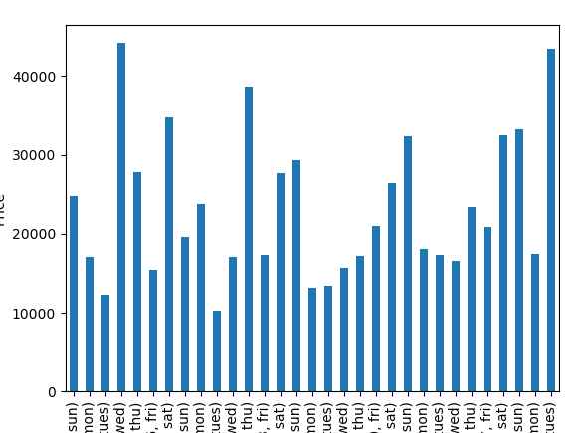
January-2012.

Slide 21
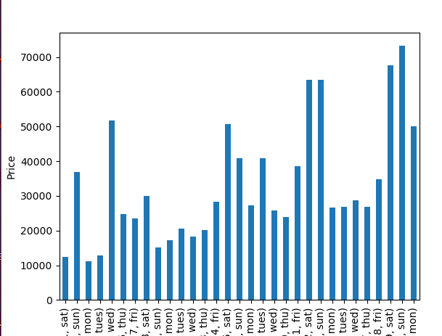
January-2013

Slide 22
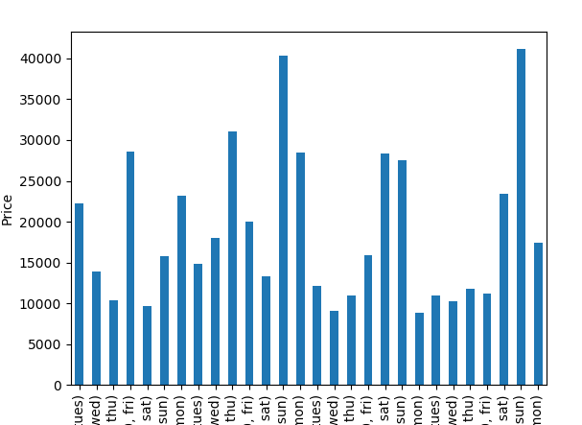
February -2011

Slide 23
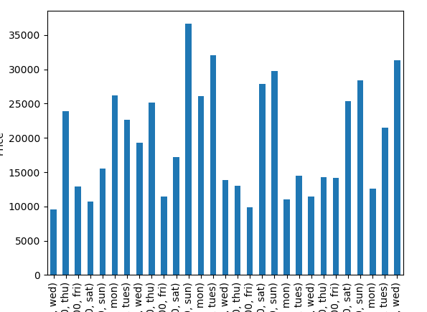
February-2012

Slide 24
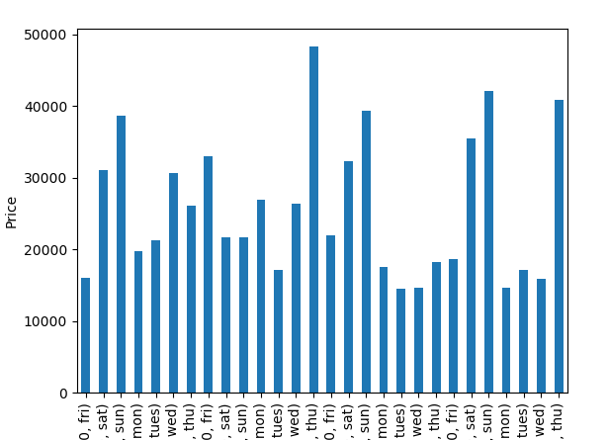
February -2013.

Slide 25
Mutual Information
For dolar; 6.1548667758760232
For euro ; 6.2165620998064757
For gold; 6.1409876654346878
For temperature; 3.2271974445774374

