Slide 1
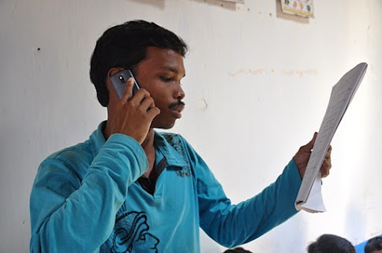
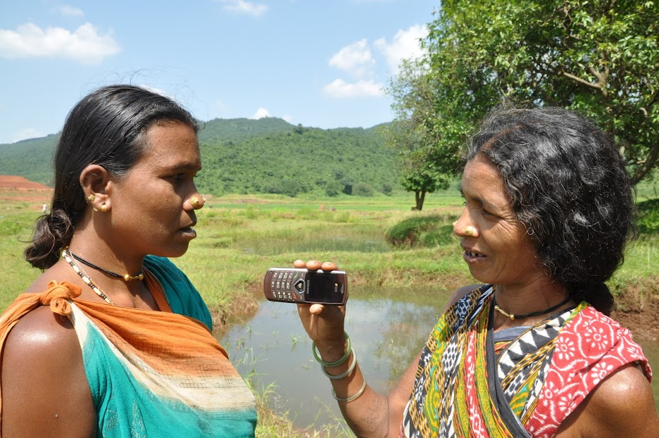
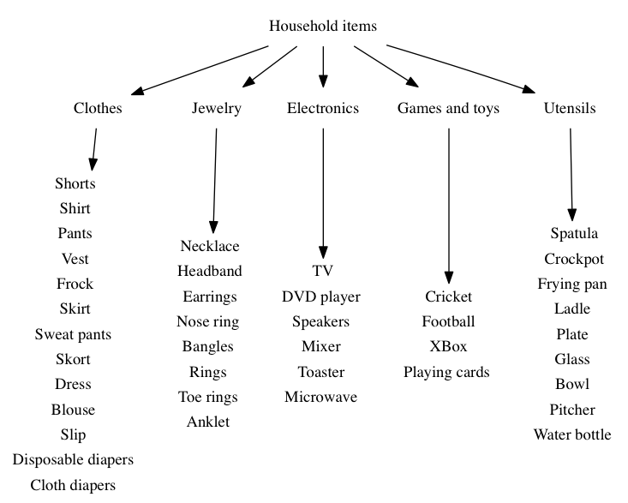
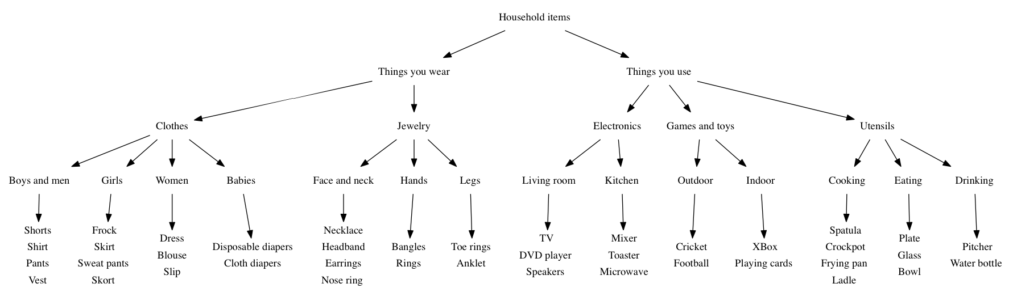
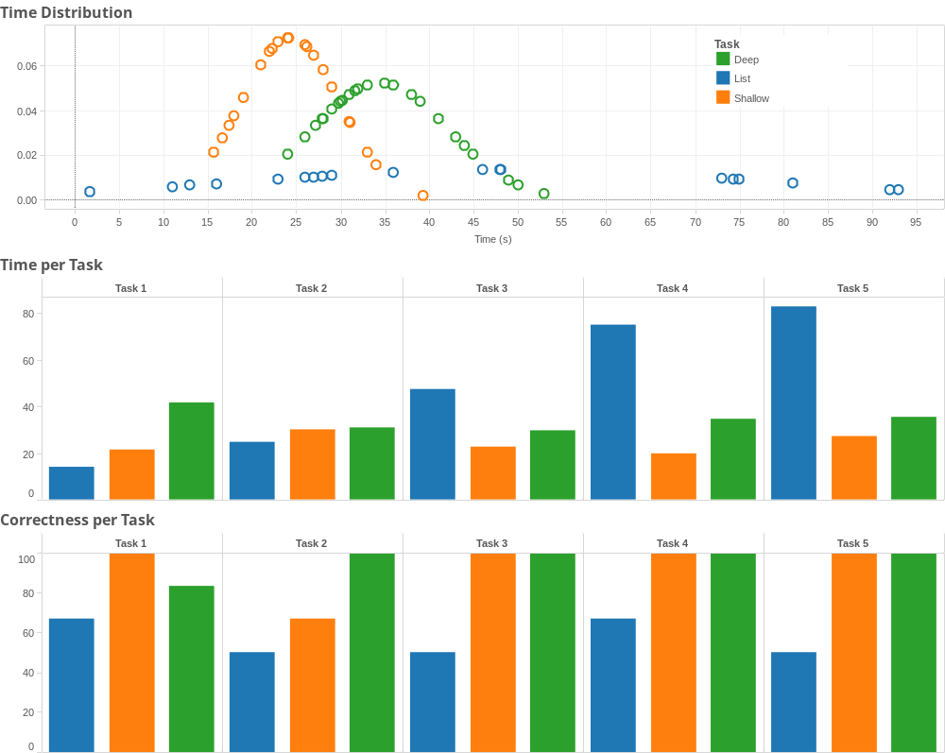
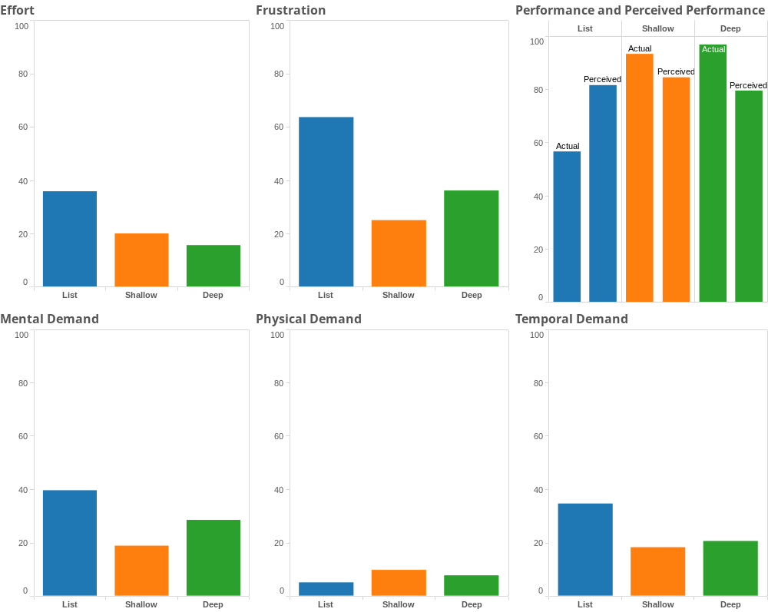
Voice Interfaces for Visually Impaired and Low-Literate Communities in the Developing World
Aditya Vashistha Sam Sudar
Problem
Our aim is to evaluate expressiveness and effectiveness of various voice interface designs for providing information to low-literate and VI communities such that information seeking time and information absorption is optimized.
Motivation
90% of all visually impaired (VI) people live in developing countries. In India, 5% of the population has access to a smartphone, 20% has access to the Internet, 26% are illiterate, and 68% live on less than US $2 a day. Millions speak tribal languages like Kui, Kurukh, and Gondi, which do not have font support. Voice interfaces are used for health information dissemination, citizen journalism, educational services, data collection, and social media platforms for low-literate, low-income, and VI communities. However, research is needed to facilitate accurate and swift retrieval of information by decreasing traversal time, increasing usability, and aiding information absorption.
Design
3 between-subjects experiment designs
6 participants in each group
5 tasks: Find Pants, Blouse, Ring, Football, Plate
Participant observation, survey, quantitative data
Analysis
12 M 6 F ; Avg. age = 27 yr ; 16 Heavy IVR users ; 2 Moderate IVR users ; Avg. education level: 17 yr
Recommendations
Future Work
Lists have a wide distribution of completion times and are frustrating to users
Hierarchies provide the opportunity for performance feedback while completing the task
Real world hierarchies will have classification ambiguity
Shallow hierarchies outperform the other two categories in frustration and performance
Do the study with VI and low-literate communities in India
Evaluate impact of hierarchy appropriateness on usability
Understand when does a shallow hierarchy become insufficient
Evaluate the ideal branching factor in intermediary levels

