Slide 1
A Visualized Toolkit for Crowdsourcing NLP Annotations
Congle Zhang
张从乐
Shengliang Xu徐生良
Hanchuan Li李寒川
Haichen Shen
沈海晨

Slide 2

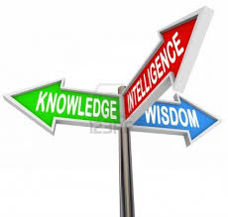
Statistical Nature Language Processing
NLP: interaction between computer and human languages
Statistical approaches have made great success
input
Statistical Model
output

Slide 3

But …
Need labeled training data, which is very expensive
input
output

Slide 4
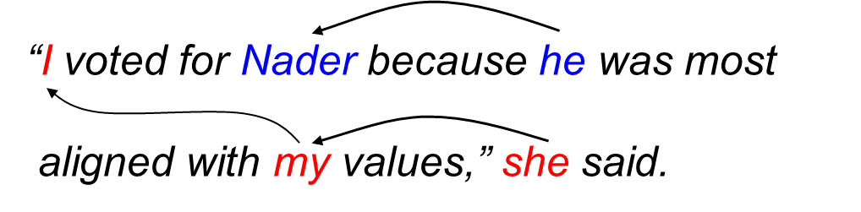
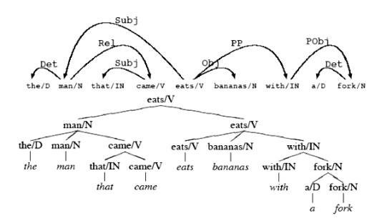
Even worse…
Structured prediction, expert only
input
output

Slide 5

Even worse…
Structured prediction (generate trees/graphs), expert only
input
output

Slide 6
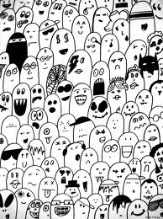
Let Crowds do the job
Visualize the NLP annotation
input
output
+ visualized toolkit

Slide 7
Goal
Visualize two categories of annotations
Undo/redo
Tree construction
Clustering

Slide 8
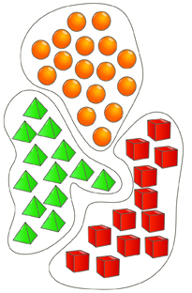
Design
Interaction
“I vote for Nadar because he most aligned with my values”, she said.
Input
Link (he, Nadar)
Tag (she, “speaker”)
Link (I, my)
History

Slide 9
Evaluation: Clustering building
Participants: 6-10 UW Undergraduate/ graduate students
Tasks: Participants will be divided into two groups and each group will be given 2 different sets of standard NLP clustering tasks. The first group will do the first task using our visualization tool and then do the second task using plain text file editors. The second group of participants will complete the task in the reverse order. Instructions will be given before they get started.
Evaluation: Both time consumption and result quality of the two groups of participants will be evaluated.

Slide 10
Evaluation: Tree Building
Participants: 6-10 UW Undergraduate/ graduate students
Tasks: Participants will be divided into two groups and each group will be given 2 different sets of standard NLP sentence sets. The first group will do the first task using our visualization tool and then do the second task using pencil sketch. The second group of participants will complete the task in the reverse order. Instructions will be given before they get started.
Evaluation: Both time consumption and result quality of the two groups of participants will be evaluated.

Slide 11
Question
Flexibility: easily transferred to other tasks
Take HTML as input, with target objects tagged.
Let NLP experts to design the input visualization
Interface
Evaluation: How to make the work load equal between two tasks?

