Slide 1
Annotation
gatherer
display
Task
objects to
cluster/parse
Crowd-sourced
workers
output
CrowdAnno
Toolkit
Interaction
visualize

Slide 2
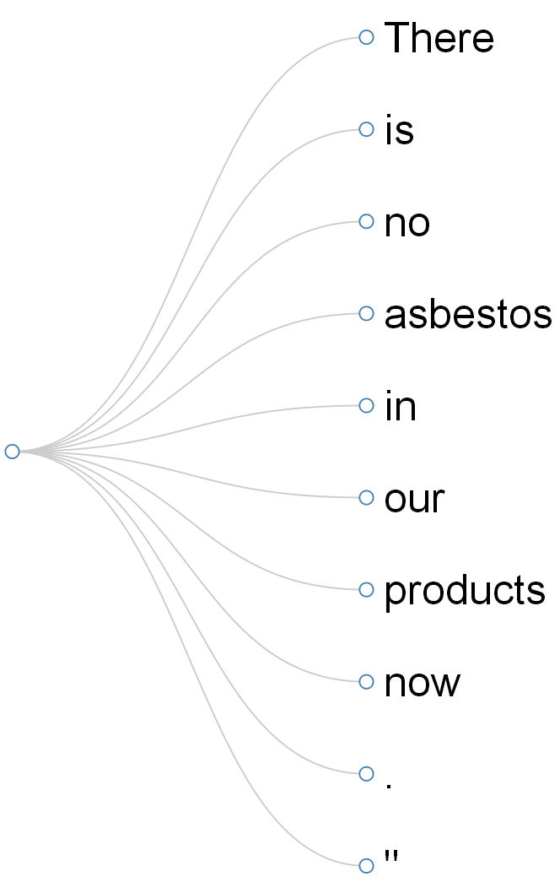
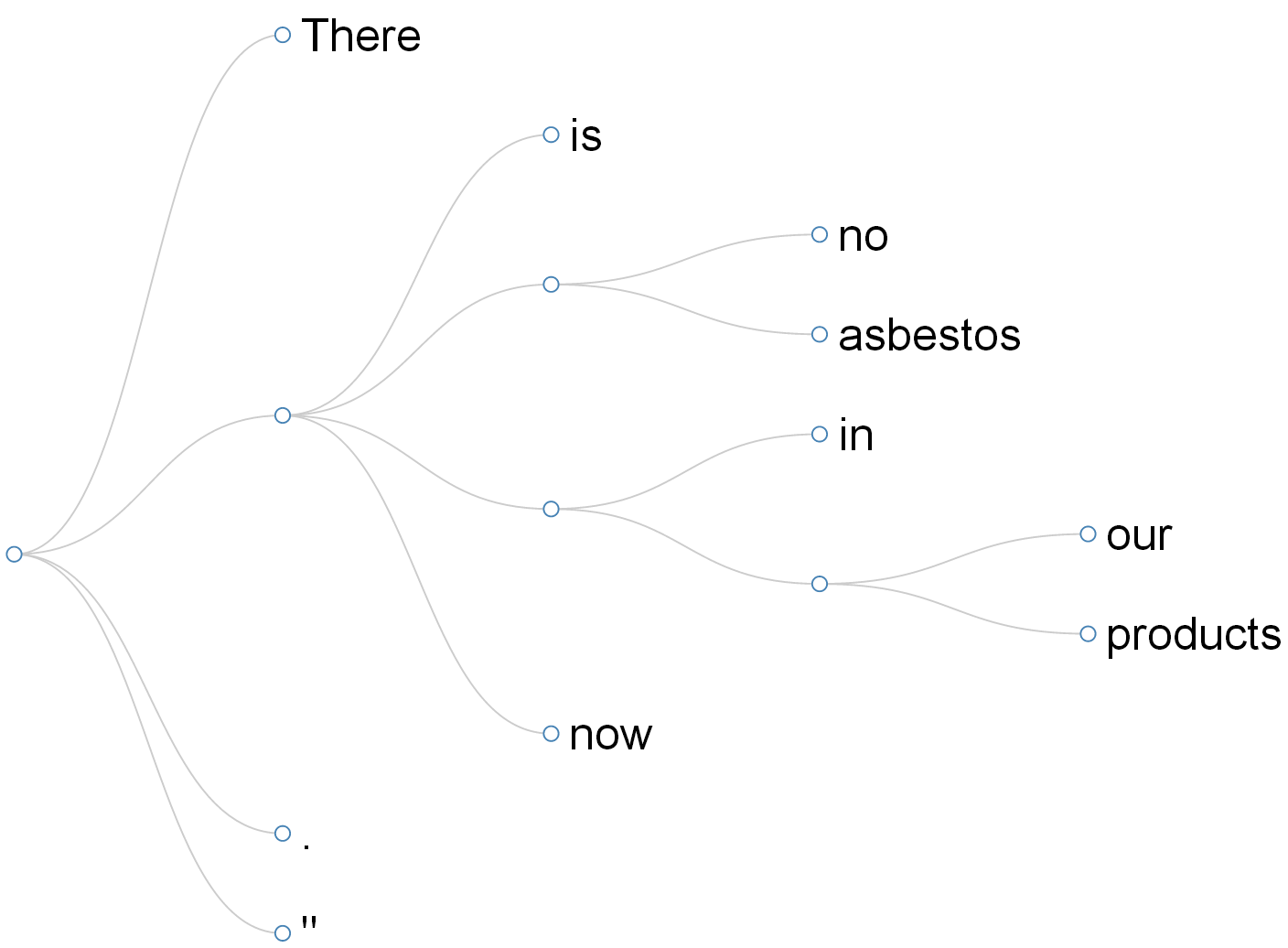
(a) before
(b) after

