Slide 1
Visualize NLP Annotations for Crowdsourcing
Hanchuan Li, Haichen Shen, Shengliang Xu and Congle Zhang

Slide 2


Statistical Nature Language Processing
NLP: interaction between computer and human languages
Statistical approaches have made great success
input
Statistical Model
output

Slide 3

But …
Need labeled training data, which is very expensive
input
output

Slide 4
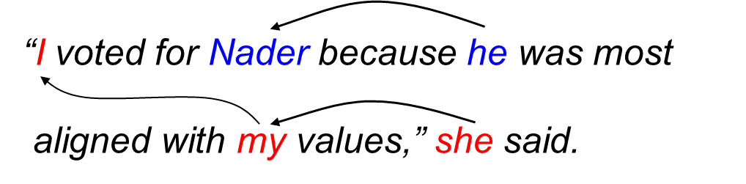
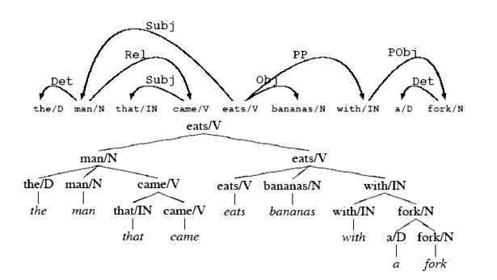
Even worse…
Structured prediction, expert only
input
output

Slide 5

Even worse…
Structured prediction (generate trees/graphs), expert only
input
output

Slide 6
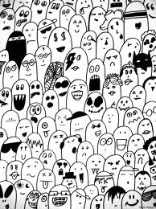
Let Crowds do the job
Visualize the NLP annotation
input
output
+ visualized toolkit

Slide 7
Goal
Visualize two categories of annotations
Undo/redo
Tree construction
Clustering

Slide 8
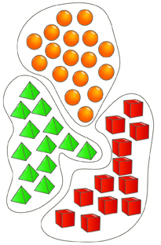
Design
Interaction
“I vote for Nadar because he most aligned with my values”, she said.
Input
Link (he, Nadar)
Tag (she, “speaker”)
Link (I, my)
History

Slide 9
Question
Flexibility: easily transferred to other tasks
Take HTML as input, with target objects tagged.
Let NLP experts to design the input visualization
Interface

