Slide 1
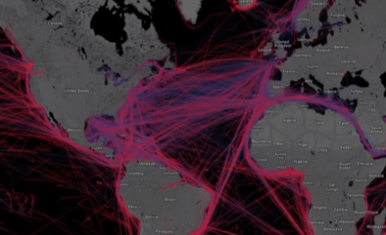
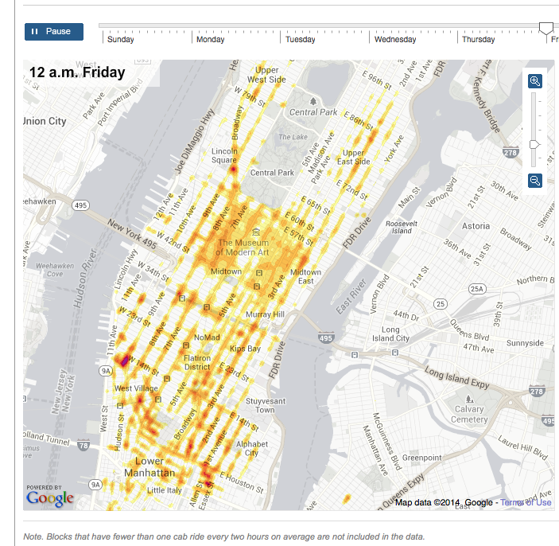
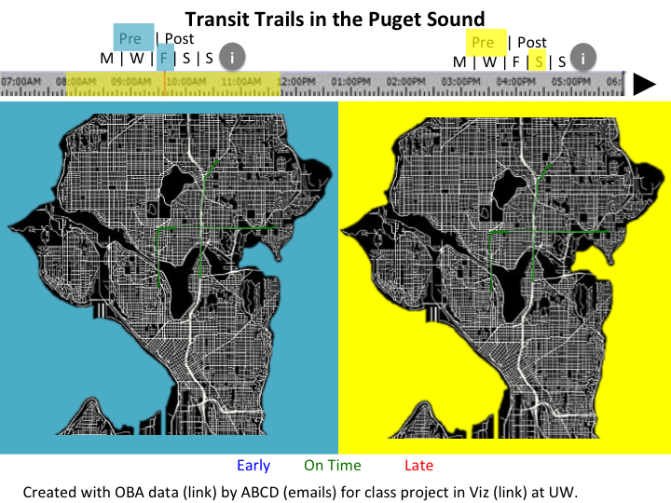
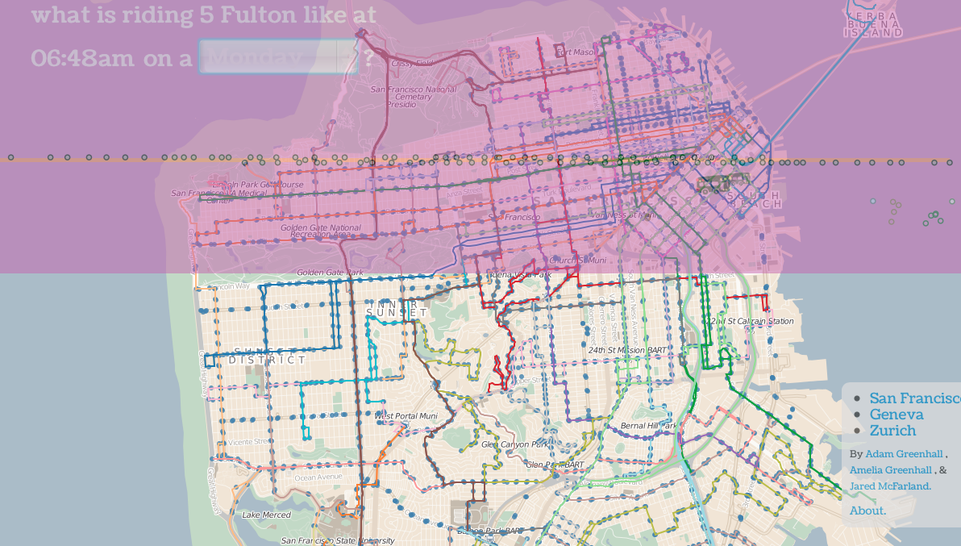
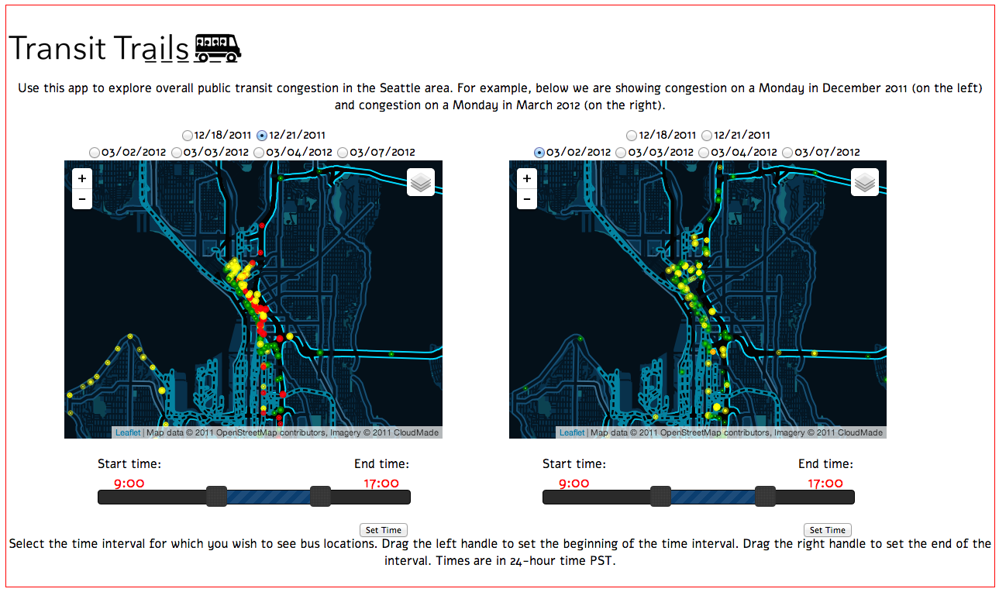



Transit Trails: How do bus cuts affect congestion & coverage?
Problem & Motivation
Cuts and changes to bus routes and schedules have complicated effects on quality of bus service across large areas and on bus delays and road congestion.
It is useful to leverage historical data to demonstrate how congestion and coverage changed as the result of route changes. This could help inform future transit policy decisions.
"The easiest way to understand the cuts is to look at our Sunday schedule. It would be like Sunday schedule, but every day”
Seattle bus driver, route 31
Design Inspiration &
Initial Prototypes
All the Ships in the World @ Google I/O 2013
Taxi Heat Map NYC
Approach
Focus on Feb 2012 transit change
Data from several pre-/post-change days
Two maps enable comparison for different days/times of day
Colored dots represent locations and delays of buses
Dots on the Bus:
San Francisco
User Study
Semi-structured interviews
8 participants (4 male, 4 female; including Seattle transit experts & transit users)
Feedback on prototype:
Relevance
Interactive features
Color choices
General usability
Desired functionality
Design Improvements
Default to “day” view
Make maps bigger
Do not require click to stet time
Ability to sync maps & times
Add legend
Day selection by day of week
Future Directions
More complete data collection
Animation to show movement during time intervals
Filter by route
Show bus frequencies
“Bus score” metrics
Show multi-day averages
CSE 512 Final Project
https://github.com/CSE512-14W/fp-cobbc12-cbonnar-pany5-kuksenok
http://homes.cs.washington.edu/~cbonnar/viz/ibusviz.html
Will Upcoming Transit Cuts Affect You?
Metro proposes 17% service cut
http://metro.kingcounty.gov/am/future/
Camille Cobb, Caitlin Bonnar,
Yi Pan, Katie Kuksenok
{cobbc12, cbonnar, pany5, kuksenok}
@cs.washington.edu

