Slide 1

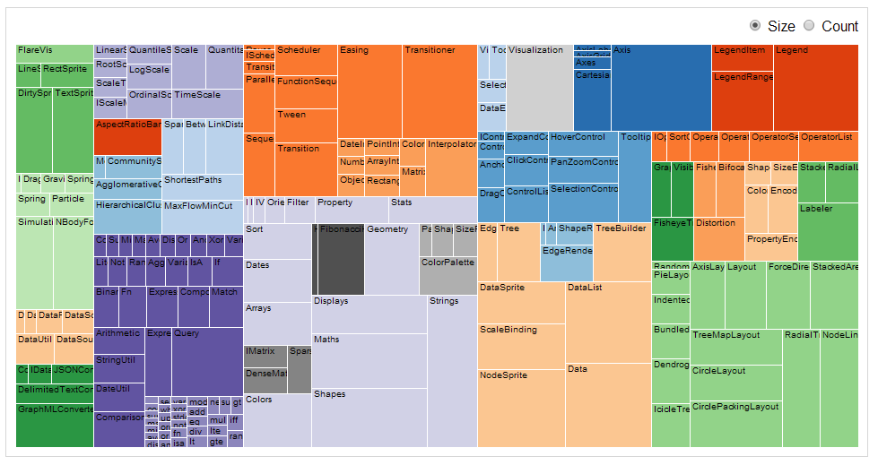
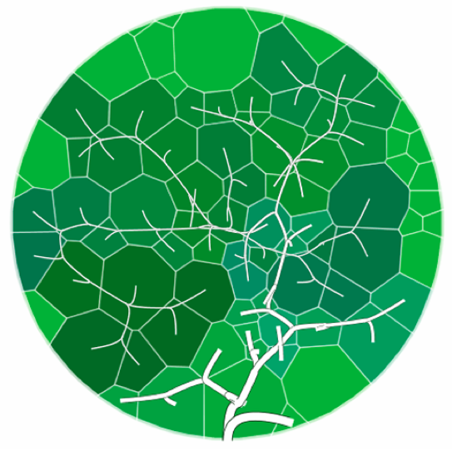
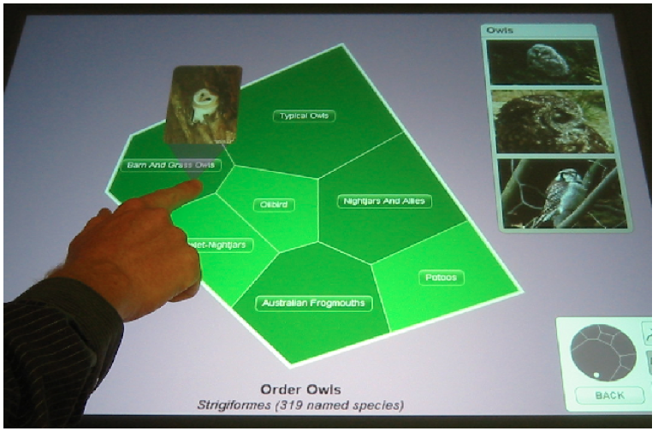
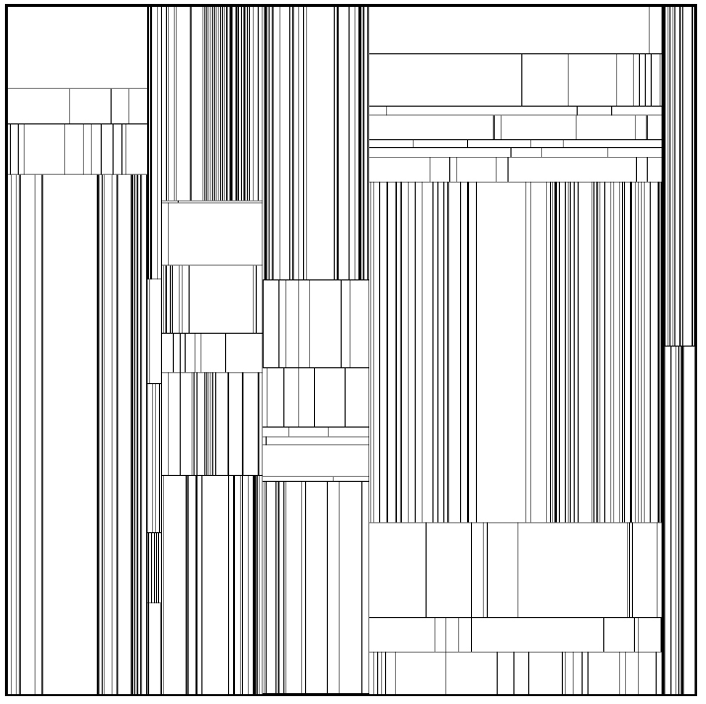
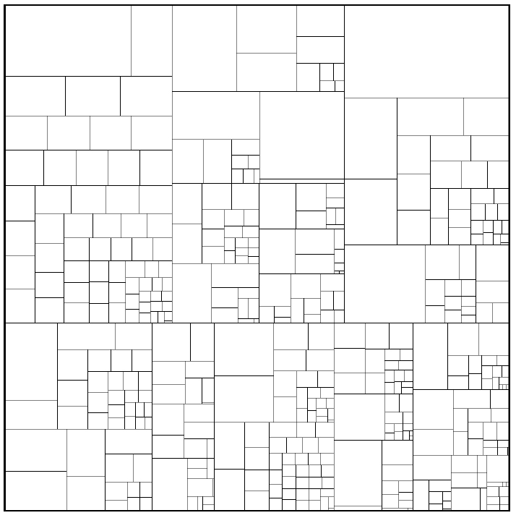
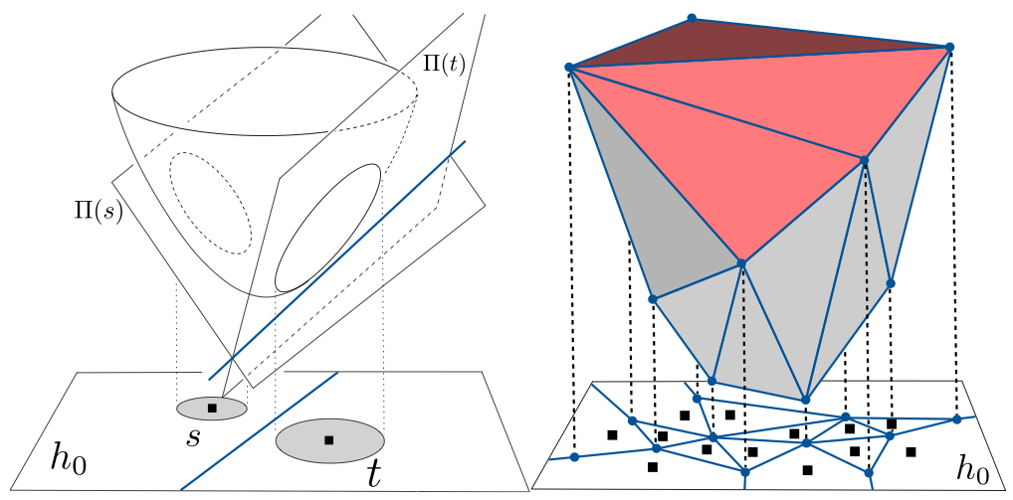
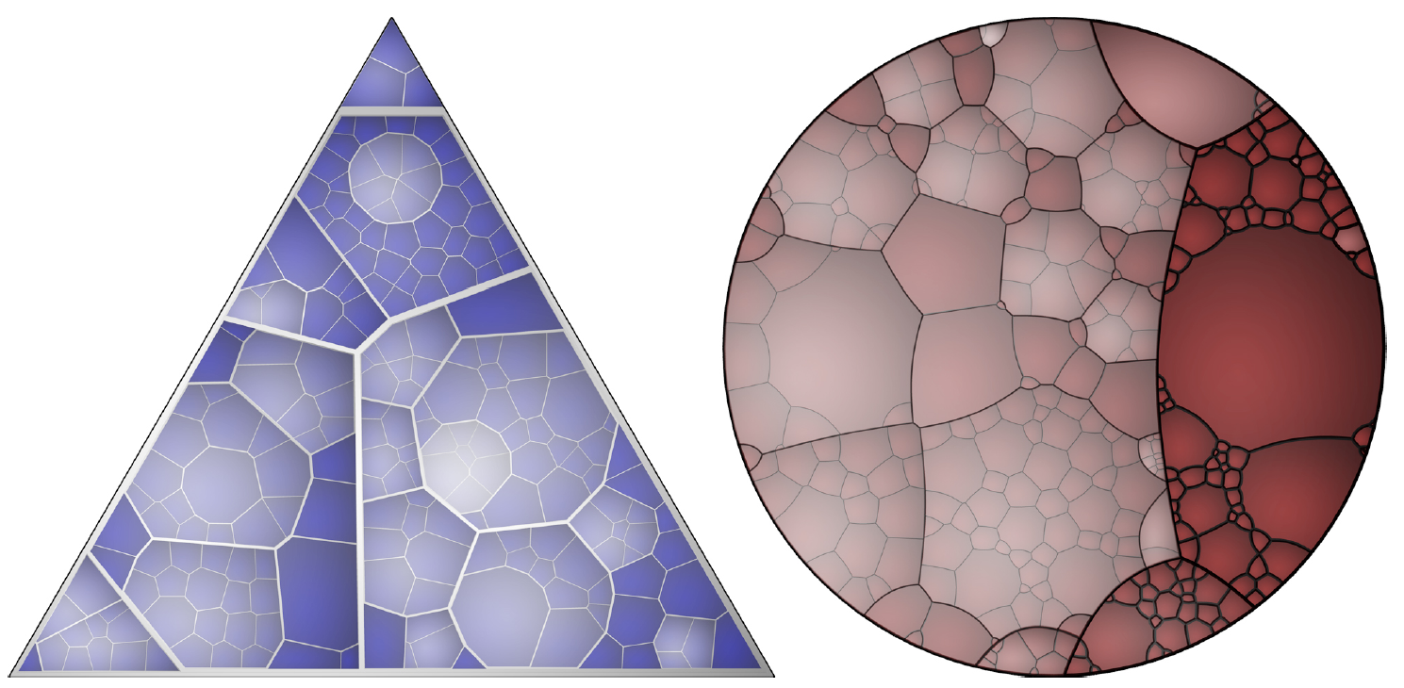
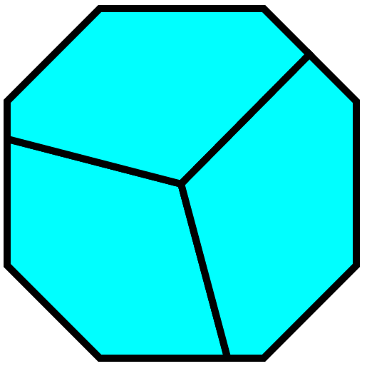
Voronoi Treemaps in D3
_{Paul Vines Peter Henry}
University of Washington Computer Science and Engineering Department
plvines@cs.washington.edu peter@cs.washington.edu
Treemaps are a space-filling visualization of hierarchical data. They can be computed quickly, but are usually limited to rectangular regions. Voronoi diagrams are a partitioning of space into regions based on nearest-neighbor seed points. Voronoi Treemaps are an alternative treemap formulation allowing for arbitrary polygon regions and better apprehension of hierarchical structure, and our goal is to bring this visualization component into D3 using JavaScript.
A heuristic, force-directed approach was previously used in [Horn 2009] for interactive browsing of an encyclopedia of life. We would like to enable such interactive visualization for the web using D3.
Treemaps [Johnson & Schneiderman 1991] are already popular and available in D3
The original algorithm suffered from poor aspect ratio. Later squarification [Bruls 2000] addresses this, but the hierarchical structure may be unclear.
A faster, resolution independent algorithm [Nocaj & Brandes 2012] makes interactive computation of true Voronoi Treemaps viable.
Voronoi Treemaps [Balzer & Deussen 2005] take on arbitrary shapes, and the hierarchical boundaries are more visually apparent. However, the iterative optimization takes multiple minutes for large diagrams.
Due to bugs in our implementation, we are currently limited to at most three sites. Recursive generation will be straightforward once the bugs are gone.
CSE 512: Data Visualization
University of Washington

