Slide 1
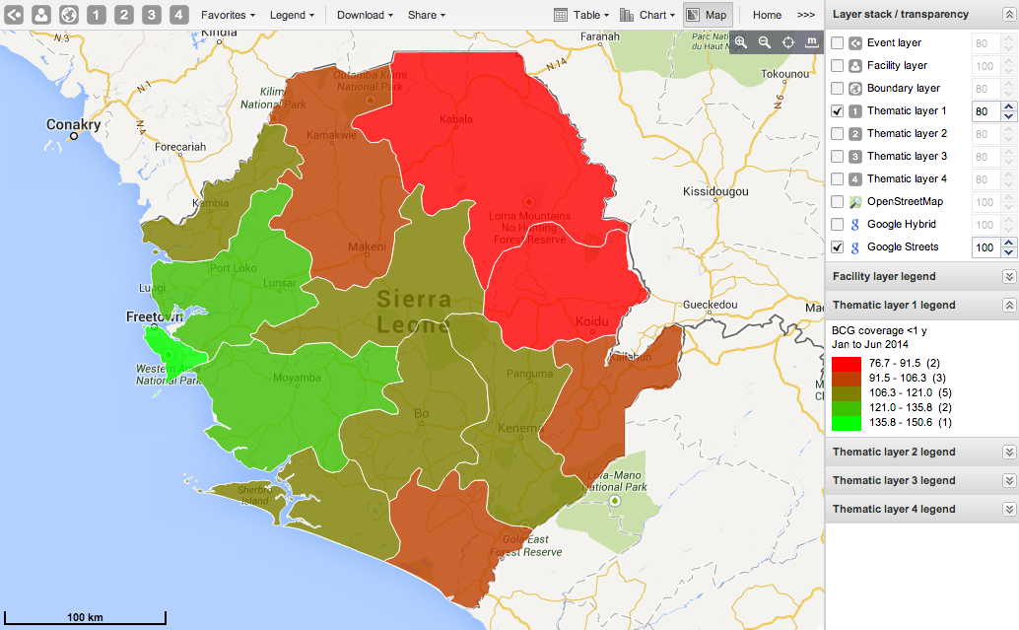
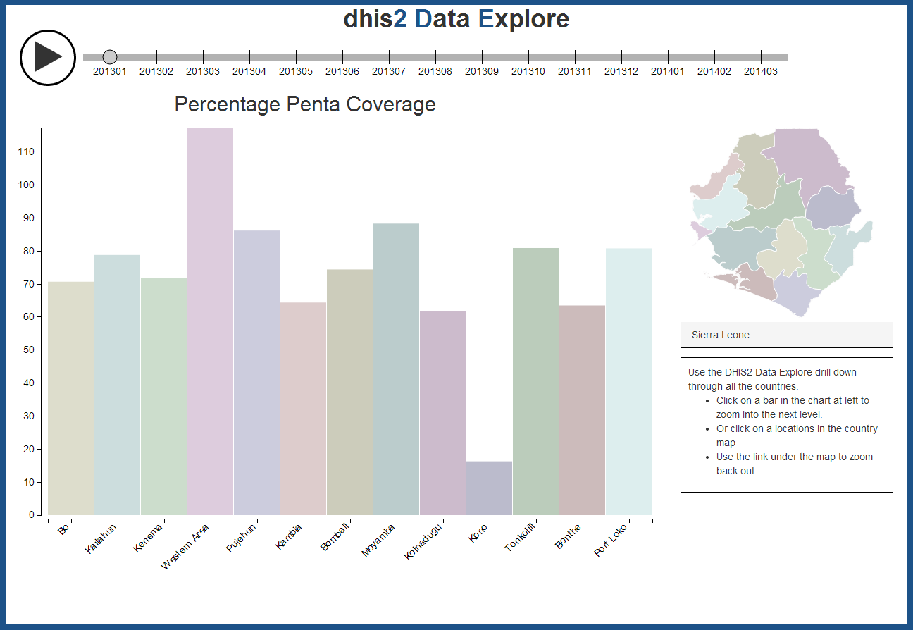
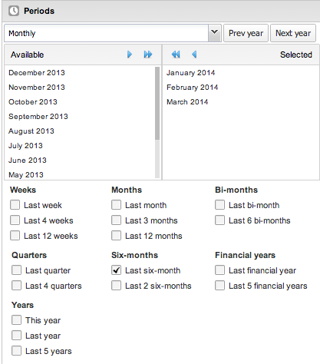
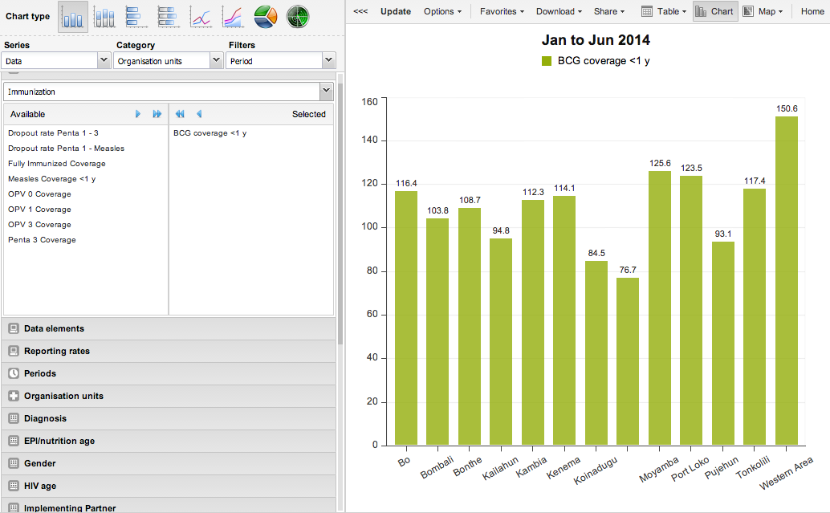
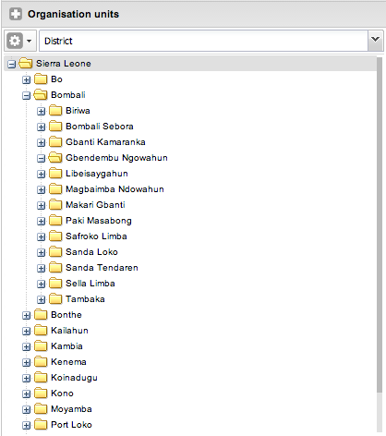






D5: Data Driven Documents Driving Development
Trevor Perrier, Fahad Pervaiz, Richard Anderson
University of Washington , Seattle USA
Problem
Solution: Widget
In order to improve general public helath in the developling world, large amount of health data has been collected in past couple of years.
Systems, such as DHIS2, are used at national level to store and visualize this data
However, these systems are very difficult to use by NGO workers, provincial and district health managers
We have made a DHIS2 plugin working with the open data for DHIS2’s Sierra Leone instance
Let users investigate highs and lows conveniently to find poor performing health units
Look at relative performance of administrative areas over time for evaluation purposes
Allow users to drill down geographically for any data element
Easily slide through time to look for temporal trends at any geographical level
DHIS2 Graphs
Demo of D5
The visualization in D5 reduce selection complexity by always plotting the given indicator for each organization units.
The periods slider lets the user view change over time.
Using clicking on the map or bars will drill down to the next level organization unit.
Complicated Menu System
cs.washington.edu/research/c4d
change.washington.edu

