Slide 1

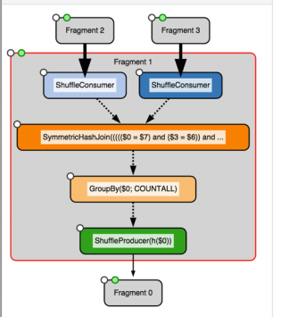
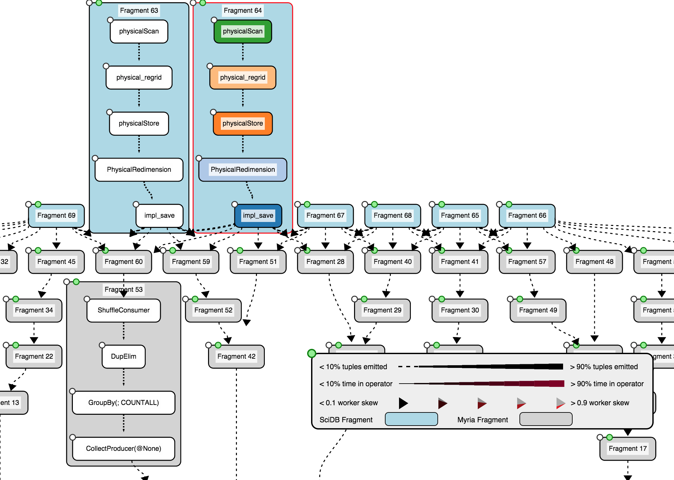


HybridPerfopticon
Query Visualization for Hybrid Distributed Databases
Brandon Haynes & Shrainik Jain
While many profiling systems exist that target queries in a single database system, no system exists that is designed to profile queries in a hybrid database context where multiple systems operate in parallel and data is shared (in various ways) across those databases.
HybridPerfopticon in action:
We present an extension to the Perfopticon (Moritz, Halperin, Howe & Heer, 2015) framework, an interactive profiling tool that provides the ability to view database query performance at varying levels of detail. We demonstrate a working prototype of this extension for a hybrid database consisting of 2 component database (SciDB and Myria).
HybridPerfopticon Architecture:
(Hybrid) Perfopticon
Hybrid Server
Interface Enhancements
Plan Multiplexing
HTTP
Hybrid
Plan Aggregator
Hybrid Profiling Multiplexer
HTTP
SciDB Plan & Profiling Subsystem
SciDBParser
Statement
QueryStatement
SciDBLog
Physical
QueryPlan
InitializedQueryStatement
Logs
ParsedQuery
Statement
Future Work:
Support extension of framework to have additional databases.
??
PlanProfile
Operator
CommittedQuery
Statement
ScatterGather
Statement

