Slide 1

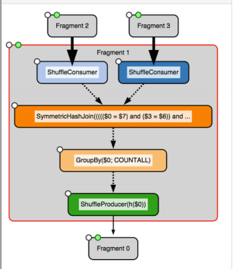
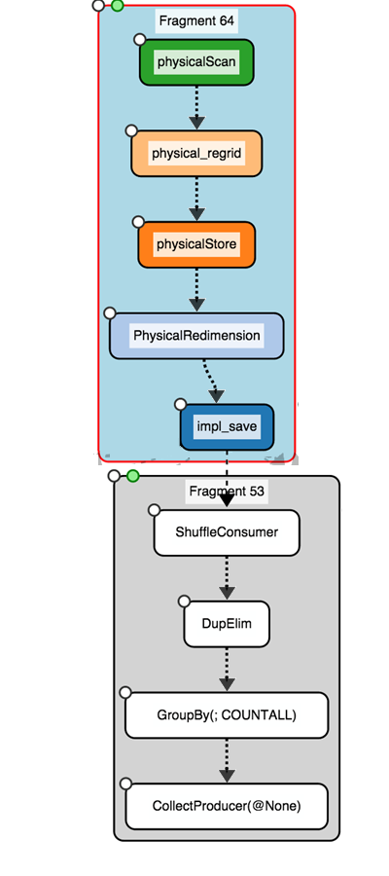



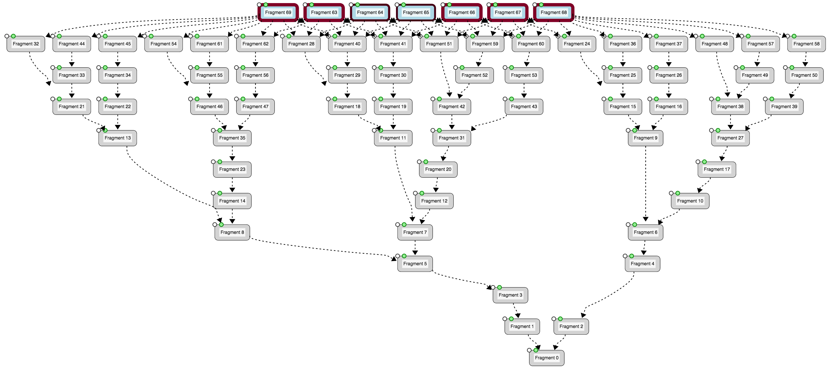

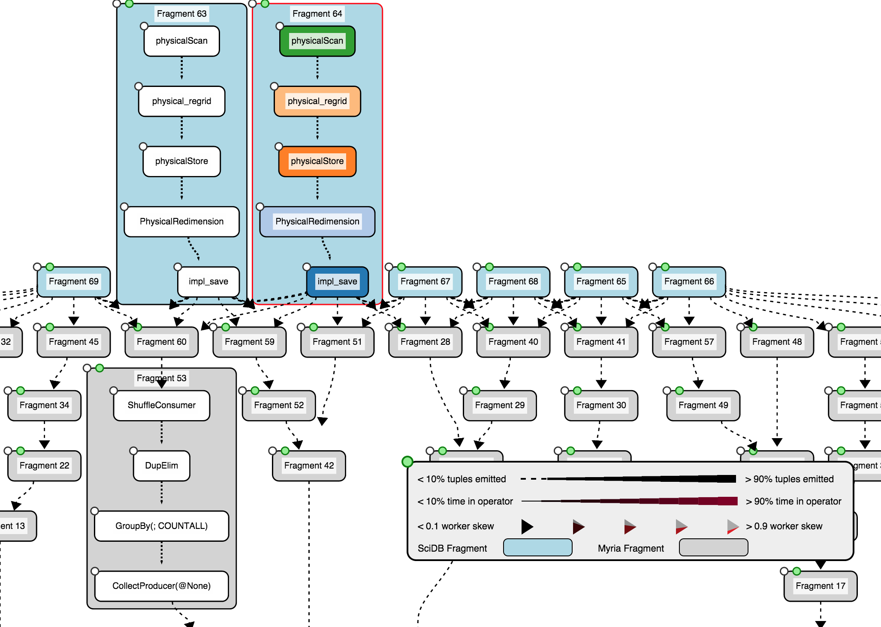
HybridPerfopticon
Query Visualization for Hybrid Distributed Database Systems
Brandon Haynes & Shrainik Jain
Aim 1
Can existing query visualization techniques be extended across multiple database systems?
No system currently exists that visualizes and profiles queries across multiple database systems (a “hybrid” database system)
We extended the Perfopticon (Moritz, Halperin, Howe & Heer, 2015) framework to multiplex plans drawn from arbitrary remote database systems
Our system highlights the relevant components of each system-specific query plan and identifies data flowing into and out of each system
Introduction
Aim 2
What techniques are required to transform disparate plans into a common format?
TODO TODO TODO TODO TODO TODO TODO TODO TODO TODO TODO TODO TODO TODO TODO TODO TODO TODO TODO TODO TODO TODO
TODO TODO TODO TODO TODO TODO TODO TODO TODO TODO TODO TODO TODO TODO TODO
HybridPerfopticon
Architecture
Plan fragments are color-coded by database system
We extended Perfopticon to display plans from the Myria and SciDB database management systems. Plans from each system are combined into a “hybrid plan” and each component is assigned an origin system. The individual plans within each hybrid plan may contain additional metadata relevant to that system. These plans are fed into HybridPerfopticon for visualization.
HybridPerfopticon
Cardinalities of database transfers are contextually width-encoded
Interface Enhancements
Plan Multiplexing
No data transfer
Dominating transfer
Units of data transfer are counted in contextually-atomic units (e.g., array elements for SciDB, tuples for Myria) and arrow width is weighted by the total element outputs across the entirety of the hybrid plan.
HTTP
Approach & Architecture
Myria Plan
Hybrid Server
Hybrid Plan
Hybrid Perfopticon
Inter-database transfer skew is binned and color-encoded
SciDB Plan
No transfer skew
Extreme transfer skew
Hybrid
Plan Aggregator
Hybrid Profiling Multiplexer
Skew is displayed as a (normalized) mean over the previous two seconds (in order to avoid distracting rapid fluctuations).
HTTP
SciDB Plan & Profiling Subsystem
Hybrid Query Visualization
We profiled a hybrid version of a complex, real-world query and demonstrated that it is accurately visualized.
SciDBParser
Statement
QueryStatement
TODO
Or leave blank as bonus whitespae
Logs
SciDBLog
Physical
QueryPlan
InitializedQueryStatement
Results
ParsedQuery
Statement
PlanProfile
Operator
CommittedQuery
Statement
Future Work
Extending the log-parsing approach as a first-class extension point in HybridPerfopticon would quickly enable the addition of other database systems
The mapping between atomic elements (e.g. tuples, graph vertices, array elements) in database systems needs additional refinement
ScatterGather
Statement

