Slide 1

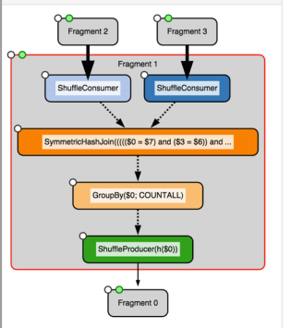
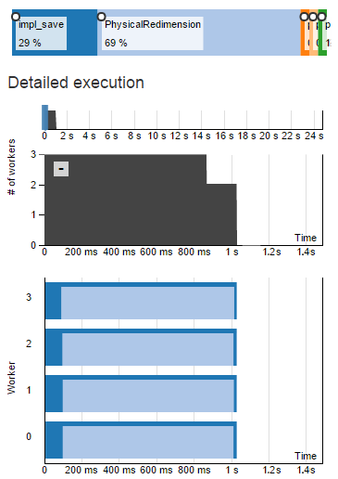
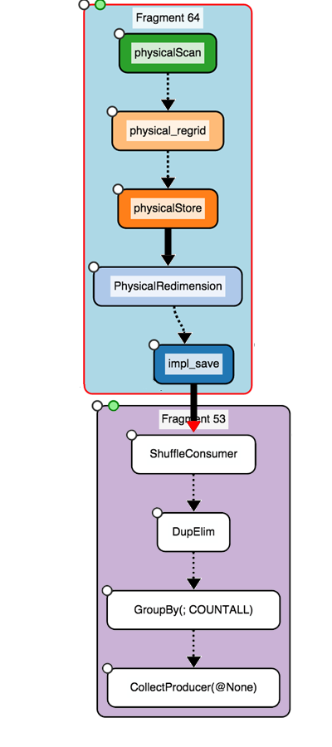




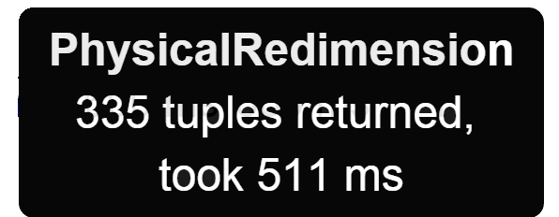
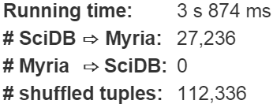
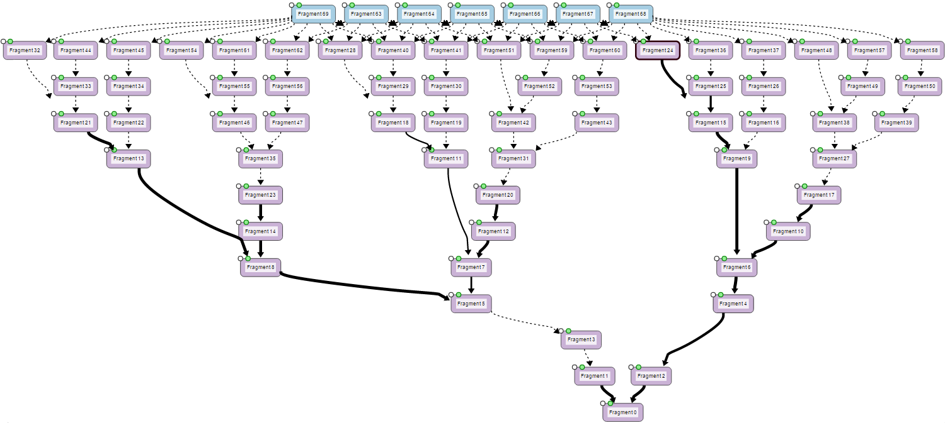


HybridPerfopticon
Query Visualization for Hybrid Distributed Database Systems
Brandon Haynes & Shrainik Jain
Problem Statement
Can existing query visualization techniques be extended across multiple database systems?
No system currently exists that visualizes and profiles queries across multiple database systems (a “hybrid” database system)
We extended the Perfopticon (Moritz, Halperin, Howe & Heer, 2015) framework to multiplex plans drawn from arbitrary database systems
Our system highlights the relevant components of each system-specific query plan and identifies data flowing into and out of each system
Introduction
Motivation
What modifications are required to Perfopticon, and to transform disparate plans into a common format?
Perfopticon’s intended extension method requires extensive operator instrumentation and collection of various timing metrics. Since these data are already present in the logging infrastructure, can we use it as an exclusive source of profiling metrics?
Coordination of multiple database plans requires changes to the Perfopticon system, and converting profiling metrics to a common format is error-prone
Plan fragments are color-coded by database system
Operators from each DBMS are displayed in the detail view
We extended Perfopticon to display plans from the Myria and SciDB database management systems. Plans from each system are combined into a “hybrid plan” and each component is assigned an origin system. The individual plans within each hybrid plan may contain additional metadata relevant to that system. These plans are fed into HybridPerfopticon for visualization.
impl_save, PhysicalRedimension,
physicalStore, physical_regrid,
physicalScan, …
Cardinalities of database transfers are dynamically width-encoded
No data transfer
Dominating transfer
HybridPerfopticon
Architecture
Units of data transfer are counted in contextually-atomic units (e.g., array elements for SciDB, tuples for Myria) and arrow width is weighted by total within-fragment output (or plan, for inter-fragment shuffle/transfers).
Approach
Plan
Inter-database transfer skew is binned and color-encoded
HybridPerfopticon
Hybrid Plan
Hybrid Perfopticon
No transfer skew
Extreme transfer skew
Interface Enhancements
Plan Multiplexing
Plan
Skew is displayed as a (normalized) mean over the previous two seconds (in order to avoid distracting rapid fluctuations).
Worker contribution and operator metrics are encoded by DBMS
HTTP
Hybrid Server
TF-IDF & $k$-NN in Myria
(Harr) Discrete Wavelet Transform in SciDB
Hybrid
Plan Aggregator
Hybrid Profiling Multiplexer
Hybrid Query Visualization
We profiled a hybrid version of a complex, real-world query and demonstrated that it is accurately visualized
HTTP
SciDB Plan & Profiling Subsystem
Visualization of a complex hybrid query from Saeed & Mark (2011)
SciDBParser
Statement
Conclusions
Log parsing works well as an easy extension point for new DBMSs
Log parsing is a useful means by
which new DBMSs may be introduced
HybridPerfopticon is a useful tool with which to visualize and debug hybrid database queries
Logs
QueryStatement
Results
SciDBLog
Physical
QueryPlan
Additional performance work is needed (e.g., caching parsed logs)
The mapping between atomic elements (e.g. tuples, graph vertices, array elements) in database systems needs additional refinement
InitializedQueryStatement
Future Work
Additional performance and caching logic is needed
PlanProfile
Operator
CommittedQuery
Statement

