Slide 1
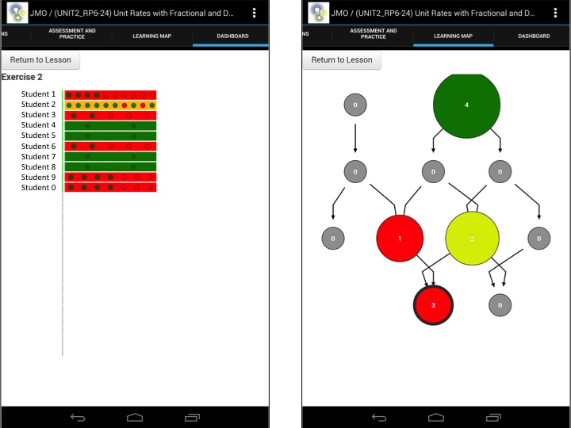
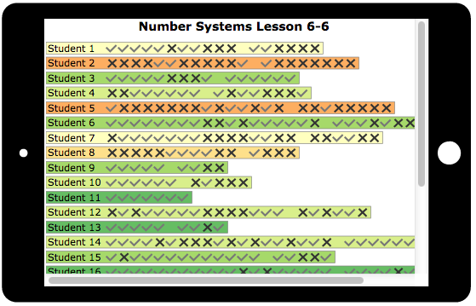
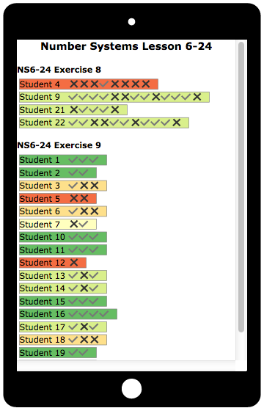
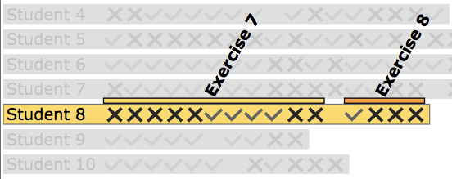
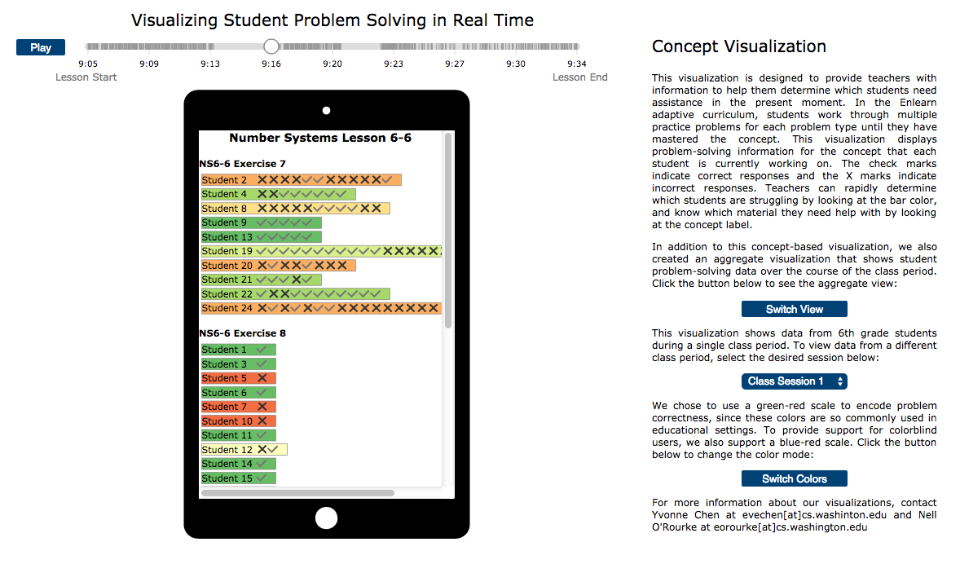
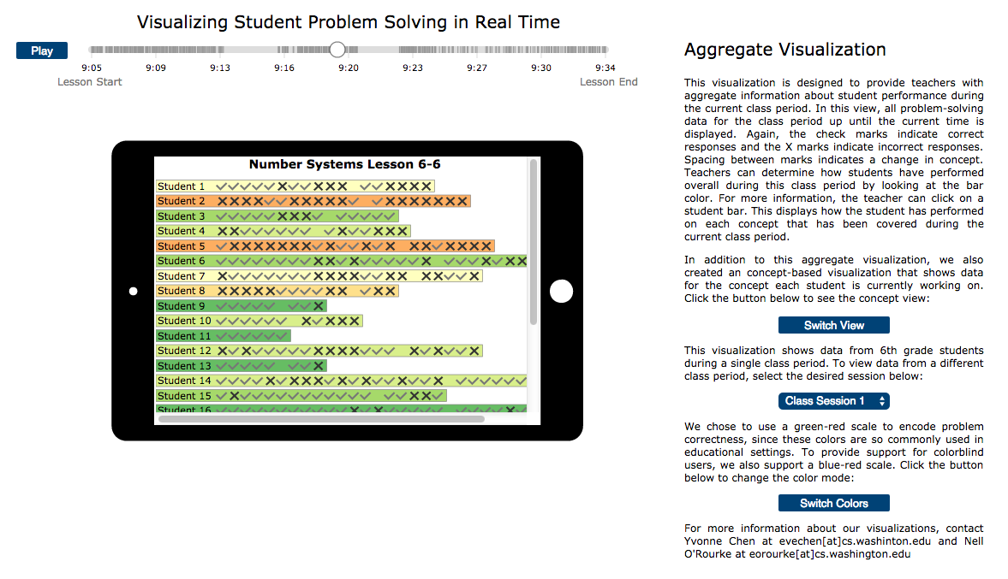
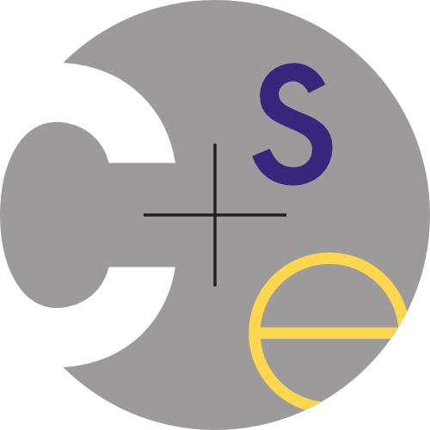
VISUALIZING STUDENT PROBLEM SOLVING
Yvonne Chen and Eleanor O’Rourke
Research Problem
Design new methods of visualizing student problem-solving data to both help classroom teachers assist students effectively during class and track student progress after class.
Motivation
Importance of Student Data
Enlearn’s Initial Visualizations
Prior research shows that teachers can benefit from having access to student data, particularly when data is accessed in real time. Yet while there are clear benefits to exposing student data, little research explores methods of effectively visualizing it. Our work targets this gap in the literature.
Enlearn found that neither visualization was effective in the classroom, in large part because the information provided did not match teacher needs. Teachers are extremely busy during class time, so they need visualizations that are both easily glanceable and that provide actionable information.
Enlearn
We partnered with Enlearn, a non-profit company founded to develop tablet-based adaptive problem-solving software for K-12 classrooms. Our visualizations display real data from Enlearn students.
Approach
Problem Characterization
Aggregate Visualization
Simulating Real-Time Data
Design guidelines based on the data visualization problem faced by teachers are:
Visualizations must provide actionable information.
Visualizations must show data for individual students.
Visualizations must display concept-level information.
We created two separate visualizations to expose student problem-solving data for teachers.
To simulate real-time data streaming of problem solving, we use data collected from students last fall. Our timeline can be played and brushed so we can quickly see what the visualizations would look like in various real-time scenarios. Lines on the timeline are visual information scent cues, showing where problem-solving actions occur. While we included the timeline for our benefit as designers, it may also be a valuable tool for teachers to play back their lessons after class time.
Concept Visualization
The aggregate visualization is designed to give teachers a high-level overview of how each student has performed over the course of the lesson. The background color of each student bar represents aggregate performance across all concepts. Clicking a student shows detailed concept-level information.
This visualization help teachers determine which students need help in the present moment, from a quick glance. Students are grouped by the concept that they are currently working on. The background color of each student bar indicates how well the student is performing on that concept.
Color Design
By default, we use a red-green color scheme to indicate problem correctness, since these colors are so common in educational settings. We also provide a red-blue color scheme option for colorblind users.
Results
Contributions and Future Work
This work makes contributions at multiple levels of Munzner’s nested model for visualization design: a characterization of the data visualization needs of classroom teachers, a data abstraction for representing student data grouped by concept, and two new visual encodings for displaying student problem-solving data in real time.
While we made significant progress in developing visualization techniques for this problem domain, we have not formally evaluated our solutions with our target users. Through Enlearn, we aim to pilot these visualizations with teachers in the classroom.
Screenshot of the Concept Visualization
Screenshot of the Aggregate Visualization
Yvonne Chen
evechen@uw.edu
homes.cs.washington.edu/~evechen
Eleanor O’Rourke
eorourke@cs.washington.edu
homes.cs.washington.edu/~eorourke

