Slide 1
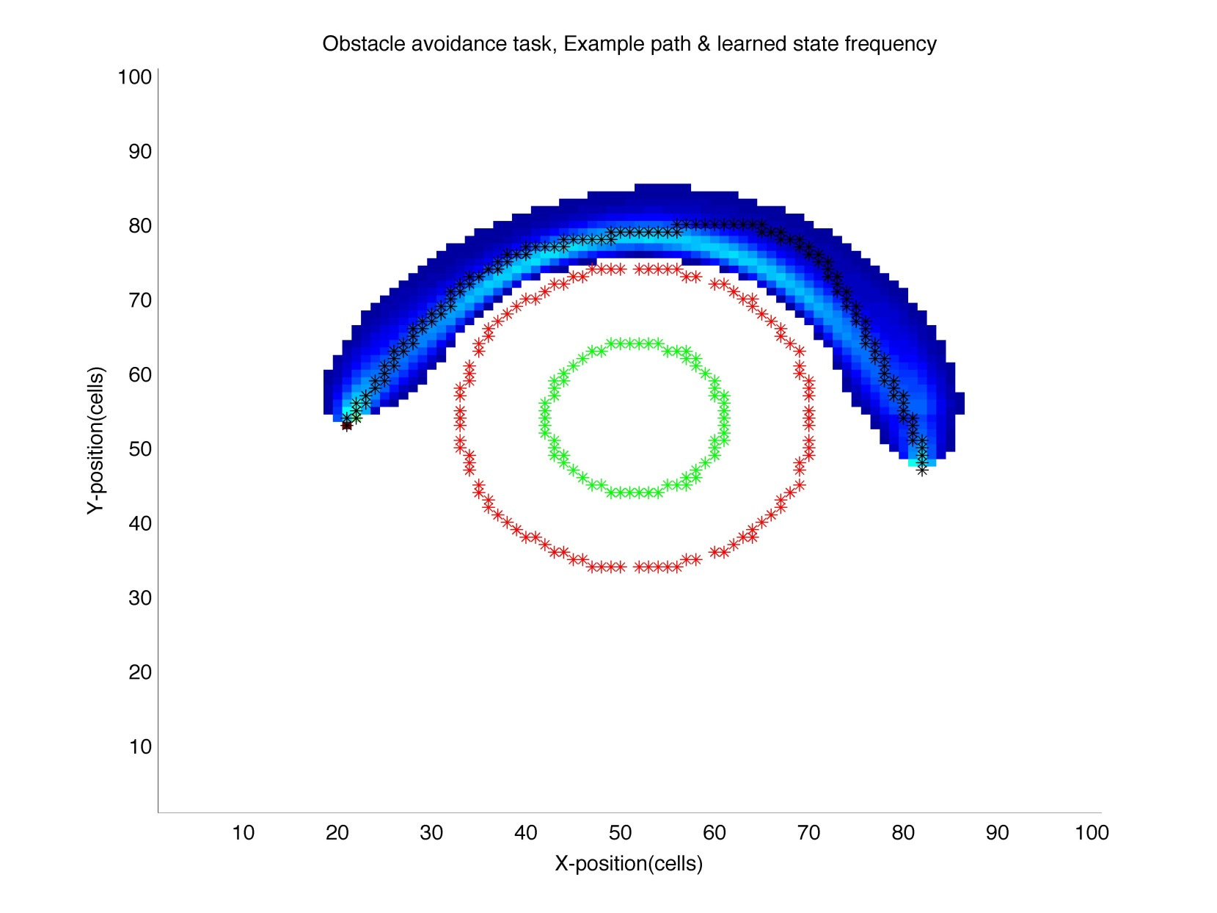
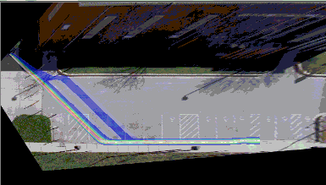
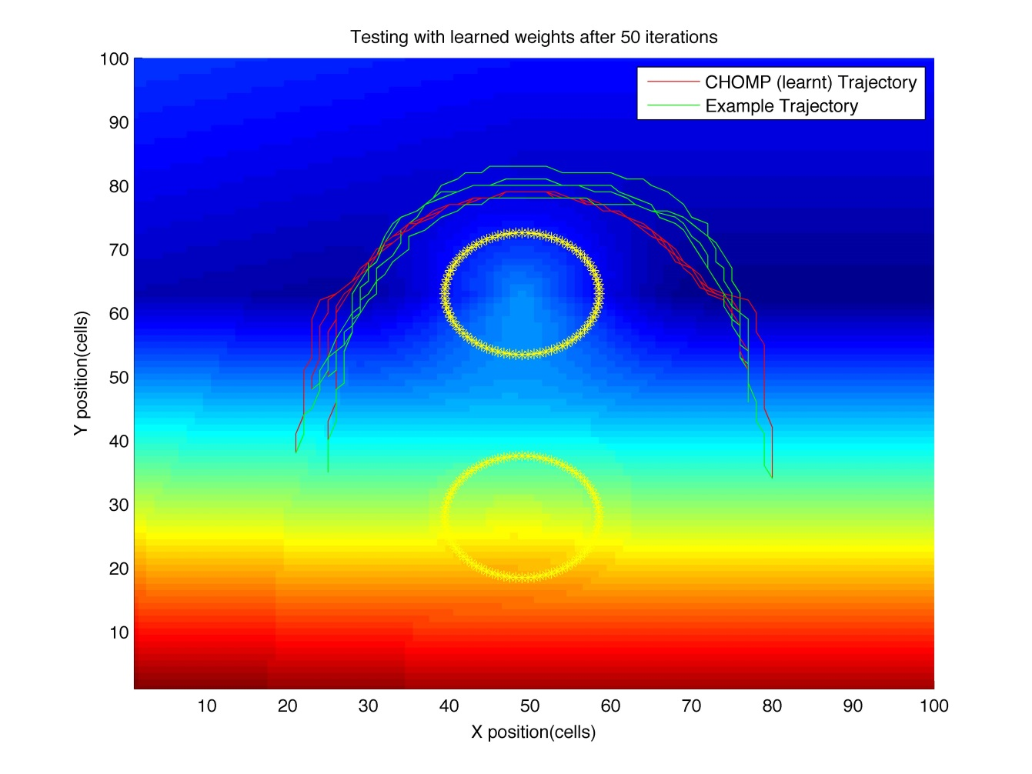
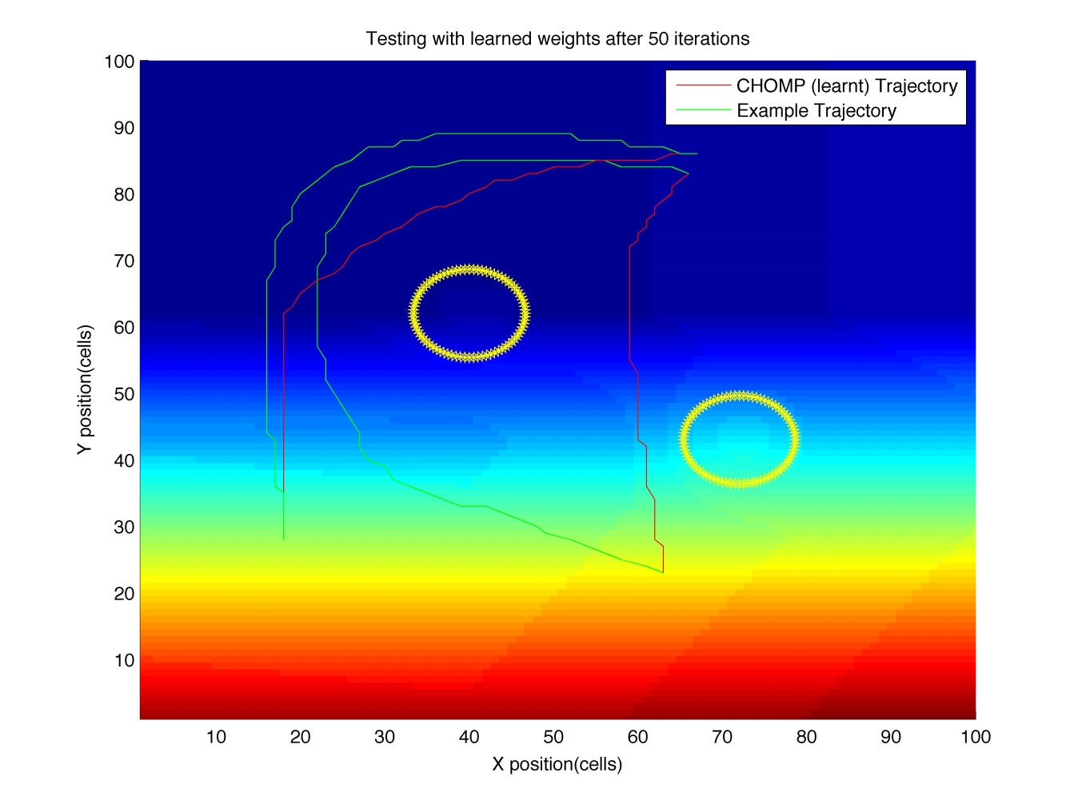
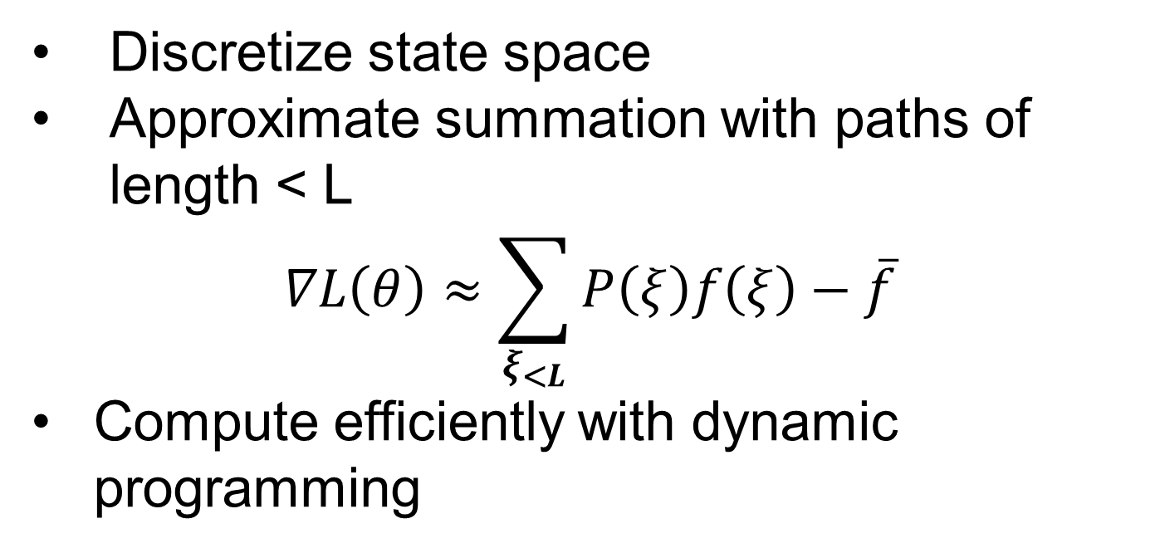
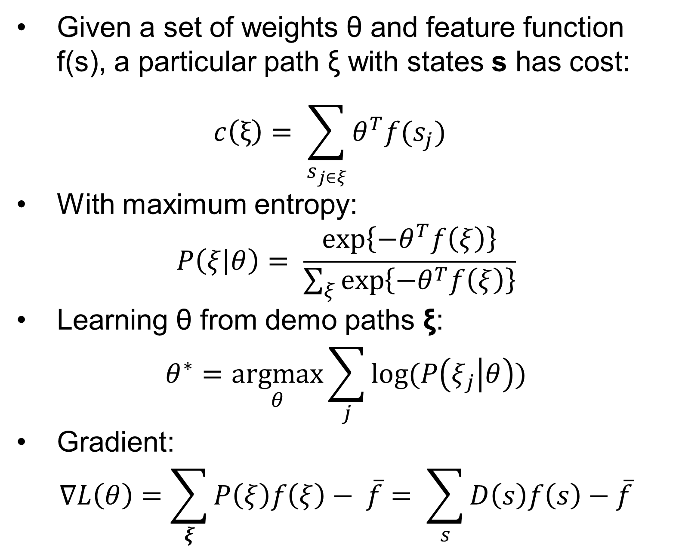
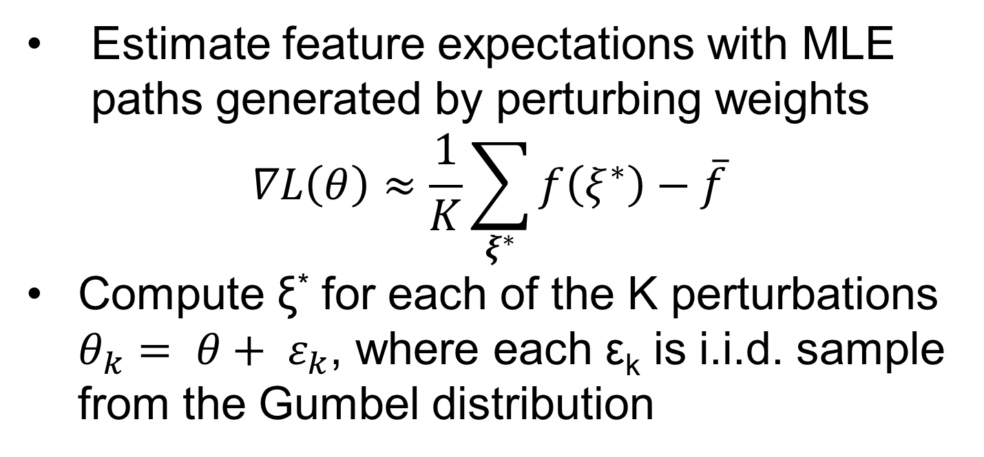
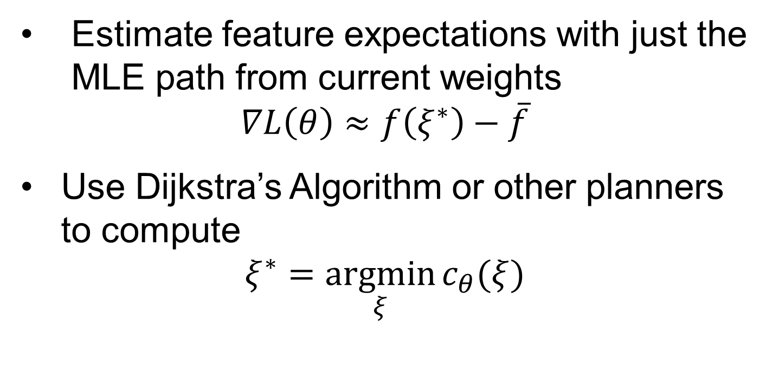
Maximum Entropy Inverse Reinforcement Learning
Background
Setup
Formulation
Inverse reinforcement learning:
Given “expert” demonstrations
Automatically imitate behavior of expert
Maximum entropy:
Problem is ill-posed with many possible solutions
Use solution which makes no more assumptions than those implied by the data
Two applications:
Manipulator obstacle avoidance
Activity forecasting
Given a set of weights θ and feature function f(s), a particular path ξ with states s has cost:
$$c\left(ξ\right)= \sum_{s_{j∈ξ}}{θ^{T}f(s_{j})}$$
With maximum entropy:
$$P\left(ξ | θ\right)= \frac{\exp\left\{−θ^{T}f\left(ξ\right)\right\}}{\sum_{ξ}{\exp\left\{{−θ}^{T}f\left(ξ\right)\right\}}}$$
Learning θ from demo paths ξ:
$$θ^{∗}=\underset{θ}{argmax}{\sum_{j}{log⁡(P\left(ξ_{j} | θ\right))}}$$
Gradient:
$$∇L\left(θ\right)=\sum_{ξ}{P\left(ξ\right)f\left(ξ\right)− \overline{f}= \sum_{s}{D\left(s\right)f\left(s\right)}−\overline{f}}$$
Methods
Problem
Forward/Backward with Discretization
Perturb and MAP
Exact gradient computation requires a sum over all possible paths, which is exponential in the size of the state space
Are there approximations to the gradient which would decrease learning time without compromising learning performance?
Estimate feature expectations with MLE paths generated by perturbing weights
$$∇L\left(θ\right)≈\frac{1}{K}\sum_{ξ^{∗}}{f\left(ξ^{∗}\right)}−\overline{f}$$
Compute ξ* for each of the K perturbations $θ_{k}= θ+ ε_{k}$, where each ε_{k} is i.i.d. sample from the Gumbel distribution
Discretize state space
Approximate summation with paths of length < L
$$∇L\left(θ\right)≈\sum_{ξ_{<L}}{P\left(ξ\right)f\left(ξ\right)}−\overline{f}$$
Compute efficiently with dynamic programming
MLE
Trade-offs
Estimate feature expectations with just the MLE path from current weights
$$∇L\left(θ\right)≈f\left(ξ^{∗}\right)−\overline{f}$$
Use Dijkstra’s Algorithm or other planners to compute
$$ξ^{∗}=\underset{ξ}{argmin}{c_{θ}(ξ)}$$
Forward/backward
Pros: Accurate approximation
Cons: Slow – O(L*|S|*|A|)
MLE
Pros: Use fast MAP solvers
Cons: Poor approximation
Perturb and MAP
In-between
Results
# of Datasets | Method | Average Euclidean Distance (m) | % of Test Paths in Collision | % of Test Paths Above Both Obstacles
1 | MLE | 0.093 | 6.6 | 81
1 | P & MAP | 0.064 | 4.167 | 91.667
5 | MLE | 0.091 | 1.042 | 88.258
5 | P & MAP | 0.062 | 0 | 95.454
1* | MLE | 0.131 | 10.653 | 65.873
3* | MLE | 0.099 | 7.628 | 86.976
5 datasets for obstacle avoidance on a 2D grid
8-15 demonstrations each
Variability in end points and obstacle positions
75-85% of each dataset for training, rest for testing
Perturb and MAP performs better than MLE
Training on multiple datasets is better than a single dataset
Training on multiple datasets generalizes better in cross-validation
Issues
Baseline forward/backward implementation
Need better feature representation
Step size for gradient descent
Motion planner needs a continuous cost function (CHOMP)
* = Train on one dataset, test on another
Future Work
Apply methods to activity forecasting
Test on a real robot manipulator (Barrett WAM)
Look at harder problems (learning spatio-temporal attributes)
Statistical Methods: CSE515
Justin Bare & Arunkumar Byravan
University of
Washington

