Slide 2
Literature Survey
Basic Citation Networks
Field Level Citation Networks
Author Level Citation Networks

Slide 3
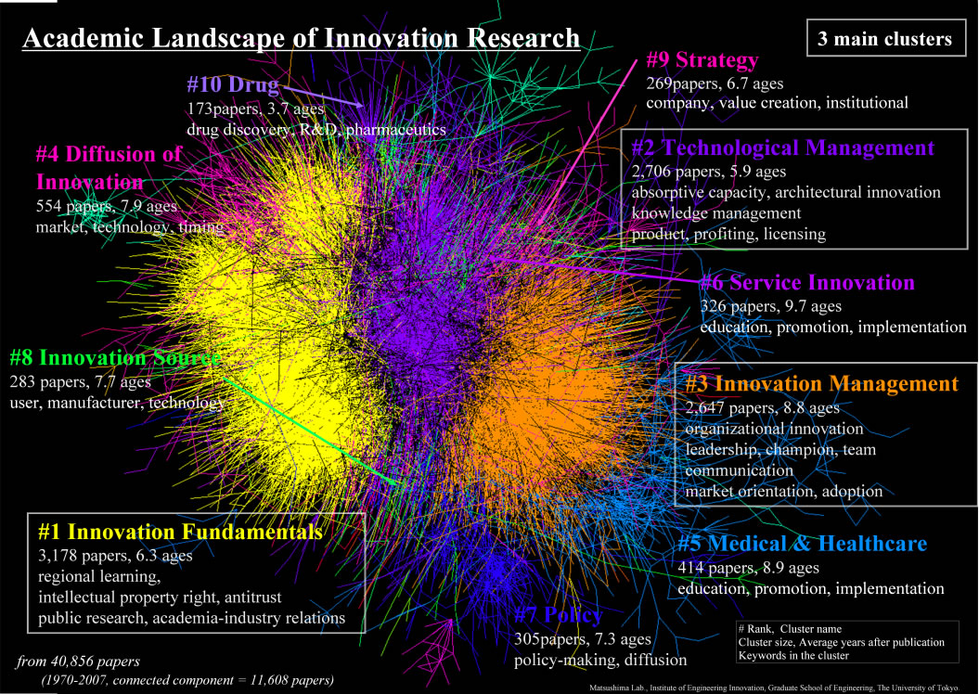
Basic Citation Networks
http://ip-science.thomsonreuters.jp/images/iifl/kajikawamap.jpg

Slide 4
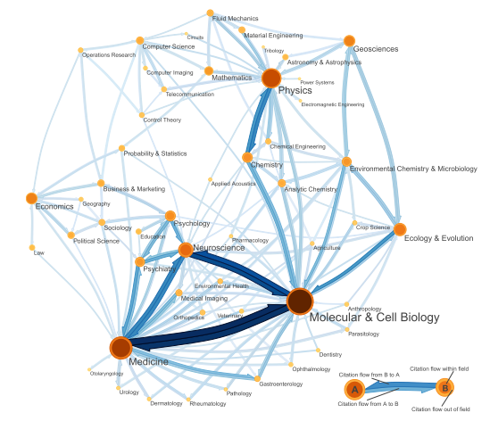
Fields Level Citation Networks
M. Rosvall and C. T. Bergstrom, “Maps of random walks on complex networks reveal community structure,” Proceedings of the National Academy of Sciences, vol. 105, no. 4, pp. 1118–1123, Jan. 2008.

Slide 5
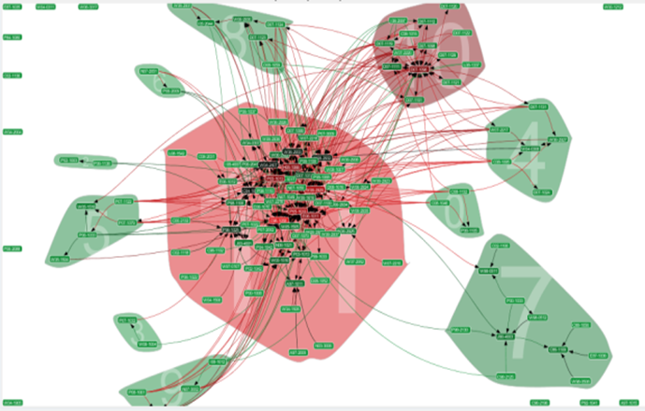
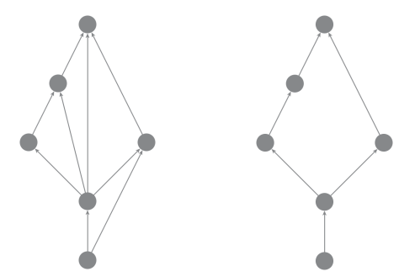
Papers Level Citation Networks
Transitive Reduction in Networks
N. J. van Eck and L. Waltman, “CitNetExplorer: A new software tool for analyzing and visualizing citation networks,” arXiv:1404.5322 [physics], Apr. 2014.

