Slide 1
Visualizing Scholarly Impact over Time
Jason Portenoy and Muhammad Raza Khan

Slide 2
Goal
Create a compelling narrative showing the influence that a particular researcher or research paper has had in scholarship.
Use a node-link diagram:
Nodes = papers
Edges = citations between papers
Watch the network develop over time.

Slide 3
Initial Progress

Slide 4
Initial Progress

Slide 5
Initial Progress

Slide 6
Initial Progress

Slide 7
Initial Progress

Slide 8
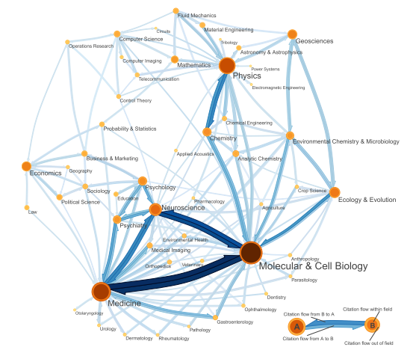
Related Work: Fields Level Citation Networks
M. Rosvall and C. T. Bergstrom, “Maps of random walks on complex networks reveal community structure,” Proceedings of the National Academy of Sciences, vol. 105, no. 4, pp. 1118–1123, Jan. 2008.

Slide 9
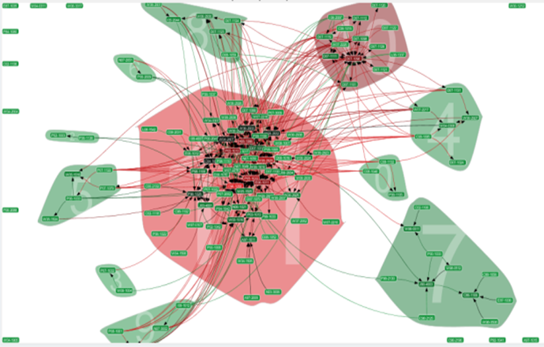
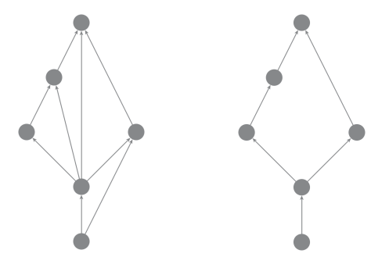
Related Work: Paper-Level Citation Networks
Transitive Reduction in Networks
N. J. van Eck and L. Waltman, “CitNetExplorer: A new software tool for analyzing and visualizing citation networks,” arXiv:1404.5322 [physics], Apr. 2014.

Slide 10
Questions for You
How to best deal with the hairball problem?
We have data on clusters (research fields) and influence (based on network structure).
Most effective ways to provide context?
Alternatives to building the network by year?

