Slide 1
Better Tools for Fault Detection, Isolation, and Recovery
Nathaniel Guy
natguy@uw.edu
May 15, 2015
University of Washington
Seattle, WA
??, 2015

Slide 2
Fault Detection
“Fault” is any sort of problem with a system
One specific type of what’s called an “anomaly” in aerospace
Many types of faults:
Off-nominal sensor readings
Off-nominal metrics calculated from various sensors
Hardware failures
Faults can be symptoms of larger root causes
Example: high current draw on wheel motor -> physical obstruction preventing wheel from turning

Slide 3
Fault Detection, Isolation, and Recovery (FDIR)
Automated fault detection system detects a fault
Sends commands/transitions vehicle state if necessary
Fault is isolated to specific part of vehicle
Triggers an alarm for human operator
Human operator evaluates alarm for root cause diagnosis
After root cause is determined (or sometimes even not), recovery steps are taken to restore operation
Much of FDIR is automated
Only complex issues require operator intervention

Slide 4
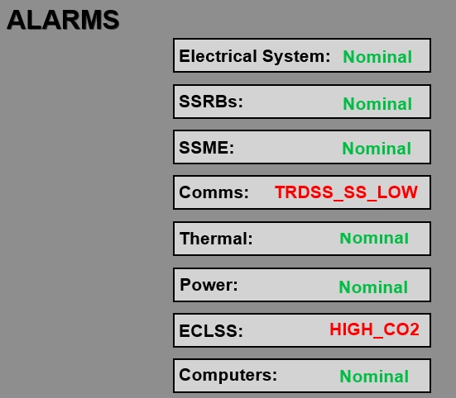
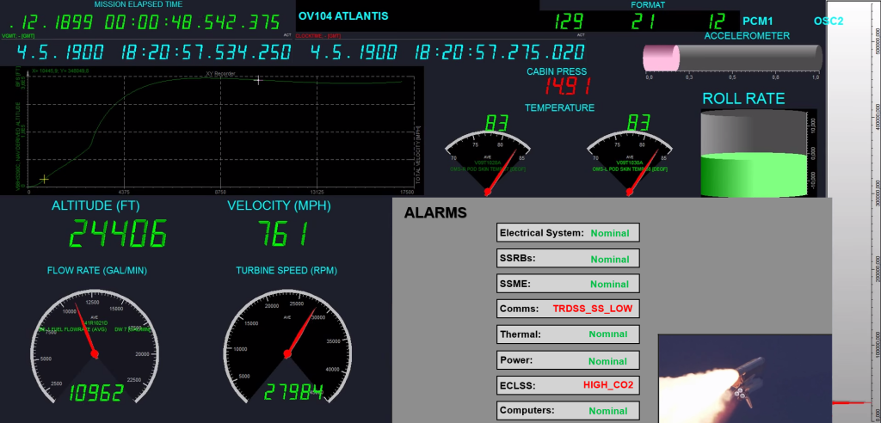
Fault Detection, Isolation, and Recovery (FDIR)

Slide 5
Model-Based Fault Detection
Build a model of normal system operation
Associate rules with particular faults
Automated recovery steps may also be associated with these faults
Example:
if (motor.current > 20A) { trigger(OvercurrentFault); }
Observer-based models and estimation models can generate new data channels that can be used
Other systems include probabilistic models, signal-processing-based models, and neural networks

Slide 6
Fault Diagnosis Difficulties
Faults are often very complex
Many faults are correlated with each other
A single fault may be caused by many possible root causes
Must discard noise and “red herrings”
Much expert knowledge is never formalized to assist with automated fault recovery
Often relies on non-captured “tribal knowledge”
Human operators often do most of the work for root cause diagnosis of in-flight anomalies in the post-mortem (slow)
SpaceX CRS-4 examples
SIGI unit
Mousetronauts

Slide 7
Getting Improved Fault Diagnosis (1)
What do we need to improve human diagnosis?
Clearly illustrate any automated alarms and their diagnoses
When automated diagnosis isn’t possible, provide diagnosis assistance
Reduce cognitive load and irrelevant data channels
Facilitate visual navigation of thousands of data channels

Slide 8
Getting Improved Fault Diagnosis (2)
Standardized encoding of data channel categories and correlations
Inform diagnosis process with embedded knowledge of control system
Automatically generate smart residuals for troubleshooting
Illustrate systems with physical analogs when possible

Slide 9
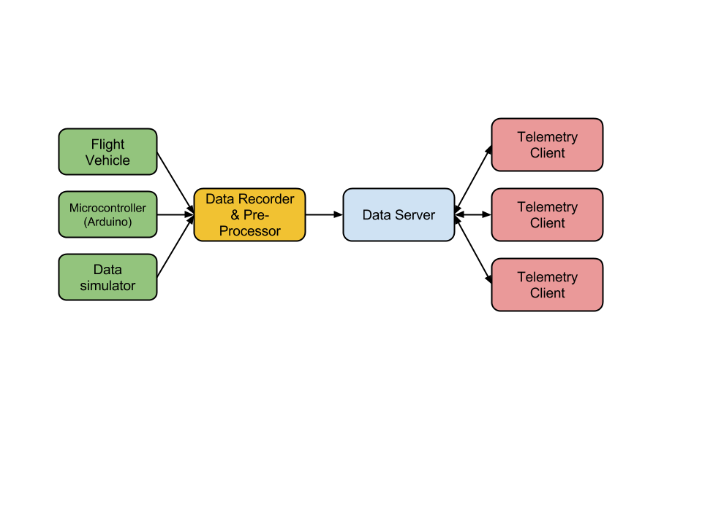
Test Setup

Slide 10
Establishing Data Correlation
Divide data into categories and sub-categories
Have meta-language for establishing relationships
In the event of a fault, cross-correlate all channels with channels involved the fault calculation
Suggest channels with higher correlations

Slide 11
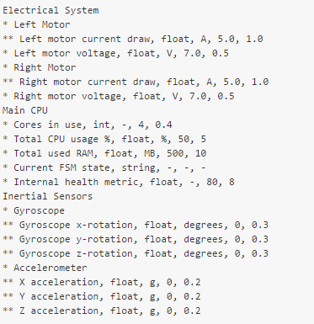

Data Channel and Alarm Metafiles

Slide 12
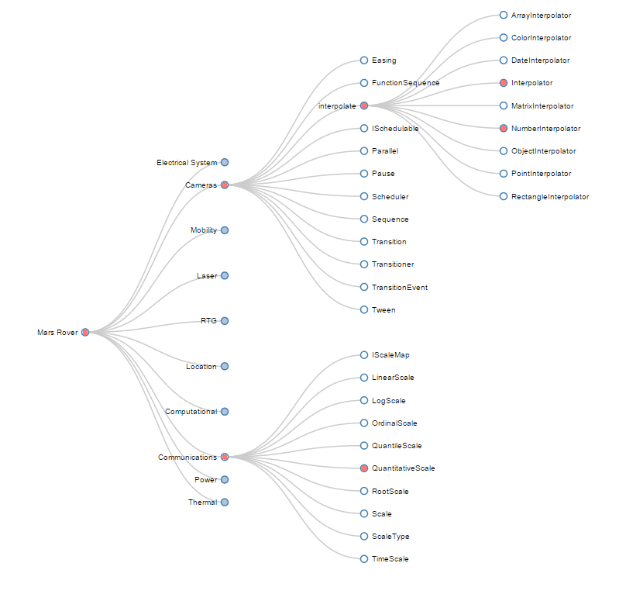
Data Navigation: Degree-of-Interest

Slide 13
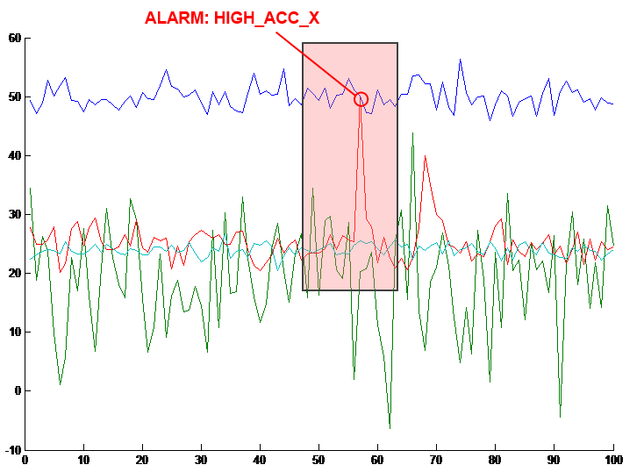
Data Navigation: Annotated Plot Events

Slide 14
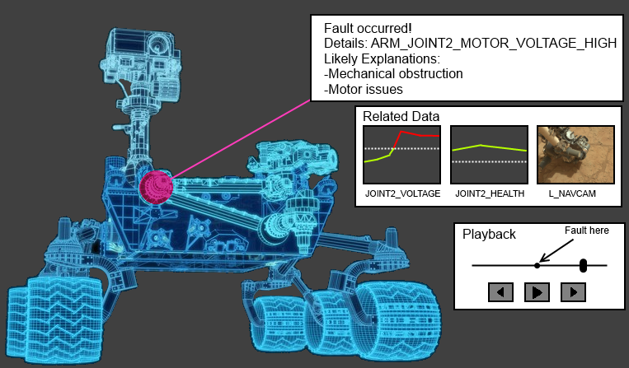
Layout / Physical Systems

Slide 15
Steps Forward
Gather opinions, suggestions
Do user interviews for various remote-operated vehicles
Build prototypes and iterate
Will be working on this in Japan from July to December

