Slide 1
S.I.E.V.E.
Statistical Interactive Explorer of Vaccine Efficacy

Slide 2
Sieve Analysis:
Vaccines as a whole are ineffective for HIV
However, new techniques show they can be effective on certain strains
Which ones???
Sieve analysis studies the similarities of the genomes the HIV in patients to the vaccine administered
Our task: create an interactive visualization to aid in exploring this data.
Working with Andrew Gartland and Allan DeCamp at Fred Hutch

Slide 3
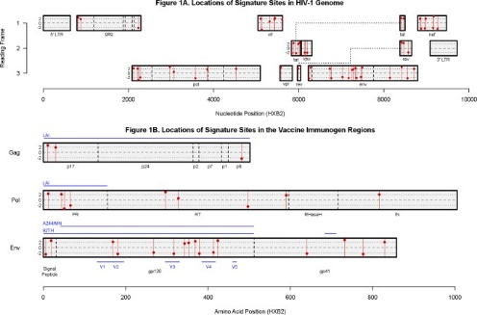
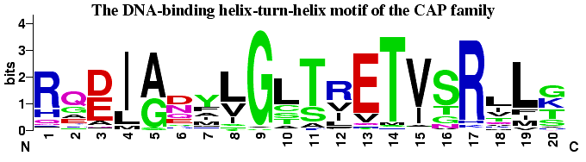
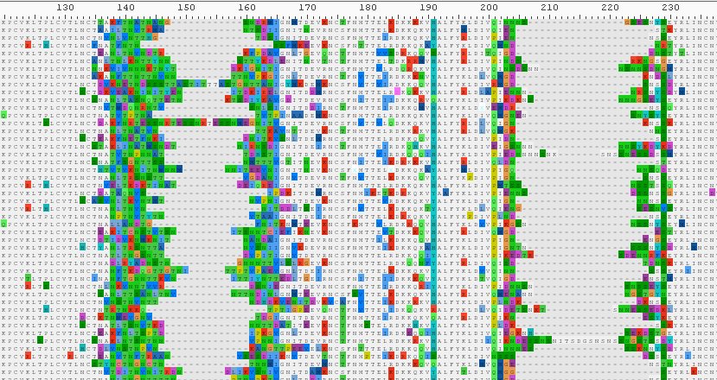

PRIOR WORK
General sequence viewers
WebLogo:
Alignment Viewers
Sieve Analysis Graphics

Slide 4
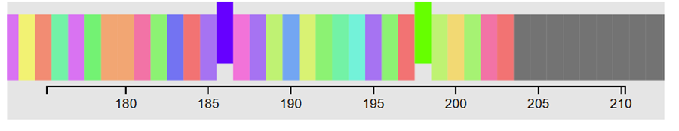
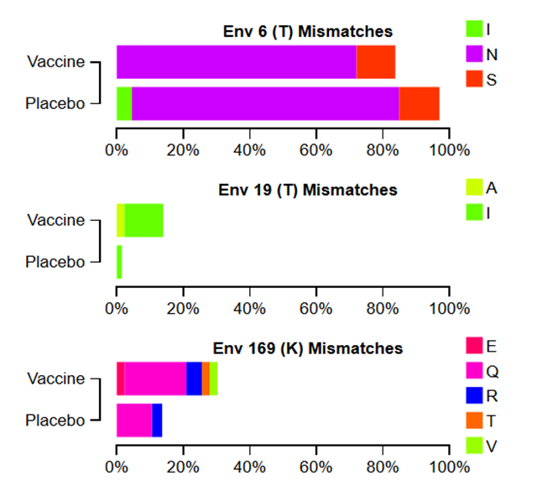
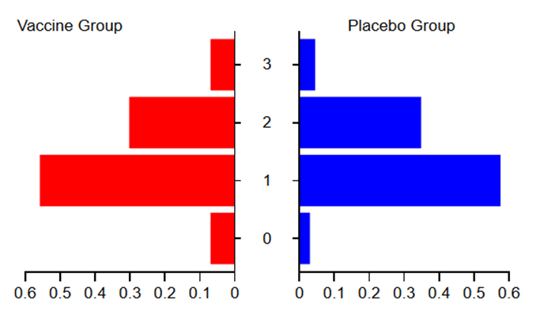
S.I.E.V.E.: 3 PARTS SO FAR
Overview Graphic/
Site Selection
Individual Site Charts
Group Statistics

Slide 5
WORKS IN PROGRESS:
Better selection
More statistics shown: visually encode statistically interesting sites to view
Allow researchers to upload their own data for other vaccine studies
Implement customization of colors, annotation of graphics, and export of images for use in sieve analysis papers

Slide 6
FEEDBACK SOLICITATION
What selection mechanism would work best for this type of data?
Data is in a very long sequence, but researchers need fine grained control
Ideally easily select multiple disconnected sequences across the genome, with ability to quickly select sequences of a specified length
Best way to export a D3 graphic to PDF format for inclusion in papers?
SVG is inconvenient for the researchers

