Slide 1
Data Mining - Checkpoint 1
RAG Based Applications
Goal: Recap the pitch, show EDA, preliminary pipeline, results and outline next steps.
(source code →)
Roopa Batavadi Shivakumar (1236446967)
Aditya Rallapalli (1236173642)

Slide 2
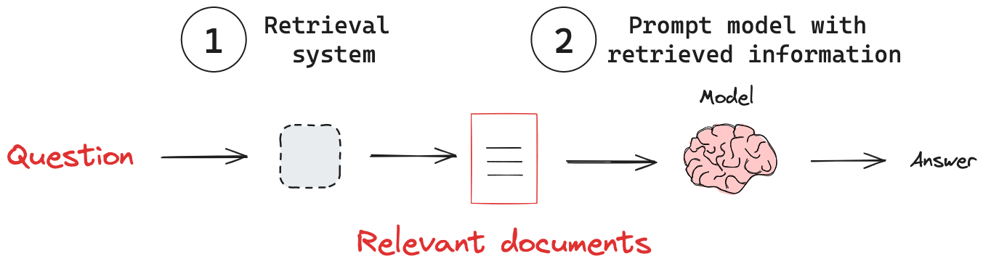
Background (What is RAG?)
RAG - Retrieval-Augmented Generation
Combines information retrieval with large language models (LLMs) to generate more accurate, grounded responses.
Why it matters:
Bridges structured + unstructured data with LLM reasoning.
Reduces hallucinations by grounding outputs in real data.
Connection to Data Mining:
  Retrieval – find relevant information efficiently.
  Ranking – prioritize the most useful results.
  Classification – organize insights into meaningful categories.

Slide 3
Motivation & Problem Statements
E‑commerce: Tons of noisy, biased reviews → need trusted, structured insight. This domain suffer from information overload, requiring intelligent retrieval and summarization.
Our task in CP‑1:
  retrieve relevant reviews,
  classify sentiment,
  and summarize topical opinions (e.g., battery life).
(Chess retained as a second domain for CP‑2 if time permits.)

Slide 4
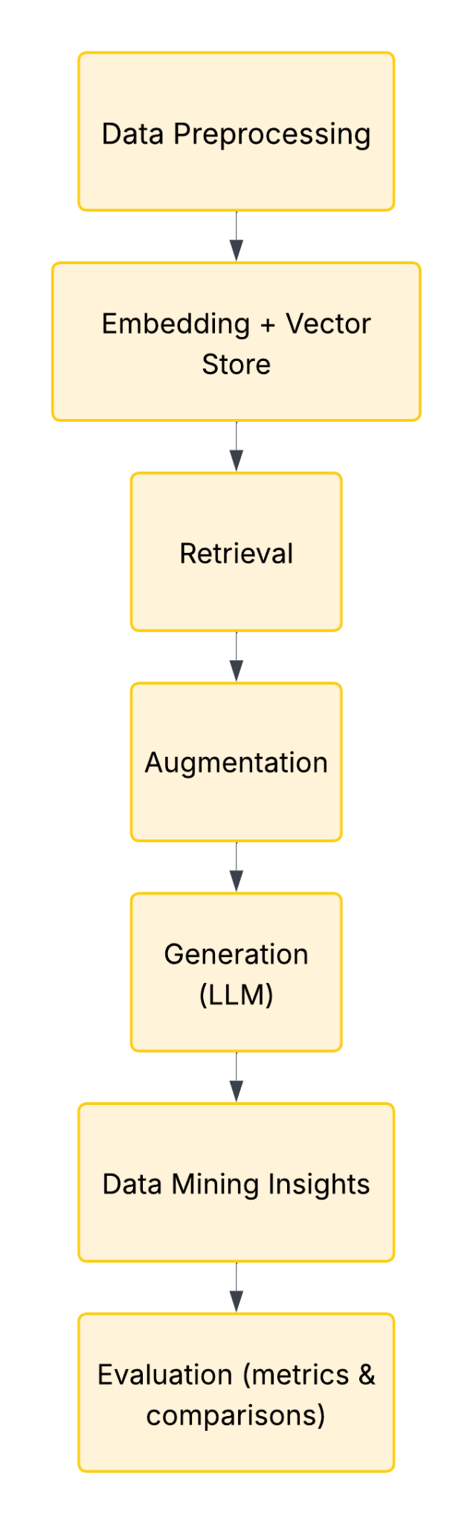
Pipeline & Evaluation (from pitch)
Pipeline: Preprocess → Embed/Index → Retrieve → Augment → (Generate) → Data‑mining insights.
Metrics: Accuracy/F1 (classification), Precision@k/Recall@k (retrieval), ROUGE/BLEU (summarization; for CP‑2).
Baseline vs Proposed: Baselines (LogReg, Linear SVC) vs RAG pipeline.

Slide 5
Dataset & Task Setup
Data: Amazon Reviews Polarity (Dataset link): 1=neg, 2=pos; titles + texts.
Sample used: 300,000 train, 100,000 test; seed=42 (for randomness).
Goal: binary sentiment (pos vs neg) + topic‑level RAG demo (no product IDs in this subset).
Amazon Reviews Polarity (Kaggle SNAP subset). Citation: Xiang Zhang, Junbo Zhao, Yann LeCun (NIPS ’15).

Slide 6
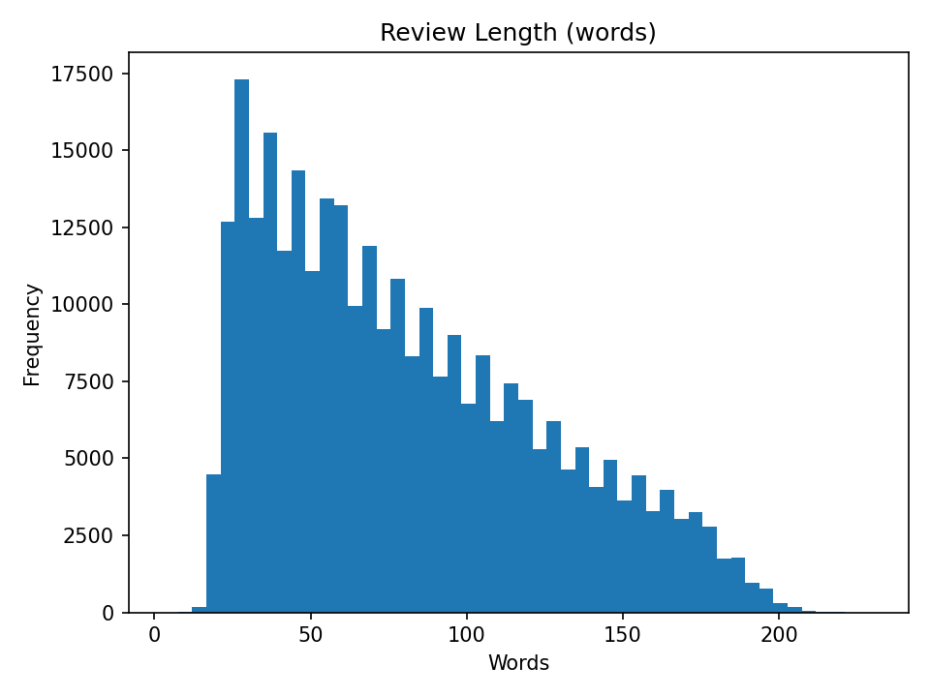
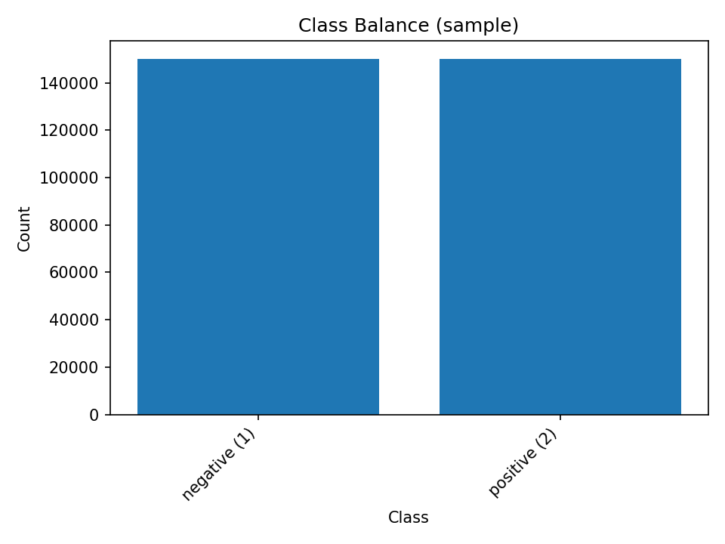
EDA: Class Balance & lengths
Balanced classes in sample: 149,970 neg / 150,030 pos.
Missing: 18 titles; duplicates: ~0.002% (negligible).
Median length: 72 words (pos 68, neg 76; negatives slightly longer).

Slide 7
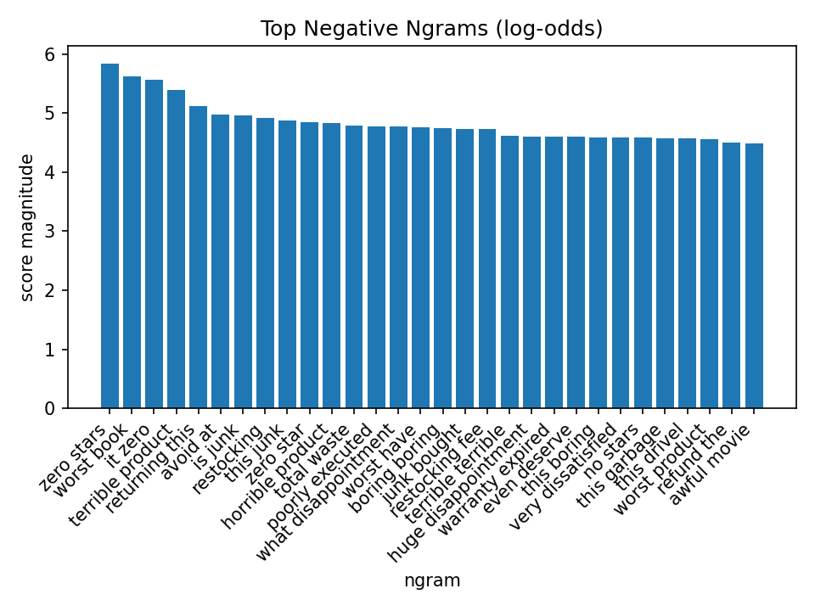
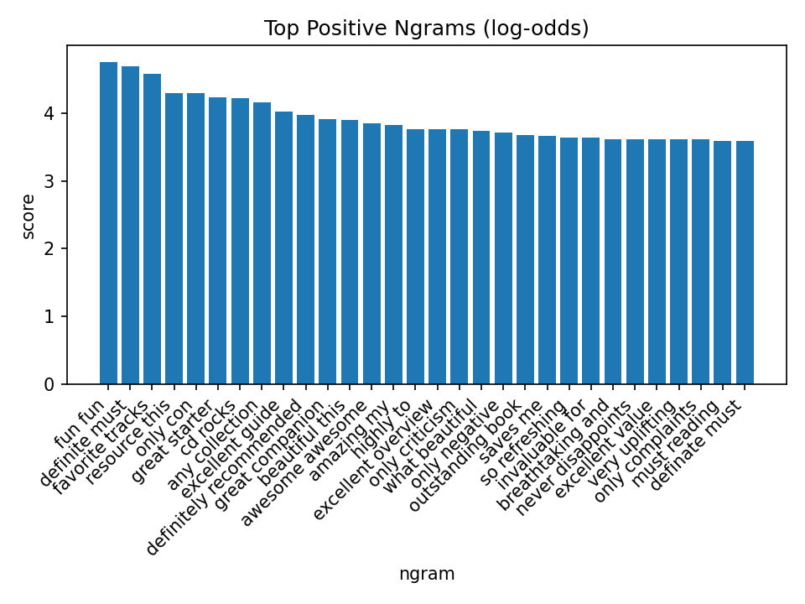
EDA: Distinctive Terms (by class)
Top discriminative uni/bi‑grams (log‑odds) separate classes well.
Confirms bag‑of‑words TF‑IDF is appropriate for a strong baseline.

Slide 8
Preliminary data-mining pipeline
Cleaning: unescape \n, lowercase, strip punctuation, collapse spaces.
Features: TF‑IDF (uni+bi), max_features=200k, min_df=5, sublinear_tf (ablation‑picked).
Baseline Models: Linear SVM, Logistic Regression (saga), Complement NB.
Train/Test: sampled official splits; pos label = 2
Reproducibility: TF‑IDF (uni+bi; max_features=200k, min_df=5, sublinear_tf=True); LinearSVC (C=0.5); LogisticRegression (saga).

Slide 9
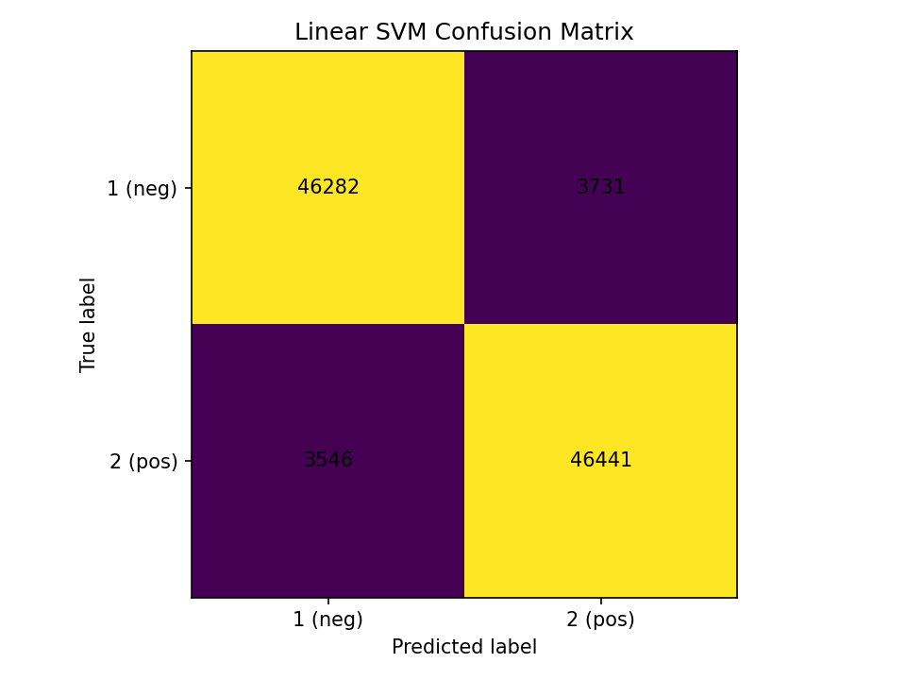
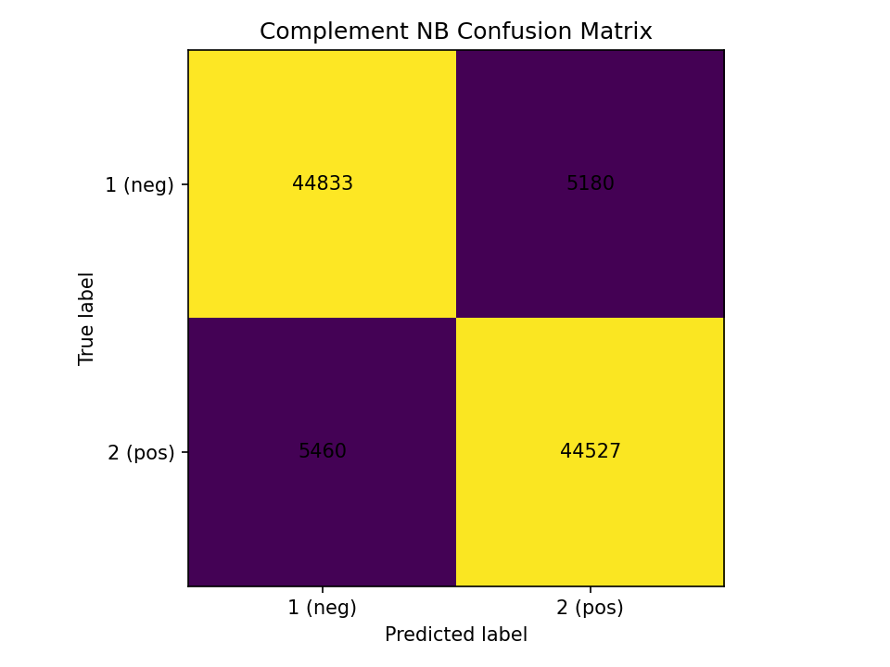
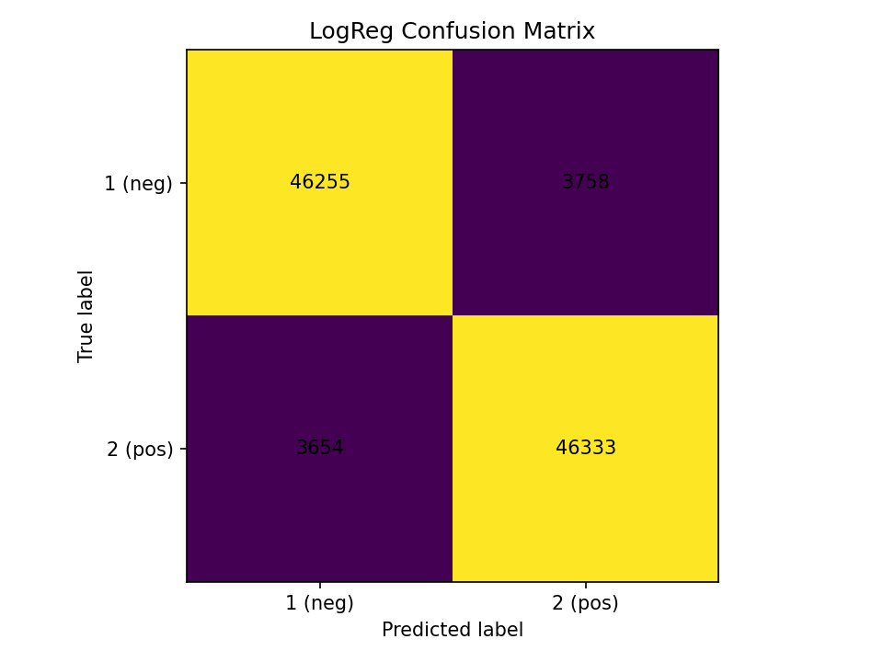
Baseline results (test = 100k)
Linear SVM: Acc 0.9272, F1 0.9273.
LogReg: Acc 0.9259, F1 0.9259, ROC‑AUC 0.9771.
Complement NB: Acc 0.8936, F1 0.8933, AUC 0.959.

Slide 10
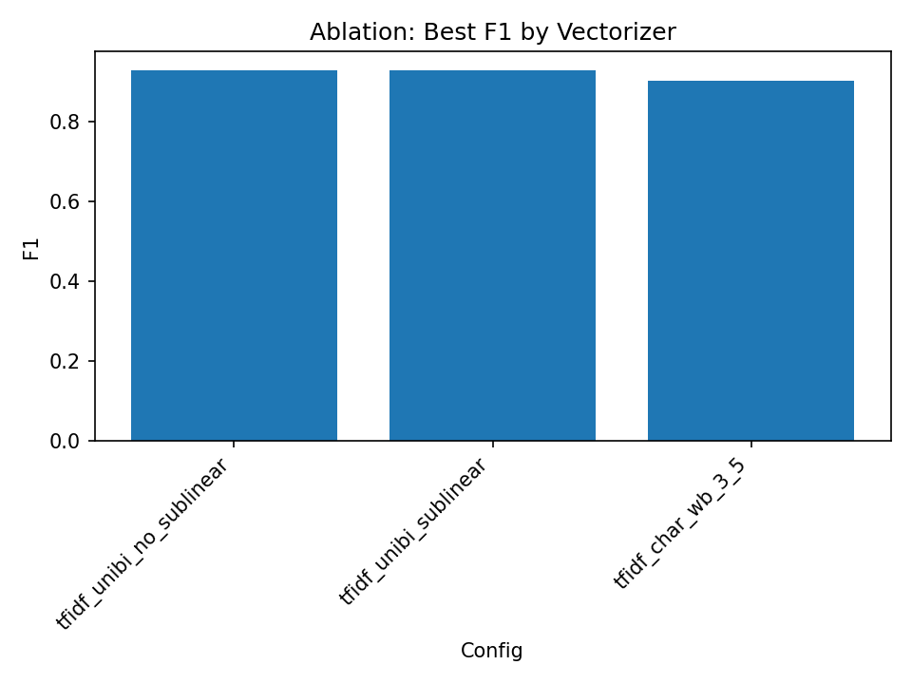
Ablation: Vectorizer tweaks
Sublinear TF → consistent bump (SVM 0.92735 → 0.92781; LR 0.92594 → 0.92657).
Char 3–5‑grams competitive but below word uni+bi here (F1 ≈ 0.90–0.903).
Decision: keep TF‑IDF uni+bi + sublinear_tf.

Slide 11
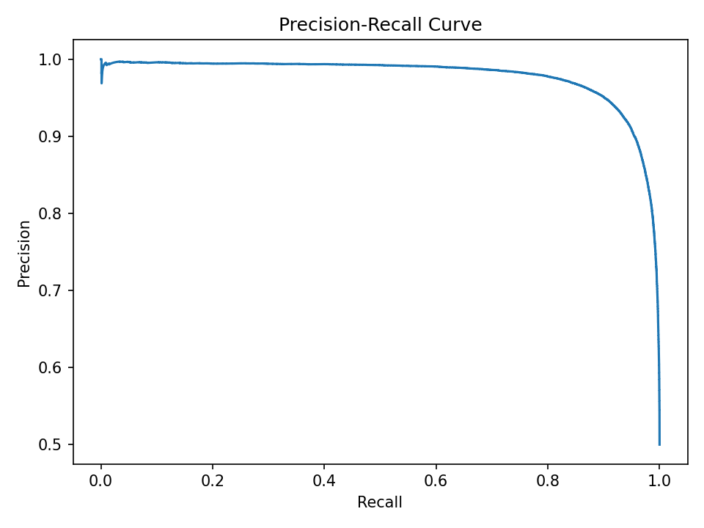
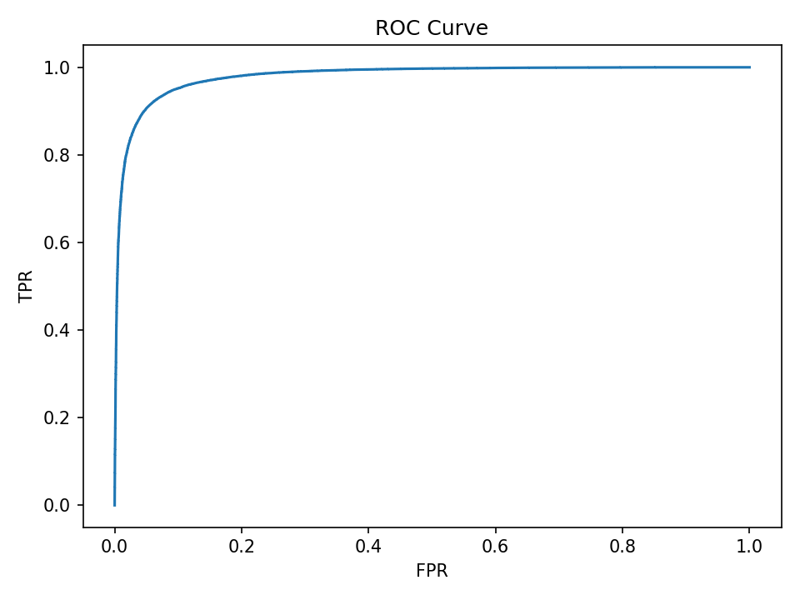
Tuned & Calibrated model
Best C = 0.5 (validation F1 0.9313).
Test (raw SVM): F1 0.9303, Acc 0.9302 (↑ from baseline 0.9273).
Calibrated: ROC‑AUC 0.9796, PR‑AUC 0.9781; F1 0.9303.

Slide 12
Error Analysis
Top false positives: overly enthusiastic wording in otherwise mixed reviews; off‑topic positives.
Top false negatives: short, terse complaints; subtle/sarcastic negatives.
Most uncertain: borderline language and mixed sentiment within the same review.
Action: add char n‑grams and expand stop‑words; consider class‑balanced thresholding with calibrated probabilities.

Slide 13
RAG prototype (classical, offline)
Q: battery life
A: too much static battery life too low like others i get a lot of of static a couple of people mentioned battery life mine gets terrible battery life very good gps except battery life i am very happy to have this gps no major complaints except one i am using it from last one month and found out that its battery life is not as good as they say it though i dont use it more then also my battery goes off in 2 to 2 5 hours while i was told that battery life will be somehwere between 4 8 hrs
Q: screen quality
A: mirror screen for iphone makes it harder to see the screen in the sunlight but it s easier to clean than the original screen or any other screen protector a really bad product it is too small for my sony clie 760c screen the edges are rounded on the screen protector while the clies screen is square leaving an uncovered area about as wide as the tip of the stylus
Issues spotted
Lexical shortcuts; noisy/misspelled inputs.
Keyword‑overlap proxy can bias P@k; we report both keyword‑only and synonym‑aware (phrase) metrics.
Extractive summaries lack paraphrase quality.
Plan
Curate qrels (10–20 queries) + write 1–2 reference bullets each → re-run 04.
Add a cross-encoder reranker (e.g., MiniLM-ce) on top of Hybrid.
Scale training set / add char n-grams for baseline gains.
Extend same RAG stack to Chess for CP-2 (PGN + commentary retrieval, opening trends, era summaries).

Slide 14
Retrieval quality (two views)
Keyword‑only proxy (literal tokens): Macro P@1 0.80, P@5 0.72 (baseline). With expansion + bigram boost under the same proxy: macro P@1 0.50, P@5 0.56 → strict literal matching under‑credits synonyms like display/panel.
Synonym‑aware (phrase) proxy: Baseline → Improved: P@1: 0.667 → 0.778, P@5: 0.578 → 0.756, P@10: 0.567 → 0.722.
Takeaway: Under fairer, phrase‑level relevance, query expansion helps; under literal‑token scoring it can appear worse. We therefore report both.

Slide 15
Qualitative examples
Screen quality: improved retrieval surfaces “display/panel/resolution” passages; summary reads more on‑topic.
Comfort & fit: needs broader phrase list (e.g., true to size, comfortable fit, runs small).
Q: screen quality
Improved: The mirror screen protector creates heavy glare, making the display hard to see in sunlight. Poor fit/edge coverage—rounded corners leave part of the screen exposed—further hurts perceived screen quality.
Q: comfort and fit
Improved: Users praise a comfortable fit and overall comfort for the earphones. The main trade‑off noted is weaker noise reduction, so comfort comes at the expense of isolation.

Slide 16
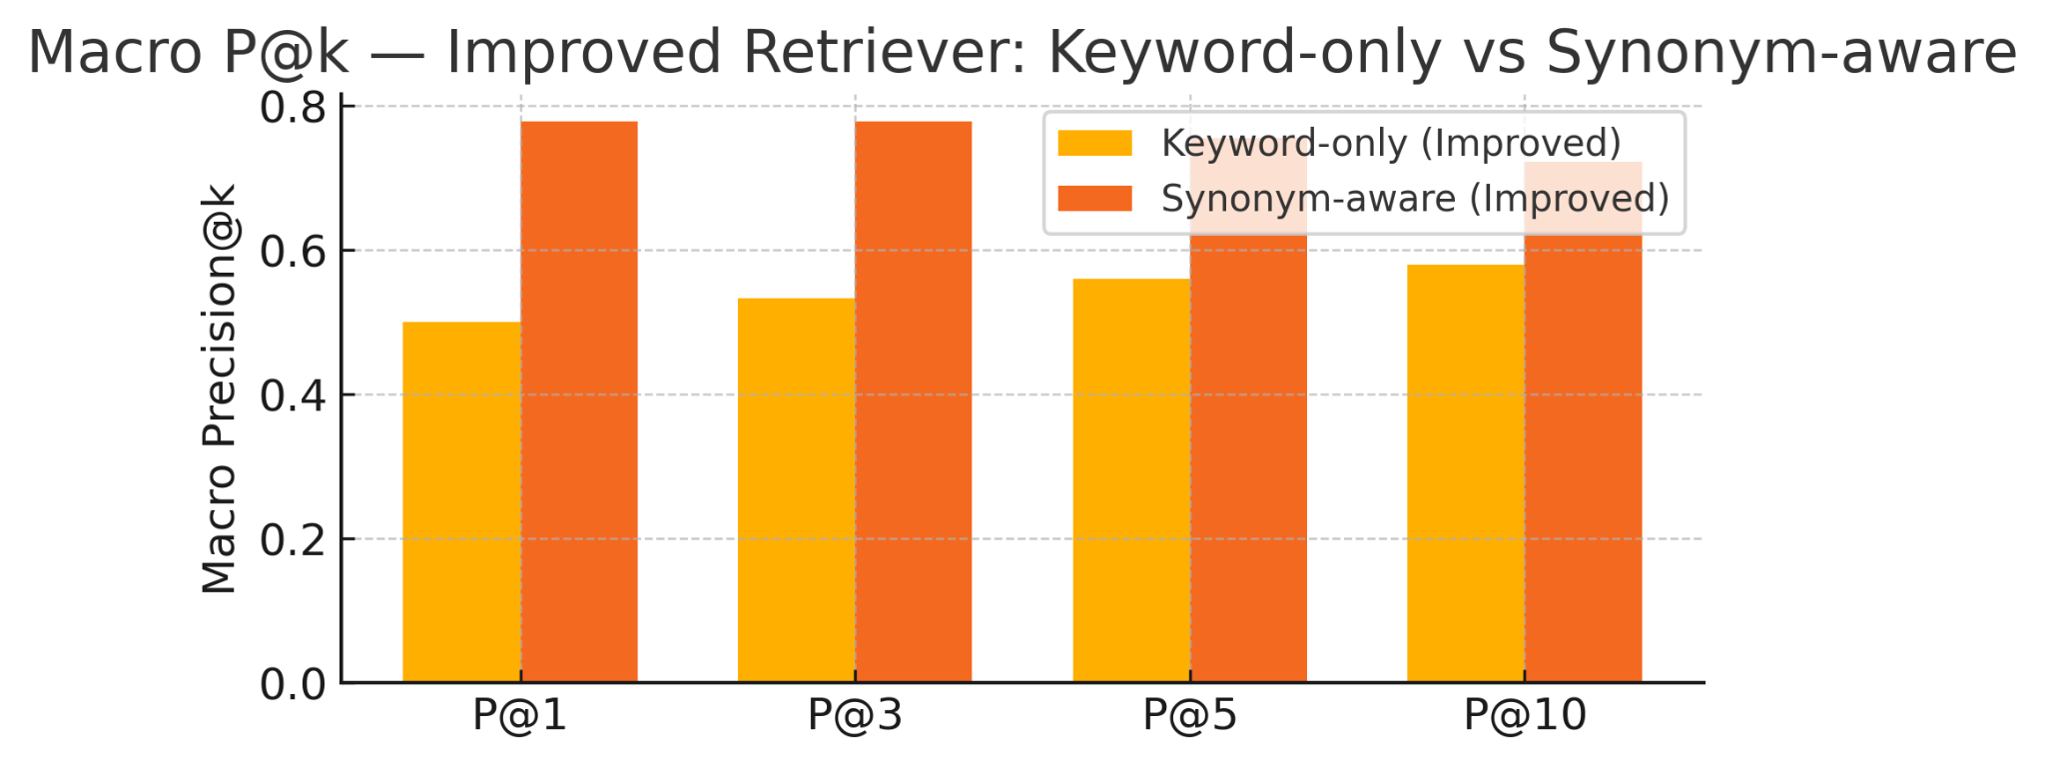
Results & Takeaways - CP1
Classification (best): Linear SVM (C=0.5) — F1 0.930, Acc 0.930; Calibrated ROC‑AUC 0.980, PR‑AUC 0.978.
Retrieval: Keyword‑only macro - P@1 0.80, P@5 0.72.Synonym‑aware (phrase) macro - P@1 0.78, P@5 0.76, P@10 0.72 (with query expansion + bigram boost).
Takeaways: TF‑IDF + linear models are strong; calibration gives reliable probabilities; classical RAG is already useful; CP‑2 will add dense retrieval (SBERT) and ROUGE for summaries (as planned in the pitch’s evaluation roadmap).

Slide 17
Threats to Validity (CP-1)
Labeling rule: Only ratings 1–2 (neg) and 4–5 (pos) are used; 3‑star reviews are excluded → class separation may be slightly cleaner than in the wild.
Temporal scope: Data up to 2013; language drift may affect generalization to newer reviews.
No product IDs in the polarity subset → we demonstrate topic‑level RAG, not per‑product opinion mining.
Proxy relevance: Keyword‑only scoring favors literals; we therefore add synonym‑aware (phrase) scoring to reduce bias.
Compute constraints: We used TF‑IDF+Linear SVM for speed/scale; deep baselines deferred to CP‑2.

Slide 18
Issues & Next steps (CP-2)
Issues (today):
Kaggle polarity subset has no product IDs → only topic‑level RAG.
Keyword‑only proxy is too strict; synonym coverage incomplete for some queries.
Compute constraints limit features/models at full scale.
Plan (from pitch + CP‑2 focus):
Dense retrieval (e.g., SBERT) + query expansion; refine synonym/phrase dictionaries.
Abstractive summaries with ROUGE; keep calibrated classifiers for decision thresholds.
Stretch: simple web app demo (per pitch “Future Plans”).

Slide 19
Thank you, see you in CP2

