Slide 1
Week 1: Intro + HTML
CSEC WEB DIVISION

Slide 2
Goals as a club
No previous programming experience needed
Tailoring our lectures to everybody, regardless of major
Allow everyone to work at their own pace
Help you create your own personal site starting today
Hosting your site on the internet
Covering Web Technologies
HTML and CSS
Front End Frameworks: Bootstrap
Javascript, Etc.
Long-term goal: Responsive, dynamic personal website
Tip: Bring your own laptop along with you so you can code alongside us in class!

Slide 3
Goals for today
Learn about Web Dev terminology
Learn the basics of HTML
Creating your first website in HTML
Setting up your own GitHub Repository

Slide 4
Setting up
Install Brackets from http://brackets.io/, and create a new file
Make a GitHub account at https://github.com/join
Download Git: https://git-scm.com/downloads

Slide 5
Web Development
An introduction

Slide 6
How do websites work?
The simple answer: CODE!
Separated into two parts: Frontend and Backend
Frontend: What’s being seen on the user’s screen, the code that visualizes information
Ex: HTML, CSS
Backend: What’s going on in the background, generating the information being displayed
Ex: Javascript, Flask, .NET
Frontend and Backend in conjunction lead to a responsive, dynamic website

Slide 7
Introduction to HTML

Slide 8
What is HTML?
Hypertext Markup Language, made in 1991 by Tim Berners-Lee
Currently on its fifth iteration (HTML5)
Not compiled, made to control the Presentation of information
“How can I display this text?”, “Where can I display this text?”
It cannot generate the information being displayed, only act as a conduit for displaying it.
Without a backend feeding it information, it can only display code that is hardcoded in

Slide 9
Markup Languages vs. Programming Languages
What differentiates a languages like HTML from a language like Python?
Markup | Programming/Scripting
Controls the Presentation of structured data | Controls the Generation/Modification of data
Syntax uses angled brackets and tags | Syntax can vary, but almost never uses brackets and tags

Slide 10
HTML: The Markup
Everything’s done with tags, starting with and ending with angled brackets
Ex: <p></p>
Your Content goes in between these tags
Ex: <p>This is an example of content</p>
An Element is a start and end tag, plus the content within.
Comments are done by putting them in between “<!—” and “-->”
Ex: <!-- This won’t run, and is used to document your code -->

Slide 11
Your basic document
Defines/starts the file
<!DOCTYPE html>
<html>
<head>
<meta charset="utf-8"/>
<title>Sample Title</title>
</head>
<body>
Insert your information here
</body>
</html>
The tag that wraps your code
The head, this is where non-presentable info like the page title and scripts go.
Where your displayable info goes

Slide 12
HTML Tag Types
Tag | What it does
<h1> <h2> <h3> | Headers (<h1> is the biggest, with subsequent tags being smaller in size)
<p> | Paragraphs – Creates a block of text
<img> | Image – Inserts an image
<a> | Anchor – Usually used when hyperlinking
<ul> | Unordered list
<ol> | Ordered list
<li> | List item – Used in relation with <ul>
<div> | Block container – Creates a container within which you store your code

Slide 13
Using tags in an example
<!DOCTYPE html>
<html>
<head>
<meta charset="utf-8"/>
<title>Sample Title</title>
</head>
<body>
<h1>Special Bulletin Announcement</h1>
<h3>By John Smith</h3>
<div>
<p>Here are some items:</p>
<ul>
<li>Feature 1</li>
<li>Feature 2</li>
<li>Feature 3</li>
</ul>
</div>
</body>
</html>
Given the following code snippet, what will this display?
Remember:
<h1>/<h3>: Headers
<div>: Block Container
<p>: Paragraph
<ul>: Unordered List
<li>: List element

Slide 14
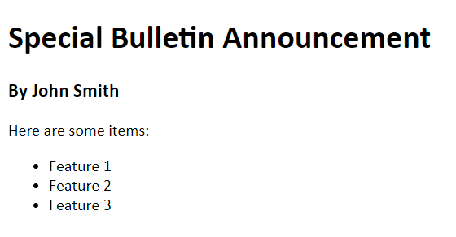

Slide 15
Looks Pretty bland, doesn’t it?

Slide 16
Next week: CSS

