Slide 1



Department of Computer Science and Engineering
Project Phase – II (18CSP83)
Review – 1
FACE MASK DETECTION
Group No.: G3 Batch No.: 2021_CSE_11
1KS18CS121 YASHWANTH K
1KS18CS101 SUDHAKAR YASWANTH
1KS18CS070 PRATEEK HAVALE
1KS18CS118 VINOD H MALALI
Guided By:
Mrs. Pavithra J
Assistant Professor
Dept of CSE, KSIT

Slide 2
Contents
Introduction
Comparison with similar work
Problem Statement and Objectives
Methodology Proposed/ Design
Technologies / Tools Used
Implementation of Modules with codes
Snapshots
References

Slide 3
Introduction
Coronavirus disease 2019 (COVID-19) has globally infected over 5.1 billion people causing over 6.2 million deaths.
Individuals with COVID-19 have had a wide scope of symptoms reported – serious illness.
Fever, dry cough, tiredness, loss of taste and smell are the major symptoms of coronavirus.
Respiratory problems like difficulty in breathing.
Elder people having lung disease can possess serious complications from COVID-19 illness as they appear to be at higher risk.

Slide 4
Cont…
Many precautionary measures have been taken to fight against coronavirus. Among them cleaning hands, maintaining a safe distance and wearing a mask.
In order to protect ourselves from the COVID-19 Pandemic, every one of us should wear a face mask.
It becomes necessary to check if the people wear face mask in most public gatherings such as School, College, Malls etc.
This model can be used to develop a full-fledged software to scan every person before they can enter the public gathering.

Slide 5
Comparison with similar work
SL NO | TITLE OF THE PAPER | AUTHOR | JOURNAL AND PUBLICATION YEAR OF PAPER | METHODOLOGY | LIMITATIONS
1 | Covid-19 Face Mask Detection Using TensorFlow, Keras and OpenCV | 1.Arjya Das 2.Mohammad Wasif Ansari 3.Rohini Bask | IEEE 2020 | The proposed method consists of a cascade classifier and a pre-trained CNN which contains two 2D convolution layers | It can detect if a person is wearing the mask or not.
2 | Detection of Face Mask using Convolutional Neural Network | 1.Riya Chiragkumar Shah 2.Rutva Jignesh Shah | IEEE 2021 | Used the MobileNetV2 of convolutional neural network for detection of mask. | Dataset size 2k images. 99% precision and 99% recall this may lead to overfitting problem.

Slide 6
Comparison with similar work
SI NO | TITLE OF THE PAPER | AUTHOR | JOURNAL AND PUBLICATION YEAR OF PAPER | METHODOLOGY | LIMITATIONS
3 | Face Mask Detection on Real-World Webcam Images | 1.Eashan Adhikarla 2.Brian D. Davison | IEEE 2021 | Used Yolo V5 Model to detect mask | Yolo V5 needs high computational devices to train and predict the images.
4 | Real Time Face Mask Detection and Recognition using Python | 1.Roshan M Thomas 2.Motty Sabu 3.Tintu Samson | IJERT 2021 | Used CNN to detect face mask. | Uses classification not object detection.

Slide 7
Problem Statement
“In order to protect ourselves from the COVID-19 Pandemic, almost every one of us tends to wear a face mask. It becomes increasingly necessary to check if the people in a crowd wear face masks in public gatherings such as Malls, Theaters, and Parks. The development of a solution to detect if the person is wearing a face mask and allow their entry would be of great help to society.”

Slide 8
Objectives
To effectively provide a working model for accurate face mask detection.
Classification of real time face images as With and Without Mask.
Increasing the number of images in Dataset in order to improve the Accuracy of the model.
Optimization of the algorithm to capture and detect With and Without Mask Faces in real time.

Slide 9
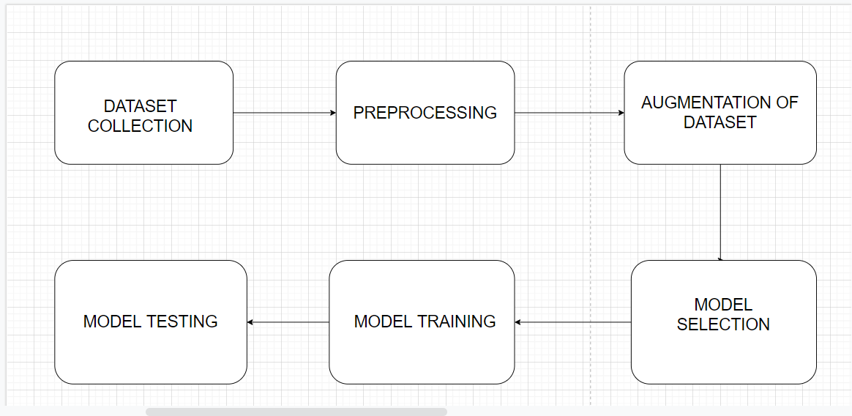
Methodology Proposed / Design

Slide 10
Methodology Proposed / Design
Dataset: Collected from GitHub repository and kaggle.
Preprocessing : Labelling, Resize done using Roboflow.
Augmentation : Increases the size of data.
Model Selection : YoloV4-tiny
Model Training : Used Darknet
Model Testing

Slide 11
Technologies / Tools Used
Google Colab
Python
YOLO V4 Tiny
Darknet
Webcam
Windows OS

Slide 12
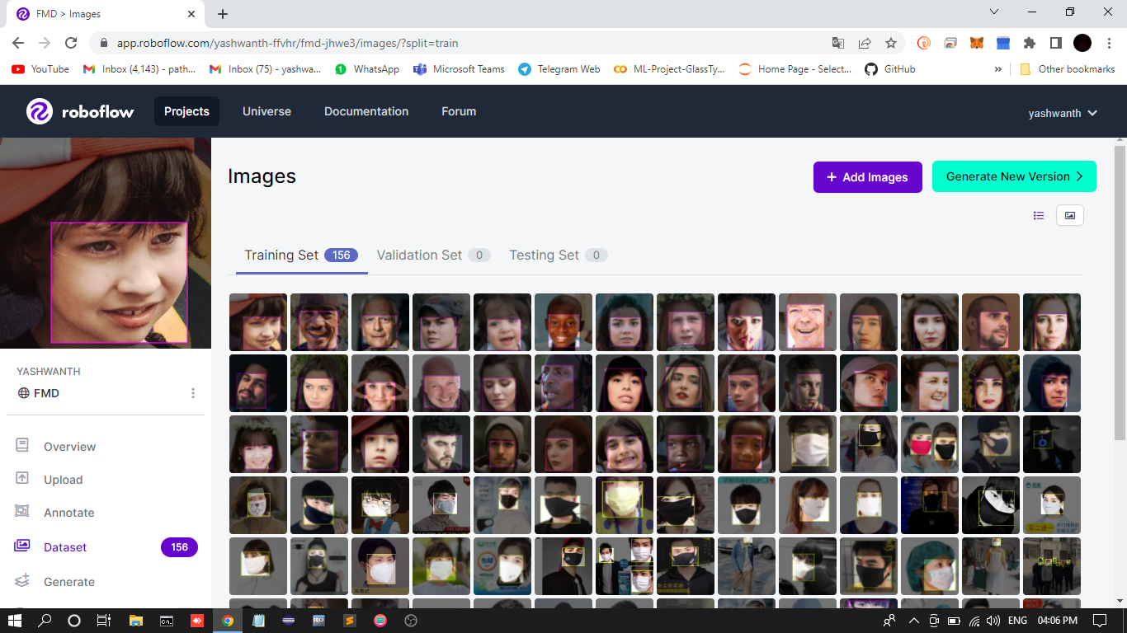
Implementation of Modules with codes

Slide 13
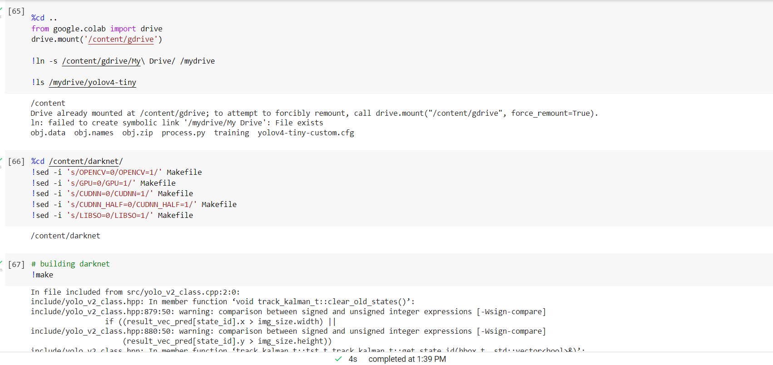
Implementation of Modules with codes

Slide 14
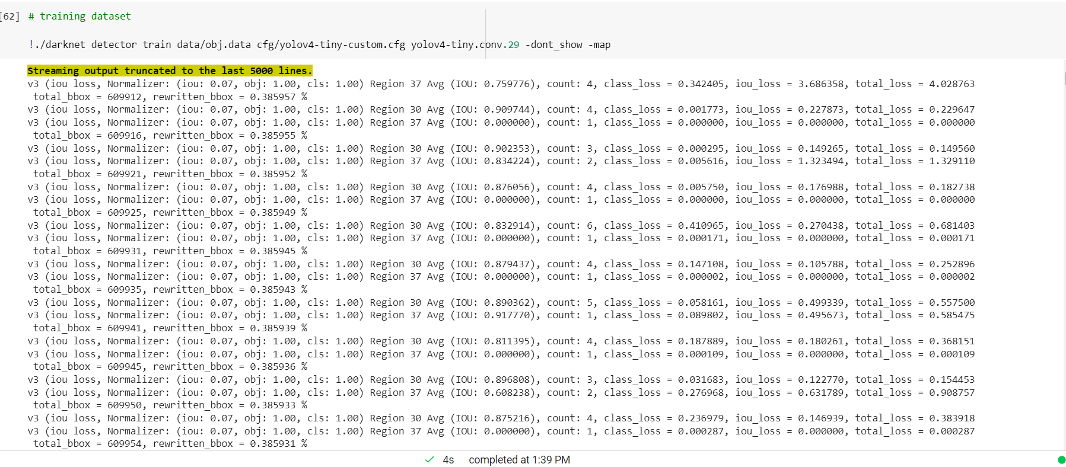
Implementation of Modules with codes

Slide 15
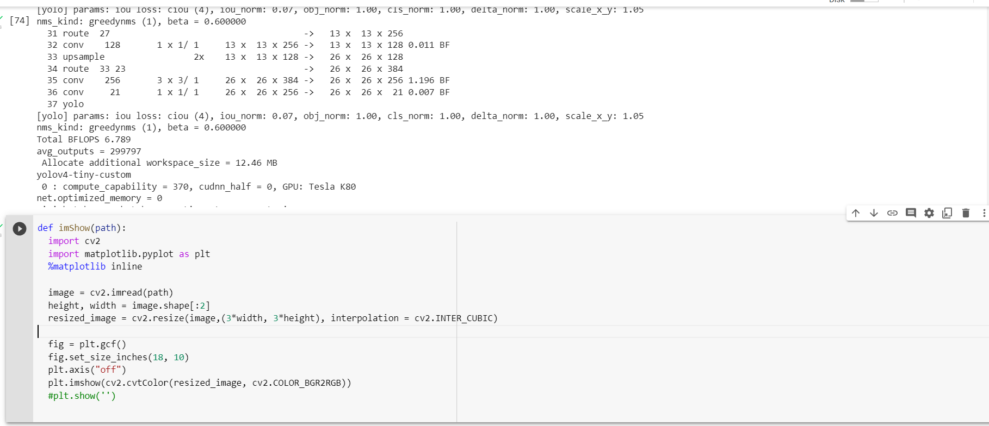
Implementation of Modules with codes

Slide 16
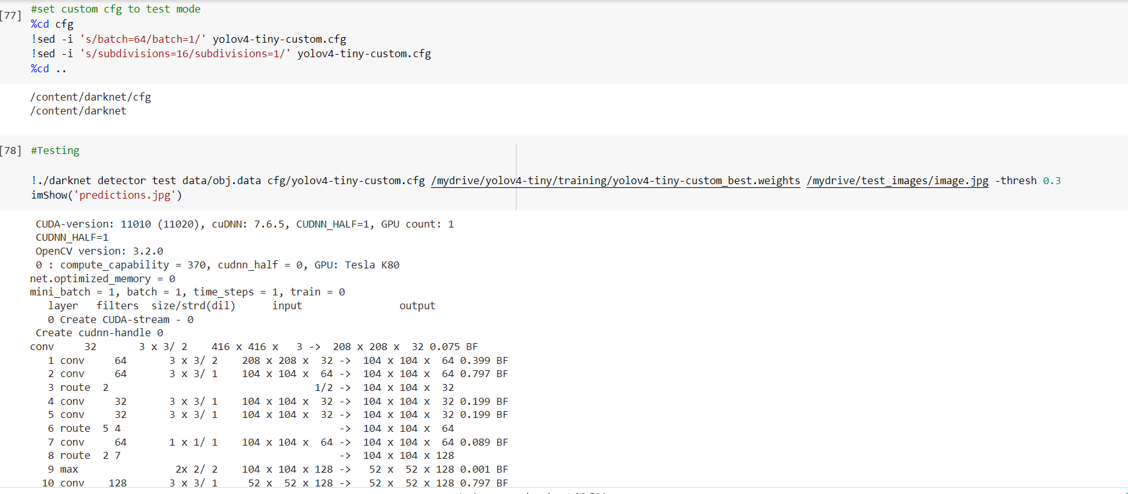
Implementation of Modules with codes

Slide 17
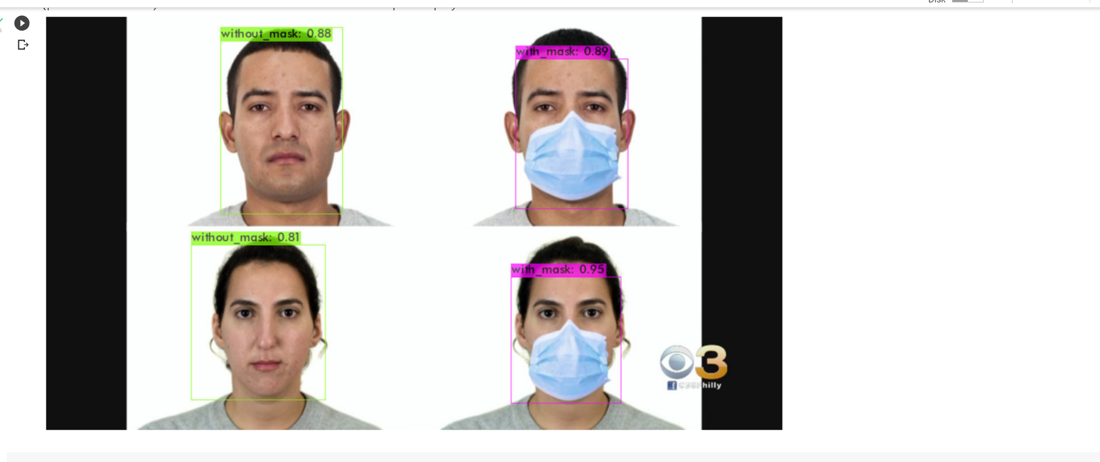
Snapshots

Slide 18
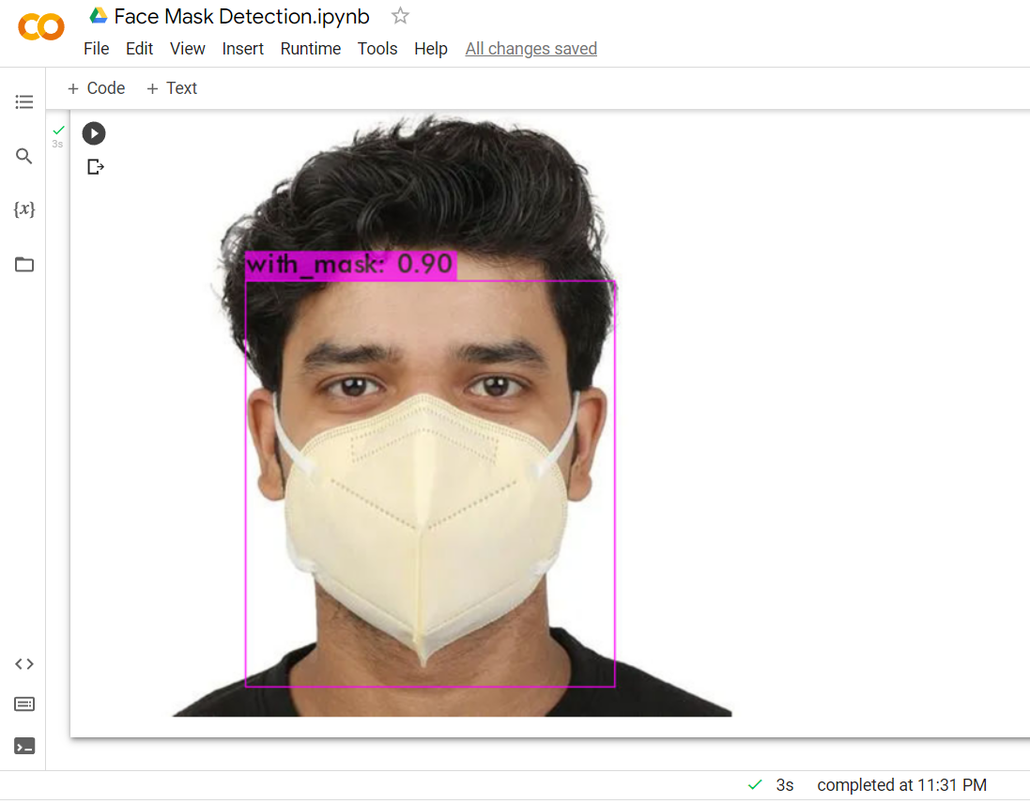
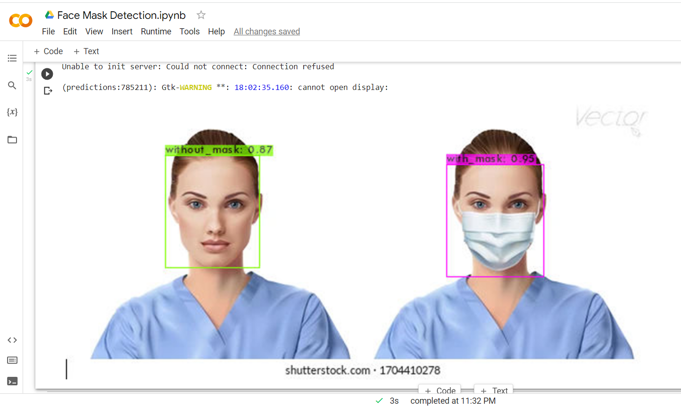
Snapshots

Slide 19
References
https://www.kaggle.com/datasets
https://roboflow.com/
[1] Arjya Das, Mohammad Wasif Ansari, Rohini Basak “Covid-19 Face Mask Detection Using TensorFlow, Keras and OpenCV”, IEEE 17th India Council International Conference (INDICON), 2020
[2] Riya Chiragkumar Shah, Rutva, “Detection of Face Mask using Convolutional Neural Network”, arXiv, 10th June 2021
[3] Eashan Adhikarla Brian, D. Davison “Face Mask Detection on Real-World Webcam Images” ACM ISBN 978-1-4503-8478- 0/21/09, 2021, pp 139-144. https://dl.acm.org/doi/10.1145/34622033475903
[4] Roshan M Thomas, Motty Sabu, Tintu Samson, Shihana Mol B, Tinu Thomas “Real Time Face Mask Detection and Recognition using Python”, IJERT, 2021, pp 57-62.

Slide 20


