Slide 1
IMPLEMENTATION OF PARSEING AND TREE GENERATION
NAME : MD. SHANEWAZ AKIB
ID : 2016-3-60-050
NAME : SHAHARIAR BHUIYAN
ID : 2015-3-60-006

Slide 2
What is Grammar ?
Terminal and nonterminal symbols are the lexical elements used in specifying the production rules constituting a formal grammar.
Terminal symbols are the elementary symbols of the language defined by a formal grammar.
The CFG(Context-Free-Grammar) is not only used to define the syntax of a programming language, it is also used as input to compiler writing tools.

Slide 3
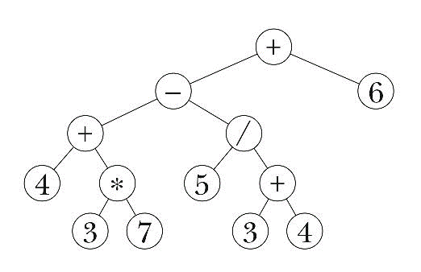
Parsing and Parsing Tree
A parse tree is an entity which represent the structure of derivation of a terminal string from non-terminal.
A parse tree or parsing tree or derivation tree or concrete syntax tree is an ordered, rooted tree that represents the syntactic structure of a string according to some context-free grammar.
A grammar is ambiguous if it can produce two different parse trees for the same string.

Slide 4
Grammar for Calculator
grammar program ;
start: declaration func;
declaration: '@' declist dectype ';' ;
declist : 'Include' | 'Define' ;
dectype : term '_' term ;
term : ID | Digit | ID op Digit;
func: term term '[' ']' parenmain ;
parenmain: 'beginmain' statement 'endmain';
statement: (
variable_declare
| loop
| if_cond
| countstat
| breakstat
| display
| returntype
)+
;
variable_declare: declare '.';
declare: term relop term | term term;
var: ID ;
incr_decr : '++'| '--' ;
op : 'plus' | 'minus' | 'multiply' | 'devide' | 'mod' ;
relop : 'equal to' | 'not equal' | 'greater than equal' | 'less than' | 'greater than' | 'less than equal' | '=' | '==' ;
loop: loopstmt ;
loopstmt: 'for''['cond']' parenfor ;
cond: var'='term ';' var relop term ';' var incr_decr | term op term relop term | term relop term ;
parenfor: 'beginfor' statement 'endfor' ;
parenif: 'beginif' statement 'endif' ;
parenelif: 'beginelif' statement 'endelif' ;
if_cond: 'if' '[' cond ']' parenif | 'if' '[' cond ']' parenif 'elif' parenelif ;
countstat: term incr_decr '.' ;
breakstat: 'break' '.';
display: 'print' '[' term ']' '.' ;
returntype: 'return' term '.';
ID : [a-zA-Z]+ ;
Digit : [0-9]+ ;
WS : [ \t\r\n]+ -> skip ;

Slide 5
Code Input File
@Include stdio_h;
int start[]
beginmain
int num.
int count.
for[num=1;num less than equal 100;num++]
beginfor
count equal to 0.
for[k=2;k less than equal num devide 2;k++] beginfor
if[num mod k == 0]
beginif
count++.
break.
Endif
Endfor
if[count == 0]
beginif
print[num].
endif
endfor
return 0.
endmain

Slide 6
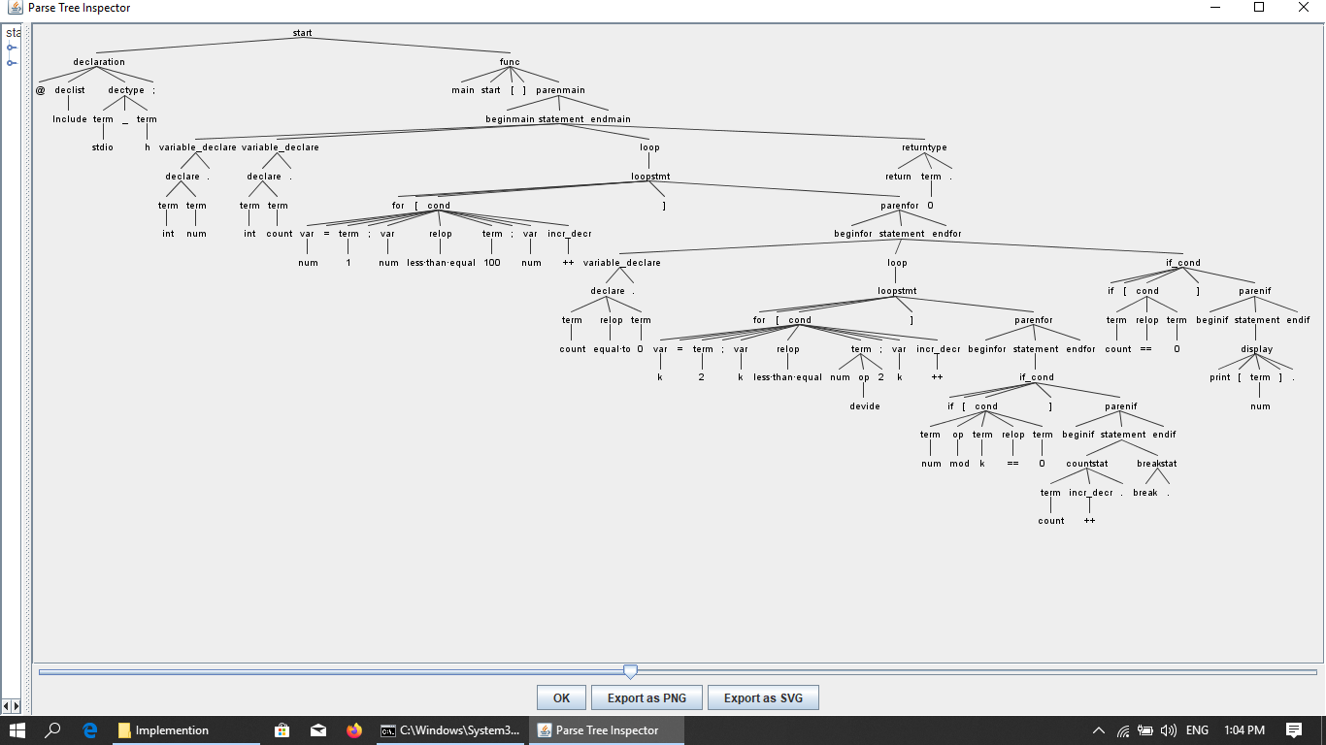
Parse Tree

Slide 7
THANK YOU

