Slide 1
KnowledgeLink :: A Web-Based Academic Portal for Collaborative Learning and Knowledge Sharing
Supervised By:
Mahmuda Khatun
Assistant Professor
Department of Computer Science & Engineering
Comilla University
Presented By
MD.MEHEDI HASAN
ID: 12108040
Session:2020-21
Department of Computer Science & Engineering
Comilla University
MD.SHORIFUL ISLAM SARKER
ID: 12108048
Session: 2020-21
Department of Computer Science & Engineering
Comilla University

Slide 2

What is
A Web-based platform for academic collaboration.
Centra Centralize course management, resource sharing, and communication for students, teachers, moderators, and admin
Addresses scattered resources and inefficient workflows in educational institutions.
Illustration of a connected network or a classroom with digital devices.
Use a simple diagram to show the concept of centralization.

Slide 3
Project Overview
A centralized web platform to manage academic resources.
Streamlines collaboration between students, teachers, moderators, and admins.
Role-based features: material uploads, course management, blogs, and announcements.
Built using modern web technologies: Node.js, Express.js, MySQL, JavaScript.

Slide 4
Challenges Addressed
Data Overload
Lack of Centralization
Access Control
Moderation
visuals

Slide 5
Goals Of
Develop a user-friendly web application for academic collaboration.
Intuitive interface for course enrollment and resource access.
Create a user-friendly interface for course enrollment, material access, and blog posting
Implement a MySQL database to manage users, courses, materials, blogs, and announcements.
Provide secure role-based authentication using JWT.

Slide 6
Technology Stack
Backend: Node.js, Express.js (RESTful APIs).
Database: MongoDB
Frontend: Vanilla JavaScript, HTML, CSS.
Tools: JWT (authentication), Multer (file uploads).
Architecture: Client-server model with MVC pattern.

Slide 7
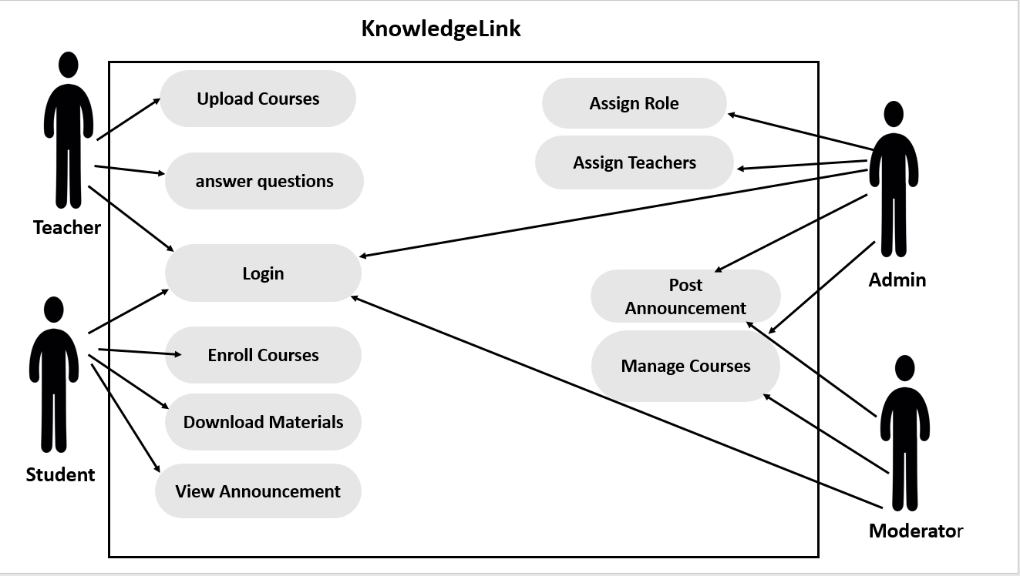
System Design
Use Case Diagram

Slide 8
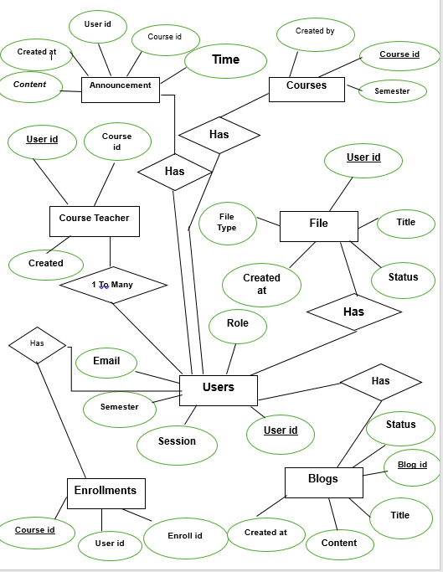
Entity Relationship Diagram

Slide 9
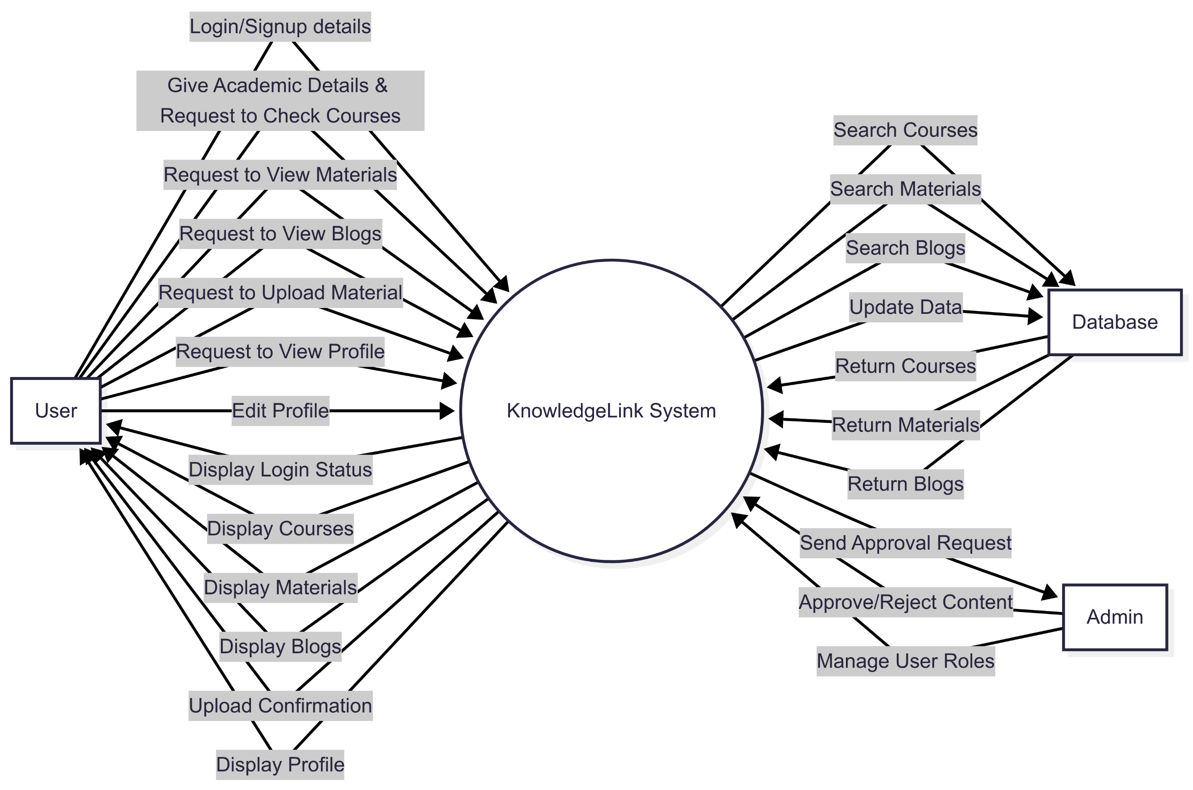
Dataflow Diagram
Fig: Dataflow Diagram Level 0

Slide 10
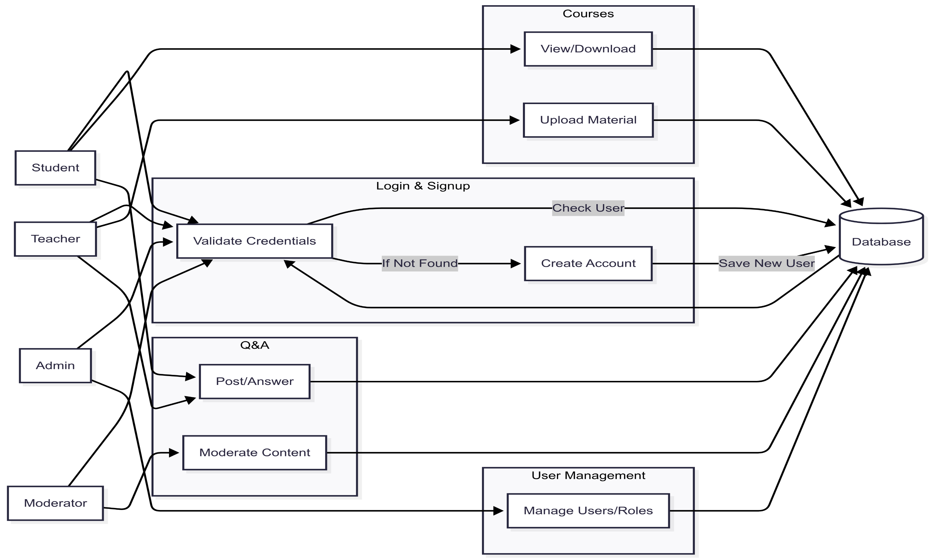
Fig: Dataflow Diagram Level 1

Slide 11
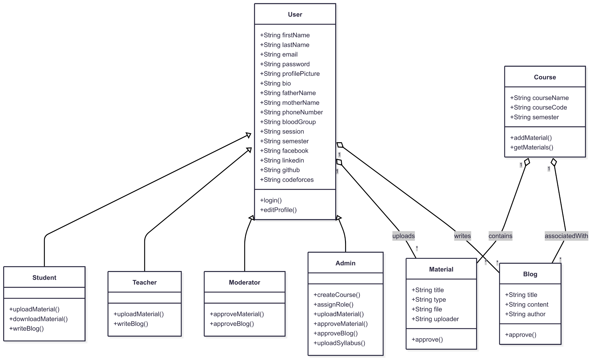
Class Diagram

Slide 12
Core Features
User Roles: Students, Teachers, Moderators, Admins.
Course Management: Create, enroll, and manage courses.
Resource Sharing: Upload/download materials (PDF, PPTX, videos).
Blogs & Announcements: Post and moderate content.
Admin Dashboard: Oversee users, courses, and approvals.

Slide 13
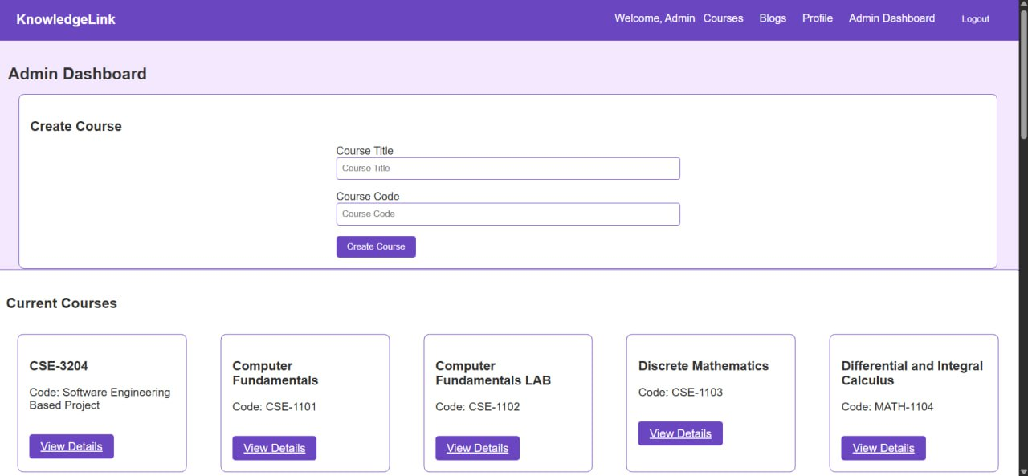
Fig:Admin Dashboard

Slide 14
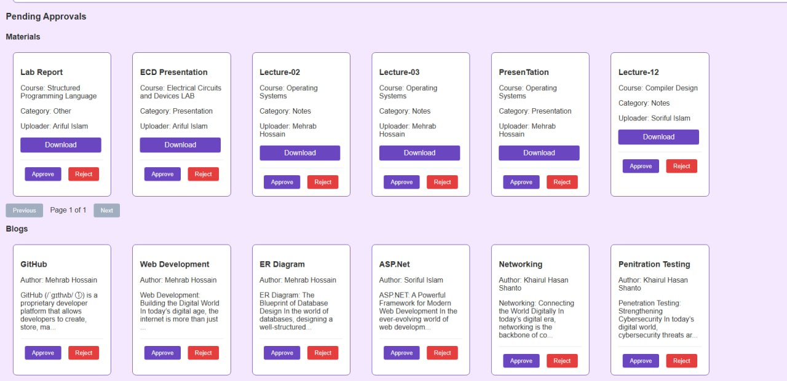
Fig:Admin Dashboard

Slide 15
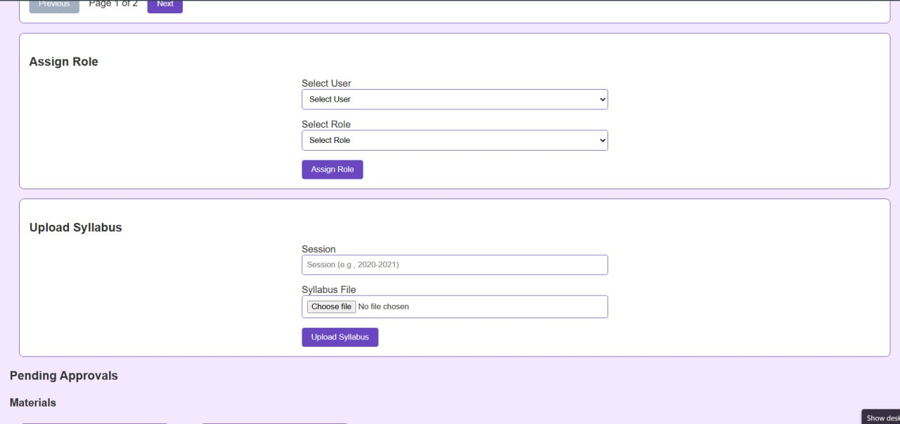
Fig:Admin Dashboard

Slide 16
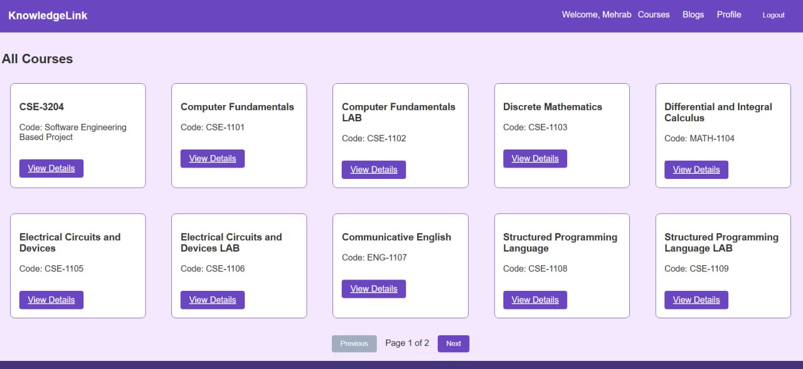
Fig: Available Courses

Slide 17
KnowledgeLink vs. Others
Moddle: Comprehensive but complex; lacks blog moderation.
Google Classroom: Simple but limited role customization.
Built-in content moderation
Lightweight Design.
Flexible role-based access

Slide 18

Current Limitations
Role Management Complexity
Approval Workflow Bottlenecks
Search Functionality Limitation
Suboptimal user experience in some areas

Slide 19
Future Work
Automated Approval
AI-Feature
Meterial Version Control
Integrate scholarship search features.
Enhance UI/UX for scalability.

Slide 20


