Slide 1
CMSC 341
Splay Trees

Slide 2
Problems with BSTs
Because the shape of a BST is determined by the order that data is inserted, we run the risk of trees that are essentially lists
21
12
32
20
24
37
15
40
55
56
77
95

Slide 3
BST Sequence of Operations
Worst case for a single BST operation can be O( N )
Not so bad if this happens only occasionally
BUT...its not uncommon for an entire sequence of “bad” operations to occur. In this case, a sequence of M operations take O (M*N) time and the time for the sequence of operations becomes noticeable.

Slide 4
Splay Tree Sequence of Operations
Splay trees guarantee that a sequence of M operations takes at most O( M * lg N ) time.
We say that the splay tree has amortized running time of
O( lg N ) cost per operation. Over a long sequence of operations, some may take more than lg N time, some will take less.
Does not preclude the possibility that any particular operation is still O( N ) in the worst case.
  Therefore, amortized O( lg N ) not as good as worst case O( lg N)
  But, the effect is the same – there is no “bad” sequence of operations or bad input sequences

Slide 5
Splay Trees
If any particular operation is O( N ) and we still want amortized O( lg N ) performance, then whenever a node is accessed it must be moved. Otherwise its access time is always O( N ).
The basic idea of the splay tree is that every time a node is accessed, it is pushed to the root by a series of tree rotations. This series of tree rotations is knowing as “splaying”.
If the node being “splayed” is deep, many nodes on the path to that node are also deep and by restructuring the tree, we make access to all of those nodes cheaper in the future.

Slide 6
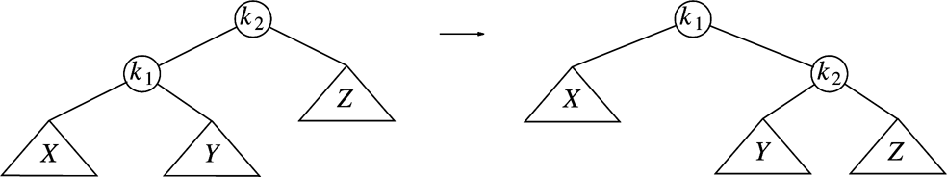
Basic “Single” Rotation in a BST
Rotating k₁ around k₂
Assuming that the tree on the left is a BST, how can we verify that the tree on the right is still a valid BST?
Note that the rotation can be performed in either direction.

Slide 7
Splay Operation
To “splay node x”, traverse up the tree from node x to root, rotating along the way until x is the root
Each rotation
  If x is root, do nothing.
  If x has no grandparent, rotate x about its parent
  If x has a grandparent,
    if x and its parent are both left children or both right children, rotate the parent about the grandparent, then rotate x about its parent
    if x and its parent are opposite type children (one left and the other right), rotate x about its parent, then rotate x about its new parent (former grandparent)

Slide 8
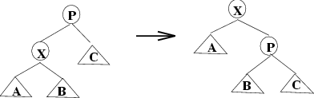
Node has no grandparent

Slide 9
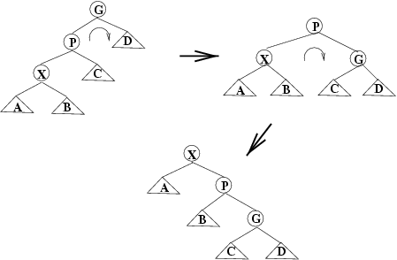
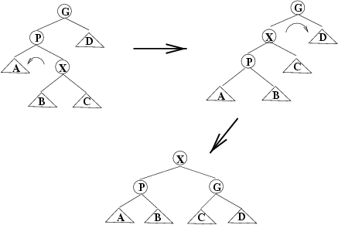
Node and Parent are Same Side
Zig-Zig
Rotate P around G, then X around P

Slide 10
Node and Parent are Different Sides
Zig-Zag
Rotate X around P, then X around G

Slide 11
Operations in Splay Trees
insert
  first insert as in normal binary search tree
  then splay inserted node
  if there is a duplicate, the node holding the duplicate element is splayed
find/contains
  search for node
  if found, splay it; otherwise splay last node accessed on the search path

Slide 12
Operations on Splay Trees (cont)
remove
  splay element to be removed
    if the element to be deleted is not in the tree, the node last visited on the search path is splayed
  disconnect left and right subtrees from root
  do one or both of:
    splay max item in T_{L} (then T_{L} has no right child)
    splay min item in T_{R} (then T_{R} has no left child)
  connect other subtree to empty child of root

Slide 13
Exercise - find( 65 )
50
40
60
20
43
70
16
65
63
66

Slide 14
Exercise - remove( 25 )
50
40
60
20
43
70
16
65
25
63
66

Slide 15
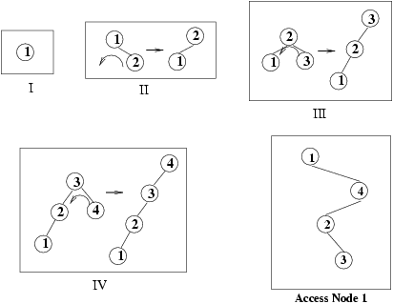
Insertion in order into a Splay Tree
In a BST, building a tree from N sorted elements was O( N² )
What is the performance of building a splay tree from N sorted elements?

Slide 16
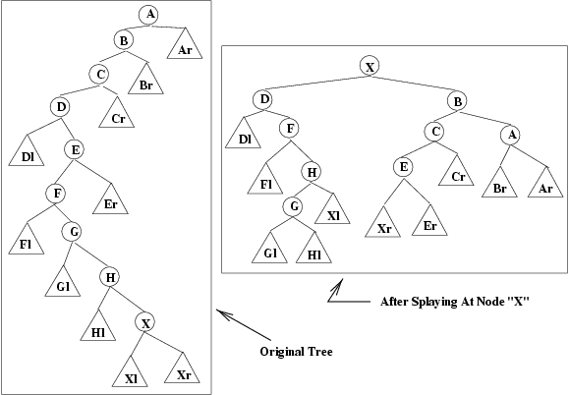
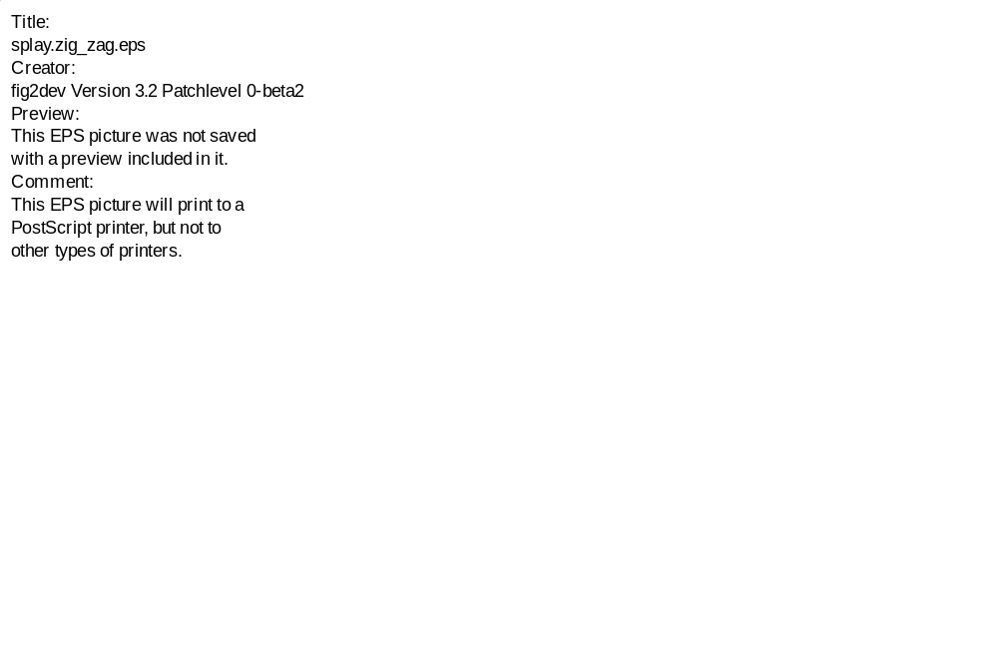
An extreme example of splaying

Slide 17
Crucial Operation called “Splay”
to “splay” something means to spread it out and flatten it
Splay (K, T), where K is a key and T is a BST modifies T so that
  it remains BST with same set of items
  new tree has K at root if K was already in T
  if K was not in T, root contains key that would be predecessor (or successor) of K if K were in tree.
Call this operation “splaying the tree around K”

Slide 18
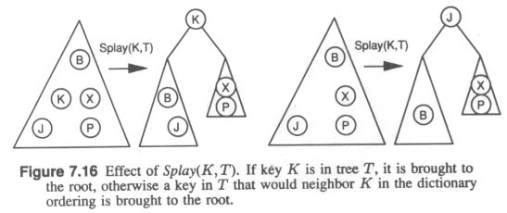

Slide 19
Rest of operations
Given an implementation of splay operation, rest of dictionary operations can be implemented easily:
  Lookup(K,T)
  Insert(K, Info, T)
  Delete (K,T)
  Concat(T1, T2):
    input -- two BST’s T1 and T2 such that every key in T1 is less than every key in T2
    output -- BST containing all keys in either T1 or T2

Slide 20
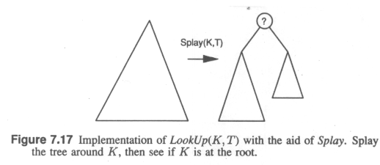

Slide 21
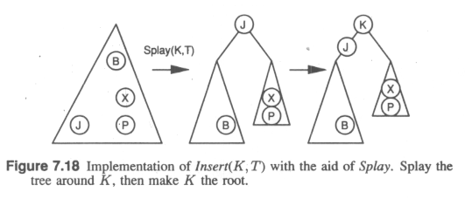

Slide 22
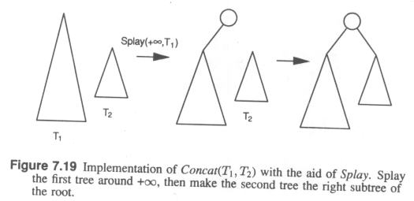

Slide 23
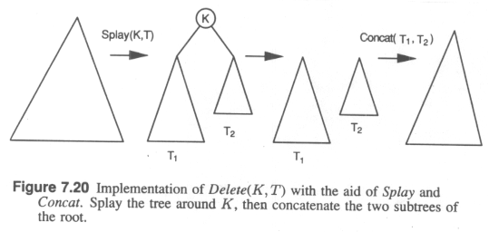

Slide 24
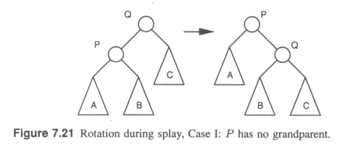

Slide 25
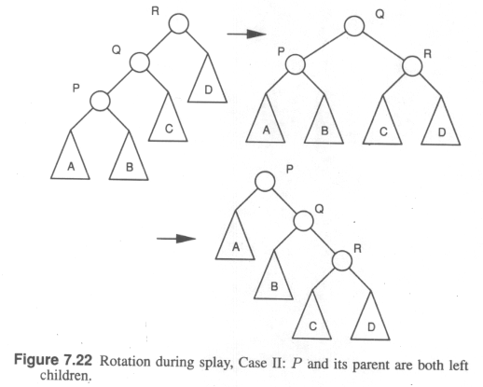

Slide 26
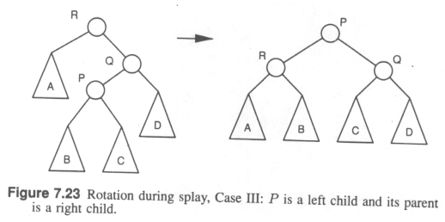

Slide 27
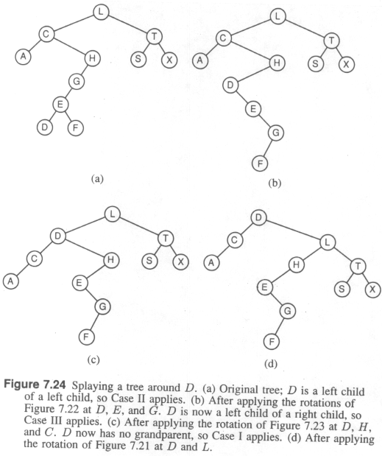

Slide 28
The big theorem
effect of rotations mysterious, subtle and actually not that well understood.
Splay Tree Theorem:
  Any sequence of m dictionary operations on a splay tree that is initially empty and never has more than n nodes uses O(m log n) time in worst case. Therefore, the operations have amortized O(log n) time.
Analysis subtle: need to show that time “saved” while performing low-cost operations can be “saved up for use” during time-consuming operations
We’ll spend the next several slides proving this.

Slide 29
Idea of Proof
use banking metaphor.
  You will give me O( log n) dollars per dictionary operation
  I will either save it or use it to pay for the rotations I do.
  If I do a Splay operation that consists of d basic steps, I will pay you d dollars.
  My only source of money is what you give me.
  If I can show that I never fail to pay you for the operations, then we can argue that the total cost of m operations is O( m log n)

Slide 30
More on idea of proof
I will save the money you give me in “bank accounts” at each node in the tree, each of which will be required to maintain a certain minimum balance.
Minimum balance in a bank account at node will be related to its number of descendents (money invariant below)
payment I make to you for each operation:
  some will come out of bank accounts at nodes
  some will come from new investment (what you paid me)

Slide 31
Definitions
for any vertex v in the tree:
  w(v): the weight of v = number of descendents of v (including v itself)
  r(v) : the rank of v = floor(log ₂ w(v))
The Money Invariant: each vertex v has r(v) dollars in its account at all times.

Slide 32
Using money during splay process
Money is used in two ways during splay process
  we pay for the time used. $1 per operation (zig, zag, zigzig, zagzag, zigzag, zagzig)
  since the shape of the tree changes as the splay is carried out, we may have to add money to the tree, or redistribute the money already in the tree, in order to maintain the Money Invariant everywhere.

Slide 33
The Investment Lemma
It costs at most 3 floor(log(n)) + 1 new dollars (this is the money you pay me) to splay a tree with n nodes while maintaining the Money Invariant everywhere.
We’ll do the proof of this later.

Slide 34
Proof of Splay Tree Theorem using Investment Lemma
Any dictionary operation on a tree T with at most n nodes costs O(log n) new dollars:
  Lookup(K,T) costs only what the splay costs, which is O(log n)
  Insert(K,Info, T) costs for splay plus what must be banked in new root to maintain invariant , for a total of O(log n)
  Concat(T1, T2), where T1 and T2 have at most n nodes, costs the splay at T1, plus what must be banked at root to make T2 a subtree, for a total of O(log n).
  Delete(K,T) costs splay of T, plus the costs to concatenate resulting subtrees, which is O(log n)
Using Investment Lemma O(m log n) dollars are enough to pay for the whole thing.

Slide 35
To prove investment lemma
Two observations about ranks
  rank of a node >= rank of any of its descendents
  Rank Rule: if a node has 2 children of equal rank, then its rank is greater than that of each child
  Proof of Rank Rule: node x has two children, u and v
  w(u ) >= 2 ^{r(u)}
w(v ) >= 2 ^{r(v)}
w(x) > w(u) + w(v) >= 2 ^{r(u) + 1}
log(w(x)) > r(u) + 1
floor(log (w(x)) >= r(u) + 1

Slide 36
Another Lemma
consider single step of splay operation (case I, II or III)
  let r(P) denote the rank of P before the operation
  let r’(P) denote the rank of P after the operation
Cost of Splay Steps Lemma
  A splay step involving node P, the parent of P and possibly the grandparent of P can be done with an investment of at most 3(r’(P)-r(P)) new dollars, plus one more dollar if this was the last step in the splay
defer proof for a moment

Slide 37
Cost of Splay Steps Lemma => Investment Lemma
Let r^{(i)}(P) denote the rank of P after i steps of the splay operation have been carried out.
By CSSL, the total investment of new money needed to carry out splay is <=
  3(r’(P) - r(P))
  + 3(r⁽²⁾(P) - r’(P))
  + ...
  + 3( r^{(k)}(P) - r^{(k-1)}(P)) + 1
  where k is the number of steps needed to bring P to root.
  But r^{(k)}(P) is the rank of the original root <= floor (log n)
  Total <= 3( r^{(k)}(P) - r(P)) + 1 <= 3 floor (log n) + 1

Slide 38
Proof of Cost of Splay Steps Lemma
Case 1: P has no grandparent (last step)
  1 extra dollar pays for time to do rotation
  # new dollars need to add
  = r’(p) - r’(q) - r(p) - r(q)
  = r’(q) - r(p)
  <= r’(p) - r(p)

Slide 40
Proof of Cost of Splay Steps Lemma, cont.
Case 2: zig zig
  to maintain money invariant need to add
  r’(p) + r’(q) + r’(r) - r(p) - r(q) - r(r)
  = r’(p) + r’(r) - r(p) - r(q)
  <= 2(r’(p) - r(p))
  Case (a): r’(p) > r(p). Then there are $ left over to pay for rotations
  Case (b): r’(p) = r(p)

Slide 41
CSSL, Case 2(b) r’(p) = r(p)
Fact 1: r’(p) = r(r)
Fact 2: r’(r) < r(p)
  r’(r) <= r’(p) = r(p)
  can’t have r’(r) = r(p) by Rank Rule on middle tree
Fact 3: r’(q) <= r(q)
  r’(q) <= r’(p) = r(p) <= r(q)
=> can move r’s money to p, p’s money to r and q’s money to q to maintain invariant and still have $ leftover to pay for rotation.

Slide 43
Proof of Cost of Splay Steps Lemma, cont.
remaining cases require similar analysis

Slide 44
Summary on Splay Trees
one of the most popular ways to implement binary search tree
  relatively simple (splaying can also be done top down)
  no extra fields needed
  excellent temporal locality properties
  m>= n operations costs O(m log n), good amortized time complexity
on negative side
  all those rotations add a significant constant factor
  worst case for a single operation can be costly
big open problem: dynamic optimality conjecture

Slide 45
Splay Tree Code
The splaying operation is performed “up the tree” from the node to the root.
How do we traverse “up” the tree?
How do we know if X and P are both left/right children or are different children?
How do we know if X has a grandparent?
What disadvantages are there to this technique?

Slide 46
Top-Down Splay Trees
Rather than write code that traverses both up and down the tree, “top-down” splay trees only traverse down the tree. On the way down, rotations are performed and the tree is split into three parts depending on the access path (zig, zig-zig, zig-zag) taken
  X, the node currently being accessed
  Left – all nodes less than X
  Right – all nodes greater than X
As we traverse down the tree, X, Left, and Right are reassembled
This method is faster in practice, uses only O( 1 ) extra space and still retains O( lg N ) amortized running time.

