Slide 1
Priority Queues (Heaps)
Notes:
Cpt S 223
Washington State University

Slide 2
Motivation
Queues are a standard mechanism for ordering tasks on a first-come, first-served basis
However, some tasks may be more important or timely than others (higher priority)
Priority queues
  Store tasks using a partial ordering based on priority
  Ensure highest priority task at head of queue
Heaps are the underlying data structure of priority queues
Notes:
Cpt S 223
Washington State University

Slide 3
Priority Queues: Specification
Main operations
  insert (i.e., enqueue)
    Dynamic insert
    specification of a priority level (0-high, 1,2.. Low)
  deleteMin (i.e., dequeue)
    Finds the current minimum element (read: “highest priority”) in the queue, deletes it from the queue, and returns it
Performance goal is for operations to be “fast”
Notes:
Cpt S 223
Washington State University

Slide 4
Using priority queues
4
10
19
5
3
13
8
11
22
insert()
deleteMin()
Dequeues the next element
with the highest priority
2
Notes:
Cpt S 223
Washington State University

Slide 5
Simple Implementations
Can we build a data structure better suited to store and retrieve priorities?
…
Unordered linked list
  O(1) insert
  O(n) deleteMin
Ordered linked list
  O(n) insert
  O(1) deleteMin
Ordered array
  O(lg n + n) insert
  O(n) deleteMin
Balanced BST
  O(log₂n) insert and deleteMin
5
2
10
3
3
5
…
10
2
2 | 3 | 5 | … | 10
Notes:
Cpt S 223
Washington State University

Slide 6
Binary Heap
A priority queue data structure
Notes:
Cpt S 223
Washington State University

Slide 7
Binary Heap
A binary heap is a binary tree with two properties
  Structure property
  Heap-order property
Notes:
Cpt S 223
Washington State University

Slide 8
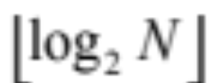
Structure Property
A binary heap is a complete binary tree
    Each level (except possibly the bottom most level) is completely filled
    The bottom most level may be partially filled
    (from left to right)
Height of a complete binary tree with N elements is
Notes:
Cpt S 223
Washington State University

Slide 9
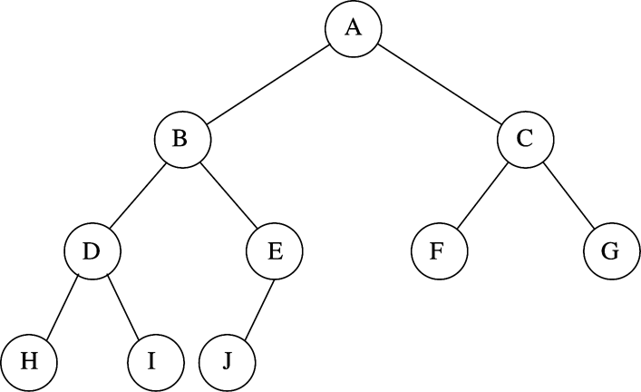
Binary Heap Example
Structure property
N=10
Every level (except last) saturated
Array representation:
Notes:
Cpt S 223
Washington State University

Slide 10
Heap-order Property
Heap-order property (for a “MinHeap”)
  For every node X, key(parent(X)) ≤ key(X)
  Except root node, which has no parent
Thus, minimum key always at root
  Alternatively, for a “MaxHeap”, always keep the maximum key at the root
Insert and deleteMin must maintain heap-order property
Notes:
Cpt S 223
Washington State University

Slide 11
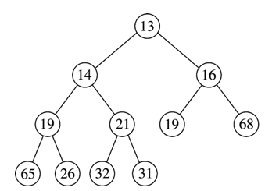
Heap Order Property
Minimum element
Duplicates are allowed
No order implied for elements which do not share ancestor-descendant relationship
≤
≤
≤
≤
≤
≤
≤
≤
≤
≤
Notes:
Cpt S 223
Washington State University

Slide 12

Implementing Complete Binary Trees as Arrays
Given element at position i in the array
  Left child(i) = at position 2i
  Right child(i) = at position 2i + 1
  Parent(i) = at position
i
2i
2i + 1
i/2
Notes:
Cpt S 223
Washington State University

Slide 13
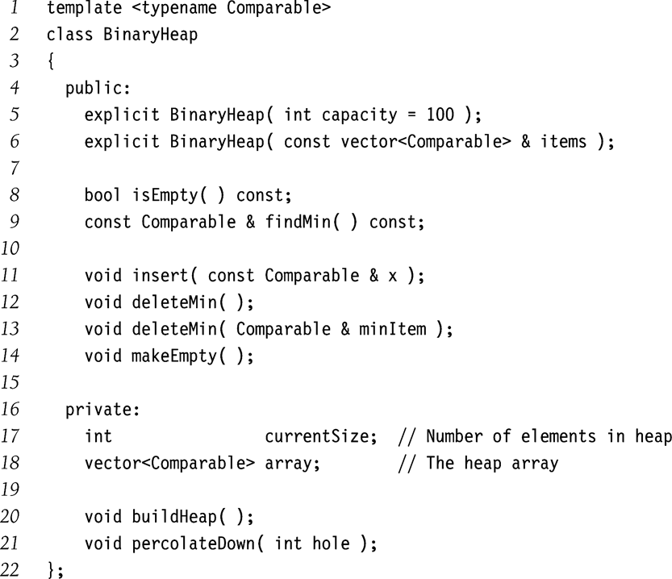
Just finds the Min without deleting it
insert
deleteMin
Note: a general delete()
function is not as important
for heaps
but could be implemented
Stores the heap as
a vector
Fix heap after deleteMin
Notes:
Cpt S 223
Washington State University

Slide 14
Heap Insert
Insert new element into the heap at the next available slot (“hole”)
  According to maintaining a complete binary tree
Then, “percolate” the element up the heap while heap-order property not satisfied
Notes:
Cpt S 223
Washington State University

Slide 15
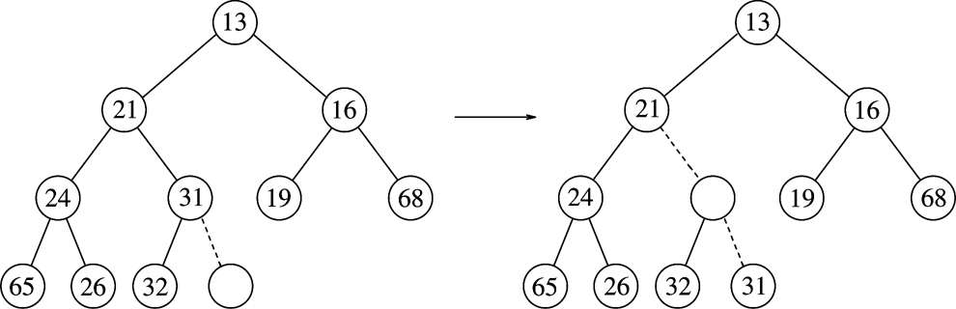
Heap Insert: Example
Percolating Up
Insert 14:
14
hole
Notes:
Cpt S 223
Washington State University

Slide 16
Heap Insert: Example
Percolating Up
(1)
14 vs. 31
Insert 14:
14
14
hole
Notes:
Cpt S 223
Washington State University

Slide 17
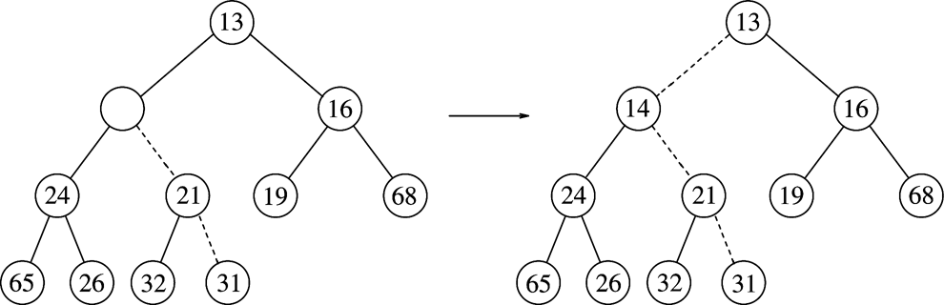
Heap Insert: Example
Percolating Up
(1)
14 vs. 31
Insert 14:
14
14
hole
(2)
14 vs. 21
14
Notes:
Cpt S 223
Washington State University

Slide 18
Heap Insert: Example
Percolating Up
(1)
14 vs. 31
Insert 14:
14
hole
(2)
14 vs. 21
(3)
14 vs. 13
Heap order prop
14
Structure prop
Path of percolation up
Notes:
Cpt S 223
Washington State University

Slide 19
Heap Insert: Implementation
// assume array implementation
void insert( const Comparable &x) {
?
}
Notes:
Cpt S 223
Washington State University

Slide 20
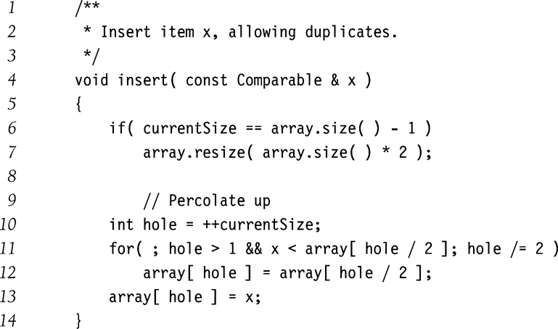
Heap Insert: Implementation
O(log N) time
Notes:
Cpt S 223
Washington State University

Slide 21
Heap DeleteMin
Minimum element is always at the root
Heap decreases by one in size
Move last element into hole at root
Percolate down while heap-order property not satisfied
Notes:
Cpt S 223
Washington State University

Slide 22
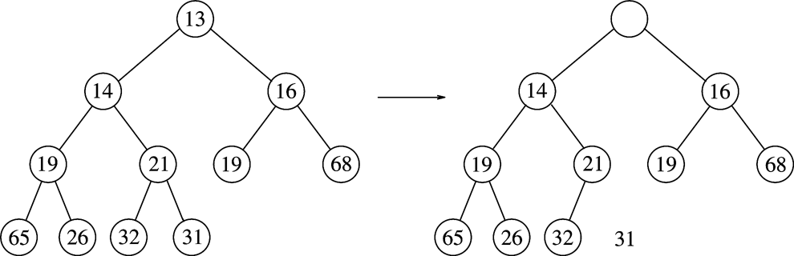
Heap DeleteMin: Example
Percolating down…
Make this position empty
Notes:
Cpt S 223
Washington State University

Slide 23
Heap DeleteMin: Example
Percolating down…
Copy 31 temporarily
here and move it down
Make this position empty
Is 31 > min(14,16)?
Yes - swap 31 with min(14,16)
Notes:
Cpt S 223
Washington State University

Slide 24
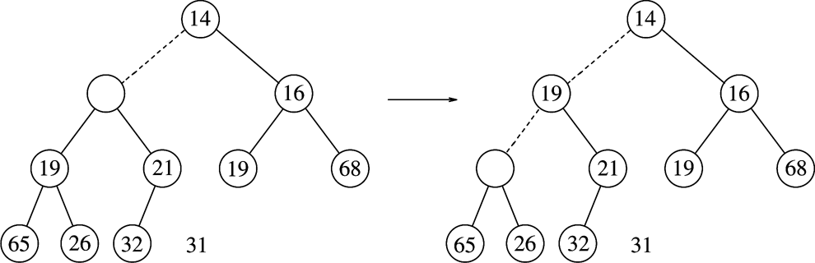
Heap DeleteMin: Example
Percolating down…
31
Is 31 > min(19,21)?
Yes - swap 31 with min(19,21)
Notes:
Cpt S 223
Washington State University

Slide 25
Heap DeleteMin: Example
Percolating down…
31
31
Is 31 > min(19,21)?
Yes - swap 31 with min(19,21)
Is 31 > min(65,26)?
Yes - swap 31 with min(65,26)
Percolating down…
Notes:
Cpt S 223
Washington State University

Slide 26
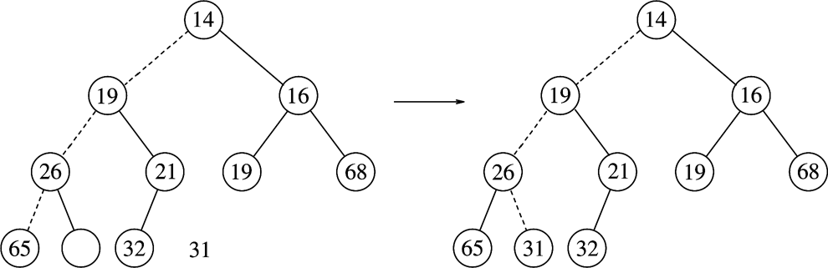
Heap DeleteMin: Example
Percolating down…
31
Percolating down…
Notes:
Cpt S 223
Washington State University

Slide 27
Heap DeleteMin: Example
Percolating down…
31
Heap order prop
Structure prop
Notes:
Cpt S 223
Washington State University

Slide 28
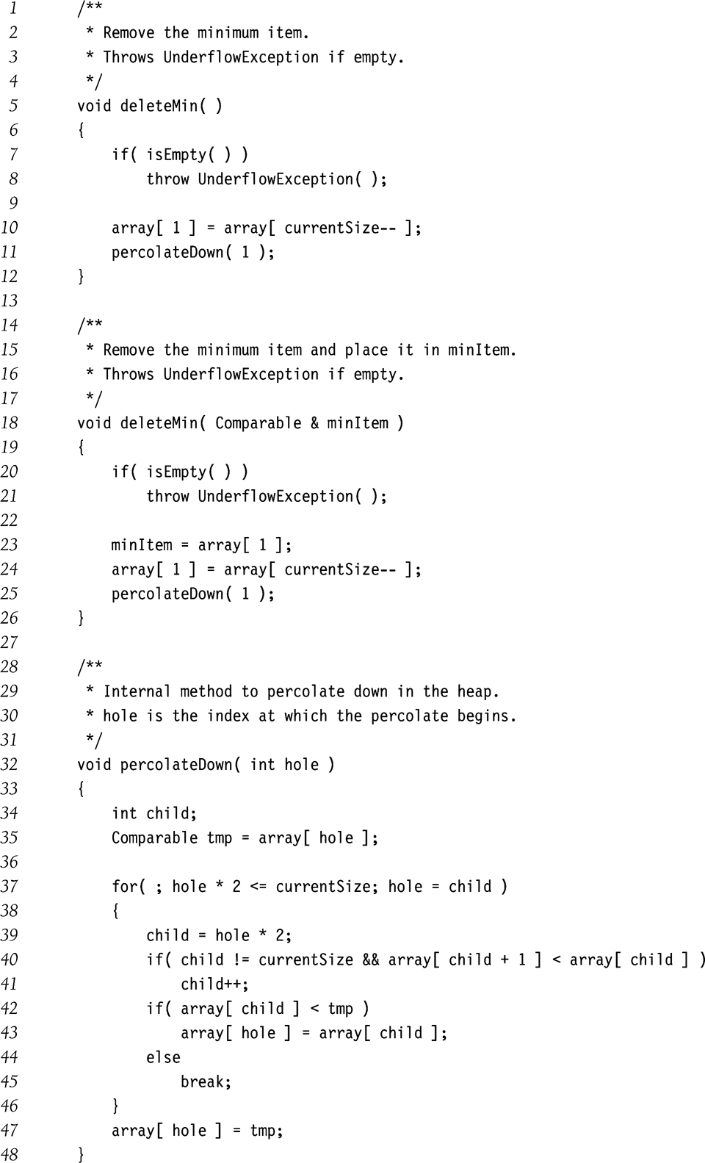
Heap DeleteMin: Implementation
O(log N) time
Notes:
Cpt S 223
Washington State University

Slide 29
Heap DeleteMin: Implementation
Percolate down
Left child
Right child
Pick child to swap with
Notes:
Cpt S 223
Washington State University

Slide 30
Other Heap Operations
decreaseKey(p,v)
  Lowers the current value of item p to new priority value v
  Need to percolate up
  E.g., promote a job
increaseKey(p,v)
  Increases the current value of item p to new priority value v
  Need to percolate down
  E.g., demote a job
remove(p)
  First, decreaseKey(p,-∞)
  Then, deleteMin
  E.g., abort/cancel a job
Run-times for all three functions?
O(lg n)
Notes:
Cpt S 223
Washington State University

Slide 31
Improving Heap Insert Time
What if all N elements are all available upfront?
To build a heap with N elements:
  Default method takes O(N lg N) time
  We will now see a new method called buildHeap() that will take O(N) time - i.e., optimal
Notes:
Cpt S 223
Washington State University

Slide 32
Building a Heap
Construct heap from initial set of N items
Solution 1
  Perform N inserts
  O(N log₂ N) worst-case
Solution 2 (use buildHeap())
  Randomly populate initial heap with structure property
  Perform a percolate-down from each internal node (H[size/2] to H[1])
    To take care of heap order property
Notes:
Cpt S 223
Washington State University

Slide 33
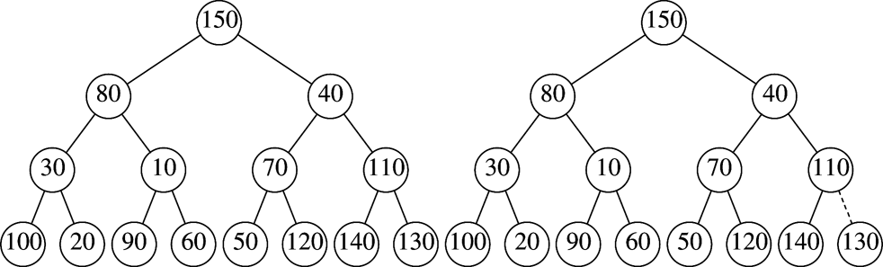
BuildHeap Example
Input: { 150, 80, 40, 10, 70, 110, 30, 120, 140, 60, 50, 130, 100, 20, 90 }
Leaves are all valid heaps (implicitly)
So, let us look at each internal node,
from bottom to top,
and fix if necessary
Arbitrarily assign elements to heap nodes
Structure property satisfied
Heap order property violated
Leaves are all valid heaps (implicit)
Notes:
Cpt S 223
Washington State University

Slide 34
BuildHeap Example
Swap with left child
Nothing to do
Randomly initialized heap
Structure property satisfied
Heap order property violated
Leaves are all valid heaps (implicit)
Notes:
Cpt S 223
Washington State University

Slide 35
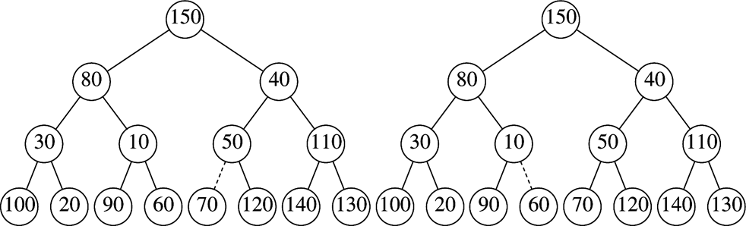
BuildHeap Example
Swap with right child
Nothing to do
Dotted lines show path of percolating down
Notes:
Cpt S 223
Washington State University

Slide 36
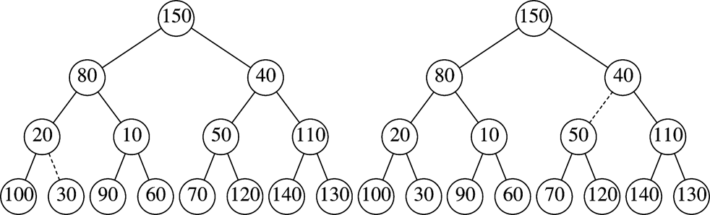
BuildHeap Example
Swap with right child
& then with 60
Nothing to do
Dotted lines show path of percolating down
Notes:
Cpt S 223
Washington State University

Slide 37
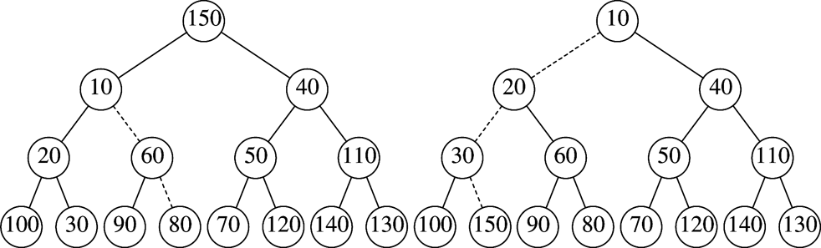
BuildHeap Example
Swap path
Final Heap
Dotted lines show path of percolating down
Notes:
Cpt S 223
Washington State University

Slide 38
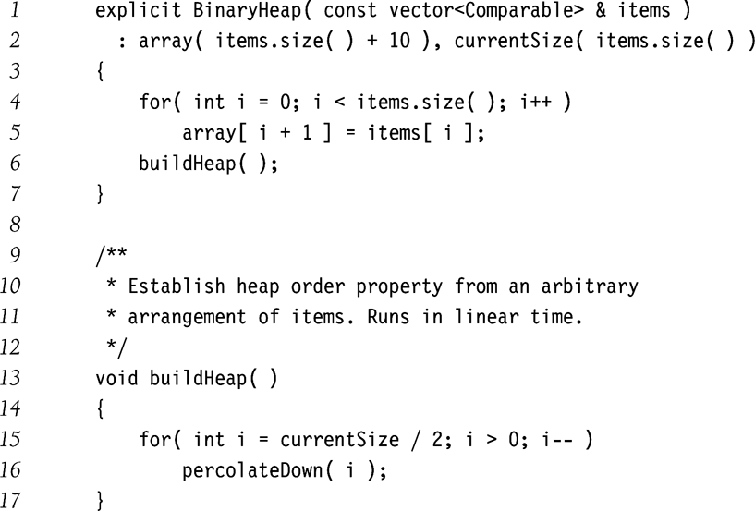
BuildHeap Implementation
Start with lowest, rightmost internal node
Notes:
Cpt S 223
Washington State University

Slide 39
BuildHeap() : Run-time Analysis
Run-time = ?
  O(sum of the heights of all the internal nodes)
  because we may have to percolate all the way down to fix every internal node in the worst-case
Theorem 6.1
  For a perfect binary tree of height h, the sum of heights of all nodes is 2^{h+1} – 1 – (h + 1)
Since h=lg N, then sum of heights is O(N)
Will be slightly better in practice
HOW?
Implication: Each insertion costs O(1) amortized time
Notes:
Cpt S 223
Washington State University

Slide 40
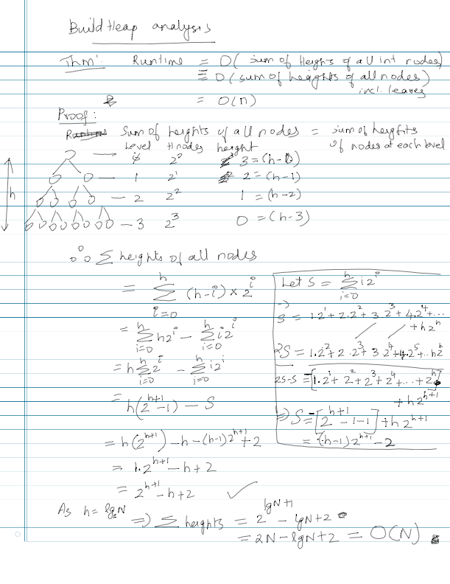
Notes:
Cpt S 223
Washington State University

Slide 41
Binary Heap Operations
Worst-case Analysis
Height of heap is
insert: O(lg N) for each insert
  In practice, expect less
buildHeap insert: O(N) for N inserts
deleteMin: O(lg N)
decreaseKey: O(lg N)
increaseKey: O(lg N)
remove: O(lg N)
Notes:
Cpt S 223
Washington State University

Slide 42
Applications
Operating system scheduling
  Process jobs by priority
Graph algorithms
  Find shortest path
Event simulation
  Instead of checking for events at each time click, look up next event to happen
Notes:
Cpt S 223
Washington State University

Slide 43
An Application:
The Selection Problem
Given a list of n elements, find the k^{th} smallest element
Algorithm 1:
  Sort the list => O(n log n)
  Pick the k^{th} element => O(1)
A better algorithm:
  Use a binary heap (minheap)
Notes:
Cpt S 223
Washington State University

Slide 44
Selection using a MinHeap
Input: n elements
Algorithm:
  buildHeap(n) ==> O(n)
  Perform k deleteMin() operations ==> O(k log n)
  Report the k^{th} deleteMin output ==> O(1)
Total run-time = O(n + k log n)
If k = O(n/log n) then the run-time becomes O(n)
Notes:
Cpt S 223
Washington State University

Slide 45
Other Types of Heaps
Binomial Heaps
d-Heaps
  Generalization of binary heaps (ie., 2-Heaps)
Leftist Heaps
  Supports merging of two heaps in o(m+n) time (ie., sub-linear)
Skew Heaps
  O(log n) amortized run-time
Fibonacci Heaps
Notes:
Cpt S 223
Washington State University

Slide 46
Run-time Per Operation
 | Insert | DeleteMin | Merge (=H₁+H₂)
Binary heap | O(log n) worst-case O(1) amortized for buildHeap | O(log n) | O(n)
Leftist Heap | O(log n) | O(log n) | O(log n)
Skew Heap | O(log n) | O(log n) | O(log n)
Binomial Heap | O(log n) worst case O(1) amortized for sequence of n inserts | O(log n) | O(log n)
Fibonacci Heap | O(1) | O(log n) | O(1)
Notes:
Cpt S 223
Washington State University

Slide 47
Priority Queues in STL
Uses Binary heap
Default is MaxHeap
Methods
  Push, top, pop, empty, clear
#include <priority_queue>
int main ()
{
priority_queue<int> Q;
Q.push (10);
cout << Q.top ();
Q.pop ();
}
Calls DeleteMax()
For MinHeap: declare priority_queue as:
priority_queue<int, vector<int>, greater<int>> Q;
Refer to Book Chapter 6, Fig 6.57 for an example
Notes:
Cpt S 223
Washington State University

Slide 48
Limitations
MinBinary heaps support insert, findMin, deleteMin, and construct efficiently.
They do not efficiently support the meld or merge operation in which 2 BHs are merged into one. If H₁ and H₂ are of size n₁ and n₂, then the merge is in O(n₁ + n₂) .

Slide 49
LEFTIST HEAPS

Slide 50
Leftist Heaps: Motivation
Binary heaps can be merged in O(N) time
Challenge:
  Build a heap that can merge in O(logN) time
  Use an array just like the Binary heap
Traditionally, data structures supporting efficient merging use linked lists
  Using linked lists is inefficient due to pointer operations

Slide 51
Leftist Heaps: Definitions
A Leftist (min) Heap is a binary tree that satisfies the following conditions:
    If X is a node and L and R are its left and right children respectively, then:
    Property 1. Heap Order Property
    X.value ≤ L.value
    X.value ≤ R.value
    Property 2. Leftist Heap Property
    null path length of L ≥ null path length of R

Slide 52
Leftist Heaps: Definitions
Null path length (npl) of a node is the shortest distance from a node to a descendant with 0 or 1 child
If a node is null, its null path length is −1.

Slide 53
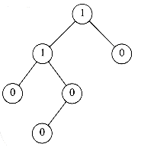
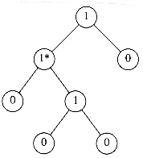
Leftist Heaps: Definitions
npl(X) of any node X is the length of the shortest path from X to a node without two children.
npl of a node with zero or one child is 0, while npl(NULL) = -1

Slide 54
Example: Null Path Length
4
8
19
12
27
20
15
25
43
node 4 8 19 12 15 25 27 20 43
npl 1 0 1 1 0 0 0 0 0

Slide 55
Theorem
Theorem: A leftist tree with r nodes on the
right path must have at least 2^{r}- 1 nodes.

Slide 56
Theorem :Proof by Induction
r=1, at least 1 tree node is required→ True
Induction hypothesis: Tree with r nodes on the right path has at least 2^{r}- 1 nodes.
For a leftist tree with r+1 nodes on the right path then the root has a right subtree with r nodes on the right path, and a left subtree with at least r nodes on the right path (npl(left)>=npl(right))
Then each subtree has at least 2^{r}-1 nodes
The tree including the root then has
(2^{r}- 1) + (2^{r}- 1) + 1 = 2^{r+1}- 1 nodes, hence, proving the theorem

Slide 57
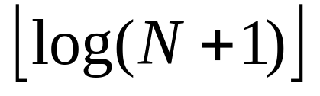
Theorem Result
From this theorem, it follows immediately that a leftist tree of N nodes has a right path containing at most nodes.
The general idea for the leftist heap operations is to perform all the work on the right path, which is guaranteed to be short.

Slide 58
Leftist Heap: Operations
The fundamental operation on leftist heaps is
merging
  Recursive
Insertion and deletion? A special case of merging

Slide 59
Some Min Leftist Tree Operations
insert()
deleteMin()
meld()
initialize()
insert() and deleteMin() use meld().

Slide 60
Insert Operation
2
4
3
6
8
5
8
6
9
insert(7)

Slide 61
Insert Operation
2
4
3
6
8
5
8
6
9
Create a single node min leftist tree.
7

Slide 62
Delete Min
2
4
3
6
8
5
8
6
9
7
Perform merge with the single node tree

Slide 63
Delete Min
2
4
3
6
8
5
8
6
9
Delete the root.

Slide 64
Delete Min
2
4
3
6
8
5
8
6
9
Delete the root.
Meld the two subtrees.

Slide 65
Melding or Merging.
Put the smaller root as the new root
Hang its left subtree on the left
Recursively merge its right subtree and the other tree.

Slide 66
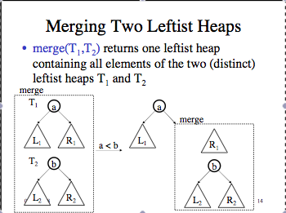

Slide 67
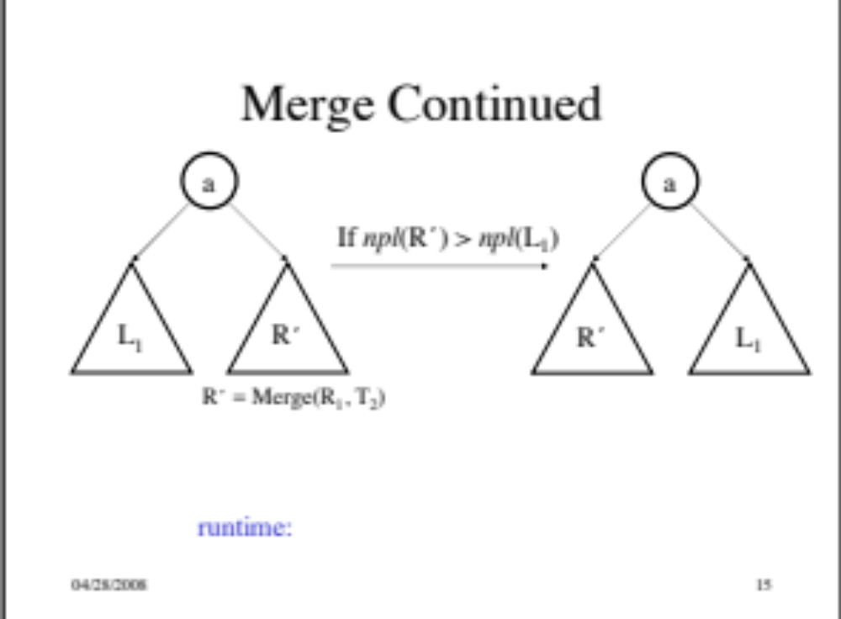

Slide 68
Lets run through an example

