Slide 1
CMSC 341
Introduction to Trees

Slide 2
Tree ADT
Tree definition
  A tree is a set of nodes which may be empty
  If not empty, then there is a distinguished node r, called root and zero or more non-empty subtrees T₁, T₂, … T_{k}, each of whose roots are connected by a directed edge from r.
This recursive definition leads to recursive tree algorithms and tree properties being proved by induction.
Every node in a tree is the root of a subtree.
2/21/2006
Notes:
The definition is recursive
for list: a list is a first element followed by a list of elements
Node and edge are not really defined
Edges not usually shown as directed (maybe gravity is implicit)

Slide 3
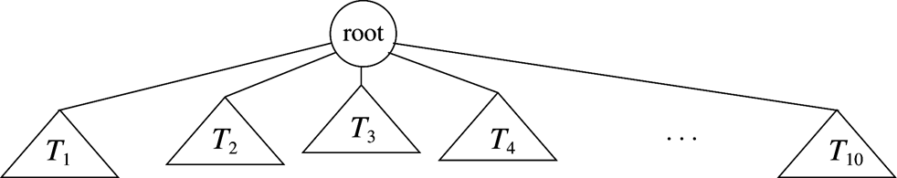
A generic tree
2/21/2006

Slide 4
Terminology
Root
Parent
Child
Sibling
External node
Internal node
Subtree
Ancestor
Descendant

Slide 5
Example Tree
root
Sami’s Home Page
Teaching
Research
Activities
CS101
CS211
Papers
Presentations
External nodes
Internal nodes
Subtree – left subtree of research?
Ancestor – papers ancestor of activities?
Descendant – papers descendant of home?
Root?
Parent – papers, activities
Children – cs101, research
Sibling - teaching

Slide 6
More Tree Terminology
A path from node V₁ to node V_{k} is a sequence of nodes such that V_{i} is the parent of V_{i+1} for 1 ≤ i ≤ k.
The length of this path is the number of edges encountered. The length of the path is one less than the number of nodes on the path ( k – 1 in this example)
The depth of any node in a tree is the length of the path from root to the node.
All nodes of the same depth are at the same level.
The depth of a tree is the depth of its deepest leaf.
The height of any node in a tree is the length of the longest path from the node to a leaf.
The height of a tree is the height of its root.
If there is a path from V₁ to V₂, then V₁ is an ancestor of V₂ and V₂ is a descendent of V₁.
2/21/2006
Notes:
Note: Path is not a sequence of edges, it is a sequence of nodes.
Suppose the sequence contains just one node. What is the path length? (zero)
A path is not any old sequence of nodes. There must be a parent-child relationship between adjacent nodes on the path.
Since there is a path (of zero length) from any node to itself -- it is technically true that every node is both an ancestor and descendent of itself.
We sometimes say “proper ancestor” or “proper descendent” to preclude this situation

Slide 7
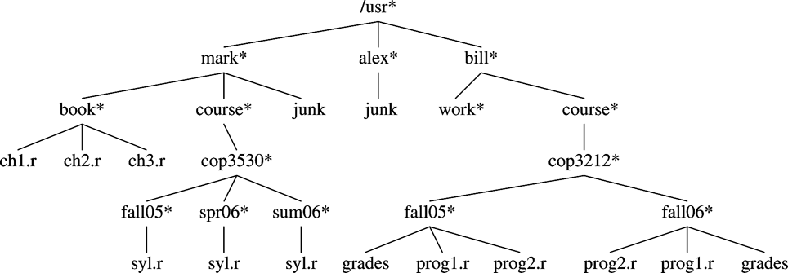
A Unix directory tree
2/21/2006

Slide 8
Tree Storage
A tree node contains:
  Data Element
  Links to other nodes
Any tree can be represented with the “first-child, next-sibling” implementation.
struct TreeNode
{
Object element;
TreeNode *firstChild;
TreeNode *nextSibling;
};
2/21/2006

Slide 9
Printing a Child/Sibling Tree
// “t” points to the root of a tree
void Print( TreeNode *t)
{
if (t == NULL) return;
cout << t->element << endl;
Print ( t->firstChild );
Print( t->nextSibling );
}
What is the output when Print( ) is used for the Unix directory tree?
2/21/2006

Slide 10
K-ary Tree
If we know the maximum number of children each node will have, K, we can use an array of children pointers in each node.
struct KTreeNode
{
Object element;
KTreeNode *children[ K ];
}
2/21/2006

Slide 11
Printing a K-ary Tree
void Print (KTreeNode *t)
{
if (t == NULL)
return;
cout << t->element << endl;
for (int i = 0; i < K; i++)
Print ( t->children[i] );
}
2/21/2006

Slide 12
Binary Trees
A special case of K-ary tree is a tree whose nodes have exactly two children pointers -- binary trees.
A binary tree is a rooted tree in which no node can have more than two children AND the children are distinguished as left and right.
struct BinaryNode
{
Object element; // The data
BinaryNode *left; // Left child
BinaryNode *right; // Right child
};
2/21/2006
Notes:
A full BT with n interior nodes has n+1 exterior nodes (leaf nodes).

Slide 13
Full Binary Tree
A full Binary Tree is a Binary Tree in which every node either has two children or is a leaf (every interior node has two children).
2/21/2006

Slide 14
FBT Theorem
Theorem: A FBT with n internal nodes has n + 1 leaf nodes.
Proof by strong induction on the number of internal nodes, n:
Base case: Binary Tree of one node (the root) has:
zero internal nodes
one external node (the root)
2/21/2006

Slide 15
FBT Proof (cont’d)
Inductive Assumption:
Assume all FBTs with up to and including n internal nodes have n + 1 external nodes.
Inductive Step (prove true for a tree with n + 1 internal nodes)
(i.e. a tree with n + 1 internal nodes has (n + 1) + 1 = n + 2 leaves)
  Let T be a FBT of n internal nodes.
  It therefore has n + 1 external nodes (Inductive Assumption)
  Enlarge T so it has n+1 internal nodes by adding two nodes to some leaf. These new nodes are therefore leaf nodes.
  Number of leaf nodes increases by 2, but the former leaf becomes internal.
  So,
    # internal nodes becomes n + 1,
    # leaves becomes (n + 1) + 1 = n + 2
2/21/2006

Slide 16
Perfect Binary Tree
A perfect Binary Tree is a full Binary Tree in which all leaves have the same depth.
2/21/2006
Notes:
The number of nodes in a PBT is always one less than a power of 2.
In fact, there are 2 ^(h+1) -1 nodes in a PBT, where h is the height of the tree

Slide 17
Complete Binary Trees
Complete Binary Tree
A complete Binary Tree is a perfect Binary Tree except that the lowest level may not be full. If not, it is filled from left to right.
2/21/2006
Notes:
Note: Every PBT is complete, but not vice versa.

Slide 18
Tree Traversal
Pre-order traversal
  Visit node, traverse left subtree, traverse right subtree
Post-order traversal
  Traverse left subtree, traverse right subtree, visit node

Slide 19
Example
Pre-order
Post-order
root
Rollins
Davidson
Truman
Brown
Ralson
Taft
Zuniga

Slide 20
Example
Pre – Rollins, Davidson, Brown, Ralson, Truman, Taft, Zuniga
Post – Brown, Ralson, Davidson, Taft, Zuniga, Truman, Rollins
root
Rollins
Do
Trimmer
Bendersky
Reardon
Tilkidjieva
Yucius

Slide 21
Another Example
Pre – Brown, Truman, Taft, Ralson, Davidson, Rollins, Zuniga
Post – Davidson, Rollins, Ralson, Taft, Zuniga, Truman, Brown
root
Brown
Truman
Taft
Zuniga
Ralson
Davidson
Rollins

Slide 22
In-order Traversal
Traverse left subtree, visit node, traverse right subtree
  Brown, Davidson, Ralson, Rollins, Taft, Truman, Zuniga
root
Rollins
Davidson
Truman
Brown
Ralson
Taft
Zuniga

Slide 23
Another Example
In-order – Brown, Davidson, Ralson, Rollins, Taft, Truman, Zuniga
root
Brown
Truman
Taft
Zuniga
Ralson
Davidson
Rollins

Slide 24
PBT Theorem
Theorem: The number of nodes in a PBT is 2^{h+1}-1, where h is height.
Proof by strong induction on h, the height of the PBT:
Notice that the number of nodes at each level is 2^{l}.
(Proof of this is a simple induction - left to student as exercise). Recall that the height of the root is 0.
Base Case:
The tree has one node; then h = 0 and n = 1.
and 2^{(h + 1)} = 2⁽⁰ ⁺ ¹⁾ – 1 = 2¹ –1 = 2 – 1 = 1 = n
2/21/2006

Slide 25
Proof of PBT Theorem(cont)
Inductive Assumption:
Assume true for all PBTs with height h ≤ H
Prove true for PBT with height H+1:
Consider a PBT with height H + 1. It consists of a root
and two subtrees of height H. Therefore, since the theorem is true for the subtrees (by the inductive assumption since they have height = H)
n = (2^{(H+1)} - 1) for the left subtree
+ (2^{(H+1)} - 1) for the right subtree
+ 1 for the root
= 2 * (2^{(H+1)} – 1) + 1
= 2^{((H+1)+1)} - 2 + 1 = 2^{((H+1)+1)} - 1
3/2/2006

Slide 26
How do we find something in a Binary Tree?
We must recursively search the entire tree. Return a pointer to node containing x, return NULL if x is not found
BinaryNode* Find( const Object& x, BinaryNode *t)
{
if ( t == NULL ) return NULL; // not found in empty tree
if ( t->data == x ) return t; // found it here
// not here, so look in the left subtree
BinaryNode *ptr = Find( x, t->left);
// if not in the left subtree, look in the right subtree
if ( ptr == NULL )
ptr = Find( x, t->right);
// return pointer, NULL if not found
return ptr;
}
12/19/2006
Notes:
12/19/2006 – added “if t->data == x”

Slide 27
Binary Trees and Recursion
A Binary Tree can have many properties
  Number of leaves
  Number of interior nodes
  Is it a full binary tree?
  Is it a perfect binary tree?
  Height of the tree
Each of these properties can be determined using a recursive function.
2/21/2006

Slide 28
Recursive Binary Tree Function
return-type Function (BinaryNode * t)
{
// base case – usually empty tree
if (t == NULL) return xxxx;
// determine if the node pointed to by t has the property
// traverse down the tree by recursively “asking” left/right children
// if their subtree has the property
return the result;
}
2/21/2006

Slide 29
Is this a full binary tree?
bool IsFBT (BinaryNode* t)
{
// base case – an empty tee is a FBT
if (t == NULL) return true;
// determine if this node is “full”
// if just one child, return – the tree is not full
if ( (t->left && !t->right) || (t->right && !t->left) )
return false;
// if this node is full, “ask” its subtrees if they are full
// if both are FBTs, then the entire tree is an FBT
// if either of the subtrees is not FBT, then the tree is not
return IsFBT( t->right ) && IsFBT( t->left );
}
2/21/2006

Slide 30
Other Recursive Binary Tree Functions
// count number of interior nodes
int CountInteriorNodes( BinaryNode* t);
// determine the height of a binary tree
// By convention (and for ease of coding) the height of an
// empty tree is -1
int Height( BinaryNode* t);
// many others
2/21/2006

Slide 31
Other Binary Tree Operations
How do we insert a new element into a binary tree?
How do we remove an element from a binary tree?
2/21/2006

Slide 32
A Binary Search Tree is a binary tree with the following properties:
All items in the left subtree are less than the root.
All items in the right subtree are greater or equal to the root.
Each subtree is itself a binary search tree.

Slide 33
Basic Property
In a binary search tree,
the left subtree contains key values less than the root
the right subtree contains key values greater than or equal to the root.

Slide 34
7-1 Basic Concepts
Binary search trees provide an excellent structure for searching a list and at the same time for inserting and deleting data into the list.

Slide 35
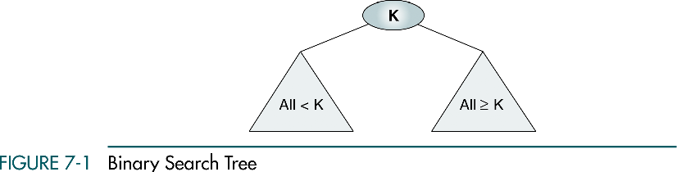

Slide 36
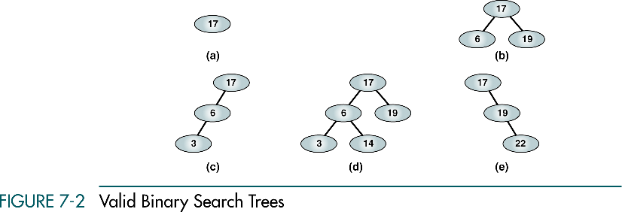
(a), (b) - complete and balanced trees;
(d) – nearly complete and balanced tree;
(c), (e) – neither complete nor balanced trees

Slide 37
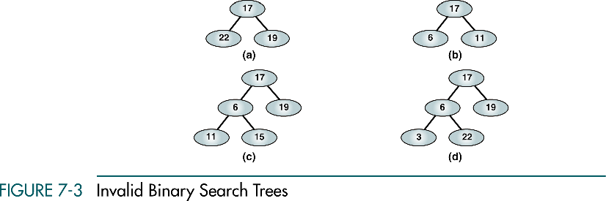

Slide 38
7-2 BST Operations
We discuss four basic BST operations: traversal, search, insert, and delete; and develop algorithms for searches, insertion, and deletion.
Traversals
Searches
Insertion
Deletion

Slide 39
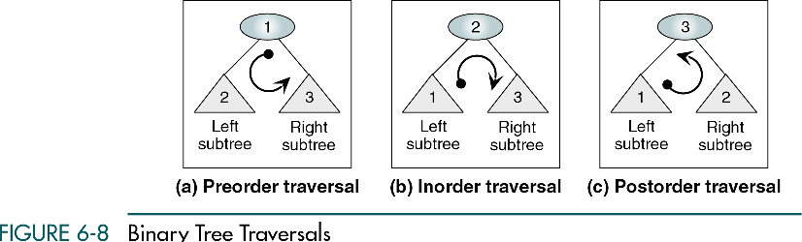

Slide 40
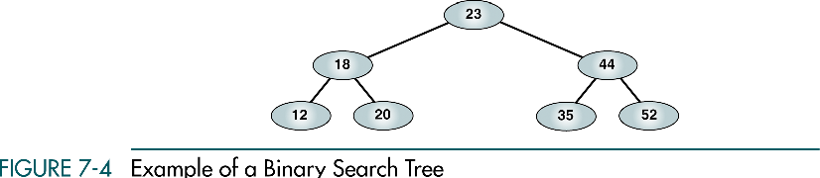

Slide 41
Preorder Traversal
23 18 12 20 44 35 52

Slide 42
Postorder Traversal
12 20 18 35 52 44 23

Slide 43
Inorder Traversal
12 18 20 23 35 44 52
Inorder traversal of a binary search tree produces a sequenced list

Slide 44
Right-Node-Left Traversal
52 44 35 23 20 18 12
Right-node-left traversal of a binary search tree produces a descending sequence

Slide 45
Three BST search algorithms:
Find the smallest node
Find the largest node
Find a requested node

Slide 46
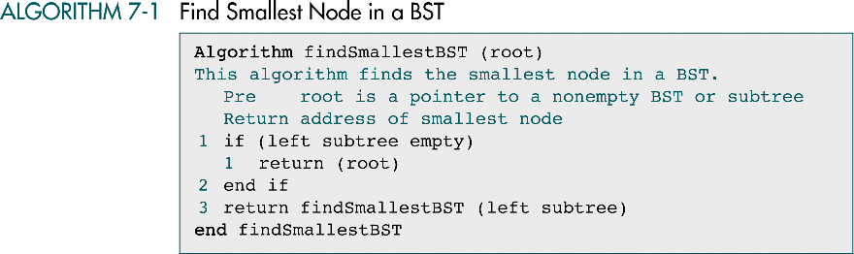

Slide 47
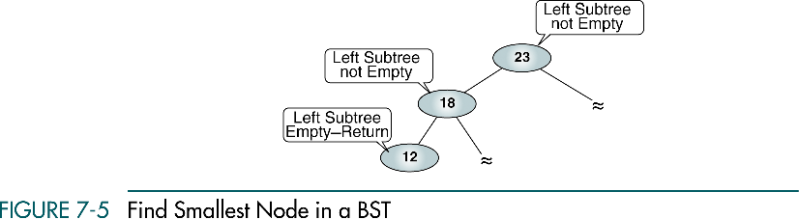

Slide 48
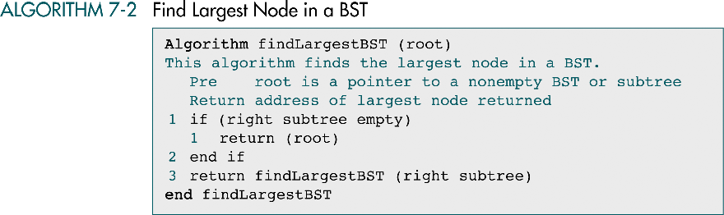

Slide 49
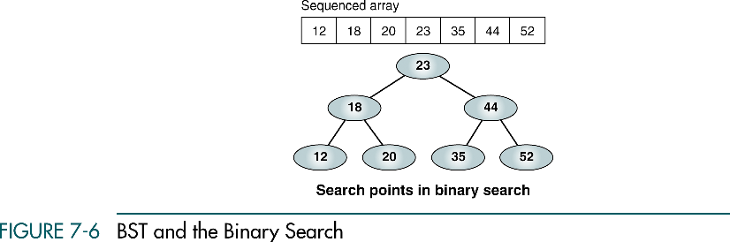

Slide 50
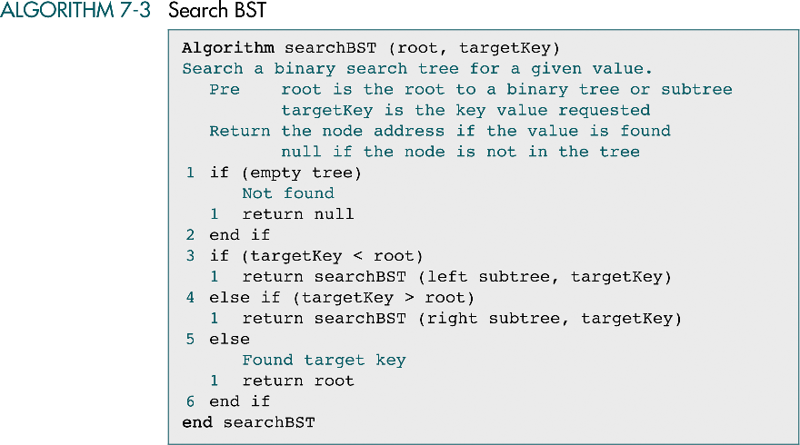

Slide 51
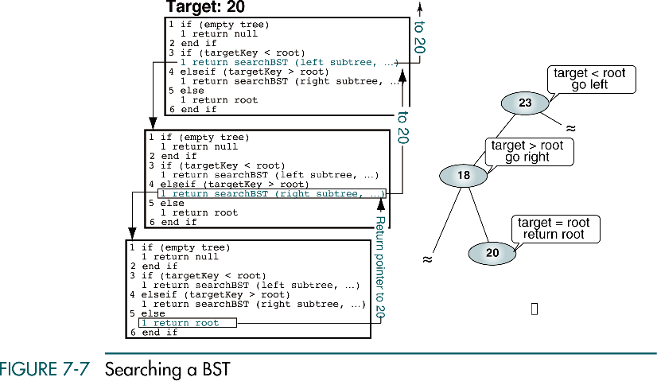

Slide 52
BST Insertion
To insert data all we need to do is follow the branches to an empty subtree and then insert the new node.
In other words, all inserts take place at a leaf or at a leaflike node – a node that has only one null subtree.

Slide 53
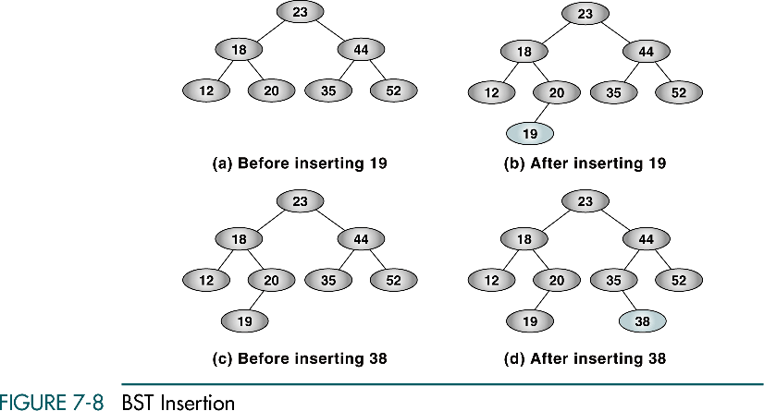

Slide 54
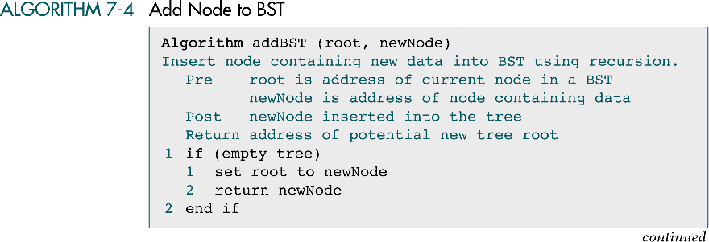

Slide 55
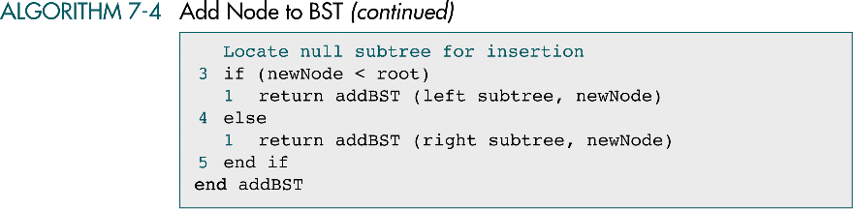

Slide 56
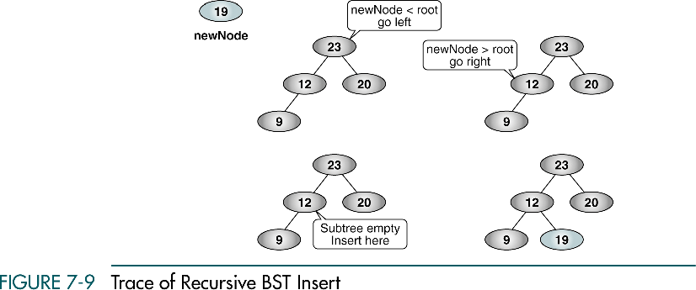
30
30
30
30

Slide 57
Deletion
There are the following possible cases when we delete a node:
The node to be deleted has no children. In this case, all we need to do is delete the node.
The node to be deleted has only a right subtree. We delete the node and attach the right subtree to the deleted node’s parent.
The node to be deleted has only a left subtree. We delete the node and attach the left subtree to the deleted node’s parent.
The node to be deleted has two subtrees. It is possible to delete a node from the middle of a tree, but the result tends to create very unbalanced trees.

Slide 58
Deletion from the middle of a tree
Rather than simply delete the node, we try to maintain the existing structure as much as possible by finding data to take the place of the deleted data. This can be done in one of two ways.

Slide 59
Deletion from the middle of a tree
We can find the largest node in the deleted node’s left subtree and move its data to replace the deleted node’s data.
We can find the smallest node on the deleted node’s right subtree and move its data to replace the deleted node’s data.
Either of these moves preserves the integrity of the binary search tree.

Slide 60
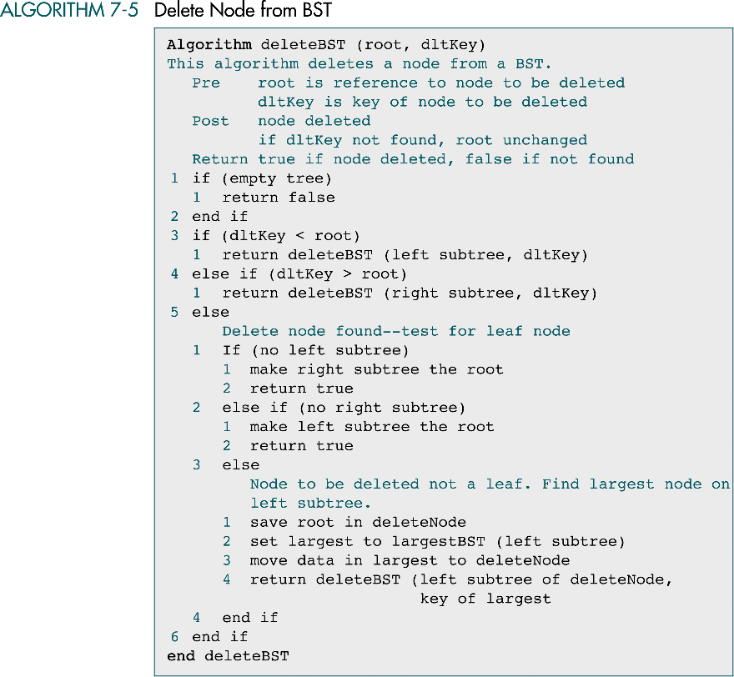

Slide 61
(continued)

Slide 62
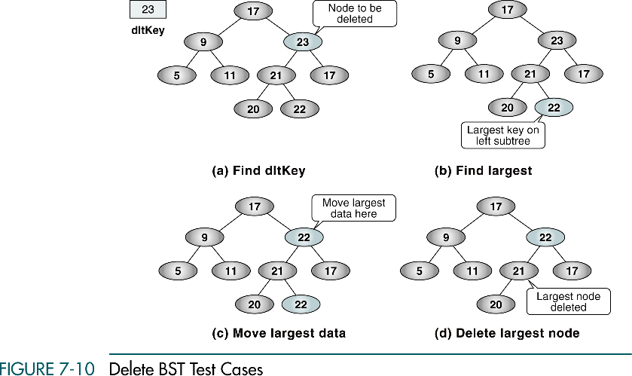
27
27
27
27

Slide 63
Lets start with an in-class assignment
(get you started with BST implementation)
You are given a BST that has integers as the data items and you have to implement finding an element in the BST.
Find(int item, Tree *root)

Slide 64
Lets start today with an in-class assignment
You are given the sequence of elements printed out during inorder and preorder traversals
Inorder: g d h b e i a f j c
Preorder: a b d g h e i c f j
Can you generate the binary seach tree?

Slide 65
Binary Tree Construction
• Suppose that the elements in a binary tree are
distinct.
• Can you construct the binary tree from which a given
traversal sequence came?
• When a traversal sequence has more than one
element, the binary tree is not uniquely defined.
• Therefore, the tree from which the sequence was
obtained cannot be reconstructed uniquely.
2/21/2006

Slide 66
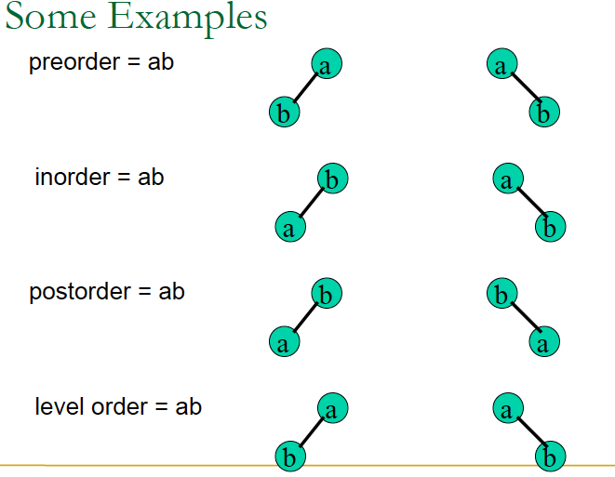
2/21/2006

Slide 67
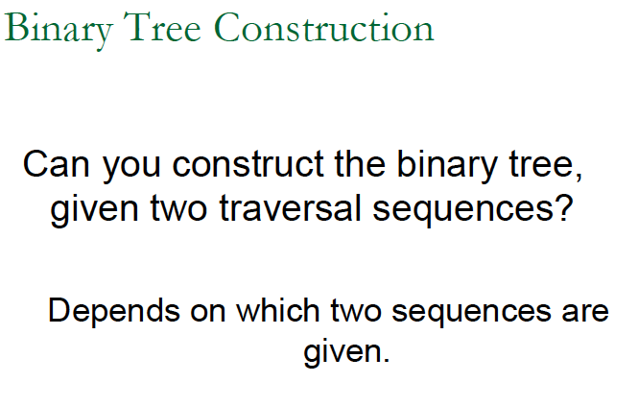
2/21/2006

Slide 68
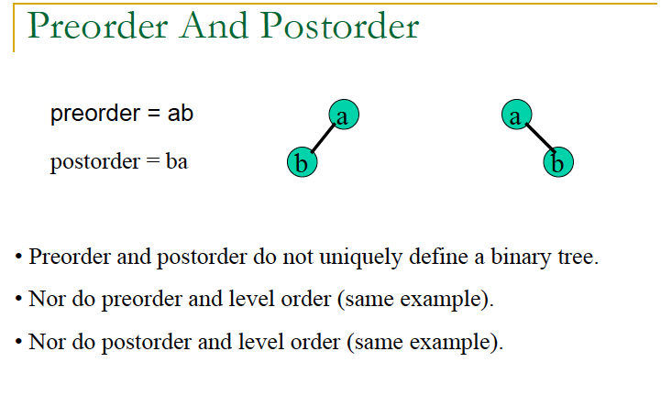
2/21/2006

Slide 69
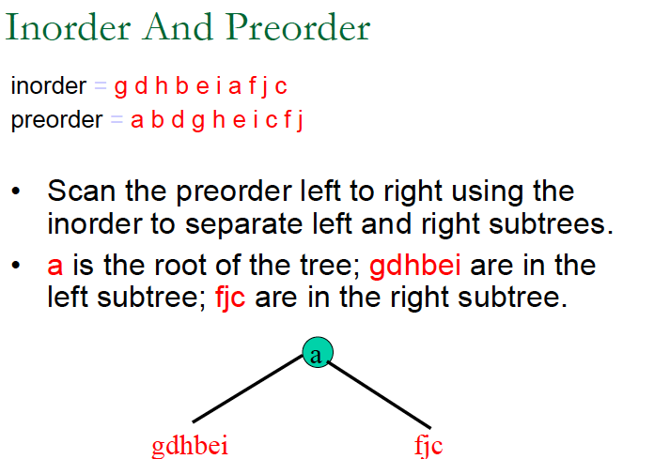
2/21/2006

Slide 70
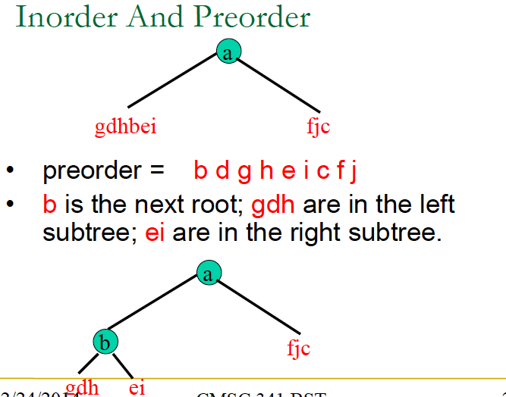
2/21/2006

Slide 71
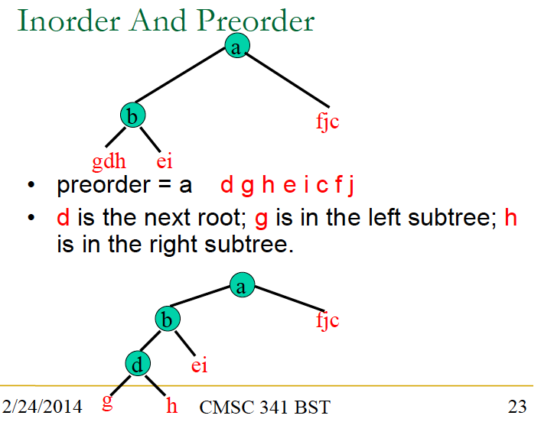
2/21/2006

Slide 72
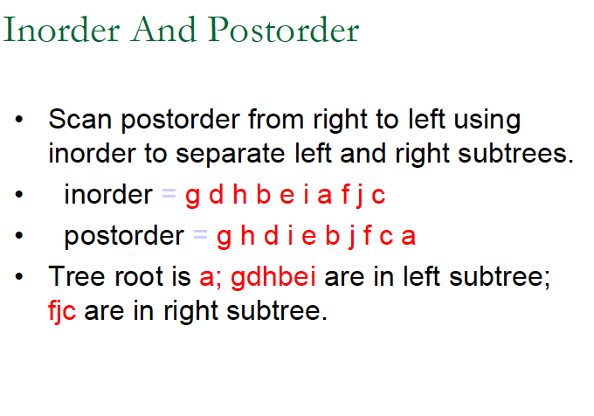
2/21/2006

Slide 73
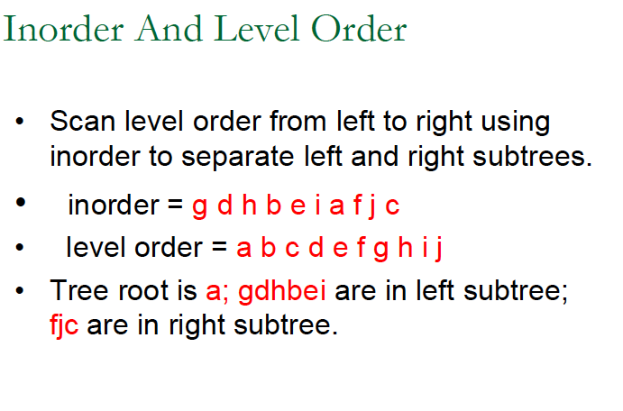
2/21/2006

Slide 74
Comparing Binary Search Trees to Linear Lists
Big-O Comparison
Operation | Binary Search Tree | Array-based List | Linked List
Constructor | O(1) | O(1) | O(1)
Destructor | O(N) | O(1) | O(N)
FBT | O(1) | O(1) | O(1)
Empty BT | O(1) | O(1) | O(1)
Search Item | O(logN) | O(logN) | O(N)
Insert Item | O(logN) | O(N) | O(N)
DeleteItem | O(logN) | O(N) | O(N)

