Slide 1
Midterm II review
Notes:
Cpt S 223
Washington State University

Slide 2
Hash Tables: Basic Idea
Use a key (arbitrary string or number) to index directly into an array – O(1) time to access records
  A[“kreplach”] = “tasty stuffed dough”
  Need a hash function to convert the key to an integer
 | Key | Data
0 | kim chi | spicy cabbage
1 | kreplach | tasty stuffed dough
2 | kiwi | Australian fruit

Slide 3
Properties of Good Hash Functions
Must return number 0, …, tablesize
Should be efficiently computable – O(1) time
Should not waste space unnecessarily
  For every index, there is at least one key that hashes to it
  Load factor lambda λ = (number of keys / TableSize)
Should minimize collisions
  = different keys hashing to same index

Slide 4
Integer Keys
Hash(x) = x % TableSize
Good idea to make TableSize prime. Why?
  Because keys are typically not randomly distributed, but usually have some pattern
    mostly even
    mostly multiples of 10
    in general: mostly multiples of some k
  If k is a factor of TableSize, then only (TableSize/k) slots will ever be used!
  Since the only factor of a prime number is itself, this phenomena only hurts in the (rare) case where k=TableSize

Slide 5
Strings as Keys
If keys are strings, can get an integer by adding up ASCII values of characters in key
  for (i=0;i<key.length();i++)
  hashVal += key.charAt(i);
Problem 1: What if TableSize is 10,000 and all keys are 8 or less characters long?
Problem 2: What if keys often contain the same characters (“abc”, “bca”, etc.)?
Notes:
Keys will hash only to positions 0 through 8*127 = 1016

Slide 6
Collisions and their Resolution
A collision occurs when two different keys hash to the same value
  E.g. For TableSize = 17, the keys 18 and 35 hash to the same value
  18 mod 17 = 1 and 35 mod 17 = 1
Cannot store both data records in the same slot in array!
Two different methods for collision resolution:
  Separate Chaining: Use a dictionary data structure (such as a linked list) to store multiple items that hash to the same slot
  Closed Hashing (or probing): search for empty slots using a second function and store item in first empty slot that is found

Slide 7
Hashing with Separate Chaining
h(a) = h(d)
h(e) = h(b)
Put a little dictionary at each entry
  choose type as appropriate
  common case is unordered linked list (chain)
Properties
  performance degrades with length of chains
  λ can be greater than 1
0
1
a
d
2
3
e
b
4
5
c
What was
λ??
6
Notes:
What decides what is appropriate?
Memory requirements
Speed requirements
Expected size of dictionaries
How easy is comparison (< vs. ==)
Why unordered ll then?
Small mem. requirement; near zero if empty dictionary!
Fast enough if small
Only need == comparison
Where should I put a new entry?
(Think splay trees)
What _might_ I do on a successful search?

Slide 8
Alternative Strategy: Closed Hashing
Problem with separate chaining:
Memory consumed by pointers –
32 (or 64) bits per key!
What if we only allow one Key at each entry?
  two objects that hash to the same spot can’t both go there
  first one there gets the spot
  next one must go in another spot
Properties
  λ ≤ 1
  performance degrades with difficulty of finding right spot
h(a) = h(d)
h(e) = h(b)
0
1
a
2
d
3
e
4
b
5
c
6
Notes:
Alright, what if we stay inside the table?
Then, we have to try somewhere else when two things collide.
That means we need a strategy for finding the next spot.
Moreover, that strategy needs to be deterministic why?
It also means that we cannot have a load factor larger than 1.

Slide 9
Closed Hashing I: Linear Probing
Main Idea: When collision occurs, scan down the array one cell at a time looking for an empty cell
  h_{i}(X) = (Hash(X) + i) mod TableSize (i = 0, 1, 2, …)
  Compute hash value and increment it until a free cell is found

Slide 10
Drawbacks of Linear Probing
Works until array is full, but as number of items N approaches TableSize (λ ≈ 1), access time approaches O(N)
Very prone to cluster formation (as in our example)
  If a key hashes anywhere into a cluster, finding a free cell involves going through the entire cluster – and making it grow!
  Primary clustering – clusters grow when keys hash to values close to each other
Can have cases where table is empty except for a few clusters
  Does not satisfy good hash function criterion of distributing keys uniformly

Slide 11
Closed Hashing II: Quadratic Probing
Main Idea: Spread out the search for an empty slot –
Increment by i² instead of i
h_{i}(X) = (Hash(X) + i²) % TableSize
  h0(X) = Hash(X) % TableSize
  h1(X) = Hash(X) + 1 % TableSize
  h2(X) = Hash(X) + 4 % TableSize
  h3(X) = Hash(X) + 9 % TableSize

Slide 12
Closed Hashing III: Double Hashing
Idea: Spread out the search for an empty slot by using a second hash function
  No primary or secondary clustering
h_{i}(X) = (Hash₁(X) + iHash₂(X)) mod TableSize
  for i = 0, 1, 2, …
Good choice of Hash₂(X) can guarantee does not get “stuck” as long as λ < 1
  Integer keys:
  Hash₂(X) = R – (X mod R)
  where R is a prime smaller than TableSize

Slide 13
Lazy Deletion
delete(2)
find(7)
0
0
0
0
Indicates deleted value:
if you find it, probe again
1
1
1
1
2
2
2
#
3
7
3
7
4
4
5
5
6
6
But now what is the problem?
Notes:
You know, I never mentioned deletion for closed hashing.
What happens if we use normal physical deletion?
If we delete 2 then try to find 7, we can’t!
Fortunately, we can use lazy deletion.
But, we pay the usual penalties. Plus, we can actually run out of space in a hash table!

Slide 14

The Squished Pigeon Principle
An insert using Closed Hashing cannot work with a load factor of 1 or more.
  Quadratic probing can fail if λ > ½
  Linear probing and double hashing slow if λ > ½
  Lazy deletion never frees space
Separate chaining becomes slow once λ > 1
  Eventually becomes a linear search of long chains
How can we relieve the pressure on the pigeons?
REHASH!
Notes:
This brings us to what happens when space does get tight.
In other words, how do we handle the squished pigeon principle: it’s hard to fit lots of pigeons into not enough extra holes.
What ever will we do?
Remember what we did for circular arrays and d-Heaps?
Just resize the array, right? But we can’t just copy elements over since their hash values change with the table size.

Slide 15
Splay Trees
If any particular operation is O( N ) and we still want amortized O( lg N ) performance, then whenever a node is accessed it must be moved. Otherwise its access time is always O( N ).
The basic idea of the splay tree is that every time a node is accessed, it is pushed to the root by a series of tree rotations. This series of tree rotations is knowing as “splaying”.
If the node being “splayed” is deep, many nodes on the path to that node are also deep and by restructuring the tree, we make access to all of those nodes cheaper in the future.

Slide 16
Splay Operation
To “splay node x”, traverse up the tree from node x to root, rotating along the way until x is the root
Each rotation
  If x is root, do nothing.
  If x has no grandparent, rotate x about its parent
  If x has a grandparent,
    if x and its parent are both left children or both right children, rotate the parent about the grandparent, then rotate x about its parent
    if x and its parent are opposite type children (one left and the other right), rotate x about its parent, then rotate x about its new parent (former grandparent)

Slide 17
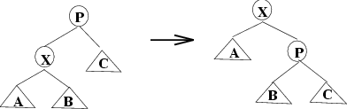
Node has no grandparent

Slide 18
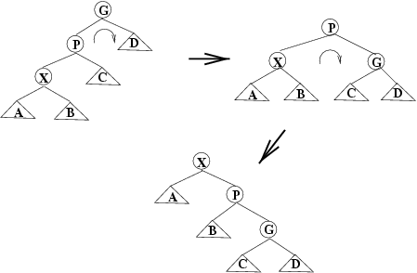
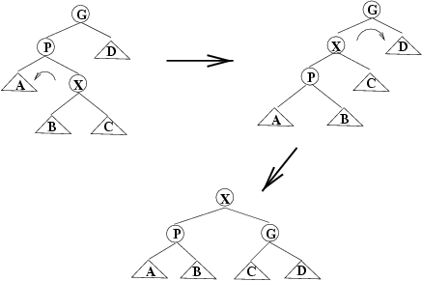
Node and Parent are Same Side
Zig-Zig
Rotate P around G, then X around P

Slide 19
Node and Parent are Different Sides
Zig-Zag
Rotate X around P, then X around G

Slide 20
Priority Queues: Specification
Main operations
  insert (i.e., enqueue)
    Dynamic insert
    specification of a priority level (0-high, 1,2.. Low)
  deleteMin (i.e., dequeue)
    Finds the current minimum element (read: “highest priority”) in the queue, deletes it from the queue, and returns it
Performance goal is for operations to be “fast”
Notes:
Cpt S 223
Washington State University

Slide 21
Binary Heap
A binary heap is a binary tree with two properties
  Structure property
  Heap-order property
Notes:
Cpt S 223
Washington State University

Slide 22

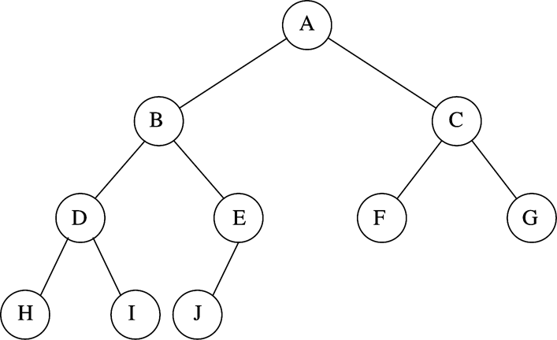
Implementing Complete Binary Trees as Arrays
Given element at position i in the array
  Left child(i) = at position 2i
  Right child(i) = at position 2i + 1
  Parent(i) = at position
i
2i
2i + 1
i/2
Notes:
Cpt S 223
Washington State University

Slide 23
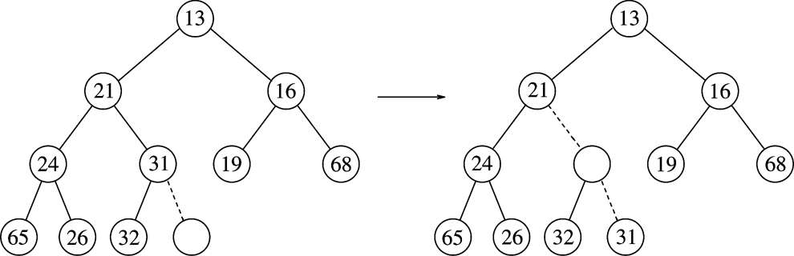
Heap Insert: Example
Percolating Up
Insert 14:
14
hole
Notes:
Cpt S 223
Washington State University

Slide 24
Heap Insert: Example
Percolating Up
(1)
14 vs. 31
Insert 14:
14
14
hole
Notes:
Cpt S 223
Washington State University

Slide 25
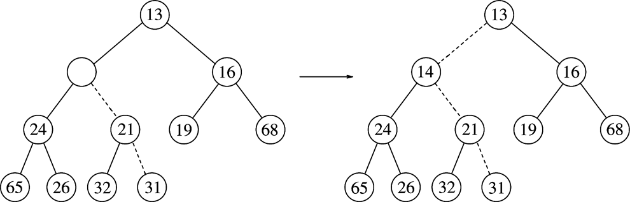
Heap Insert: Example
Percolating Up
(1)
14 vs. 31
Insert 14:
14
14
hole
(2)
14 vs. 21
14
Notes:
Cpt S 223
Washington State University

Slide 26
Heap Insert: Example
Percolating Up
(1)
14 vs. 31
Insert 14:
14
hole
(2)
14 vs. 21
(3)
14 vs. 13
Heap order prop
14
Structure prop
Path of percolation up
Notes:
Cpt S 223
Washington State University

Slide 27
Heap DeleteMin
Minimum element is always at the root
Heap decreases by one in size
Move last element into hole at root
Percolate down while heap-order property not satisfied
Notes:
Cpt S 223
Washington State University

Slide 28
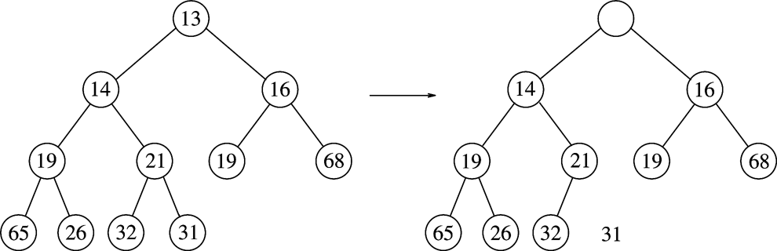
Heap DeleteMin: Example
Percolating down…
Make this position empty
Notes:
Cpt S 223
Washington State University

Slide 29
Heap DeleteMin: Example
Percolating down…
Copy 31 temporarily
here and move it down
Make this position empty
Is 31 > min(14,16)?
Yes - swap 31 with min(14,16)
Notes:
Cpt S 223
Washington State University

Slide 30
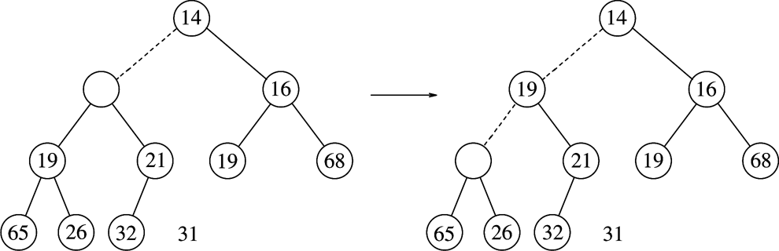
Heap DeleteMin: Example
Percolating down…
31
Is 31 > min(19,21)?
Yes - swap 31 with min(19,21)
Notes:
Cpt S 223
Washington State University

Slide 31
Heap DeleteMin: Example
Percolating down…
31
31
Is 31 > min(19,21)?
Yes - swap 31 with min(19,21)
Is 31 > min(65,26)?
Yes - swap 31 with min(65,26)
Percolating down…
Notes:
Cpt S 223
Washington State University

Slide 32
Building a Heap
Construct heap from initial set of N items
Solution 1
  Perform N inserts
  O(N log₂ N) worst-case
Solution 2 (use buildHeap())
  Randomly populate initial heap with structure property
  Perform a percolate-down from each internal node (H[size/2] to H[1])
    To take care of heap order property
Notes:
Cpt S 223
Washington State University

Slide 33
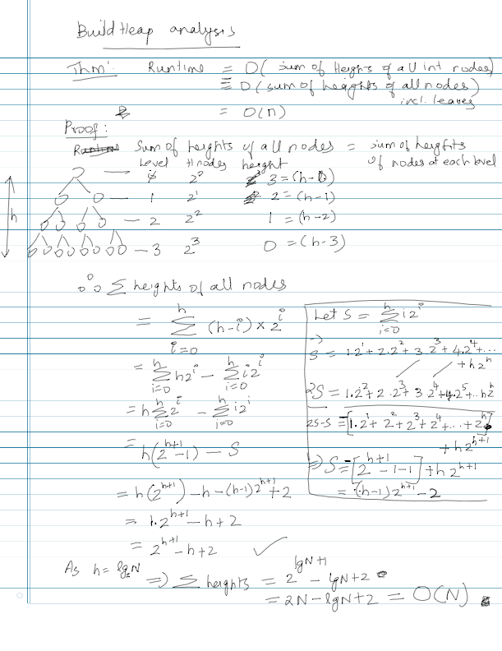
Notes:
Cpt S 223
Washington State University

Slide 34
Union-Find Data Structure
How is a Union Find Data Structure implemented
What is the quick-find operation
What is the quick-union operation
What are the two optimization
  Weighing
  Path compression
Notes:
Cpt S 223
Washington State University

