Slide 1

2024 The Course of Making AI Tutor of [X]
10 Weeks of AI Innovation and Hands-On Learning
by Alwin Lin

Slide 2
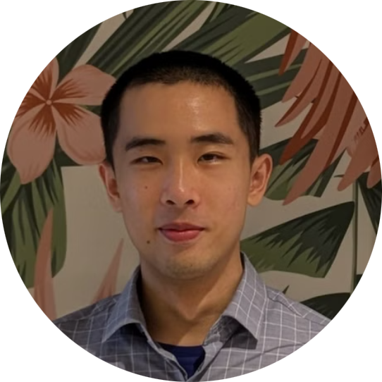


Who are we?
Yu-Jen Lin
Li-Ta Hsu
Sam Lin
Founder/Lecturer
Lead Mentor
Lead Coach
CS Equity AI
Hong Kong Polytechnic University
Google

Slide 3
About this bootcamp
What is this Bootcamp About?
Bootcamp Goals
Duration: 10 weeks, excluding holidays
Understand AI Fundamentals: Learn LLMs, embeddings, and RAG.
Goal: Build a RAG-based AI Tutor tailored to your interests.
Experience: Learn AI fundamentals, work hands-on, and showcase your creativity.
Develop Practical Skills: Work with Gemini, ChromaDB, and other libraries.
Create a Custom AI Tutor: Apply skills to a real-world project.
Prepare for Applications: Gain transferable skills for academics and beyond.

Slide 4
Attendance Policy
One absence for personal reasons.
Inform your team lead and lecturer at least three days in advance via email at csquityai@gmail.com.
Second absence is accepted for health or unavoidable circumstances.
Beyond two absences, your participation may be affected and you will not be eligible for a certificate.
Recordings will be available for missed sessions.

Slide 5
Weekly schedule
Phase 1: The basics
Phase 2: Meeting with your coaches
Week 1: Orientation
Week 6: Advanced RAG Techniques
Week 2: Introduction to Prompt Engineering
Week 7: Building the AI Tutor Core
Week 3: Introduction to Ducky AI & Gemini
Week 8: Testing and Evaluation
Week 4: Gemini API Labs & Setting up for Interactions
Week 9: Deployment and Scalability
Week 5: Vector Embedding and Semantic Retrieval
Week 10: Showcase and Presentations

Slide 6
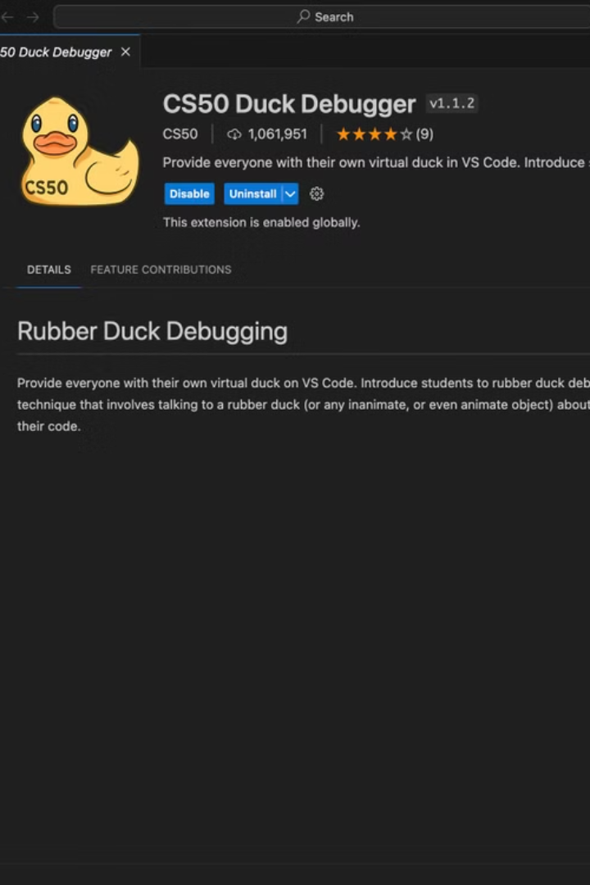
Week 5 Midterm
Who
1 submission per group to your Github
What
A baseline chat bot with RAG capabilities that could:
Ingest multiple filse
Proper data chunking
Chat history
When
Due 01/23, 1 day before week 6
How
Fork GitHub repo

Slide 7
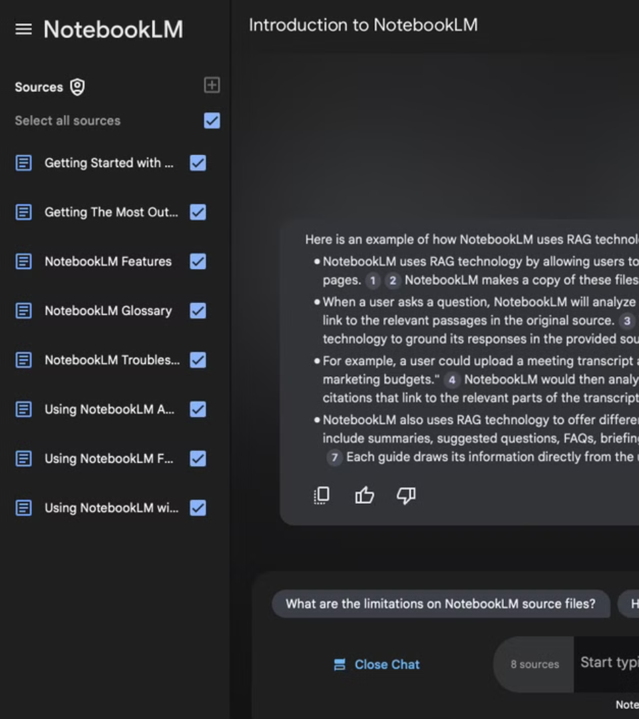
Final Project
Who:
You and your team of 5~6
Showcase to peers, instructors, and invited guests.
What:
Present a functioning AI Tutor using RAG principles.
Documentations
Upload code to GitHub
When:
March 1st
How:
Explain your project’s goals, design, and implementation.

Slide 8
Grading Rubric
Category
Weight
Criteria
Functionality
50%
- The bot operates without errors and fulfills its intended purpose.
- Accurate integration of RAG (e.g., demonstrates retrieval of relevant external data sources and effectively grounds responses).
- Smooth interactions (clear responses, low latency, logical outputs).
Innovation & Creativity
25%
- Unique or creative application of the bot for a specific subject or user group.
- Effective use of Gemini and embedding techniques to tailor the project.
- Demonstrates originality in features or design.
Presentation Quality
25%
- Clear and structured presentation explaining the bot’s goals, design choices, and technical implementation.
- Demonstrates a solid understanding of RAG principles and embedding models.
- Engages the audience with visuals (e.g., slides, live demo, or flowcharts) and answers questions effectively.

Slide 9
Tools and Preparation Overview
GitHub:
Create a GitHub account.
Learn how to make a pull request.
Google Cloud Platform (GCP):
Familiarize yourself with GCP basics.
Set up access to the Gemini API.
Google Colab:
Explore Google Colab features.
Learn markdown basics.
Practice GitHub integration.

Slide 10
Q&A and Next Steps
Team Breakout room
Come up with a team name
Think about areas where AI could help your studies.
Setup Accounts if you are missing Github or Gmail
Prepare for Week 2:
Complete pre-work (Gemini setup, GitHub basics).
Review reading materials.

