Slide 1
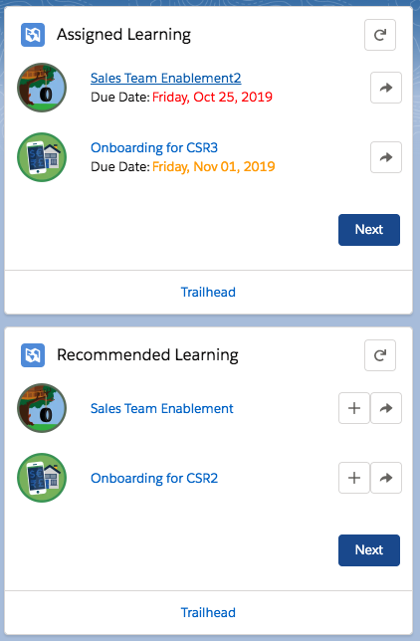
th_trailheadAssignments
th_TrailheadRecommend
th_paginator
th_trailhead
Assignment_entry

