Slide 1



Geometric Morphometrics and Archaeology
Dr. Christian Hoggard
CSHoggard

Slide 2
いらっしゃいませ! (Welcome!)
Get connected to the Wi-Fi
Get the workshop materials https://github.com/CSHoggard/-Morph2019
Ensure R/Rstudio and packages are on your laptop Follow instructions in setup.R
Stuck? Please ask for help!

Slide 3
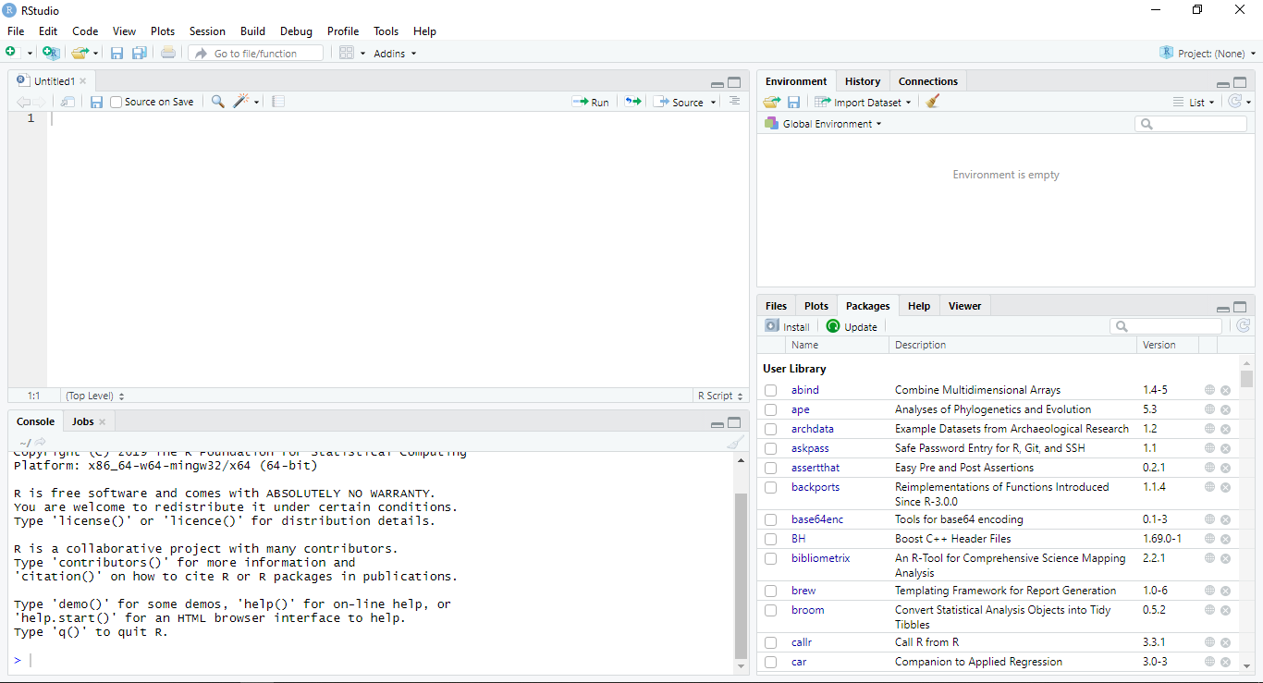

Slide 4
Dr. Christian S. Hoggard
Position: Visiting Fellow (University of Southampton)
Previous: Postdoctoral Researcher (Aarhus University)
Interests: R Stats / GMM (2D) / Palaeolithic / Cultural Taxonomies
Recent publications
Vestergaard, C. and Hoggard, C.S. (2019). A Novel Geometric Morphometric (GMM) Application to the Study of Bronze Age Tutuli. Danish Journal of Archaeology.
Riede, F., Hoggard, C.S. and Shennan, S. (2019). Reconciling material cultures in archaeology with genetic data requires robust cultural evolutionary taxonomies. Nature: Palgrave Communications..
Hoggard, C.S., McNabb, J. and Cole, J.N. (2019). The application of elliptic Fourier analysis in understanding biface shape and symmetry through the British Acheulean. Journal of Paleolithic Archaeology.
Hoggard, C.S. and Stade, C.M. (2018). The efficiency Of Middle Palaeolithic technological blade strategies: an experimental investigation. Lithics: the journal of the Lithic Studies Society.

Slide 5
Format for today…
An introduction to GMM (c. 45 minutes)
Practical #1: Landmark analysis (c. 60 minutes)
Outline analysis (c. 45 minutes)
Practical #2: Elliptic Fourier Analysis (EFA) (c. 60 minutes)
Session wrap-up (c. 15 minutes)

Slide 6

“Art of the possible”

Slide 7
Morphometrics and Geometric Morphometrics…

Slide 8
Morphometrics 101
First coined by Professor of Zoology (UCD) Robert Blackith in 1957
Quantitative study of shape, shape variation and shape covariation
Two types of morphometric studies:
Traditional morphometrics (e.g. length measurements, angles, ratios…)
Geometric morphometrics (e.g. landmarks, outlines and curves, surfaces…)
Note: Geometric Morphometrics ≯ Traditional Morphometrics
Blackith, E.R. (1957). Polymorphism in Some Australian Locusts and Grasshoppers. Biometrics., 13.: 183.

Slide 9
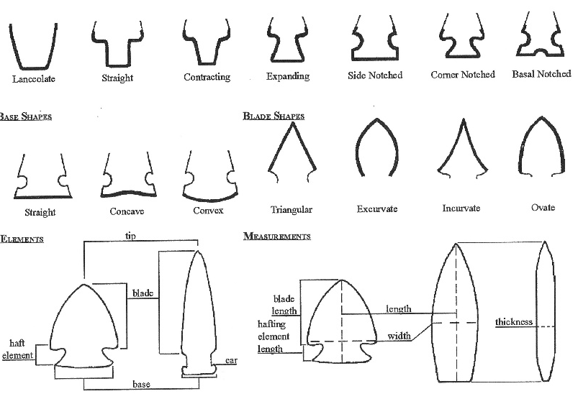
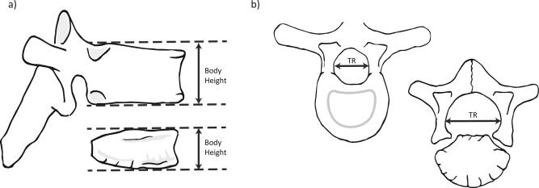

Slide 10
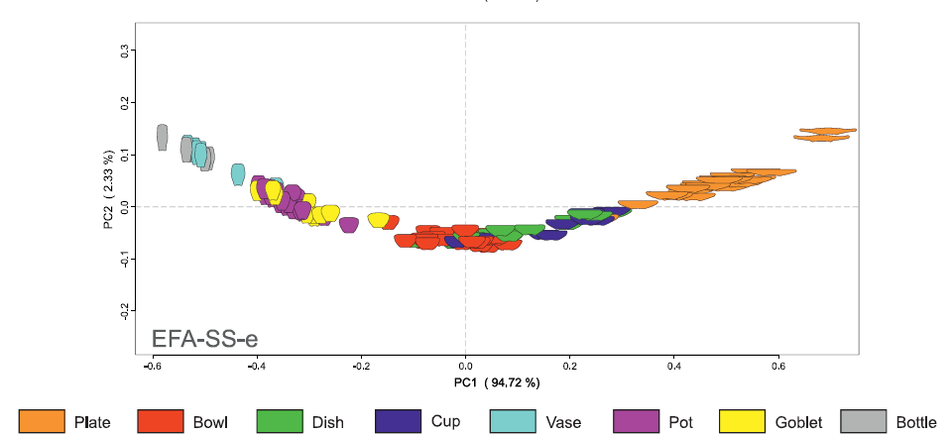
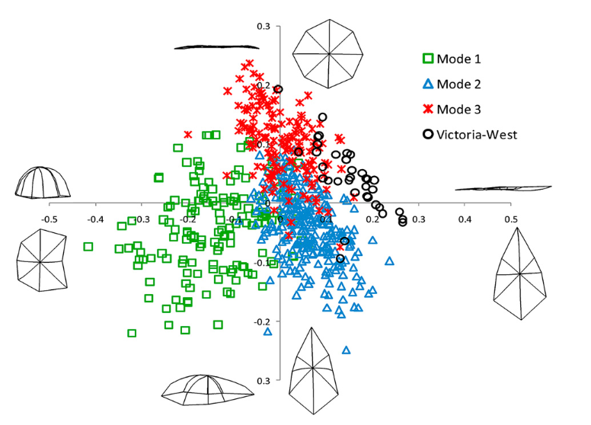
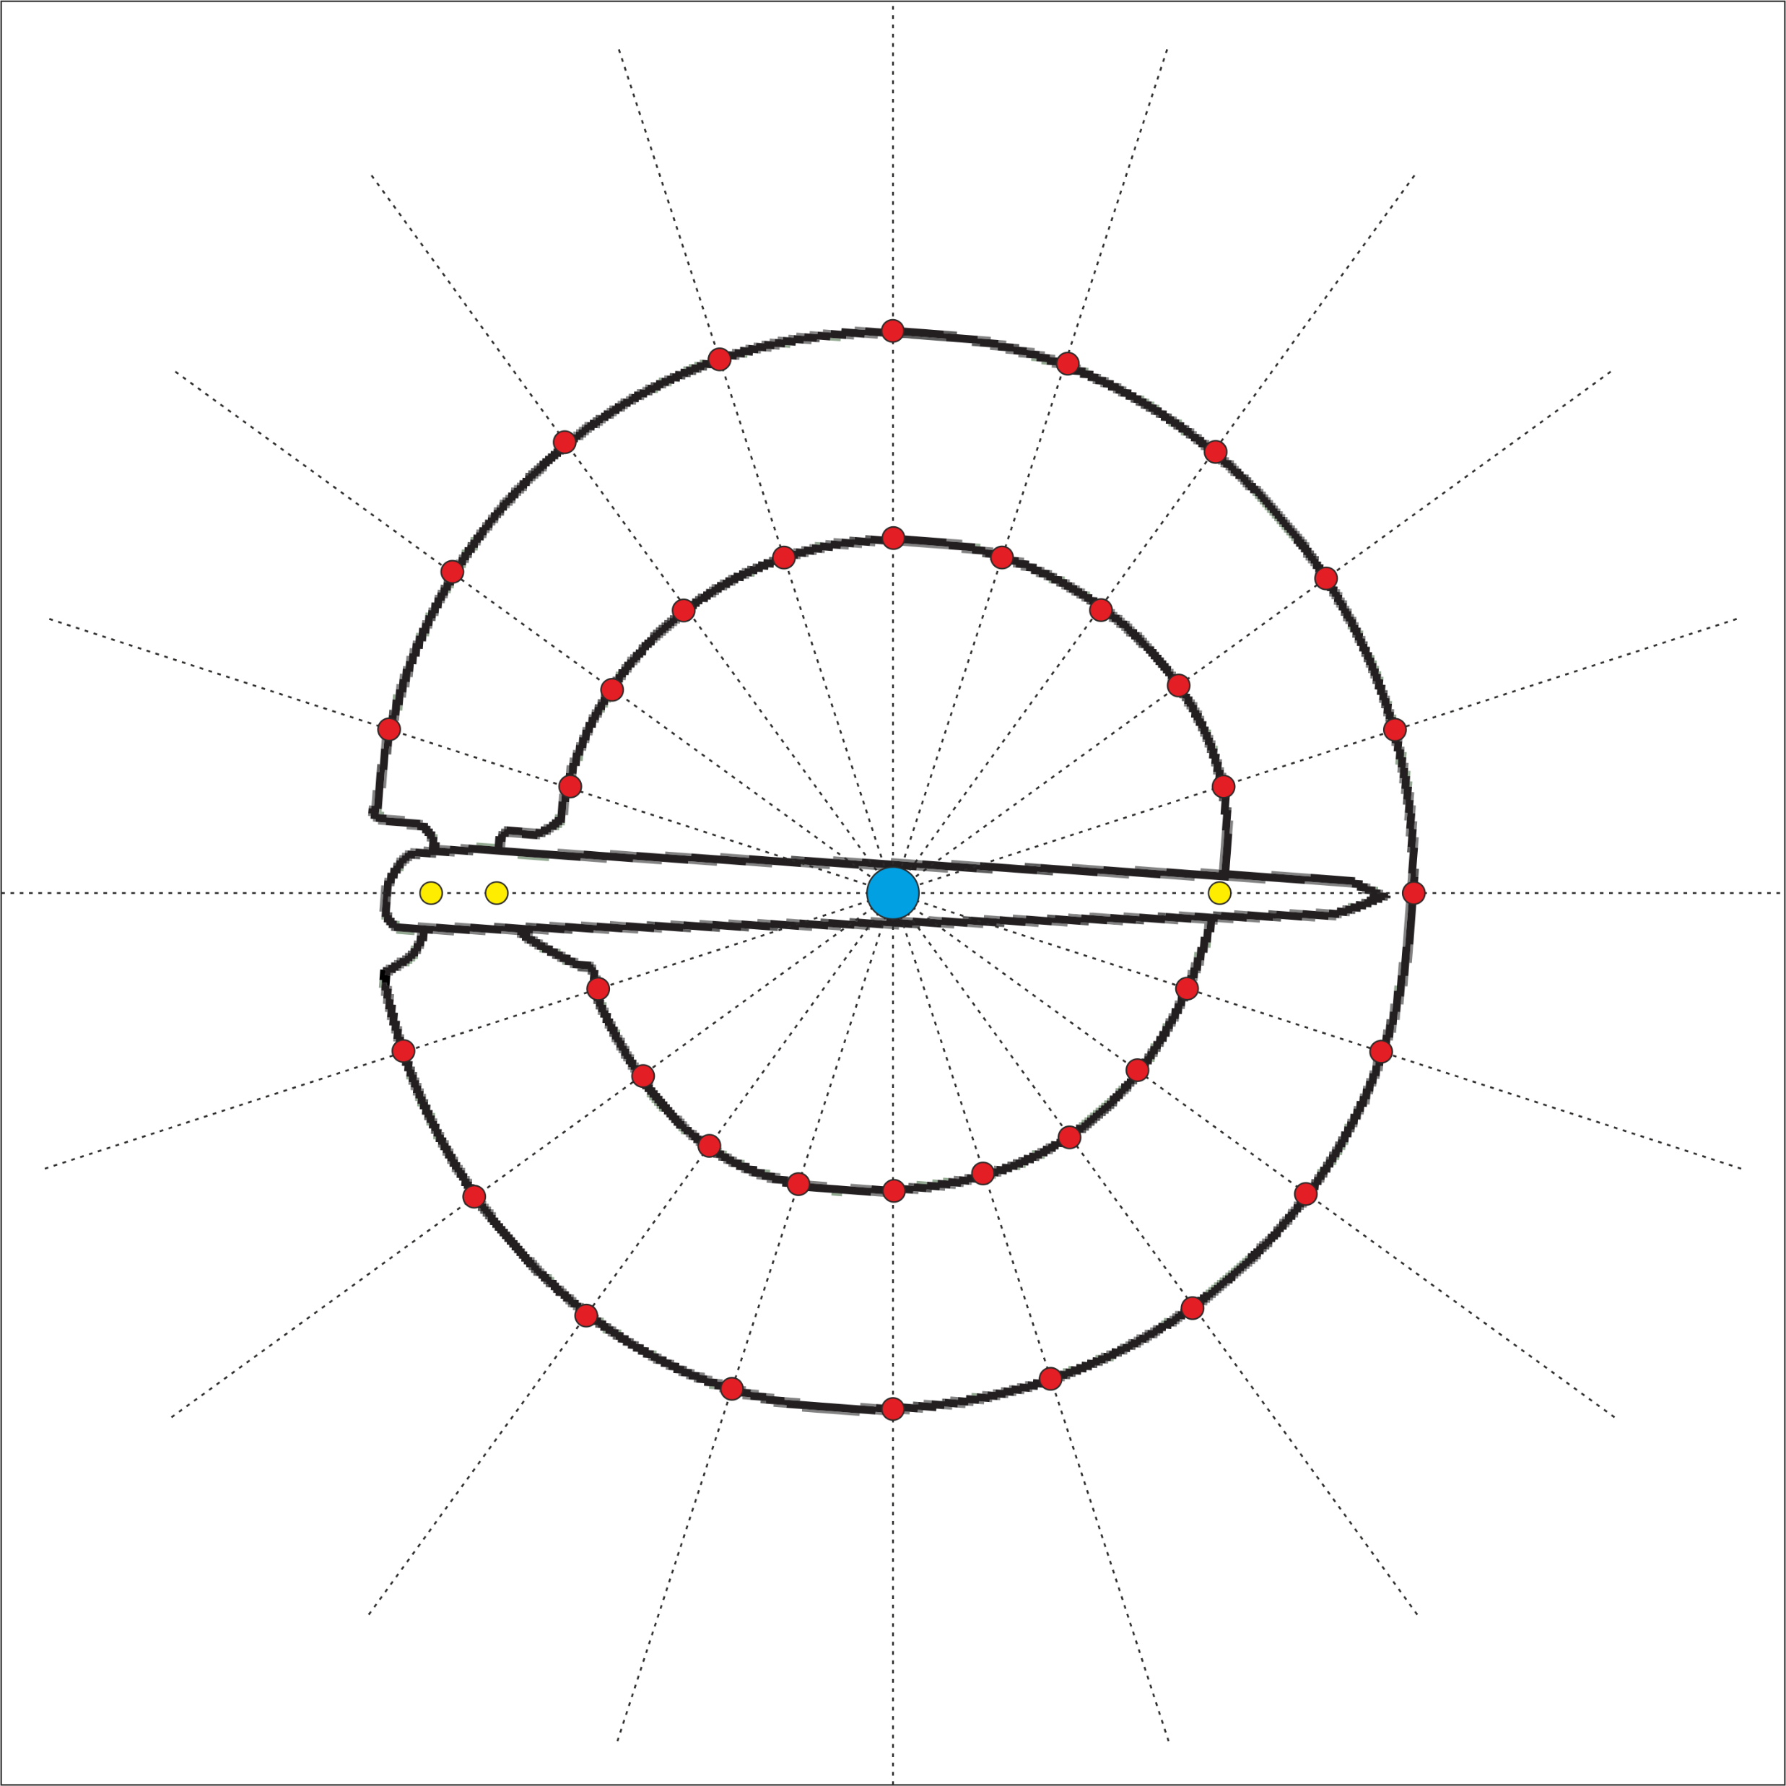

Slide 11

What do we mean by shape and size

Slide 12
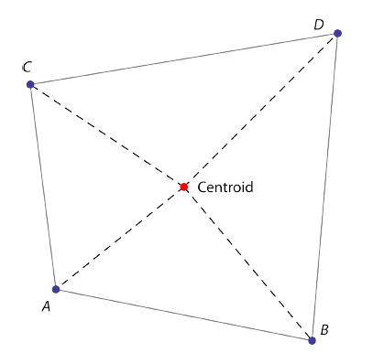
Shape
Size
Vague term: what to use? Length? Circumference?
(Small, 1996)
Preferred term…
(Small, 1996)
“In general terms, the shape of an object, dataset or image that can be defined as the total of all information is invariant under translation, rotation, and isotropic rescalings”
Centroid size: square root of the summed squared lengths of the dashed lines
Mitteroecker, P., Gunz, P., Windhager, S., Schaefer, K. (2013). A brief review of shape, form, and allometry in geometric morphometrics, with applications to human facial morphology. Hysterix, the Italian Journal of Mammalogy. pp. 59-66.
Small, C. (1996). The statistical theory of shape. New York: Springer.

Slide 13
Aim of Geometric Morphometrics
Determine whether two assemblages are different in terms of their shape?
Determine how are these related to size? time? raw material? hominin?
Determine whether differences correspond to a hypothesis or a model?
Determine on an assemblage level: what is the mean shape?
Determine, with respect to size: is there an allometric relationship?

Slide 14
Advantages
Disadvantages
Powerful method of documenting shape change
Less information is lost in comparison to lineal measurements
Can easily be collected from a variety of methods (e.g. photographs)
Abstraction and registration method permits an analysis of exclusively shape
Size is often removed which may be of biological importance (can be reintegrated)
Skill competency: often requires specialised software and knowledge

Slide 15

A short history of geometric morphometrics…

Slide 16
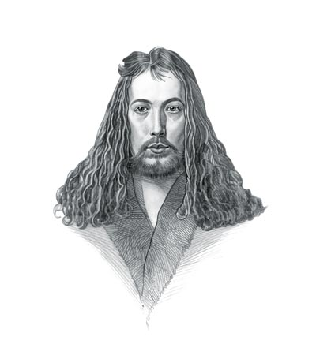
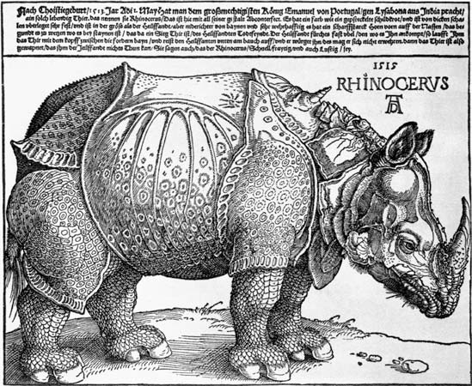
Albrecht Dürer (1471-1528)
Painter, printmaker and theorist
Founder of descriptive geometry working on helices, conchoids and epicycloids
Investigated the Delian Problem (doubling the cube)
Used shape transformations of the human head in his studies on human proportions (providing the basis of determining shape change)

Slide 17
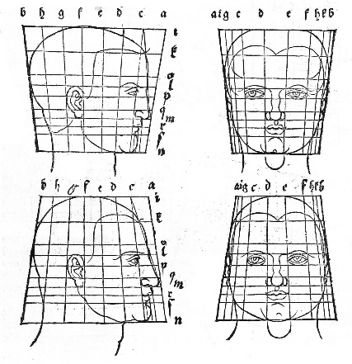
Dü rer, A. (1528). De Symetria Partium in Rectis Formis Humanorum Corporum Libri, German edn. Patav. Nuremberg: Parisiis Curvi ac recti proportio.

Slide 18
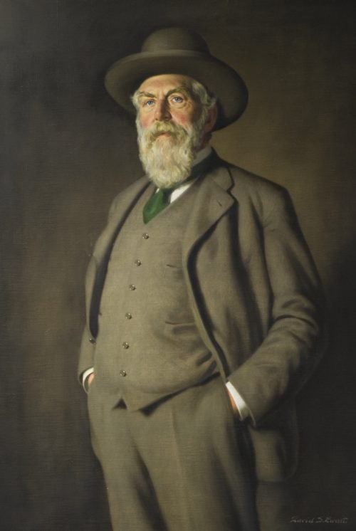
Sir D’Arcy Wentworth Thompson (1860-1948)
Biologist, mathematician and classics scholar
Famous for his quotes on the mathematical beauty of nature (inspired Huxley, Turing, Lévi-Straussand van der Rohe)
On Growth and Form (1917)
Fundamental book documenting the process of body structures formed in plants and animals
Emphasis on mathematical structures accounting for biological diversity

Slide 19
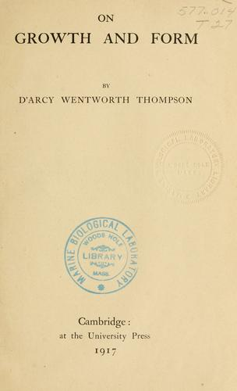
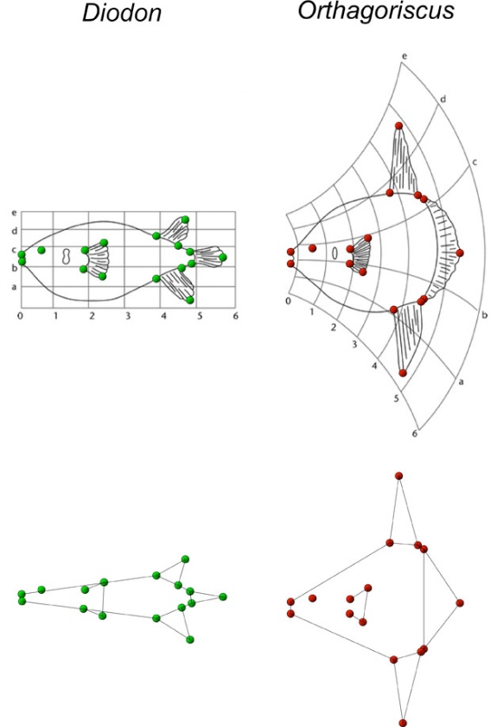
“The harmony of the world is made manifest in Form and Number, and the heart and soul and all the poetry of Natural Philosophy are embodied in the concept of mathematical beauty.”
Thompson, D.W. (1917). On Growth and Form. Cambridge University Press.

Slide 20
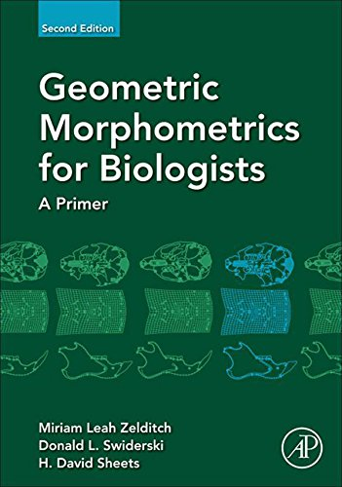
Towards a statistical framework…
From the 1960s onwards...
Fred Bookstein
Dennis Slice
Miriam Zelditch
Norman MacLeod
Ian Dryden and Kanti Mardia
James Rohlf

Slide 21
How do we ‘do’ geometric morphometrics
(Following the design study)

Slide 22
Stage 1: Dataset creation
Methods include…
CT scanning
Photogrammetry and structure from motion (SfM) recording
Microphotogrammetry
Microscribe
3D scanners (e.g. NextEngine)
Data obtained from drawings and photographs
Note: Considered the error associated with each technique

Slide 23
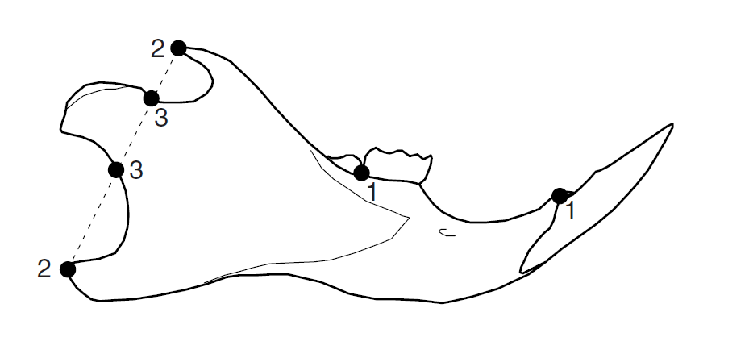
Stage 2: Landmark choice
Central to geometric morphometrics are landmarks
Landmark: coordinate point used to represent a shape and/or a homologous point on a structure
Quantifiable as Cartesian coordinates (x , y / z coordinates)
Variety of different ways of approaching what type of landmarks are necessary
Can be treated as individual points or converted (using various techniques) into curves and outlines

Slide 24
Stage 2: Landmark choice (types)
Various types of landmarks
Type I: Homologous biological structures
Type II: Geometric definition e.g. greatest curvature
Type III: Point with reference to another point
A special example: semilandmarks
Placed using an algorithm
Equidistant and placed between one or two end-points
A special Type III landmark
See also sliding semilandmarks

Slide 25
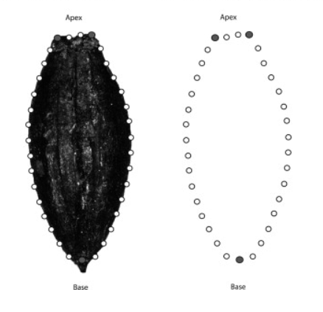
Ros, J., Evin, A., Bouby, L. & Marie-Pierre, R. (2013). Geometric morphometric analysis of grain shape and the identification of two-rowed barley (Hordeum vulgare subsp. distichum L.) in southern France. Journal of Archaeological Science. 41.

Slide 26
Stage 2: Landmark choice (position)
Quantity and coverage of landmarks:
Landmarks should sample aspects of shape which are of archaeological interest
Landmarks should be repeatable and identifiable on all examples if possible
Landmarks should cover as much of the shape as possible (issues of distortion during GPA)
Sufficient as to not increase the ‘weighting of areas’
Combination of both landmarks and semilandmarks considered ‘optimal’
Ordering:
Landmarks should always be plotted in the same order (otherwise the math wouldn’t work!)

Slide 27
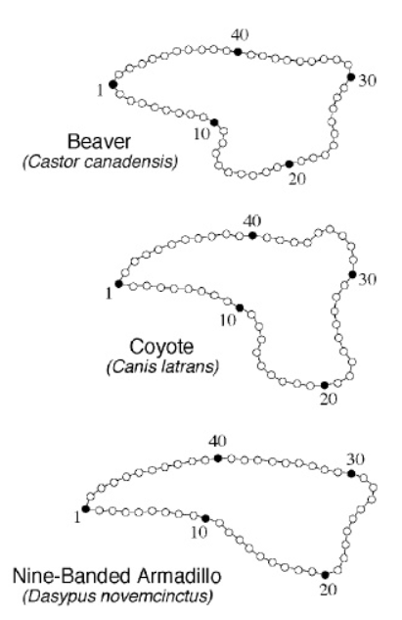
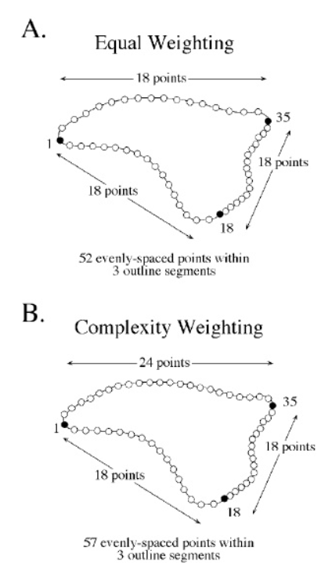
Norman MacLeod’s PalaeoMath 101 Series (http://www.palass.org/publications/newsletter/palaeomath-101)

Slide 28
Stage 2: Landmark choice (final comments)
For…
Bioarchaeologists
Greater number of points of morphological correspondence on specimens
Easier to study three-dimensional shape (orientation is less of an issue)
Archaeologists studying non-biological material
Greater creativity and thought is needed in orienting specimens and placing landmarks
Fewer case studies to compare geometric morphometric methodologies
All archaeologists
Fragmentation and sample size (representation of a population) need to be considered

Slide 29
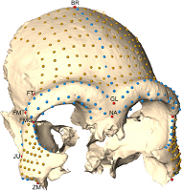
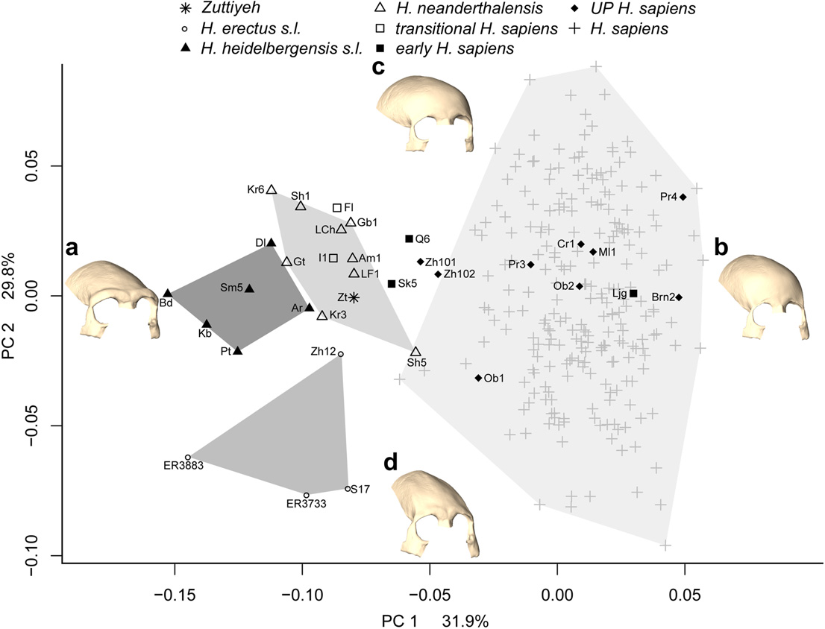
Freidline S.E, Gunz P., Janković I., Harvati K., Hublin J-J. (2012). A comprehensive morphometric analysis of the frontal and zygomatic bone of the Zuttiyeh fossil from Israel.. Journal of Human Evolution: 225-241.

Slide 30
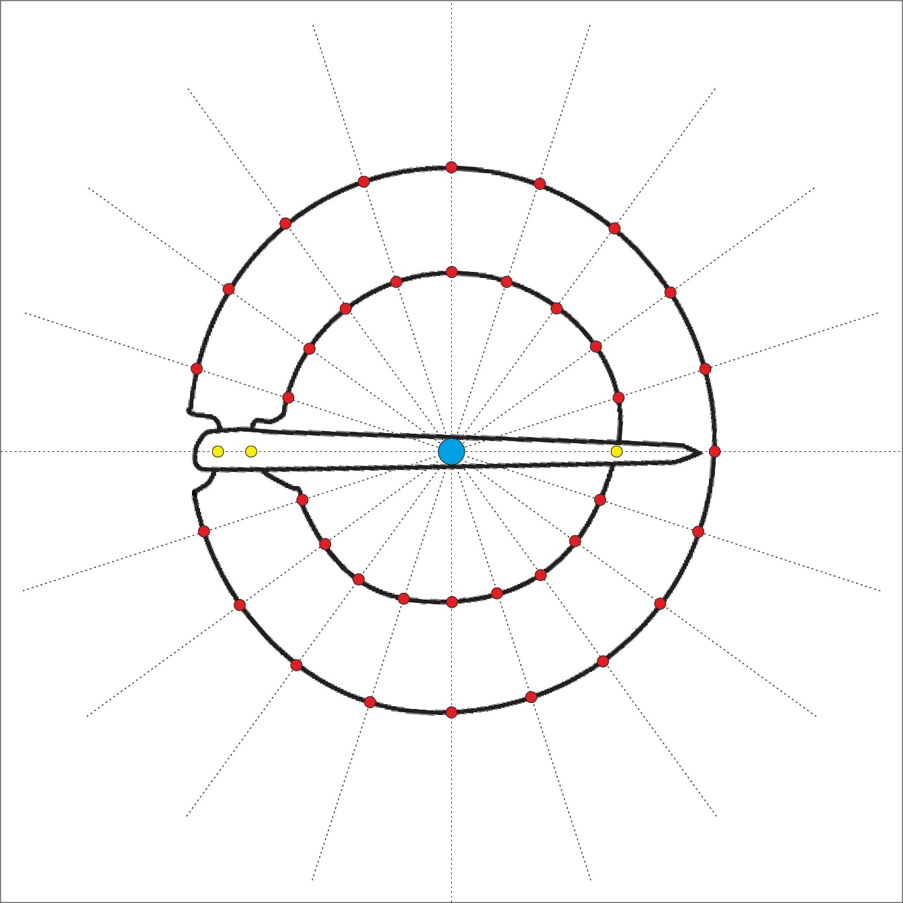
Hoggard, C.S., Lauridsen, L. and Witte, K.B. (2019). The Potential of Geometric Morphometrics for Danish Archaeology: Two Case Studies. Arkæologisk Forum, 40: 30-42.
Article: (http://www.archaeology.dk/16738/Nr.%2040%20-%202019).
OSF: https://osf.io/en5d2/.

Slide 31
Stage 3: Landmark digitisation
Variety of different programs including:
TPS Suite (TpsUtil and TpsDig2)*
R Packages (geomorph, StereoMorph and GUImorph)*
Landmark Editor (IDAV)
PhyloNimbus
Variety of different output files created including:
.tps*
.nts
.csv
.text
*using in today’s practicals

Slide 32
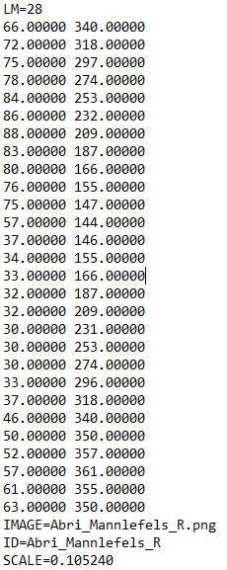
Stage 3: Landmark digitisation
Ask yourself…
Do all my specimens have the correct number of points?
Are all my landmarks in the correct order?
Are the ID labels correct?
Are they to scale? (For size-integrated analyses)

Slide 33
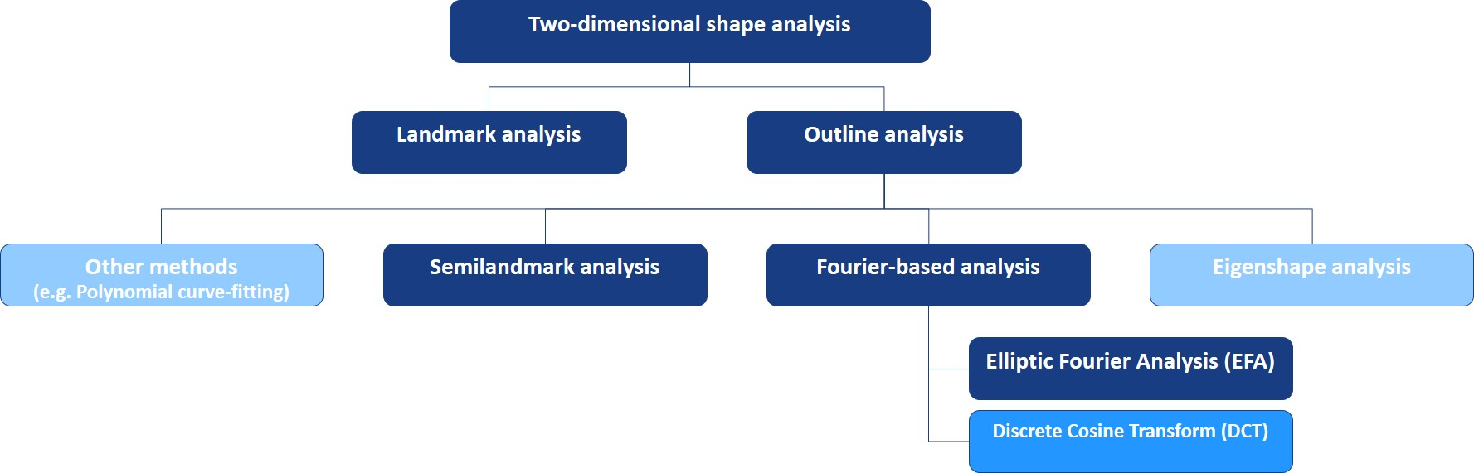

Slide 34
Landmark analysis: Generalised Procrustes Analysis (GPA)
Also known as…
Procrustes Superimposition
Procrustes Analysis
Procrustes Fitting
Generalised Least Squares
Procedure to isolate shape from a number of sometimes related variables, specifically rotation, size and translation

Slide 35
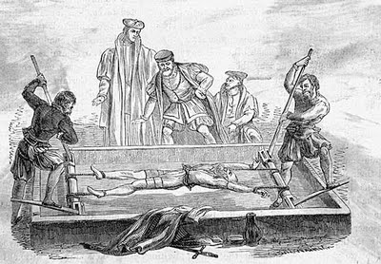
Generalised Procrustes Analysis (GPA)
In Greek Mythology…
Procrustes was a son of Poseidon and lived on a sacred way between Athens and Eleusis
There he had a bed, in which he invited every passer-by to spend the night, and where he set to work on them with his blacksmith's hammer, to stretch them to fit
In later tellings, if the guest proved too tall, Procrustes would amputate the excess length; nobody ever fitted the bed exactly
Procrustes continued his reign of terror until he was captured by Theseus, travelling to Athens along the sacred way, who "fitted" Procrustes to his own bed

Slide 36
Generalised Procrustes Analysis (GPA)
The raw coordinates are…
Translated to a common centroid
Scaled to the same centroid size
Rotated to minimise the summed square distances between corresponding landmarks
Outcome: Procrustes coordinates
The Procrustes coordinates describe shape per se
The Procrustes distance: sum of distance between corresponding transformed landmarks
These are used in subsequent statistical analyses

Slide 37
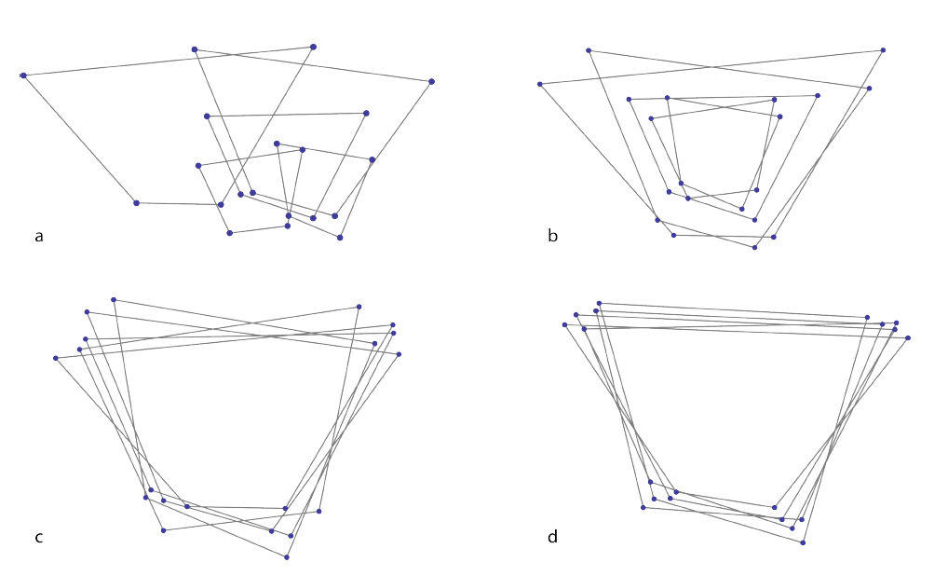
Generalised Procrustes Analysis (GPA)
Mitteroecker, P., Gunz, P., Windhager, S. & Schaefer, K. (2013). A brief review of shape, form, and allometry in geometric morphometrics, with applications to human facial morphology. Hysterix, the Italian Journal of Mammalogy. pp. 59-66.

Slide 38
Analysis
PCA: to explore the main sources of variation in shape among a dataset
LDA/CVA: to explore and assign specimens based on maximum between-group variance
Correlation and regression: shape and size (e.g. PC1 vs. centroid size)
Procrustes ANOVA: Statistical testing of difference (MANOVA)
Cluster analysis: task of grouping objects with similar shapes
Maximum likelihood (ML): permutation method of identifying trends/cluster (useful in phylogenetic studies)
Methods include…

Slide 39
Software
PCA: Eigenshape, PAST, tpsRelw, MorphoJ, R (geomorph, shapes, Momocs)
LDA/CVA: Statistica, tpsRel, MorphoJ, PAST, R (geomorph, Momocs)
Correlation and regression: Statistica, tpsRel, MorphoJ, PAST, R (geomorph, Momocs)
Procrustes ANOVA: R (geomorph)
Cluster analysis: PAST, R (Geomorph, Momocs)
Maximum likelihood: RPhylip
Programs include…

Slide 40
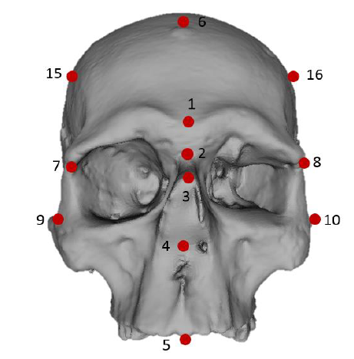
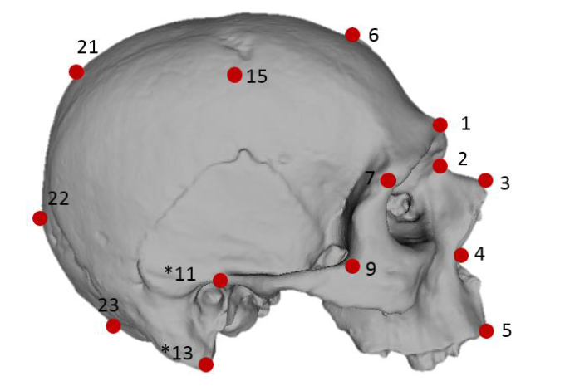
Practical #1: Landmark analysis
Step 1: Download all files on GitHub (https://github.com/CSHoggard/-Morph2019) and save in an appropriate directory
Step 2: Load “Practical_1.R” in Rstudio and set the working directory as appropriate
Step 3: Follow through the instructions and guidance in the script
Dataset used in this practical:
Six skulls (3d mesh files)
Two factors: sex and location
Methodology:
Creation of a template (23 landmarks and 200 surface semilandmarks)
Digitsation of landmarks
Generalised Procrustes Analysis
Principal Component Analysis
Procrustes ANOVA (MANOVA)

Slide 42
Outline analysis
Outline coordinates: XY coordinates along an open or closed curve
Useful for structures which are comparable in a geometric sense but where individual homologous landmarks are difficult to pinpoint e.g. tooth perimeters
Three main types of outline or curve analysis:
Semilandmark analysis
Eigenshape analysis (not as widely used)
Fourier-based analyses (EFA/DCT)

Slide 43
About the data used in outline analysis
For semilandmark analysis we need the same amount of points (the process is the same as with landmark analysis)
For Fourier-based analysis we do not need the same amount of points
For semilandmark analysis we need to start at exactly the same position
For Fourier-based analysis we do not need to start at exactly the same position

Slide 44
Elliptical Fourier Analysis (EFA)
One of a number of ‘Fourier’ based methods of curve (de-)composition
Derived from the first series by Jean Baptiste Joseph Fourier (1768-1830)
EFA was developed during the Cold War, partly by Giardina and Kuhl (1977) and Kuhl and Giardina (1982): used as a method of categorising enemy aircraft
Grounded on a set of parametric equations to fit a curve (Fourier harmonic amplitudes) from x and y Cartesian landmarks
Math: sine and cosine transformations
Product: Fourier coefficients

Slide 45
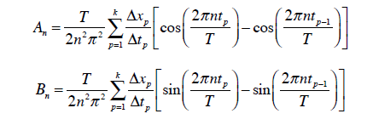
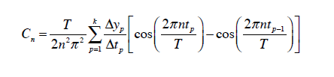
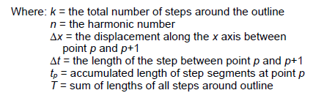

Elliptical Fourier Analysis (EFA)
When summed together, these transformations represent an approximation of an artefact form

Slide 46
Elliptical Fourier Analysis (EFA)
Outline estimation process that can provide a shape of varying detail depending on the number of harmonics you used.
Greater number of harmonics = greater detail (and more closely resembling the shape)
Too much detail = too much statistical noise
So the right level of harmonics are necessary

Slide 47
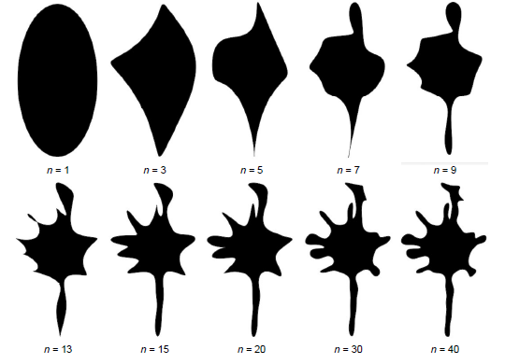
Norman MacLeod’s PalaeoMath 101 Series (http://www.palass.org/publications/newsletter/palaeomath-101)

Slide 48
Calculating harmonic power
‘Eyeing it’: see at what harmonic the shape looks right
Calculating 99% harmonic power
Calculating deviation in % of the centroid size
Calculating deviation in coefficients
For 2-4:
R/Momocs: calibrate() functions
Norman MacLeod’s PalaeoMath 101 Series (http://www.palass.org/publications/newsletter/palaeomath-101)

Slide 49
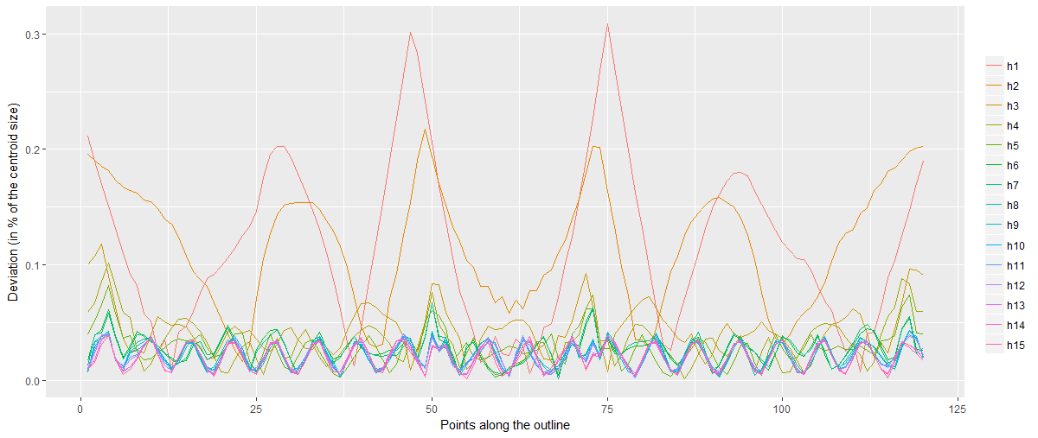
Calculating harmonic power
calibrate_deviations_efourier()

Slide 50
The output: Fourier coefficients
Similarly to landmarks a number of analyses can be performed including…
Principal Component Analysis (PCA)
Discriminant (LDA/DF/CVA) Analysis
Regression and correlation frameworks
MANOVA and statistical testing
Cluster and Maximum Likelihood (ML) methodologies
Note: coefficients can also be used to calculate symmetry, roundness and rectilinearity

Slide 51
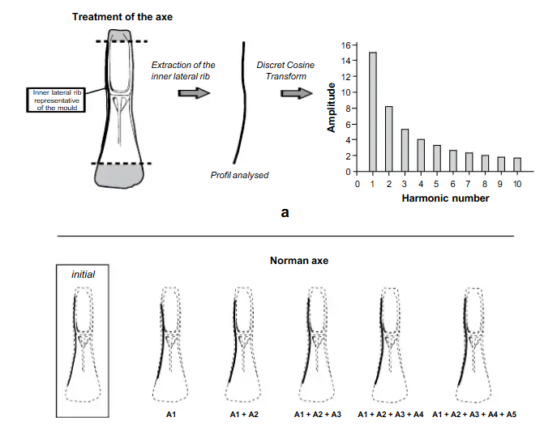
Discrete Cosine Transform (DCT)
An alternative method to EFA using cosine transformations to calculate the shape.
Useful for open outlines.
See Dommergues et al. (2007).
Note: can be performed in Momocs using the dfourier() functions.
Dommergues, C. H., Dommergues, J.-L., & Verrecchia, E. P. (2007). The Discrete Cosine Transform, a Fourier-related Method for Morphometric Analysis of Open Contours. Mathematical
Geology, 39(8), 749-763.
Forel, B. et al. (2009). Morphometry of Middle Bronze Age palstaves by Discrete Cosine Transform. Journal of Archaeological Science., 36. 721-729.

Slide 52
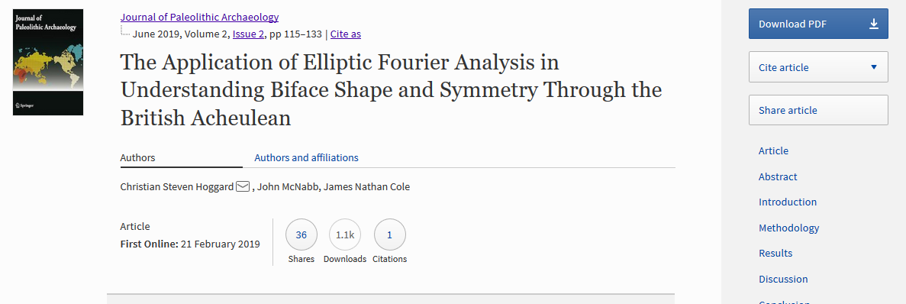
Practical #2: Outline analysis
https://doi.org/10.1007/s41982-019-00024-6

Slide 53
Practical #2: Outline analysis
RQ1: How does biface shape change throughout the British Acheulean and can increasing standardisation in biface shape be observed?
RQ2: How does biface symmetry change throughout the British Acheulean and can increasing standardisation in biface symmetry be observed?
RQ3: How are the main sources of biface shape variation linked to variations in
symmetry, and how does biface size relate to both biface shape and symmetry?
Dataset used in this practical:
Silhouettes of handaxes (silhouettes made using photographs in Photoshop CS6)
Handaxes created throughout the Acheulean period (MIS 13 onwards)
Control dataset: Lynford (MIS 4/3)
Methodology:
Elliptic Fourier Analysis of the raw coordinates to create coefficients
Extraction of symmetry values
Principal Component Analysis (and visual summaries) of shape data
Discriminant Analysis and MANOVA of shape data (shape vs. MIS)
Visual summaries of symmetry data
Statistical testing of symmetry (symmetry vs. MIS)
Correlation analysis

Slide 54
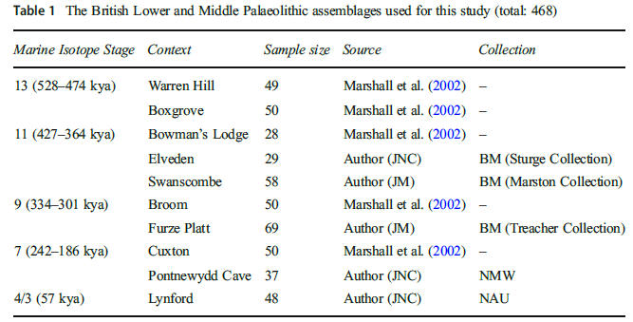
Practical #2: Outline analysis

Slide 55
Practical #2: Outline analysis
Step 1: Download all files on GitHub (https://github.com/CSHoggard/-Morph2019) and save in an appropriate directory
Step 2: Load “Practical_.R” in Rstudio and set the working directory as appropriate
Step 3: Follow through the instructions and guidance in the script (we’ll work through it together after!)

Slide 56
GMM and Archaeology: The Future
Greater application of GMM in a variety of new (non biological) archaeologies
Methodological applications: automisation (recording and landmarking)
Coding developments: towards a replicable, reproducible and Shiny GMM…
More powerful analytics: e.g. Bayesian and Machine Learning techniques

Slide 57
Thank you for attending!
Enjoy Morph2019!
Enjoy Sendai!

