Slide 1


HTML and CSS Workshop
Welcome to the HTML and CSS Workshop! In this interactive session, you will learn the fundamentals of web development and design, from creating beautiful web pages to styling them with CSS.

Slide 2

Introduction to HTML
What is HTML?
Tags and elements
Basic HTML tags
HTML (Hypertext Markup Language) is the standard language for creating web pages. It provides the structure and elements that define the content of a web page.
HTML uses tags to mark up different parts of a web page. Tags are enclosed in angle brackets and consist of an opening tag and a closing tag.
HTML offers a variety of tags to structure the content of a web page, including headings, paragraphs, links, images, lists, and more.

Slide 3

Introduction to CSS
1
What is CSS?
2
Syntax and structure of CSS
CSS (Cascading Style Sheets) is a style sheet language used for describing the look and formatting of a document written in HTML.
CSS uses a combination of selectors and properties to apply styles to HTML elements. Selectors target specific elements, while properties define how those elements should be styled.
3
Styling elements with CSS
With CSS, you can customize the appearance of HTML elements, such as changing colors, fonts, sizes, margins, and more, giving your web pages a unique and polished look.

Slide 4
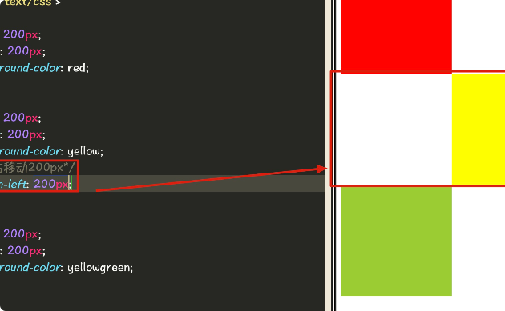
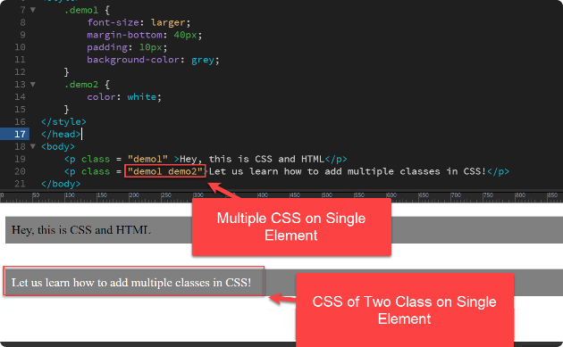
HTML and CSS Integration
Linking CSS stylesheets to HTML documents
Applying CSS styles to HTML elements
By linking an external CSS stylesheet to an HTML document, you can separate the structure of your web page from its presentation, making it easier to maintain and update.
CSS styles can be applied directly to HTML elements using inline styles or internally within the

Slide 5

Intermediate HTML and CSS Techniques
1
Working with images
Learn how to optimize and display images on your website, including techniques such as responsive images, image galleries, and image manipulation with CSS filters.
Creating forms
2
Discover how to create user-friendly forms with HTML form elements, validate user inputs, and enhance form usability with CSS styling and JavaScript interactivity.
3
Adding interactivity with JavaScript
Explore how to enhance your website with JavaScript, enabling dynamic content updates, interactive features, form validation, and more.

Slide 6
Best Practices and Tips
Writing clean and maintainable code
Using CSS frameworks and libraries
Testing and debugging
Learn coding best practices and techniques, including proper indentation, consistent naming conventions, code commenting, and organizing files and folders.
Explore techniques and tools for testing your web pages across different browsers and devices, identifying and fixing common bugs, and optimizing performance.
Discover popular CSS frameworks such as Bootstrap and Tailwind CSS, and leverage their pre-designed components and styles to expedite your web development process.

Slide 7

Conclusion
1
Recap of key concepts
2
Resources for further learning
3
Q&A session
Open the floor for a question and answer session, allowing participants to seek clarification and engage in discussions related to the workshop content.
Summarize the key concepts learned throughout the workshop, highlighting the importance of HTML and CSS in creating well-designed and functional web pages.
MDN Web DOC
W3 Schools

